Slide 1
3’s Company Figures

Slide 2
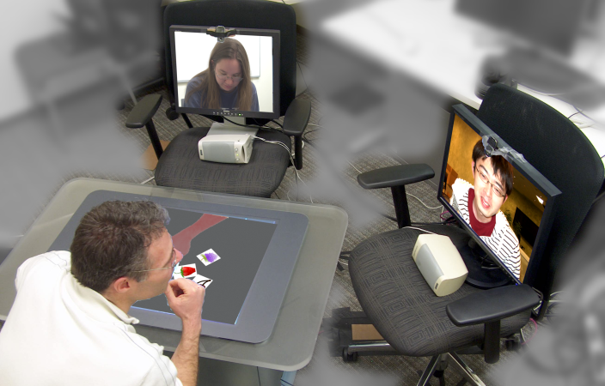
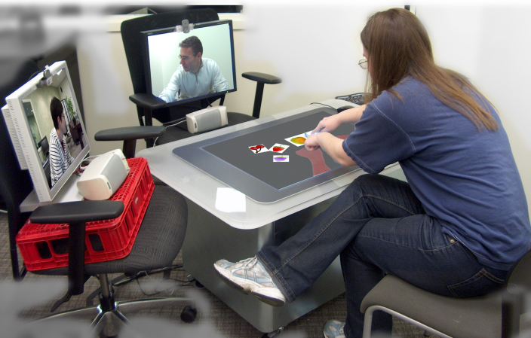
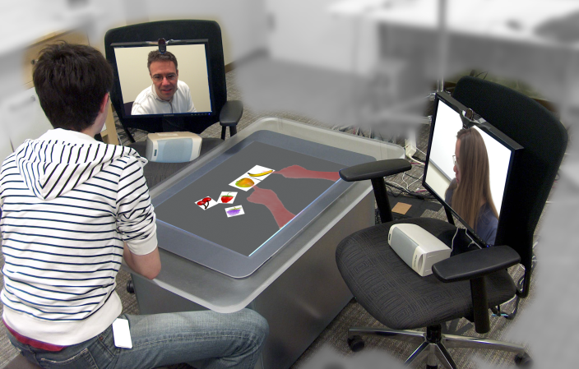
Figure 1. Three collaborators working over a shared workspace, and connected with one
another through audio/video surrogates. Note the presence of the arm shadows for the
collaborator in the center, and how they are propagated to remote workstations. Finally,
observe that each collaborator sits on his/her own side of the table, and that spatial
orientation of the distributed space is preserved.
Context: As illustrated in Figure 1, each workstation employs a touch-sensitive tabletop display as a collaborative workspace, as well as two physical surrogates that represent remote collaborators.

Slide 3
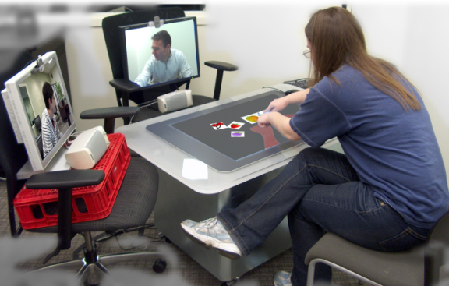
B
B
A
A
C
B
C
C
C
B
A
A
Figure 1. Three collaborators working over a shared workspace, and connected with one
another through audio/video surrogates. Note the presence of the arm shadows for the
collaborator in the center, and how they are propagated to remote workstations. Finally,
observe that each collaborator sits on his/her own side of the table, and that spatial
orientation of the distributed space is preserved.

Slide 4
B
B
A
A
B
C
C
C
C
B
A
A
Figure 1. Three collaborators working around a shared virtual tabletop. Far left is an overhead schematic view. In each physical space, remote participants are embodied as surrogates (with display, camera, microphone and speaker). Note that the spatial relationships are preserved in this setup. Also note that as B works in the space, her arm shadows are propagated to remote surfaces.
Context: As illustrated in Figure 1, each workstation employs a touch-sensitive tabletop display as a collaborative workspace, as well as two physical surrogates that represent remote collaborators.

Slide 5
Configuration 1
Configuration 2
Configuration 3
Figure 2. Three user configurations that we considered. 1 mimics the canonical real-life configuration. 2 allows all participants to sit with the same orientation to the task space. 3 configures users around the table, but imagines remote participants being presented on the same large display.
Context: We considered three possible configurations (illustrated in Figure 2): the first mimics the real-life metaphor “around the table”; the second places collaborators virtually at the same location in the workspace so they share the same perspective, but their surrogates across the tabletop, and finally, a third compromise configuration, placing collaborators around the workspace, but their surrogates across the tabletop.

Slide 6
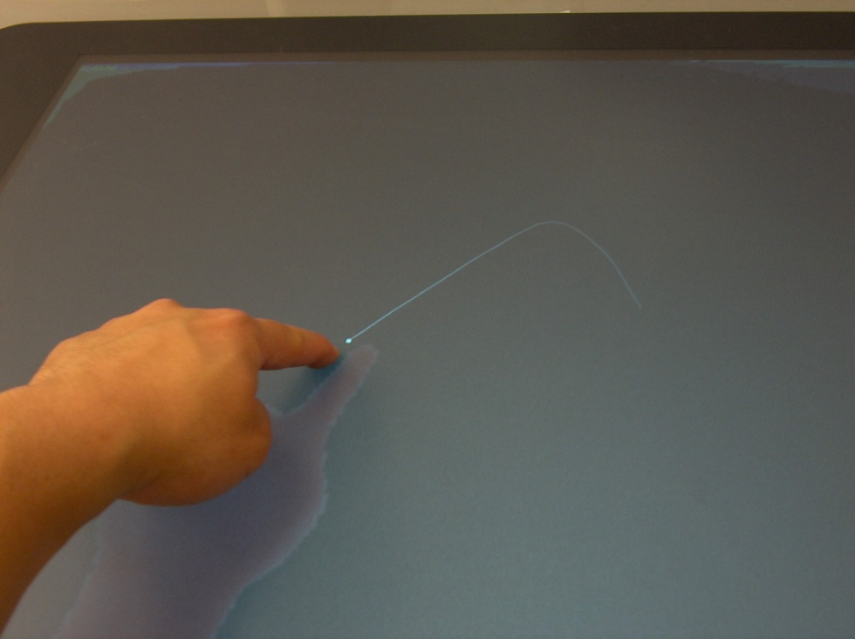
Local
Remote
Figure X. The arm shadows are displayed locally as feedback, as well as being sent to remote sites. Finger contacts are transmitted to remote sites, and conveyed via trace pearls: the contact point is represented by a small disc, and the trail fades over time.
Context:-- the bit about shadows and arms

Slide 7
(a)
Context: Figure 3 illustrates representative traces from two trials by the same group, showing that in the around-the-table configuration, participants partitioned their activities, whereas in the same-side configuration, they did not.
Figure 3 also highlights another point: it is instructive to contrast the territorial behavior characteristic of our orientation-free task with the semantic partitioning we observed in the single-orientation tasks. Here, we see that the characteristics of the task (tiles have more semantic meaning, and are oriented) dominate the way in which users interact with the space.
(b)
(c)
Figure 4. Contact traces for one group in three separate trials. Each cell represents a user, and each row is a trial. (a) Around configuration, logo task; (b) Around configuration, word task; (c) Same side configuration, logo task.

Slide 8
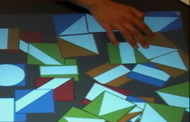
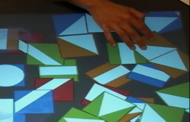
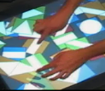
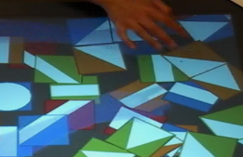
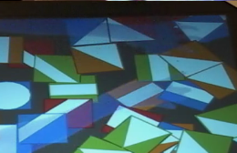
(a)
(b)
(c)
(d)
(e)
(f)
Figure 5. In this sequence lasting 2s, we see (a) the first user manipulating a tile; (b) a second user’s (blue) shadow approaches from the left; (c) the first user is still manipulating as the second user approaches; (d) the blue user arrives; (e) the first user quickly withdraws as the second begins to manipulate the tile; (f) finally, only the second user is manipulating the tile.

