Slide 1
Trap Handling, Domain Crossing, Interrupts, Processes/Threads
CPEN 331, UBC
Alexandra Fedorova
Content adapted from the slides by Margo Seltzer and Matt Welsh

Slide 2
Outline
Context switching
Domain crossing
Thread switching
Process switching
Context switching
What hardware support is needed?
How does it happen in real processors?
Understand basic system call handling

Slide 3
Thread Switch
Changes from one thread of execution to another.
Does not require a change of protection domain.
Continue running in the same address space.
Can change threads in user mode or in supervisor mode.

Slide 4
Domain Crossing
Changes the privilege at which the processor is executing.
Can change from user to supervisor.
Can change from supervisor to user.
Requires a trap or return from trap.
Requires an address space change (either user to kernel or kernel to user)

Slide 5
Process Switch
Changes from execution in one (user) process to execution in another (user) process.
Requires two domain crossings + a thread switch in the kernel.

Slide 6
Context switch
Usage varies
Sometimes used for either thread or process switch.
Sometimes used to mean only process switch.
Every once in a while used to mean domain crossing.

Slide 7
Does a thread switch require domain crossing?
Yes
No
Depends on the thread implementation

Slide 8
User-Level Thread Switch
User address space
Kernel address space

Slide 9
User-Level Thread Switch
User address space
Kernel address space

Slide 10
Kernel-Supported Thread Switch
User address space
Kernel address space

Slide 11
Kernel-Supported Thread Switch
User address space
Kernel address space

Slide 12
Processes and Threads
How to support multithreaded processes?

Slide 13
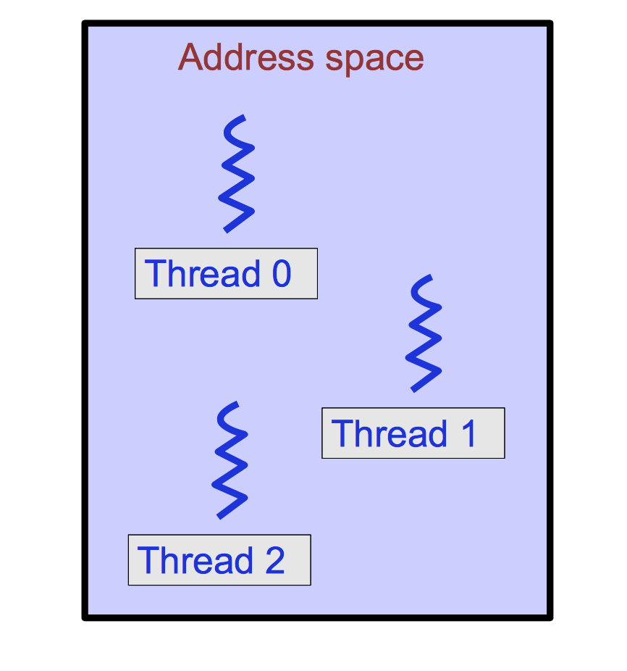
Address space of a multithreaded process

Slide 14
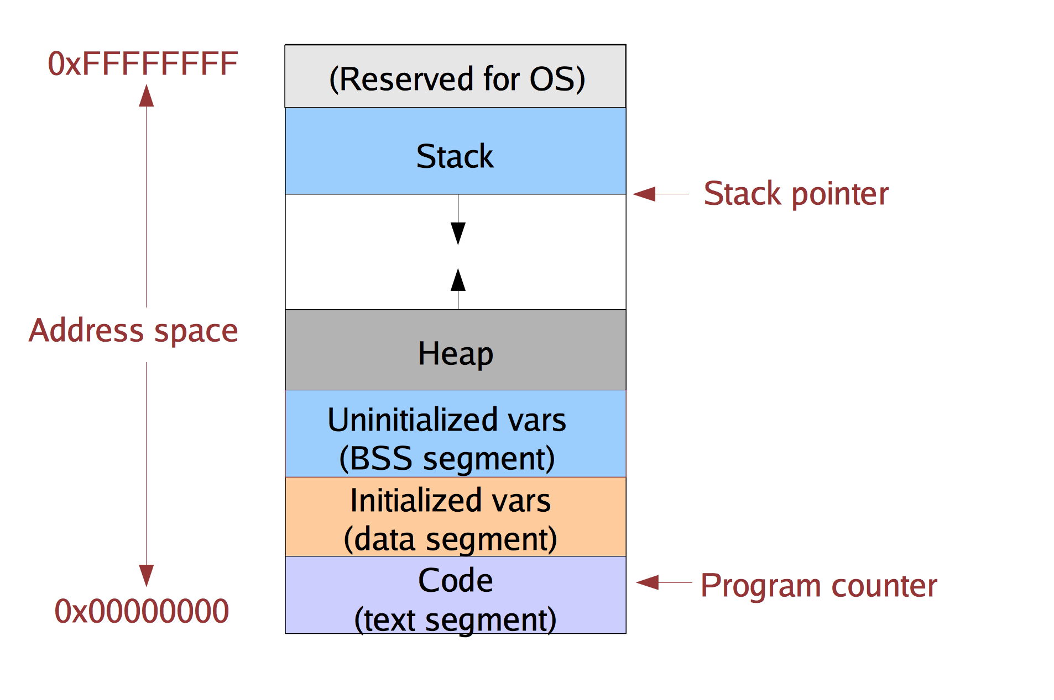
Single-threaded Address Space

Slide 15
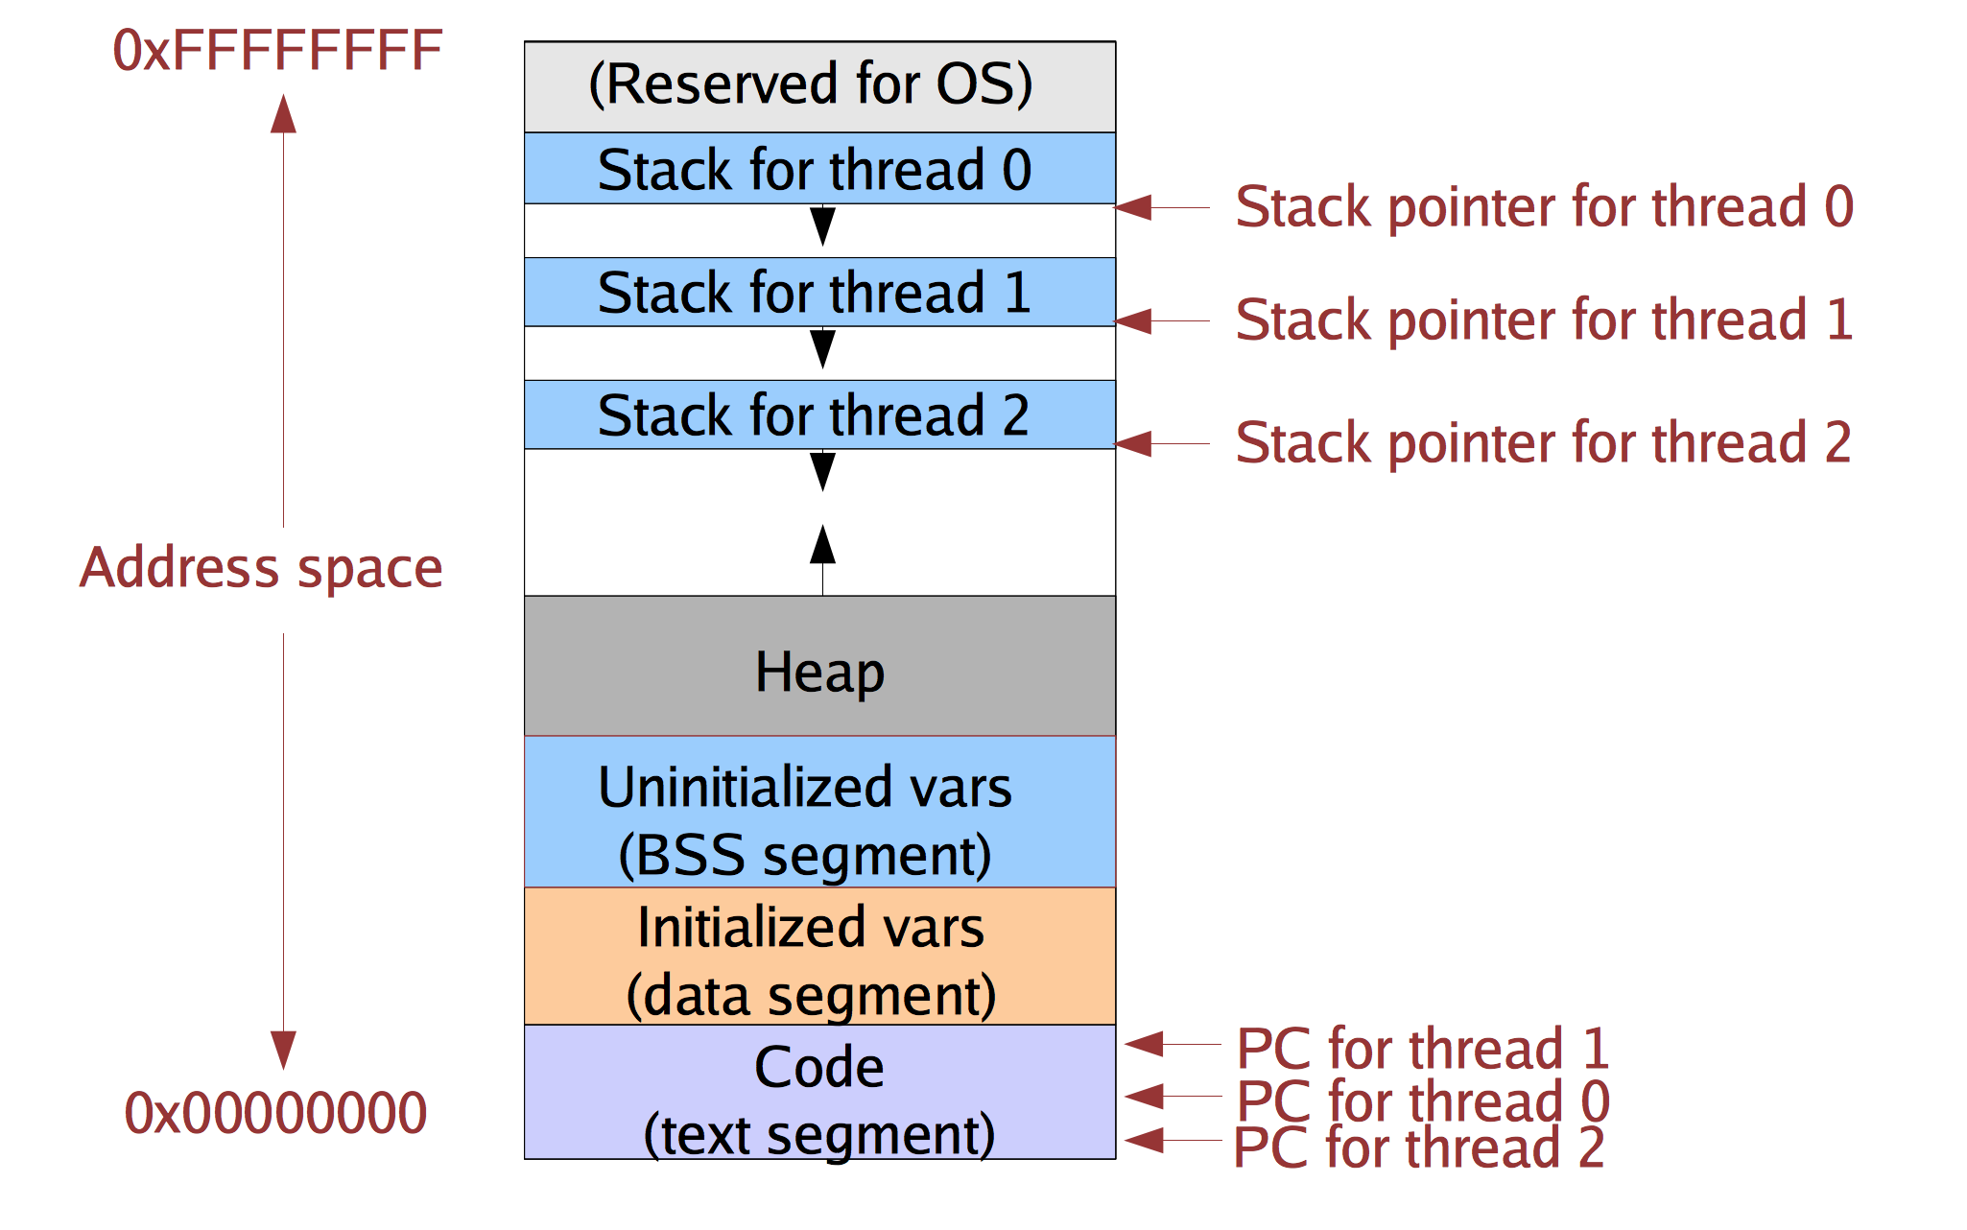
Multithreaded process address space

Slide 16
Implementing threads
Kernel-supported threads
The kernel is aware of the threads within the process
It keeps track of each thread’s stack and its processor state (registers, program counter)
Threads are a unit of scheduling. Each can be scheduled independently. Different threads can run concurrently on different CPUs.
User-level
The kernel unaware of the existence of threads
The user program creates stacks on its heap (via malloc)
The user program keeps track of the program counter and other context
Changes context via library functions (e.g., setjmp/longjmp in C).

Slide 17
Kernel-level Threads
Process Control Block
(E.g. struct proc)
Process ID (pid)
Thread Control Block
Address space
Thread ID (tid)
File Table
Program counter (PC)
…
Registers
Threads
Scheduler state
Thread ID (tid)
…
Program counter (PC)
Registers
Scheduler state
…

Slide 18
Switching threads within a process
Change the PC
Change the stack pointer
No need to change the address space

Slide 19
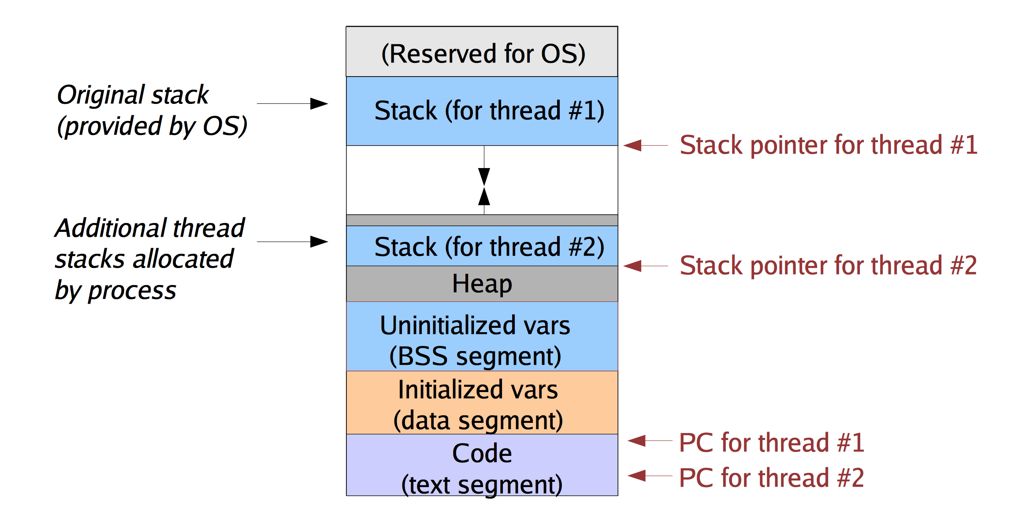
User-level Threads

Slide 20
User-level Thread Management
Stacks are allocated and managed by a user-level library
How to switch between user-level threads?
Need some way to swap CPU state.
This does not require any privileged instructions
Threads library can use the same instructions as the OS to change the PC and stackpointer (SP)
Why is it safe to do so?

Slide 21
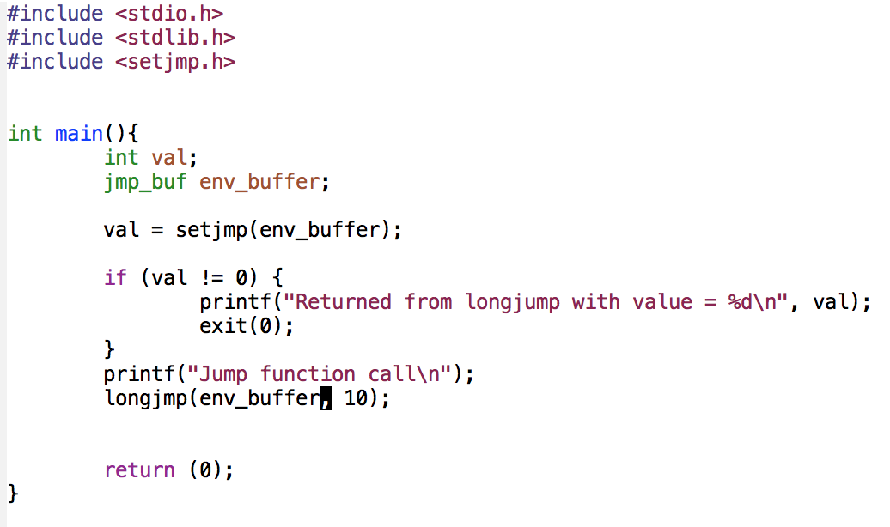
Setjmp/Longjmp example
Answer the following question without running the code.
Assuming that the call to setjmp succeeds, what will be the output of this program?
“Jump function call”
“Jump function call” ”Returned from longjump with value = 10”
”Returned from longjump with value = 10” “Jump function call”
None of the above

Slide 22
Pros and cons of the two thread types

Slide 23
Properties of domain crossing on MIPS R3000 (and similar hardware): which statements are true?
It relies on hardware support
It involves changing a privilege level
It requires kernel support for user-level threads
All of the above
1 and 2
2 and 3
1 and 3

Slide 24
Causes of a trap? Which statements are true?
System call
Interrupt
Illegal activity in a user-level program
Illegal activity in the kernel
All of the above
1, 2 and 4
1, 2 and 3
2, 3 and 4

Slide 25
Crossing Protection Domain
User address space
trap
Kernel address space

Slide 26
What Causes a Trap?
The thread requests a trap: System Call
Every system call requires a domain crossing.
The thread does something bad: Exception
E.g., Accessing invalid memory.
An external event happens: Interrupt
E.g., Timer goes off, disk operation completes, network packet arrives, one processor pokes another.
Regardless of the cause, the kernel handles all traps.
A user process that causes a trap causes a protection domain crossing.
A trap that happens while the kernel is already running, does not cause a domain crossing.

Slide 27
Let’s go over the code!
kern/arch/mips/locore/exception-mips1.S
kern/arch/mips/locore/trap.c
kern/arch/mips/syscall/syscall.c
Notes:
CLASS EXERCISE: For every line on the previous slide, go over the code to see where the corresponding actions are done.

Slide 28
What Does the Kernel Do on a Trap?
The kernel has to find a stack on which to run.
If you were already in the kernel, the stack you use is the same as the one on which you were running.
If you were running in userland, then you have to find a stack on which to run.
Why can’t we just use the user-level stack?
Implication: every kernel-supported user level thread has a corresponding kernel stack.
Before doing anything else, the kernel has to save state
We’ll go through this in detail in a few slides.
Figure out what caused the trap.

Slide 29
Process Switch
Process 1
Process 2
User address space
User address space
Kernel address space

Slide 30
Process Switch
Process 1
Process 2
User address space
User address space
Kernel address space

Slide 31
Summarize Process Switch
Change protection domain: user to supervisor (kernel).
Change stacks: switch from using the user-level stack to using a kernel stack.
Save execution state (on kernel’s stack).
Do kernel stuff
Kernel thread switch
Restore user-level execution state of the new process
Change protection domain: from supervisor (kernel) to user.

Slide 32
MIPS Domain Crossing
The PC is saved into a special supervisor register.
The status and cause registers (two other special purpose registers) are set to reflect the details of the trap being processed.
The processor switches into kernel mode with interrupts disabled.
The rest is done in software.

Slide 33
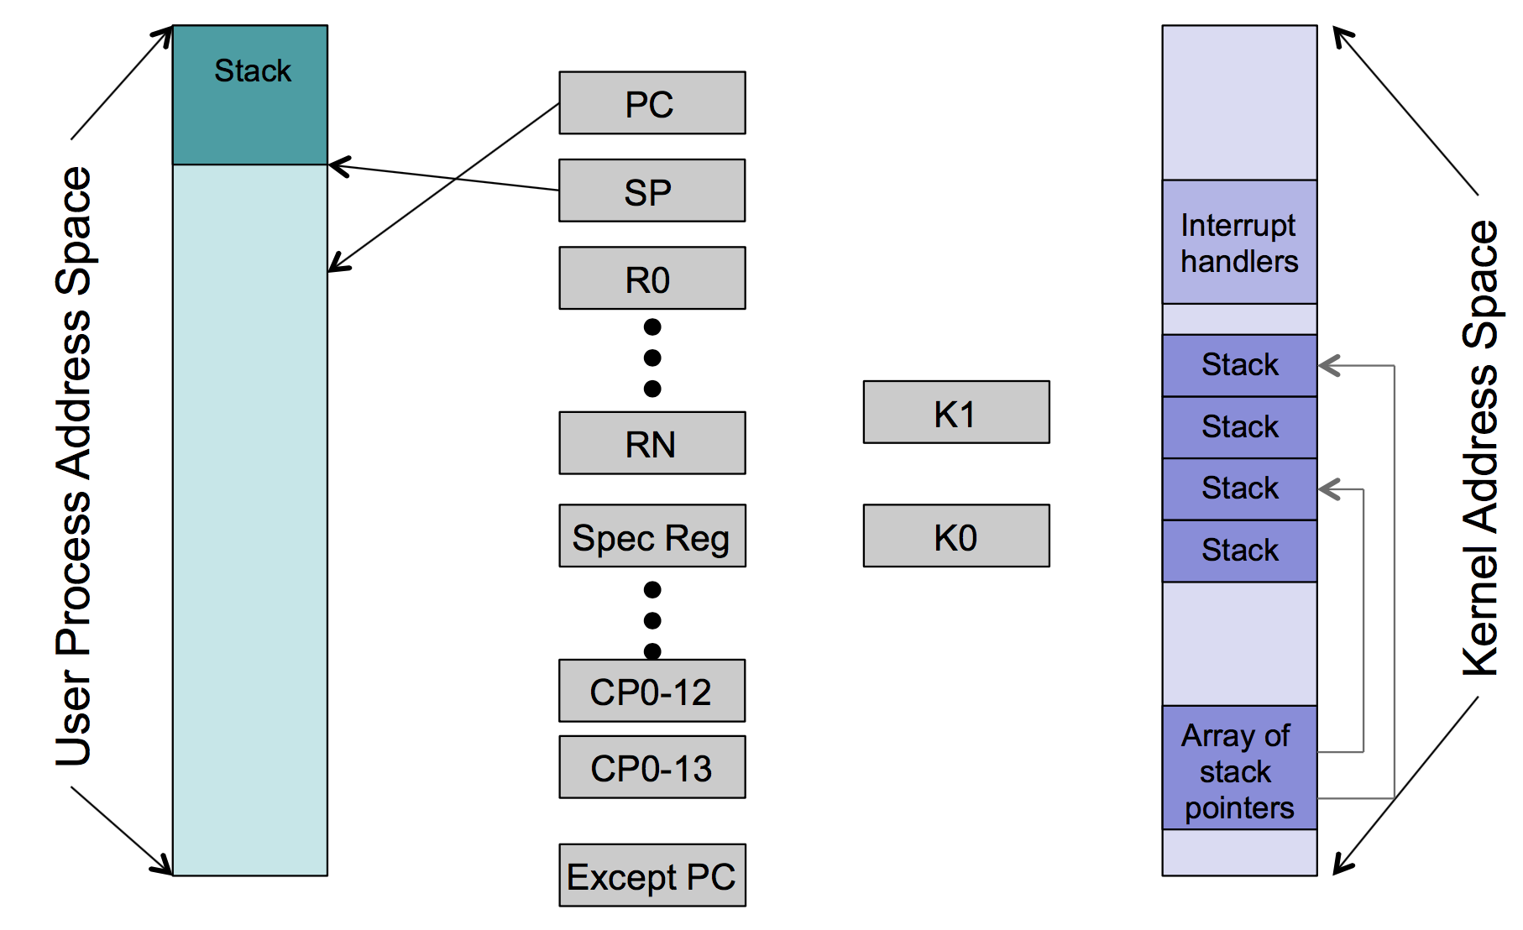

Slide 34
MIPS R3000 Hardware
Update status register (CP0$12) with bits that: • turn off interrupts; • put processor in supervisor mode; • indicate prior state (interrupts on/off; user/supervisor mode)
Sets cause register (CP0$13) with: • what trap happened • bit indicating if you are in a branch delay slot
Sets the exception PC (CP0$14) (address where execution is to resume after we handle the trap)
Sets the PC to the address of the appropriate handler.

Slide 35
MIPS R3000 Software
Save whatever other state that must be saved!
Since you need to be able to save the user registers and run various code, there are two registers that the kernel is allowed to use in whatever way is necessary (without this, you couldn’t do anything).
In assembly (kern/arch/mips/locore/exception-mips1.S)
Save the previous stack pointer
Get the status register
If we were in user mode:
Find the appropriate kernel stack
Get the cause of the current trap
Create a trap frame (on the kernel stack) that will contain
General registers
Special registers (status, cause)
Now, call the trap handling code (in C).

Slide 36
System calls
Upon entry into our syscall handler, we:
Are in supervisor mode:
Have saved away the process’s state
System call details
Where did we leave the arguments?
How do we know which system call to execute?
Where do we return an error?
Do we need to do anything special with the arguments?
Where does data referenced by an argument live?
How do we get to it?
Notes:
CLASS EXERCISE: /os161/src/kern/arch/mips/syscall/syscall.c

Slide 37
Copyin/copyout
Processes that issue system calls with pointer arguments pose two problems:
The items referenced reside in the process address space.
Those pointers could be bad addresses.
Most kernels have some pair of routines that perform both of these functions.
In OS/161 they are called: copyin, copyout
Find copyin/copyout in OS/161 and explain how they work
Notes:
CLASS EXERCISE: Go over the code to understand how copyin/copyout works.

Slide 38
How does the kernel distinguish between the system call and another trap?
Where do we use the previously saved trapframe to restore an execution context?
What function implements the system call dispatcher – the code that decides what system call to invoke based on the properties of the trap?
How do you access the argument on the stack once you know its address?
How are system calls invoked from user level?
kern/arch/mips/locore/exception-mips1.S
kern/arch/mips/locore/trap.c
kern/arch/mips/syscall/syscall.c
Hint: take a look inside gensyscalls.sh
Then find syscalls.S somewhere in the src/build directory.

Slide 39
How does the kernel distinguish between the system call and another trap?
It gets the trap type from a “cause” register.
System calls invoke different instructions than other traps, so a different exception handler is invoked.
All traps are handled the same way in the kernel.
It’s an argument to common_exception()

Slide 40
Where do we use the previously saved trapframe to restore an execution context?
In syscall()
In exception_return()
In thread_switch()

Slide 41
What function implements the system call dispatcher – the code that decides what system call to invoke based on the properties of the trap?
mips_trap()
common_exception()
syscall()
syscall_dispatch()

Slide 42
Where do system calls get the arguments?
From registers a0-a3
From the trapframe
From registers a0-a3 and from the stack
From the stack
They are passed to syscall()

Slide 43
How would you locate an argument that’s not in a register?

Slide 44
What is the best way to access arguments in user level memory once you know their addresses?
You simply dereference the pointers. The kernel can freely access user memory
You use special routines
You need to copy the values into registers first

Slide 45
How are system calls invoked from user level?
Hint: take a look inside gensyscalls.sh
Then find syscalls.S somewhere in the src/build directory.
The kernel developer manually writes code in a user-level library for each new system call.
When you build user-level libraries stubs for system calls are generated automatically based on a header file.
Invocation of a system all is automatically translated into the right instruction by the hardware.

