Slide 1
Technology Trends or
Why Operating Systems are not a Solved Problem
CPEN 331, UBC
Alexandra Fedorova
Notes:
Take a poll: who wants to be a hardware engineer, software engineer, scientist (go to grad school)?

Slide 2
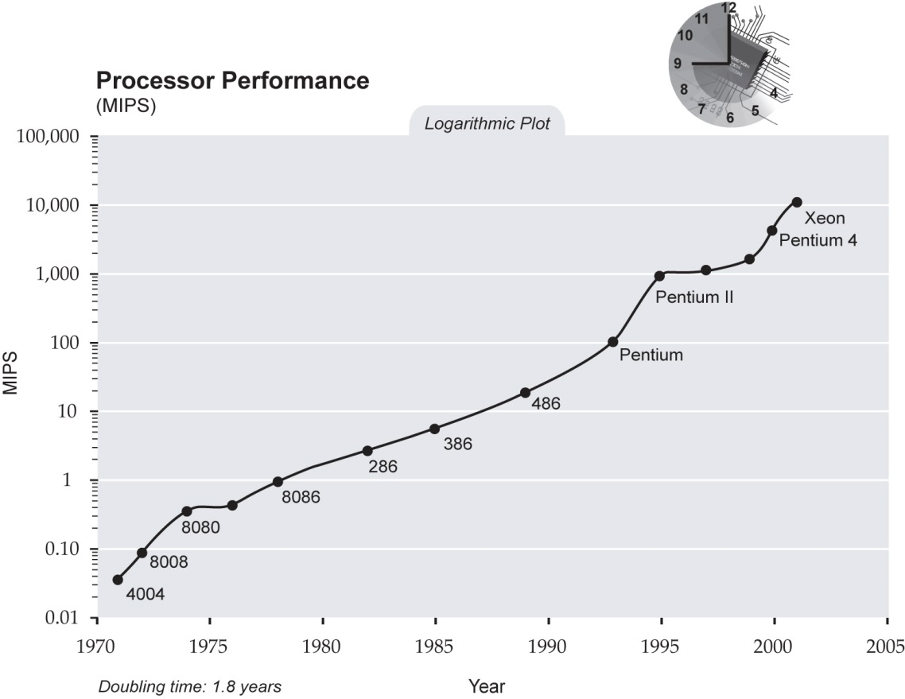

Slide 3
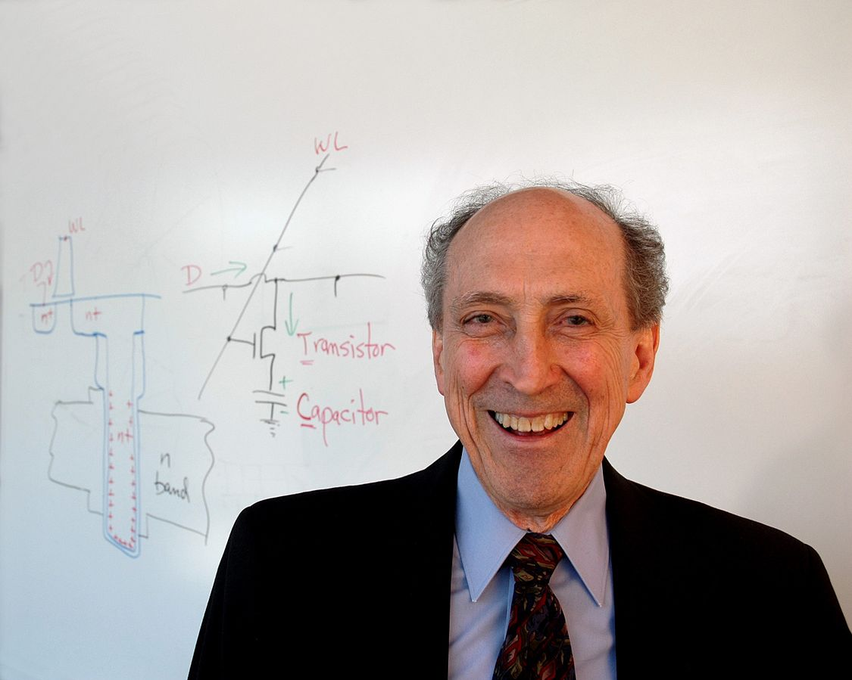
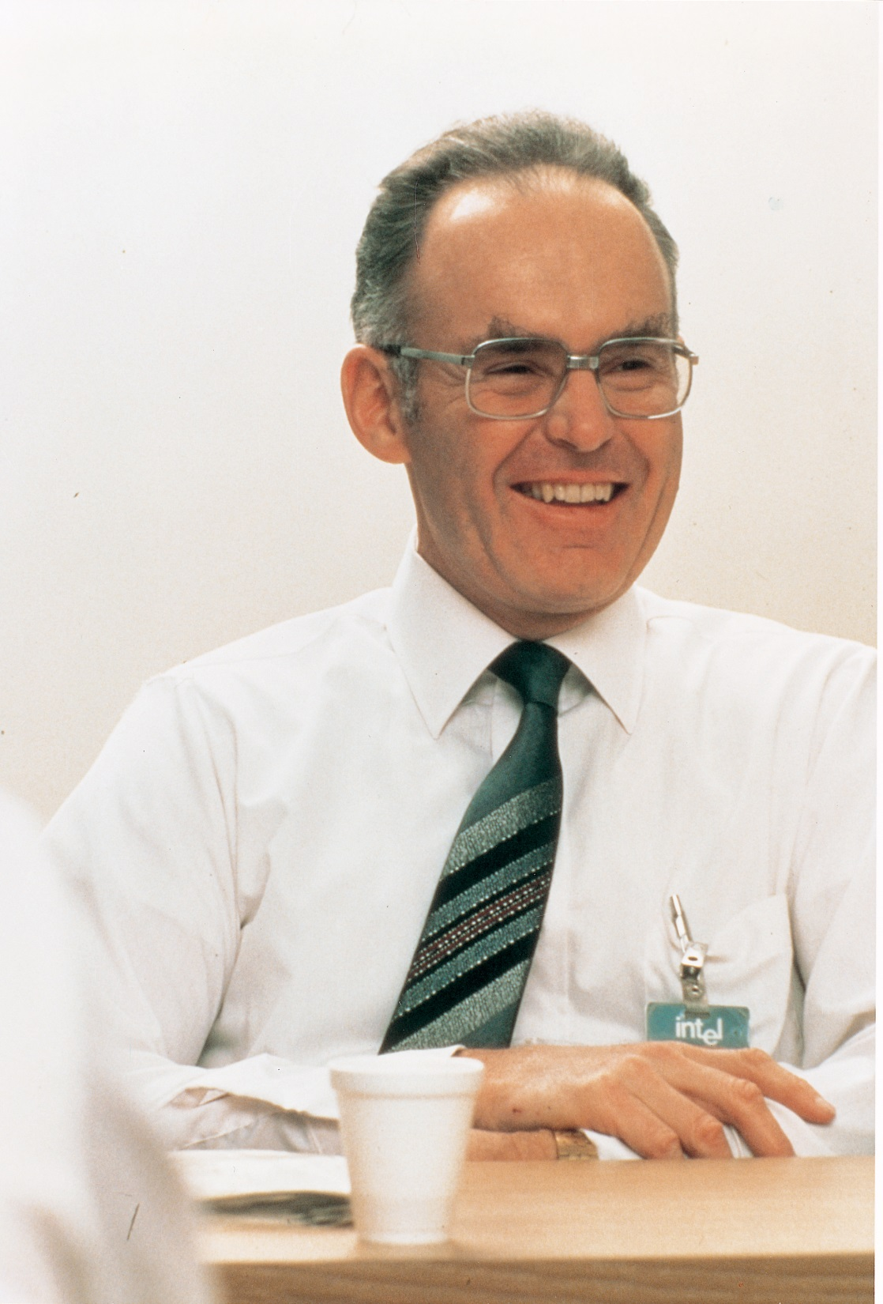
Gordon Moore
Robert Dennard
Transistor density doubles every 18 months
Power density remains constant as we scale

Slide 4

Moore’s Law and Dennard’s Scaling
Transistor length reduces by half every 18 months
Scaling Before 2004
Scaling After 2004
Transistor length
L' = L/2
L' = L/2
Transistor density
  D' = 1/L² = 4D
  D' = 1/L² = 4D
Chip frequency
  f' = 2f
  f' = 2f
  Put 4× things on the chip,
  run them 2× fast.
  Put 4× things on the chip,
  run them 2× fast.
Voltage
V' = V/2
V' = V
Capacitance
C ~ L; C' = C/2
C ~ L; C' = C/2
Energy
E' = CV² = E/8
E' = CV² = E/2
Power
P ' = P
P ' = 4P
  Power density remains constant
  Chip
  melts
Notes:
Hardware:
Not trivial to just make it more power efficient
Use less voltage, but must also lower frequency – lower performance, need to use it for longer time. Leakage power increases.
Need radical solutions:
Completely new materials
New organization of the CPU
Challenge: requires radical changes to software

Slide 6
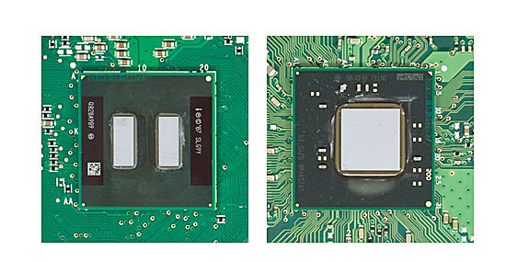
Industry’s Solution: Multicore Processors
We have more transistors, but can’t run them faster. Let’s do more things in parallel!
Systems-on-chip with a bunch of accelerators
Single core
Multi-core
Both require changes to the operating system!

Slide 7
Memory trends
Lots of applications are interested in processing massive amounts of data – have you heard the term Big Data?
Memories are becoming denser and
cheaper
Can get a server with 1TB of RAM
for ~ $30K
In-memory analytics appliances:
SAP Hana

Slide 8
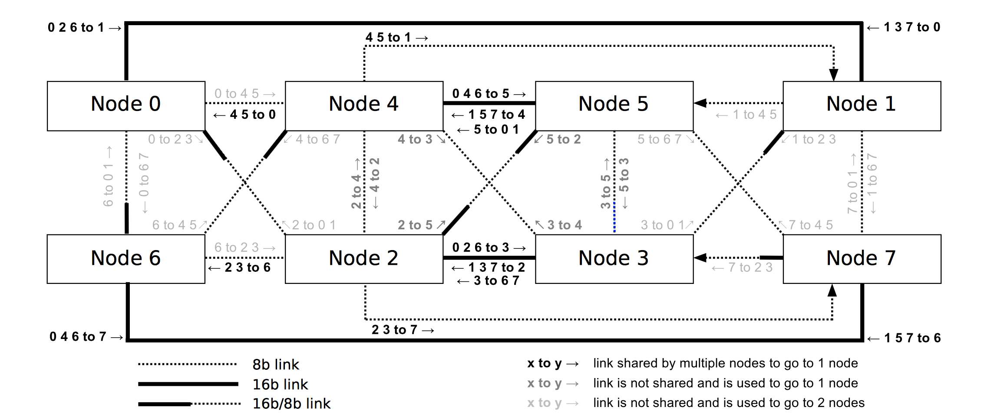
More memory means scaling problems
It is difficult to just put more memory into the system – there is limited number of pins (channels on which the data travels)
Solutions:
  3D stacking (your chip tends to heat up a lot more)
  Memory is distributed across the system – looks a lot like a distributed system cluster

Slide 9
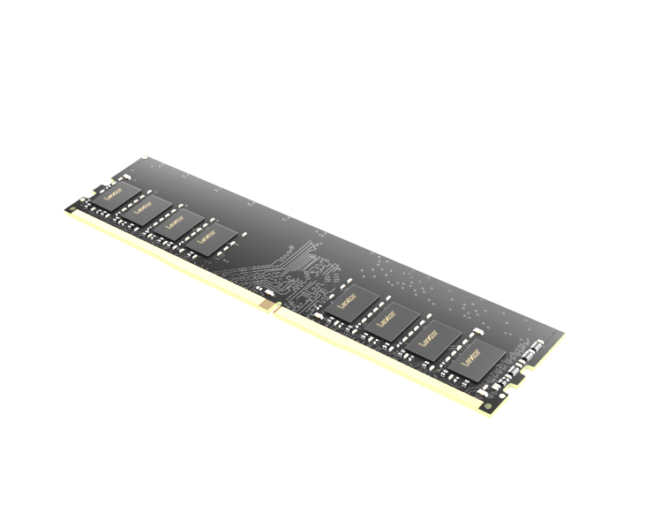
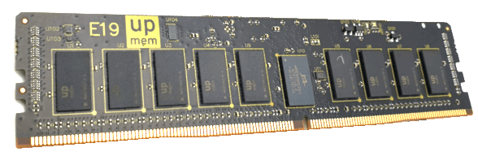
Processing-in-memory
New kind of DRAM with general-purpose chips inside!
regular DRAM
DRAM with processors

Slide 10
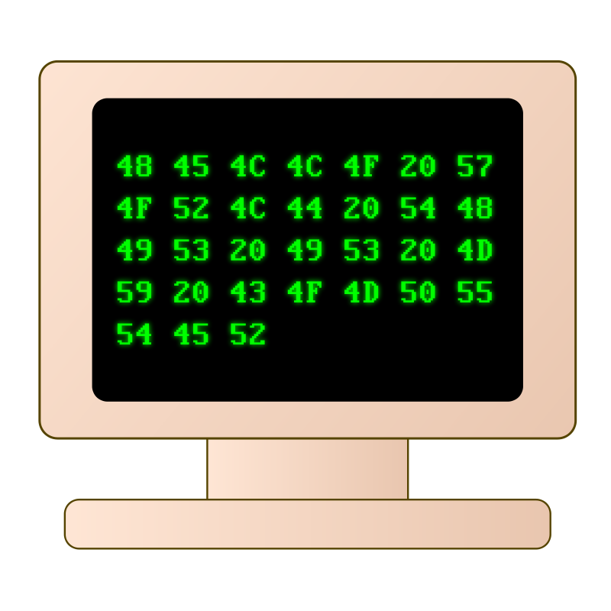

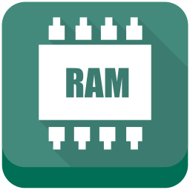
Disaggregated memory?
CPU nodes
Memory nodes/blades

Slide 11
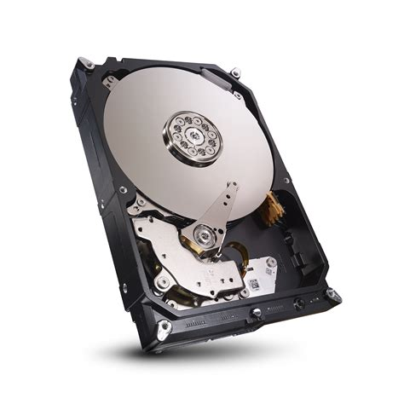
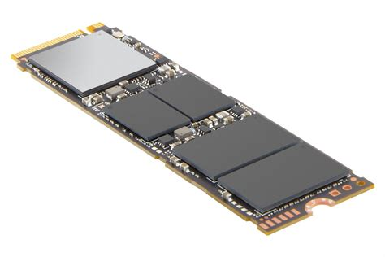
Storage trends
Hard disks are being replaced by SSDs.
  Your device is a lot faster: software needs to run faster.
Non-volatile memory:
  Looks both like storage and memory

Slide 12
Implications for operating systems
Operating systems provide abstractions for accessing diverse and complex hardware
Hardware is becoming more complex
So operating systems are becoming more complex
There is a lot of things that operating systems must do today that they didn’t use to do 20 years ago

Slide 13
Challenges for modern operating systems
Supporting concurrency
  Threads, synchronization primitives, extensions to scheduling
Supporting heterogeneous CPUs
  Do you treat them the same as regular CPUs or differently?
Supporting larger and remote memories
  Memory is distributed, interconnect channels become the bottleneck
  Must care about data locality, traffic distribution
Supporting new I/O devices
  SSD drives
  NVRAM
Bigger concerns about security

Slide 14
Operating systems are changing!
Version 3.10 of the Linux kernel, released in June 2013, contains 15,803,499 lines of code
Version 4.1, released in June 2015, has grown to over 19.5 million lines of code
Contributed to by almost 14,000 programmers
Many big companies have their own Linux distribution
  Google
  Amazon
  Oracle

Slide 15
iClicker Poll
Are you interested in attending a graduate school to perform research?
Yes
No
Maybe
Haven’t thought about this
Don’t worry, there no grade is assigned and there is no “right” or “wrong” answer.

