Slide 1
Synchronization Patterns
CPEN 331, UBC
Alexandra Fedorova

Slide 2
Synchronization Patterns
Ways in which threads synchronize
Not only about protecting shared state
Sometimes a thread wants to wait until a certain condition has occurred
Sometimes you have to protect multiple pieces of shared state without causing deadlock

Slide 3
We will look at the following patterns
Simple mutual exclusion
Data-centric locking
Locking multiple items in an arbitrary order
Reference tracking

Slide 4
Simple Mutual Exclusion
You have a set of actions that you want to appear atomic
It is common to use a lock
int withdraw(account, amount)
{
balance = get_balance(account);
balance = balance - amount;
put_balance(account, balance);
return balance;
}
int withdraw(account, amount)
{
acquire(lock);
balance = get_balance(account);
balance = balance - amount;
put_balance(account, balance);
release(lock);
return balance;
}

Slide 5
Simple Mutual Exclusion
What kind of lock to use?
Spinlock?
Blocking lock?

Slide 6
Which statements are true?
S1: Spinlocks make sense only on a multiprocessor
S2: It never makes sense to block on a multiprocessor
Both statements are True
Both statements are False
Only S1 is true
Only S2 is true
Notes:
Discuss spinning when you run more threads than cores on a multiprocessor.

Slide 7
Using Atomic Instructions for Mutual Exclusion
Example: CAS (compare and swap)
Implemented in hardware
Old value at location P (previously read)
Location you want to modify
New value you wish you put into P
Someone wrote the value after you have read it. Can’t modify it!
bool CAS(int old, void *p, int new)
{
if( *p != old)
return false;
*p = new;
return true;
}
atomic

Slide 8
Using Atomic Instructions for Mutual Exclusion
bool CAS(int old, void *p, int new)
{
if( *p != old)
return false;
*p = new;
return true;
}
Let’s see if we can use CAS to synchronize access to shared variables!
Notes:
Do you see any problems with this solution

Slide 9
Is this code synchronized correctly?
int withdraw(account, amount)
{
bool success = false;
while(!success)
{
balance = get_balance(account);
new_balance = balance - amount;
success = CAS(balance, &account->balance,
new_balance);
}
return balance;
}
Yes
No

Slide 10
Is this code synchronized correctly?
void transfer(accountFrom, accountTo, amount)
{
bool success;
retry:
/* Retrieve initial balance */
oldBalanceFrom = get_balance(accountFrom);
oldBalanceTo = get_balance(accountTo);
/* Change the balance */
newBalanceFrom = oldBalanceFrom - amount;
newBalanceTo = oldBalanceTo + amount;
/* Write back atomically */
success = CAS(oldBalanceFrom, &accountFrom, newBalanceFrom);
if (!success) goto retry;
success = CAS(oldBalanceTo, &accountTo, newBalanceTo);
if (!success) goto retry;
}
Yes
No

Slide 11
Typical Use of CAS
To implement locks
To update shared counters
bool lockObtained = false;
int locked;
retry:
/* Spin while the lock looks taken */
while(lock->locked) ;
/* Read the state of the lock */
locked = lock->locked;
/* If it is locked, try again */
if(locked)
goto retry;
/* Try to get the lock */
lockObtained = CAS(locked, &lock->locked, 1);
/* If we could not get the lock, try again */
if(! lockObtained)
goto retry;
bool success = false;
while(!success) {
int old_val = counter;
success = CAS(old_val, &counter, old_val + 1);
}

Slide 12
Eliding synchronization in simple cases
Example: Many people update a shared counter like so:
void increment_counter(int *counter)
{
(*counter)++;
}
Is this correct?
Yes
No
Notes:
Depends on the compiler
Depends on the hardware
You cannot assume that it is, unless you are coding for a specific hardware/compiler

Slide 13
Treacherous Shared Counters
How is this implemented in machine instructions?
Let’s look at a hypothetical MIPS-like processor
Assembly language:
void increment_counter(int *counter)
{
(*counter)++;
}
load a0, [counter]
add a0, 1
store [counter], a0
Notes:
Not atomic!
What happens if you avoid the synchronization?
You might lose accuracy?
How bad can it get?
VERY BAD on a multicore processor under high contention!

Slide 14
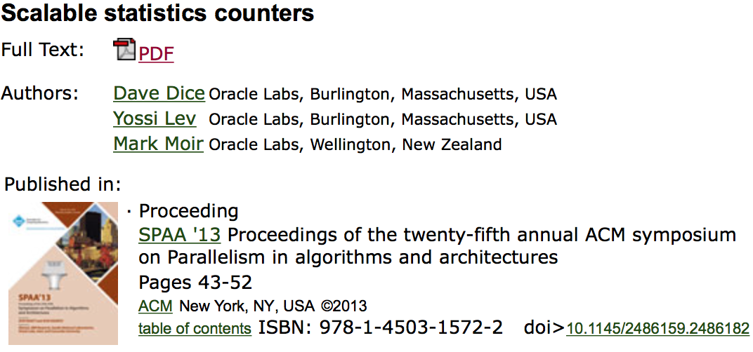
Eliding Synchronization
Another thread gets in here and increments the counter
Assembly language:
void increment_counter(int *counter)
{
(*counter)++;
}
load a0, [counter]
add a0, 1
store [counter], a0
The other thread’s update is lost!
How bad is it? Could be okay to lose a few?
Number of threads | Percent of updates that are lost
8 | 10%
64 | 75%
256 | 99%
Experimental conditions:
Low contention: 99% external work.
Source:

Slide 15
Are counters such a bid deal?
Counters disabled
Counters enabled
non-synchronized counters!
4x performance drop from using unsynchronized shared counters
Higher is better
Old version of WiredTiger key value store (before scalable counters)
Workload: LevelDB Readseq

Slide 16
Why is there such a huge performance impact?
There is a thread switch overhead requiring locks in the OS kernel. Locking causes overhead.
Writes to the shared counter cause invalidations in hardware caches. Invalidations clog the system bus and delay instructions.
Atomic operations, even those not acquiring locks are very expensive.
There is more misses in local caches, but this is unrelated to inter-thread communication.

Slide 17
We will look at the following patterns
Simple mutual exclusion
Data-centric locking
Locking multiple items in an arbitrary order
Reference tracking

Slide 18
Data-Centric Locking
void transfer(accountFrom, accountTo, amount)
{
lock(global_lock);
balanceFrom = get_balance(accountFrom);
balanceTo = get_balance(accountTo);
balanceFrom = balanceFrom - amount;
balanceTo = balanceTo + amount;
put_balance(accountFrom, balanceFrom);
put_balance(accountTo, balanceTo);
unlock(global_lock);
}
Synchronization bottleneck!
No one else can perform bank transactions at the same time!
void transfer(accountFrom, accountTo, amount)
{
lock(&accountFrom->lock);
lock(&accountTo->lock);
balanceFrom = get_balance(accountFrom);
balanceTo = get_balance(accountTo);
balanceFrom = balanceFrom - amount;
balanceTo = balanceTo + amount;
put_balance(accountFrom, balanceFrom);
put_balance(accountTo, balanceTo);
unlock(&accountFrom->lock);
unlock(&accountTo->lock);
}
Lock each data item individually

Slide 19
Deadlock potential
Thread 1
Thread 2
void transfer(accountA, accountB, amount)
{
lock(accountA);
lock(accountB);
…
}
void transfer(accountB, accountA, amount)
{
lock(accountB);
lock(accountA);
…
}
Account A
Account B
Thread 1
Thread 2

Slide 20
Locking multiple items in arbitrary order?
Very common in operating systems
Example: shared file objects; dup2 system call (assignment 4!)
Probably have to lock both file objects
Process 1
Process 2
File object 1
File table
File object 2

Slide 21
So you have to lock multiple items…
Order them
Use trylock
Allow the deadlock to occur – then resolve it!
Requires a way to “roll back” the changes
Notes:
Group discussion. What can you do?

Slide 22
We will look at the following patterns
Simple mutual exclusion
Data-centric locking
Locking multiple items in an arbitrary order
Reference tracking

Slide 23
Example: Keeping track of files
Should the second read fail?
open() – get back a file handle
Process A
read
Process B
remove
read
foo
Notes:
A couple of ways to think about this:
Suppose that B looks up the file every time it does a read. Then it’s okay for the lookup (and the read) to fail after A removes foo.
In Unix, B gets a “handle” on foo – an in-memory data structure that represents foo. The handle could be come invalid after A removes foo, but the handle shouldn’t just go away.
Alternative, we can keep the file available for I/O for everyone who has obtained a handle on it before A deleted in. When the handles are released, we can clean up and completely remove foo.
Both options 2 and 3 require keeping track of who owns a handle to a file WITHOUT LOCKING THE FILE. (Otherwise, if we lock the file, we can have only one outstanding operation on the file – no concurrency, thus poor efficiency.) One way to keep track of file handles is to use a Reference Count.

Slide 24
Summary
Simple mutual exclusion
A small number of instructions must be atomic
Data-centric locking
Locks are associated with specific data objects
Locking multiple items in an arbitrary order
May lead to deadlock!
Order them, use trylock, or resolve the deadlock!
Reference tracking
When you need to signal that you are using the object, but locking is not appropriate.
Notes:
Potential exercise: look at the implementation of __wt_fair_lock in WT. Can you tell how it works? (Look at trylock as well, explain in what ways it is different from __wt_fair_lock and why).

