Slide 1
Scheduling: How could such a simple thing could possibly be so complicated?
CPEN 331, UBC
Alexandra Fedorova

Slide 2
HARDWARE
SOFTWARE
Scheduling runqueue
System software and hardware
Core 0
Core 1
Core 2
Core 3
Tasks (threads)
timeslice
time
timeslice

Slide 3
HARDWARE
SOFTWARE
How do we pick the next thread from the scheduling queue?
Scheduling runqueue
System software and hardware
Core 0
Core 1
Core 2
Core 3
Tasks (threads)
timeslice
context switch time
=
Time to switch from one thread to another
time
Can context switch take a long time?
timeslice
How to determine the “right” length for the timeslice?

Slide 4
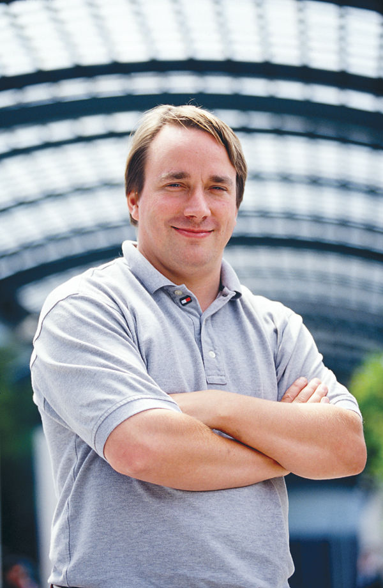
“And you have to realize that there are not very many things that have aged as well as the scheduler. Which is just another proof that scheduling is easy.”
Linus Torvalds, 2001
“The scheduler simply isn’t that important.” Linus Torvalds, 2001
Linus Torvalds

Slide 5
By year 2000, scheduling was a solved problem…
We figured out what the timeslice should be
Multi-Level Feedback Queues (MLFQ) algorithm
Give a larger timeslice to non-iteractive programs, but let them run less often
Give a smaller timeslice to interactive programs, but let them run more often
We also figure out how to set thread priorities
… and then came year 2000

Slide 6
What happened in year 2000?
The dot-com boom
Everyone is using the Internet
Unix runs on servers, desktops and cell phones
Very different applications
Servers vs video streaming vs data analysis
Machine are increasingly shared by multiple applications
A single scheduling algorithm does not fit different application styles…
… but wait, then came 2004

Slide 7
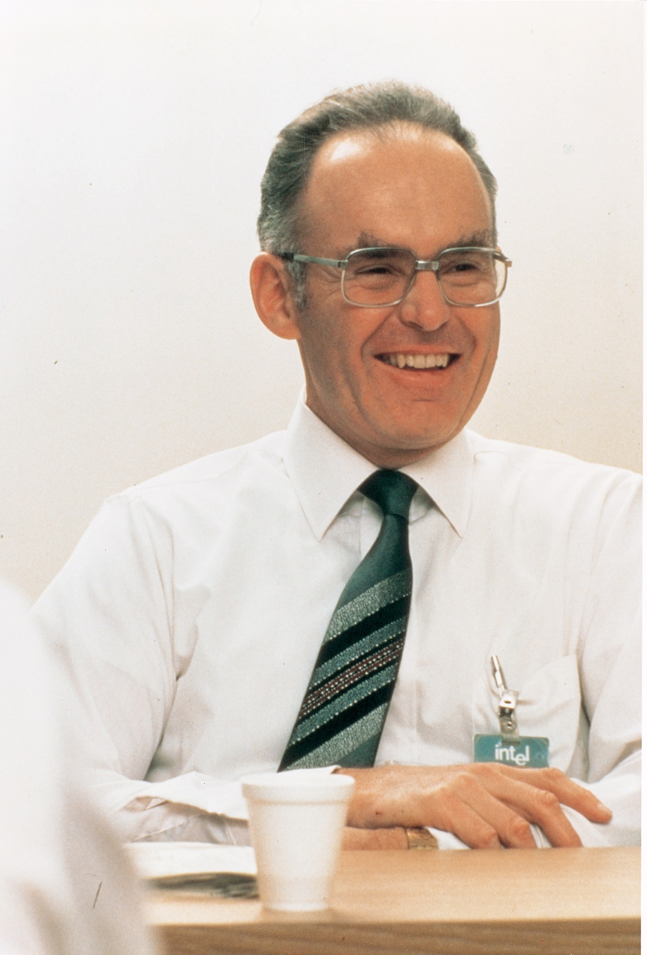
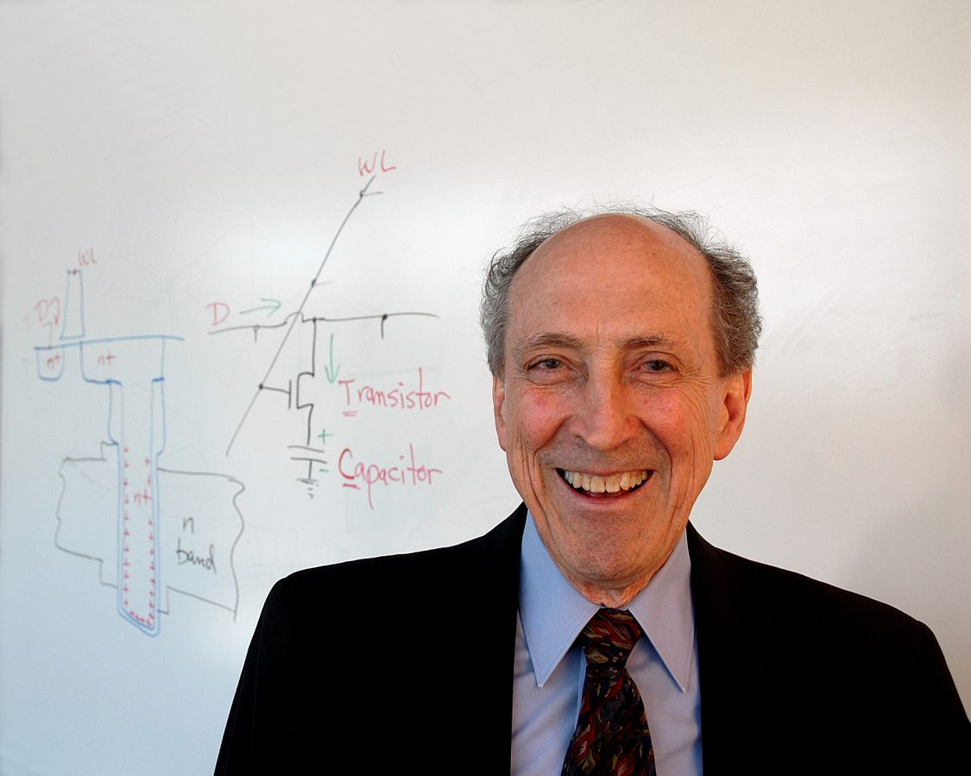
Power density remains constant as we put more and more transistors on the chip
Gordon Moore
Robert Dennard
Transistor density doubles every 18 months: we can put more and more transistors on the chip

Slide 8
End of Dennard scaling
We can still put more cores on the chip
But we can’t run them faster
And we don’t get better performance with more transistors

Slide 9
All hail the multicore era!

Slide 10
HARDWARE
SOFTWARE
ALL CORES ACCESS A SINGLE RUNQUEUE
Scheduling runqueue
Can you think of any problems with that?
System software and hardware
Core 0
Core 1
Core 2
Core 3
Multiple runqueues
timeslice
time
timeslice
Can you think of any problems with that?

Slide 11
HARDWARE
SOFTWARE
Does it matter on which core to run a thread?
Scheduling runqueue
System software and hardware
shared cache
shared cache
cache
cache
cache
cache
Core 0
Core 1
Core 2
Core 3
Tasks (threads)
timeslice
Threads running on cores that share a cache may compete for the cache and various hardware queues.
Or they may share data in caches!
A thread processing network packets is better off running close to the network card
context switch time
time
timeslice

Slide 12
Contention for shared resources
Threads
shared cache
shared cache
cache
cache
cache
cache
Core 0
Core 1
Core 2
Core 3
soplex
sphinx
namd
gamess
Experiment 1: run each application alone on the machine
Run #1
measure the running time
measure the running time
Run #2
solo running time
Run #3
measure the running time
Run #4
measure the running time

Slide 13
Contention for shared resources
Threads
shared cache
shared cache
cache
cache
cache
cache
Core 0
Core 1
Core 2
Core 3
soplex
sphinx
namd
gamess
Experiment 2: run threads together, co-scheduled in different ways
Run #1
measure the running time for each application
Run #2
measure the running time for each application
Contended running time
Run #3
measure the running time for each application
BEST co-schedule: lowest average runtime for all apps.
WORST co-schedule: highest average runtime for all apps.

Slide 14
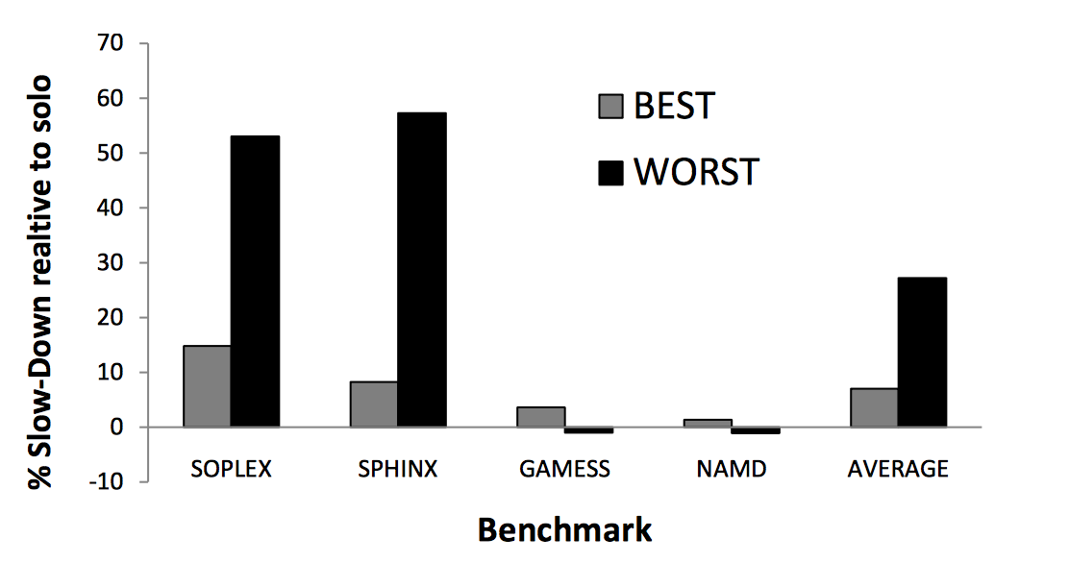
How much slowdown in co-scheduled runs?
How much slower the app runs when contending compared to running alone
BEST co-schedule: lowest average runtime for all apps.
WORST co-schedule: highest average runtime for all apps.

Slide 15
Which cores run your threads really matters!

Slide 16
In the meantime… the rebirth of NUMA
Non-Uniform Memory Access architecture
Was invented in 1990s
Rebirth in the multicore world around 2007

Slide 17
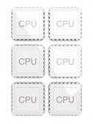
A NUMA System
NUMA: Non-Uniform Memory Access latency
Multiple nodes connected via an interconnect
interconnect
node
A CPU core
(caches not shown)
main memory

Slide 18
How do NUMA systems make scheduling more complicated?

Slide 19
Thread placement on NUMA systems
threads
~200 cycles
no delays
data
~300 cycles
no delays

Slide 20
Does remote latency hurt performance? Let’s run an experiment!
Experiment 1: all data is local
Experiment 2: all data is remote

Slide 21
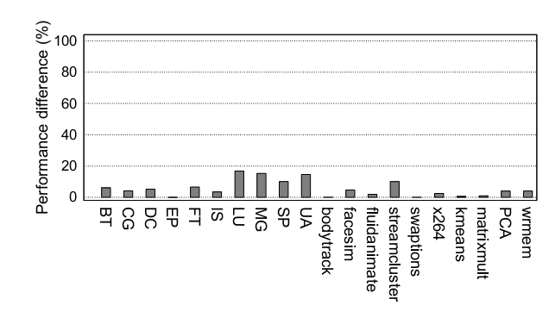
How much worse do we run when all data is remote?
The scheduler must place threads close to their data!
<20% performance impact
How much worse we run when all data is remote

Slide 22
But wait, it gets even worse!

Slide 23
Interconnect congestion
popular data
ALL THREADS ACCESS THIS DATA!
threads
data
MEMORY CONTROLLER CONGESTION
INTERCONNECT CONGESTION
Memory latency gets to ~1000 cycles
under bad congestion!

Slide 24
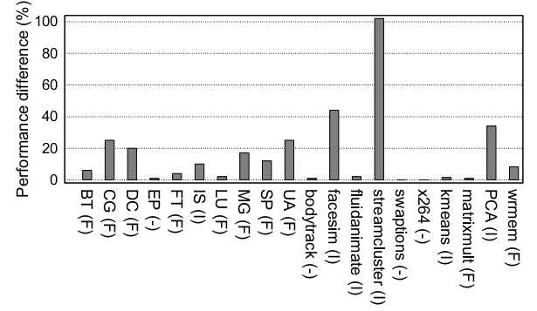
Congestion kills performance
The scheduler must place threads and data to avoid congestion!
How much slower we run when there is congestion relative to when there is none

Slide 25
What I told you so far…
Scheduling is conceptually simple
It was simple to implement prior to 2000
Internet boom forced systems a wider variety of applications and made multi-program and multiuser servers more common
Multicore revolution placed new challenges on software performance
The rebirth of NUMA hardware added even more challenges
A scheduler can do a lot to avoid these problems
So, naturally, people started hacking the scheduler
Let’s see what happened and what we learned…

