Slide 1
Processes and Threads

Slide 2
What is a process?

Slide 3
What is a thread? How is a thread different from a process?

Slide 4
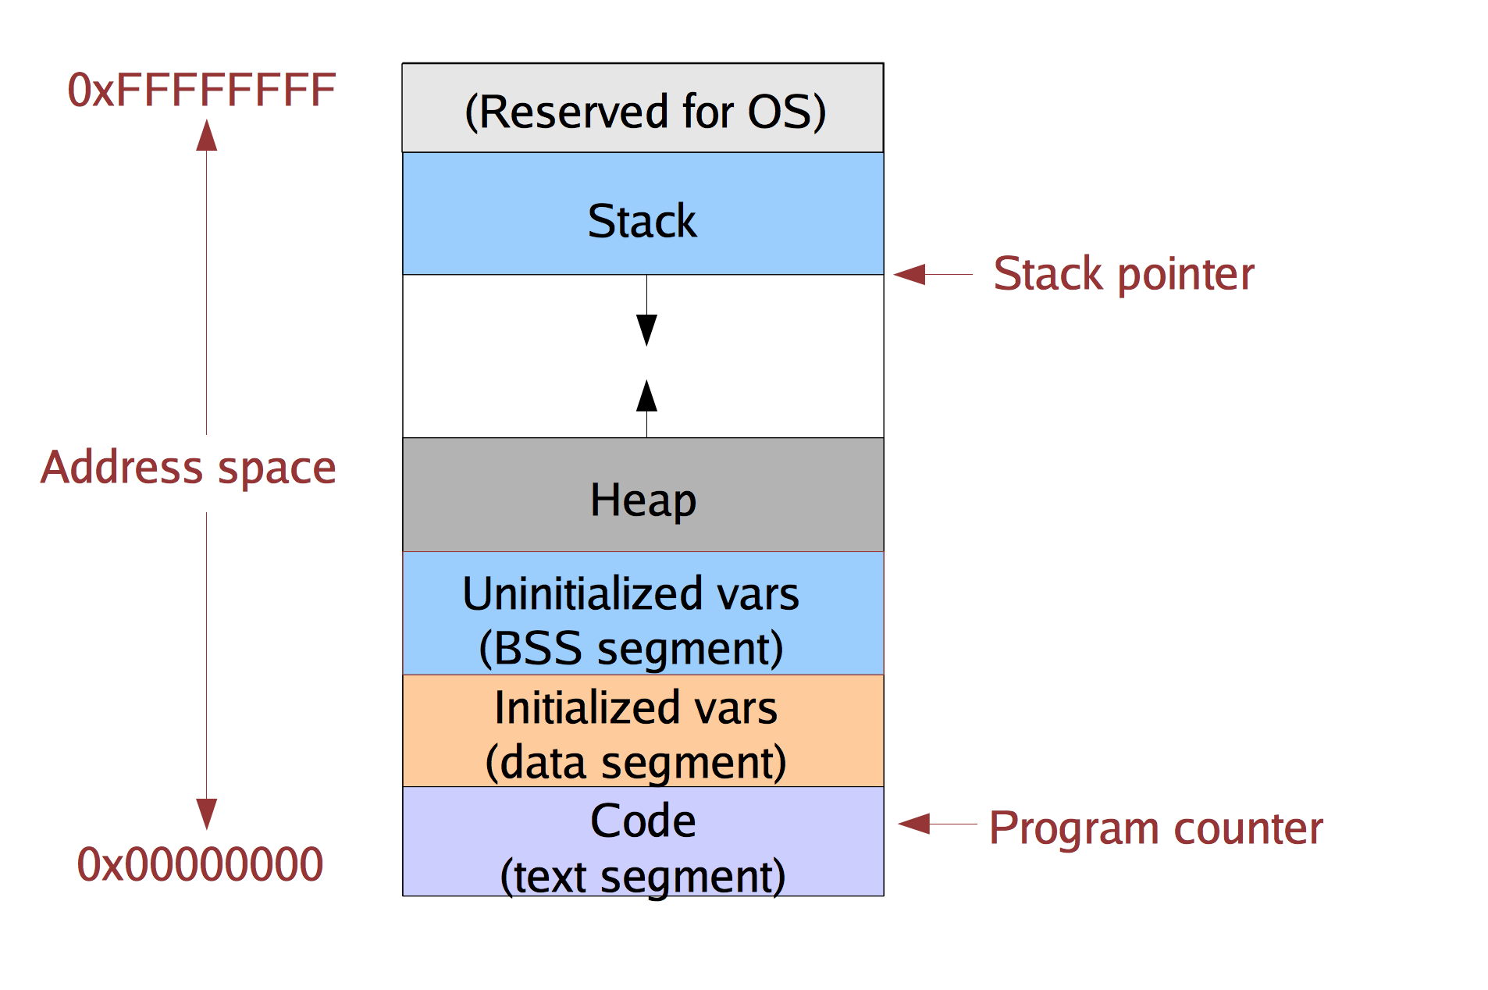
Single-threaded Address Space

Slide 5
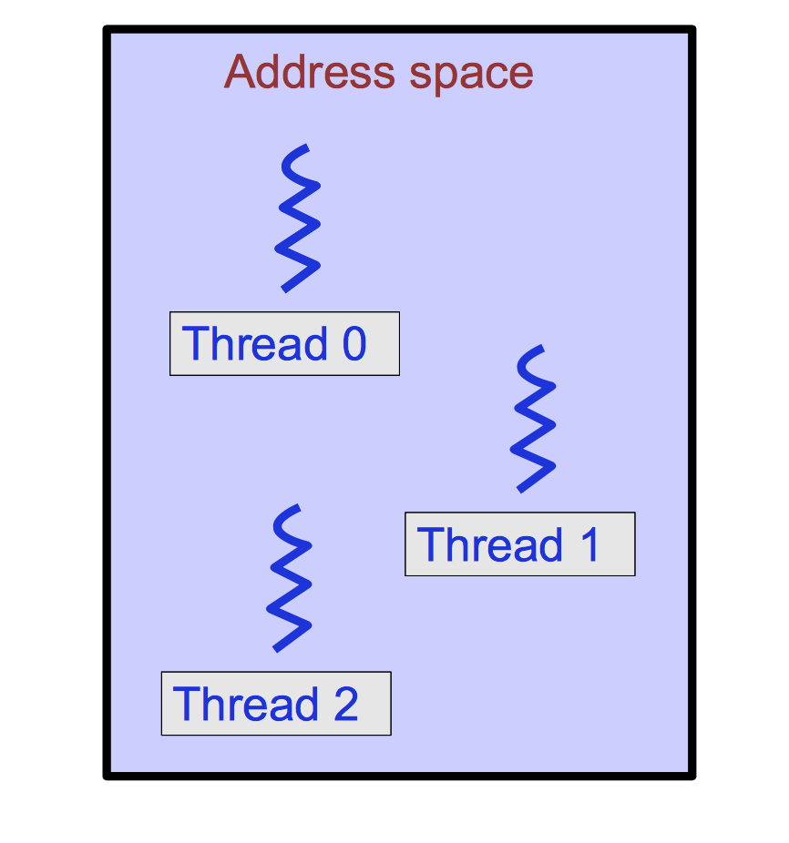
Multithreaded process

Slide 6
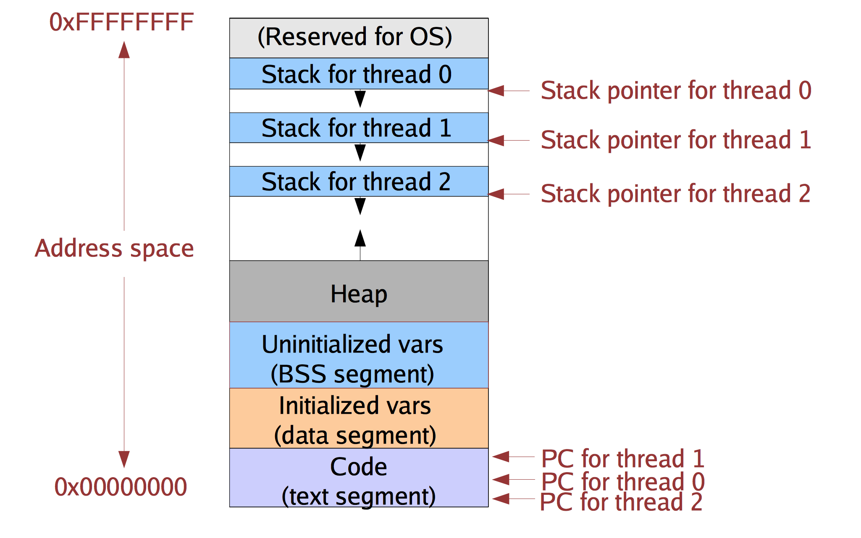
Multithreaded process address space

Slide 7
Implementing threads
Kernel-supported threads
The kernel is aware of the threads within the process
It keeps track of each thread’s stack and its processor state (registers, program counter)
Threads are a unit of scheduling. Each can be scheduled independently. Different threads can run concurrently on different CPUs.
User-level
The kernel unaware of the existence of threads
The user program creates stacks on its heap (via malloc)
The user program keeps track of the program counter and other context

Slide 8
Kernel-Supported Thread Switch
User address space
Kernel address space

Slide 9
Kernel-Supported Thread Switch
User address space
Kernel address space

Slide 10
User-Level Thread Switch
User address space
Kernel address space

Slide 11
User-Level Thread Switch
User address space
Kernel address space

Slide 12
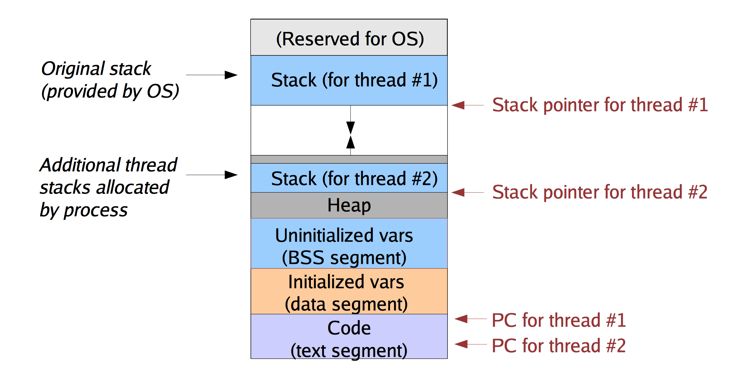
User-level Threads

Slide 13
User-level Thread Management
Stacks are allocated and managed by a user-level library
How to switch between user-level threads?
Need some way to swap CPU state.
This does not require any privileged instructions
Threads library can use the same instructions as the OS to change the PC and stackpointer (SP)
Why is it safe to do so?

Slide 14
Does a thread switch require trapping into the kernel?
Yes
No
Depends on the thread implementation

