Slide 1
File Tables
CPEN 331, UBC
Alexandra Fedorova

Slide 2
File-related System Calls
int open(char *name, int flags)
File handle – or file descriptor: a number that identifies this open file.
size_t read(int fd, char *buf, int buflen)
int close(int fd)

Slide 3
Semantics of the file system calls
Just a fancy way to say
How should they behave?

Slide 4
Opening files
int fd1 = open(/foo, O_RDWR);
Will fd1 be equal to fd2?
…
int fd2 = open(/foo, O_RDWR);
YES
NO

Slide 5
Reading from a file
File handle
Buffer size
User-level buffer pointer
ret = read(fd1, buf, buflen);
Suppose we just opened the file. From which location (offset) in the file will this system call read?
This system call will return an error, because we must first set a file offset using the lseek() system call.
From zero.
From the location where we left off before the open() system call. The last offset will be set in the kernel.

Slide 6
What if I want to read from a new offset?
64-bit return value
64-bit argument
off_t lseek(int fd, off_t pos, int whence);
If whence is
SEEK_SET, the new position is pos.
SEEK_CUR, the new position is the current position plus pos.
SEEK_END, the new position is the position of end-of-file plus pos.

Slide 7
Closing the file
int close(int fd);
Why do you need to explicitly close the file?

Slide 8
Keeping track of files
What kind of state does the operating system have to track in order to support these system calls?
A good way to get started with Assignment 4.

Slide 9
Files, files, files
Files for user processes
Representation of files to support file-related system calls
Files inside the kernel
Representation of files for use inside the kernel
Wrapper around
struct vnode
Just some data structures to keep track of open files

Slide 10
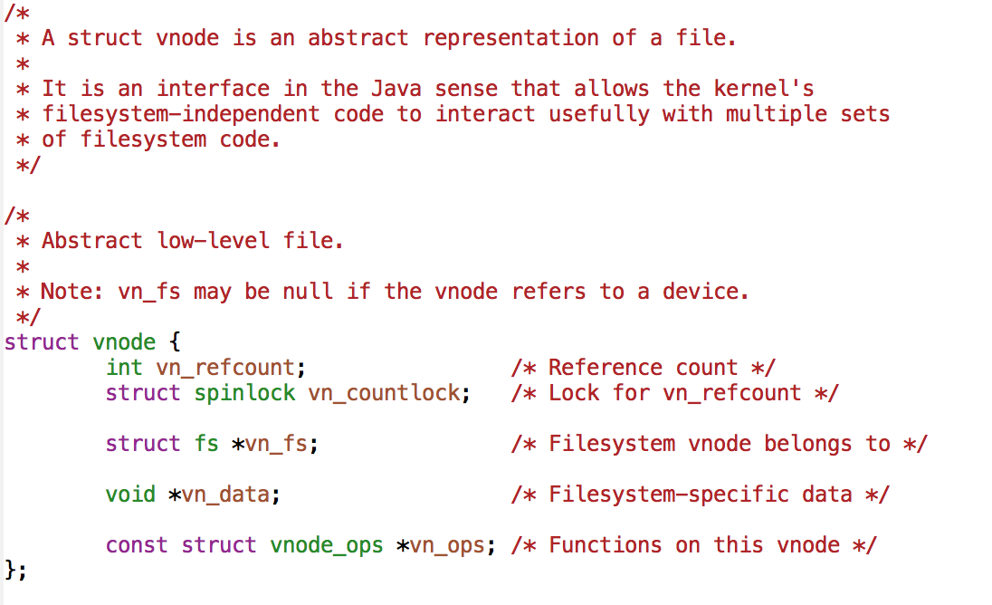
struct vnode

Slide 11
File descriptor
5
User level
Kernel level
Some struct keeping track of open files
Why do you need this?
struct vnode *vn;

Slide 12
File Table
pid: 13
addrspace: 0x5678
file /foo
struct vnode *vn
mode flags
offset
…
FDs | Fobj ptr
0
1
2
3 | 0x1234
4
Code reading question: How can you get a pointer to struct vnode for a given file name in OS161?
File handle
numbers
File Object Pointers

Slide 13
Reference counts

Slide 14
Concurrent read and remove
open() – get back a file descriptor
Process A
read
Process B
remove
read ?
foo

Slide 15
Reference counts
Reference count makes sure that a file does not disappear in case of concurrent remove!
open() – get back a file descriptor
Process A
read
Process B
remove
read
foo
remove() – seeing that reference count is not zero, it will hide the file name for further lookups, but will not delete the contents.
Refcount = 1

Slide 16
pid: 13
addrspace: 0x5678
file /foo
vnode ptr
mode flags
offset
…
FDs | Fobj ptr
0
1
2
3 | 0x1234
4
Is there anything special about file descriptors 0, 1 and 2?
They are reserved for kernel used and cannot be accessed from user level.
By default they are used for standard input/output and standard error.
They are not special.
File handle numbers
File Object Pointers

Slide 17
Setting up your processes
Set up special file descriptors in the first process.
You open a special file con:
For reading – mapped to stdin
For writing – mapped to stdout
One more mapped to stderr
Other processes will inherit these descriptors as you copy them
First ever process
Manually crafted
In OS161 this is done in one of the menu commands (menu.c)
Assignment 4
Other process
Created by copying the parent via fork()
Assignment 5

Slide 18
Duplicating File Descriptors
int dup2(int oldfd, int newfd);

Slide 19
Dup2: what is the correct outcome?
dup2(3, 4);
1
2
pid: 13
addrspace: 0x5678
file /foo 0x1234
pid: 13
addrspace: 0x5678
file /foo 0x1245
vnode ptr
mode flags
offset
…
vnode ptr
mode flags
offset
…
FDs | Fobj ptr
0
1
2
3 | 0x1234
4 | 0x1234
5
FDs | Fobj ptr
0
1
2
3 | 0x1234
4 | 0xABCD
5
file /foo 0xABCD
vnode ptr
mode flags
offset
…
1. Two descriptors point to the same file object
2. The second descriptor points to a new file object for the same file /foo

Slide 20
What will happen?
What happens if we execute the following system call, assuming that fd contains a handle for an open file foo.
dup2 (fd, STDOUT_FILENO);
The contents of file foo will be printed to standard out.
This behaviour is undefined.
This will result in an error.
Strings passed to printf will appear in file foo.

Slide 21
A Potential Failure Scenario
Process 13 closes fd 3
File object is deleted
Process 13 attempts to operate on fd 4 and accesses invalid memory.
pid: 13
addrspace: 0x5678
file /foo
vnode ptr
mode flags
offset
…
FDs | Fobj ptr
0
1
2
3 | 0x1234
4 | 0x1234
How do you prevent this from happening?

