Slide 1
The New Life of a Process
CPEN 331, UBC
Alexandra Fedorova
Some of the content was adapted from the slides by Matt Welsh

Slide 2
Outline
What we know so far:
How a new process gets create in Unix
fork () – create an exact copy of the parent
But what happens next?
How do all these processes get to run together?
How is their memory managed?
What if we want to run a new program, not the same as parent?
That is the subject of today’s lecture!

Slide 3
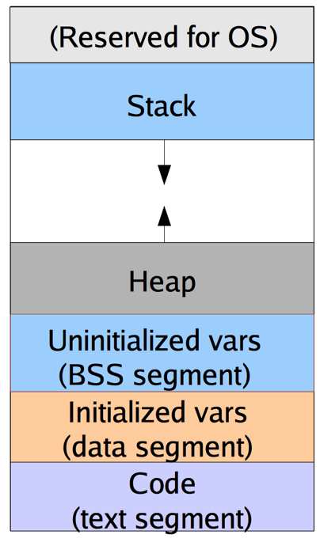
Memory of Multiple Processes
Virtual memory system
Physical memory

Slide 4
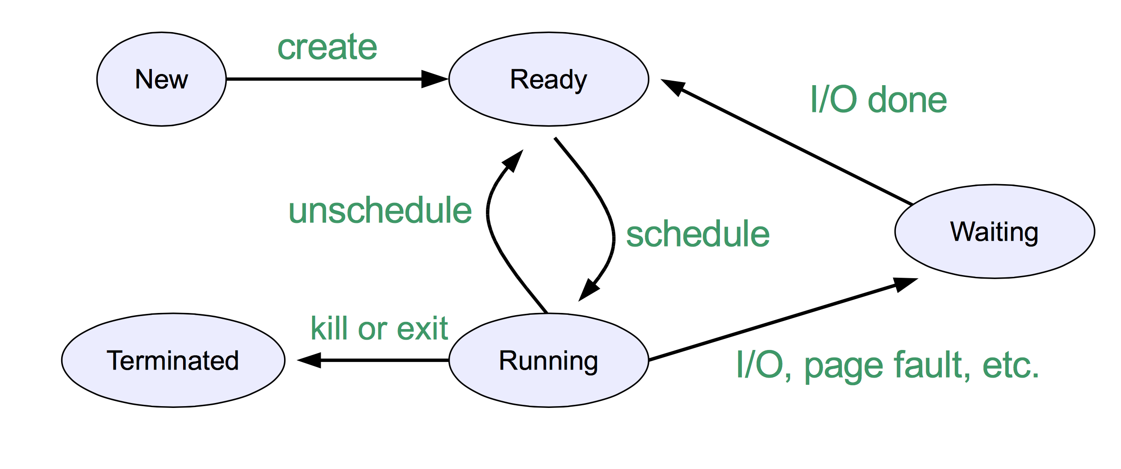
Process State Transitions

Slide 5
Process States
Running
Actually running on the processor
All architectural state is in the processor
Ready (or runnable)
Ready to run, but is not running – process state is saved
Process pointer is put in some kind of a queue
Architectural state is saved in memory (e.g., struct trapframe)
Waiting
The process is not ready to run
State is saved in some kind of queue – e.g., I/O wait queue, wait channel

Slide 6
Running Multiple Processes
Process A
Process B
1) Timer interrupt fires
User
Kernel
2) Trap into the kernel
8) Return from timer interrupt, restore saved state, enter user mode
3) Save process state to memory
Timer interrupt handler
Timer interrupt handler
4) Call schedule() routine
7) Another thread resumes execution after thread_switch()
5) Decide whom to run next, call thread_switch()
Scheduler
6) Restore state of another thread
time

Slide 7
Running a new program after fork()
What if we wanted to execute a different program than the parent?
In Unix this is done via the exec() system call.
Let’s take a look at an example: Download:
http://people.ece.ubc.ca/os161/download/LECTURES-CODE/exec.c

Slide 8
Overview of exec()
You write this one
Not this one
Replace the old address space with a new one
Copy the arguments into the new address space
Return to user mode

Slide 9
The mechanics of exec()
To get started with exec():
For each of the available actions, write down a function in OS161 that can help you accomplish this action.
Write “create your own” if no such function is available.
Copy the arguments from the old address space
Get a new address space
Switch to the new address space
Load a new executable
Define a new stack region
Copy the arguments to the new address space, properly arranging them.
Clean up the old address space
Warp to user mode
Not too soon!
Must come back to the old address space if exec fails

Slide 10
Copy arguments into the new address space
To think before starting exec():
Where are the arguments located when the exec system call in invoked? In whose address space? How do you know their address?
How do we get them into the kernel? How do you figure out their total size?
Where do the arguments need to end up before we return to the user mode? Whose address space? Stack or heap?
How do we get them there? How do we organize them there.
If a group presents the answer, all members of the group get class participation points!

Slide 11
Passing arguments within exec
Old address space
Arguments to provide to the new process
Process calling execv
execv(const char *progname, char **argv)
The process will replace the old address space with a new one!
Must copy in the arguments from the old address space, then copy them out into the new address space.
User-level memory
(not drawn to scale)
Null-terminated array of pointers to strings
argv = argv[0]
0x1234
0x1238
0
c
a
t
\0
d
o
g
\0
argv[1]
pointer to the first string
0x1234
pointer to the second string
null terminator
Copyin:
Copyin each pointer starting at argv[0]
Until you encounter NULL
Copyin the string at each pointer
First string
0x1238
Second string
By the time you are done copying in the arguments, you know:
How many arguments there are
The length of each argument
You have all the args in the kernel memory
Addresses
Data

Slide 12
Passing arguments: after copyin
Old address space
Questions to ponder:
What if the arguments array is huge, but you cannot allocate enough kernel memory contiguously?
How do you deal with that?
Process calling execv
execv(const char *progname, char **argv)
User-level memory
(not drawn to scale)
Kernel memory
(not drawn to scale)
argv = argv[0]
0x1234
0x1238
0
c
a
t
\0
d
o
g
\0
2
0xabcd
0xabdb
c
a
t
\0
d
o
g
\0
argument count
argv[1]
0x1234
pointer to the first string
copyin
pointer to the second string
No need for a null terminator
0x1238
First string
Second string
Addresses
Data

Slide 13
Passing arguments: copyout
number of arguments
argv array pointer
main(int argc, char **argv)
Old address space
New
address space
Passed in registers – set this up in the trapframe before going to user mode! Hint: use enter_new_process()
Create and switch to the new address space
Process calling execv
execv(const char *progname, char **argv)
User-level memory
(not drawn to scale)
Kernel memory
(not drawn to scale)
User-level memory: stack
(not drawn to scale)
as_define_stack()
argv = argv[0]
0x1234
0x1238
0
c
a
t
\0
d
o
g
\0
2
0xabcd
0xabdb
c
a
t
\0
d
o
g
\0
argv[1]
address of the argv array
0x1234
Needs to contain the strings and the null-terminated argv array
copyin
copyout
0x1238
Addresses
Data

