Slide 1
A Life of a Process
CPEN 331, UBC
Alexandra Fedorova

Slide 2
How do you create a process in operating systems (in general)?
You construct it from scratch, using the program binary and building up the needed memory structures.
You create a copy of an existing process
All of the above

Slide 3
Today: Fork: Copying a process
Review the different parts of the process
Understand how they are constructed.
Understand how to copy them.

Slide 4
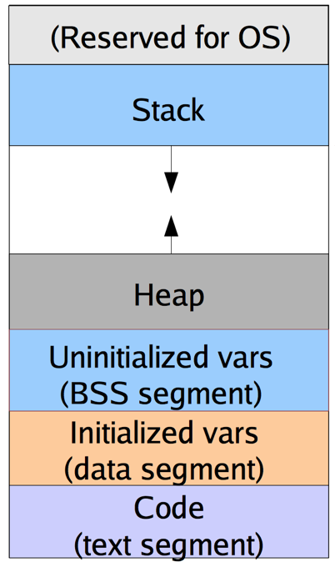
Fork: the concept
PROCESS
pid: 13
addrspace: 0x5678
FDs | Fobj ptr
0
1
2
3 | 0x1234
4
COPY
NEW PROCESS
Arch
state

Slide 5
What comprises a process’ state?
Address space
Threads
Architectural state
File table
A kernel thread that gets assigned to a process when the process traps into the kernel

Slide 6
Fork: the guts
End goal:
Copy address space
Copy file table
Copy architectural state
Copy kernel thread
Return to user mode
Parent process
Child process
Address space
Architectural state
User
Kernel
1. Call fork() system call and trap into the kernel
2. Gets a kernel stack
and a kernel thread
OS161: common_exception in exception-mips1.S
3. Save architectural state
OS161: struct trapframe
in exception-mips1.S
4. Invoke sys_fork:
File table
trapframe
Kernel thread
You write this
time

Slide 7
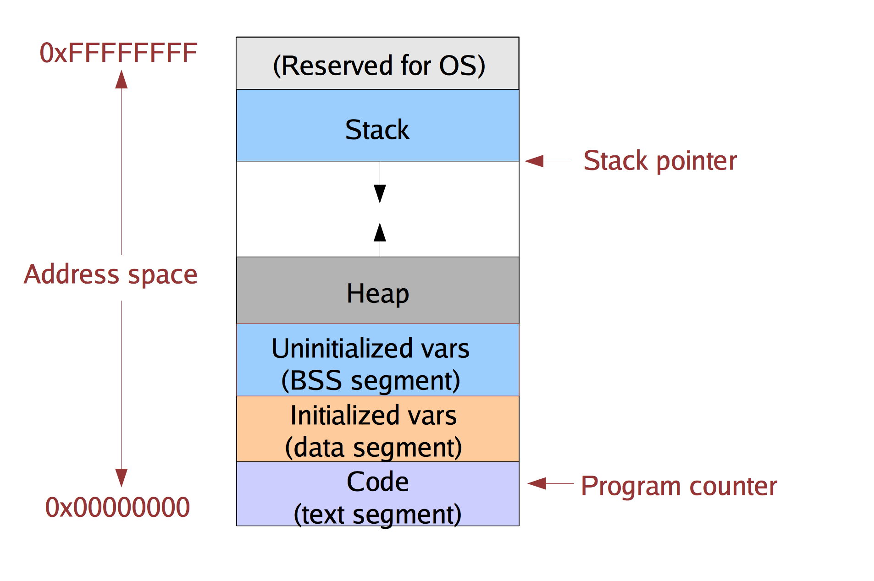
Address Space
Where do these pieces come from?
Defined at a pre-determined virtual address
In os161: as_define_stack()
User-level allocator (e.g., malloc) asks to extend the address space.
In os161 (and Unix): sbrk()
Directly from the executable
In os161: load_elf()

Slide 8
Copying the address space
ADDRESS SPACES MUST END UP IDENTICAL

Slide 9
Code-reading Exercises
Read the code in kern/arch/mips/vm/dumbvm.c and in the related include files.
What data structure does os161 use to keep track of the different parts of the address space?
vaddr_t
vbase1 vbase2, stackbase, vtop
struct addrspace
struct vnode
struct uio

Slide 10
Code-reading Exercises
Read the code in kern/arch/mips/vm/dumbvm.c.
Which function helps you create a copy of an address space?
load_elf
VOP_READ
as_activate
as_copy
None of the above

Slide 11
Fork: the guts
End goal:
Copy address space
Copy file table
Copy architectural state
Copy kernel thread
Return to user mode
Parent process
Child process
Address space
Address space
Architectural state
User
Kernel
1. Call fork() system call and trap into the kernel
2. Gets a kernel stack
and a kernel thread
OS161: common_exception in exception-mips1.S
3. Save architectural state
OS161: struct trapframe
in exception-mips1.S
4. Invoke sys_fork:
Copy address space
File table
trapframe
Kernel thread
You write this
time

Slide 12
File Tables: part copied / part shared
pid: 13
addrspace: 0x5678
file /foo
pid: 14
addrspace: 0x789a
vnode ptr
mode flags
offset
…
FDs | Fobj ptr
0
1
2
3 | 0x1234
4
FDs | Fobj ptr
0
1
2
3 | 0x1234
4
When a process is forked, file descriptor entries of the new process point to the same file objects as in the parent process.
If the parent changes the offset of a file, the child sees that change, and vice versa
We will see later why things are done this way.
File descriptors
File Object Pointers
You write the code to copy your file table.

Slide 13
Fork: the guts
End goal:
Copy address space
Copy file table
Copy architectural state
Copy kernel thread
Return to user mode
Parent process
Child process
Address space
Address space
Architectural state
User
Kernel
1. Call fork() system call and trap into the kernel
2. Gets a kernel stack
and a kernel thread
OS161: common_exception in exception-mips1.S
3. Save architectural state
OS161: struct trapframe
in exception-mips1.S
4. Invoke sys_fork:
Copy address space
Copy file table
File table
trapframe
Kernel thread
File table
You write this
time

Slide 14
Architectural State
Registers, including %pc, %sp.
Why do you need to save this stuff?
Let’s review the semantics of fork() to understand what we need to do with the architectural state.

Slide 15
Example: forking a new process
Download the code from:
http://people.ece.ubc.ca/os161/download/LECTURES-CODE/fork.c

Slide 16
Architectural state: almost identical
PARENT
Return to the same location, DIFFERENT return values;
CHILD
Child gets zero
Parent gets a child PID
Program counter: same of not?
Same
Not the same
Stack pointer: same or not?
Same
Not the same
Registers: same or not?
Same
Not the same

Slide 17
In OS161, where is the architectural state saved once we trap into the kernel and once we are done with the code in exception-mips1.S?
In registers
In struct trapframe
In the process struct

Slide 18
So how do you copy architectural state?

Slide 19
Code reading exercise
Review the system call dispatch code in os161. What register would be different between the parent and the child as they both return to usermode from an exception?
%sp
%pc
%v0
%a3
%v0 and %a3
In your implementation of A5, you will have to make sure the right value is returned to the right process.

Slide 20
Fork: the guts
End goal:
Copy address space
Copy file table
Copy architectural state
Copy kernel thread
Return to user mode
Parent process
Child process
Address space
Address space
Architectural state
User
Kernel
1. Call fork() system call and trap into the kernel
2. Gets a kernel stack
and a kernel thread
OS161: common_exception in exception-mips1.S
3. Save architectural state
OS161: struct trapframe
in exception-mips1.S
4. Invoke sys_fork:
Copy address space
Copy file table
Copy and tweak trapframe
File table
trapframe
Kernel thread
File table
trapframe
You write this
time

Slide 21
Fork: the guts
End goal:
Copy address space
Copy file table
Copy architectural state
Copy kernel thread
Return to user mode
Parent process
Child process
Address space
Address space
Architectural state
User
Kernel
1. Call fork() system call and trap into the kernel
2. Gets a kernel stack
and a kernel thread
OS161: common_exception in exception-mips1.S
3. Save architectural state
OS161: struct trapframe
in exception-mips1.S
4. Invoke sys_fork:
Copy address space
Copy file table
Copy and tweak trapframe
Copy kernel thread
File table
trapframe
Kernel thread
Kernel thread
thread_fork()
File table
trapframe
You write this
time

Slide 22
When you fork a new process, you fork a new kernel thread to provide to the child process. To fork that thread, you need to provide it a function to run. You’ll need to write that function. What do you think that function should do?

Slide 23
How does the child process get to run in user mode for the very first time? (Hints)
Think about how the parent process returns to user mode after executing the system call.
Read the code and find out how the user process constructed by os161 gets to run in user mode – e.g., when you ask it to run a user program in a menu, such as ’p /testbin/badcall’
Can you figure out how to make the new child process run in user mode?

Slide 24
Fork: the guts
End goal:
Copy address space
Copy file table
Copy architectural state
Copy kernel thread
Return to user mode
Parent process
Child process
Address space
Address space
Architectural state
The parent just returns from exception.
The child returns via the “usermode” function.
User
Kernel
1. Call fork() system call and trap into the kernel
2. Gets a kernel stack
and a kernel thread
OS161: common_exception in exception-mips1.S
3. Save architectural state
OS161: struct trapframe
in exception-mips1.S
4. Invoke sys_fork:
Copy address space
Copy file table
Copy and tweak trapframe
Copy kernel thread
Return to user mode
6. Both parent and child return to user mode.
File table
trapframe
Kernel thread
Kernel thread
thread_fork()
File table
trapframe
5. New thread calls a function that will take it to user mode
You write this
time

Slide 25
File Tables: part copied / part shared
pid: 13
addrspace: 0x5678
file /foo
pid: 14
addrspace: 0x789a
vnode ptr
mode flags
offset
…
FDs | Fobj ptr
0
1
2
3 | 0x1234
4
FDs | Fobj ptr
0
1
2
3 | 0x1234
4
When a process is forked, file descriptor entries of the new process point to the same file objects as in the parent process.
If the parent changes the offset of a file, the child sees that change, and vise versa
We will see later why things are done this way.
File descriptors
File Object Pointers

Slide 26
Why share file descriptors?
First, let’s look at a few simple examples to understand the effects of shared file objects
From the directory http://people.ece.ubc.ca/~os161/download/LECTURES-CODE download the following files:
pipes.c
pipes2.c

Slide 27
The mechanics of pipes (pipe.c)
Parent process
Child process
vnodes
pid: 13
addrspace: 0x5678
A special “pipe” file
pid: 14
addrspace: 0x789A
FDs | Fobj ptr
0
1
2
3 | 0x1234
4 | 0x4567
FDs | Fobj ptr
0
1
2
3 | 0x1234
4 | 0x4567
(just a memory buffer)
for reading
for reading
for writing
for writing
Step 1:
A special “pipe” file is created in memory
Two file descriptors refer to its vnode: one for reading, one for writing
Step 2:
A child is forked
It shares file handles with the parent; can read/write the same pipe.

Slide 28
Redirecting Pipe I/O via dup2 (pipes2.c)
Parent process
Child process
vnodes
pid: 13
addrspace: 0x5678
A special “pipe” file
pid: 14
addrspace: 0x789A
FDs | Fobj ptr
0
1 | 0x4567
2
3 | 0x1234
4 | 0x4567
FDs | Fobj ptr
0
1
2
3 | 0x1234
4 | 0x4567
(just a memory buffer)
Step 1:
Parent closes the descriptor associated with the unused end of the pipe (pfd[0])
Outcome:
Whatever the parent is writing to STDOUT…
Can be read by the child from the pipe
Step 2:
Parent redirects output end of the pipe (pfd[1]) to STDOUT via the dup2 system call.

Slide 29
A more interesting use case
Suppose you wanted to do something like this:
% cat log-file.txt | grep error
From the directory http://people.ece.ubc.ca/~os161/download/LECTURES-CODE download the following files:
pipes-exec.c

Slide 30
How are file descriptors shared?

Slide 31
pid: 13
addrspace: 0x5678
file /foo
pid: 14
addrspace: 0x789a
vnode ptr
mode flags
offset
…
FDs | Fobj ptr
0
1
2
3 | 0x1234
4
FDs | Fobj ptr
0
1
2
3 | 0x1234
4
When a process is forked, file descriptor entries of the new process point to the same file objects as in the parent process.
Why not share the entire file table including the file descriptors?
File descriptors
File Object Pointers

Slide 32
pid: 13
addrspace: 0x5678
file /foo
pid: 14
addrspace: 0x789a
vnode ptr
mode flags
offset
…
FDs | Fobj ptr
0
1
2
3 | 0x1234
4
FDs | Fobj ptr
0
1
2
3 | 0x1234
4 | 0x5432
file /foo
vnode ptr
mode flags
offset
…
File descriptors
File Object Pointers
If process 14 opens a file via an open() system call, it will get a separate file object.
The parent DOES NOT see that file object

Slide 33
pid: 13
addrspace: 0x5678
file /foo
pid: 14
addrspace: 0x789a
vnode ptr
mode flags
offset
…
FDs | Fobj ptr
0
1
2
3 | 0x1234
4
FDs | Fobj ptr
0
1
2
3 | 0x1234
4 | 0x5432
file /foo
vnode ptr
mode flags
offset
…
File descriptors
File Object Pointers
If process 14 closes a file, that file is NOT closed in the parent.

Slide 34
Rules of file descriptor sharing
Files opened after fork() do not share file objects with the parent/child.
Files closed after fork() only free the descriptor in the process that closed it

Slide 35
pid: 13
addrspace: 0x5678
file /foo
pid: 14
addrspace: 0x789a
vnode ptr
mode flags
offset
…
FDs | Fobj ptr
0
1
2
3 | 0x1234
4
FDs | Fobj ptr
0
1
2
3 | 0x1234
4
What kind of race conditions do you have to worry about?
File descriptors
File Object Pointers
Notes:
Two processes simultaneously modifying the values of the offset.
CLASS EXERCISE: Discuss the race conditions, think how to avoid them.
Race in the kernel: Two processes 13 and 14 are reading/writing at the same time. While they are inside the kernel, Process13’s thread increments the offset, but before it gets a chance to read, Process14’s thread increments the offset. Is this bad? –
If you are not careful, Process13 may end up reading from the offset set by Process14, not the one that it intended!
How do you avoid this? Hold a lock while doing I/O? – Sure, that will work.
CLASS EXERCISE: can you hold a spinlock while doing I/O?
Spinlocks turn off interrupts; I/O completion is signaled via an interrupt. If you turn off interrupts and then go do I/O, YOU WILL NEVER GET NOTIFIED!
Hold a regular lock? That will work. But do we have to hold the lock?
-- Not really. We can set up the uio struct with the right offset, release the lock, do the I/O, then acquire it again and update the offset if I/O was successful. Can’t update the offset prior to I/O completion – what if it fails?
It all depends what kind of semantics you would like to expose to user applications.
Race at user level: One process modifies the offset via lseek, gets descheduled, another process comes in, also modifies an offset via lseek. The first process reads/writes, but from the wrong offset!
-- UNIX doesn’t guard against these race conditions. Why? (You’d need to hold the lock across system calls – what if the user process never comes back into the kernel mode? DEADLOCK!)
However, appends are atomic if you open the file with O_APPEND flag. (No need to support in os161).

