Slide 1
Persistent memory
It’s finally here! What do I do with it?
Alexandra (Sasha) Fedorova
MongoDB and University of British Columbia

Slide 2
Outline
What is persistent memory?
How much does it cost?
How do I use it?
How does it perform?
What are the implications for databases?

Slide 3
Persistent memory
Memory that retains the data even after a power loss.
A.K.A.:
NVRAM – non-volatile RAM
NVDIMM – non-volatile dual inline memory modules
PMM – persistent memory modules
Can be built using many different technologies
PCM – phase change memory
STT-RAM – spin-torque transfer RAM
ReRAM – resistive memory
3D XPoint technology

Slide 5
This talk: Intel Optane™ DC Persistent memory
Developed together with Micron
Previously known as 3D XPoint

Slide 6
Intel Optane™ DC Persistent memory
Released April 2, 2019
Optane™ (3D XPoint): new NVRAM technology
Faster than NAND Flash

Slide 7
Intel Optane™ DC Persistent memory
Memory controller
memory bus
PCIe
controller
PCI bus
Cascade Lake

Slide 8
Intel Optane™ DC Persistent memory
Up to 6 PMMs
128GB-512GB each
A single CPU can support up to
6 PMMs
Up to a total of:
6 x 512GB = 3TB persistent memory
Cascade Lake
PMM: persistent memory module

Slide 9
Outline
What is persistent memory?
How much does it cost?
How do I use it?
How does it perform?
What are the implications for databases?

Slide 10
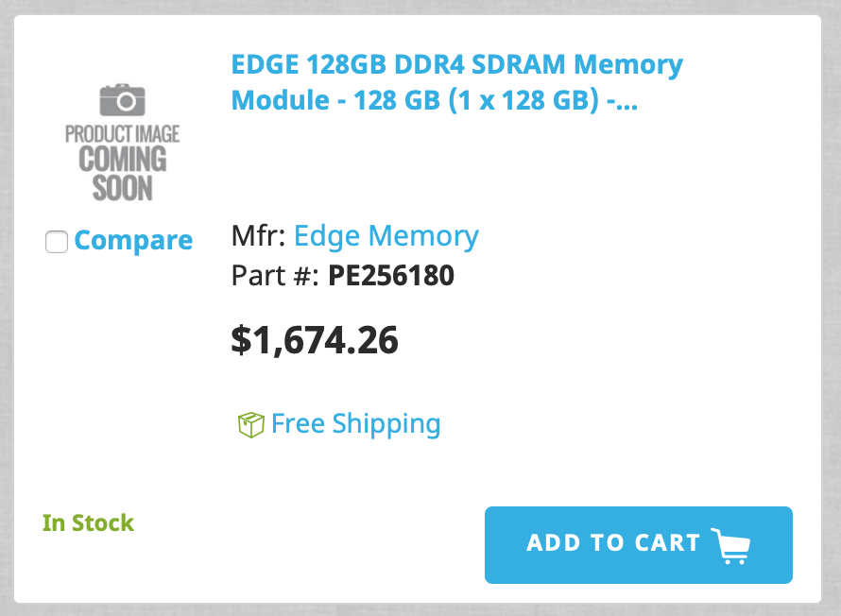
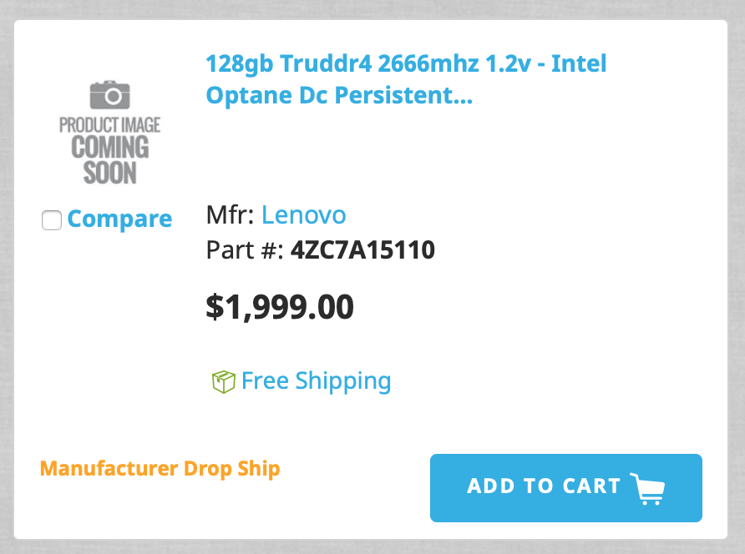
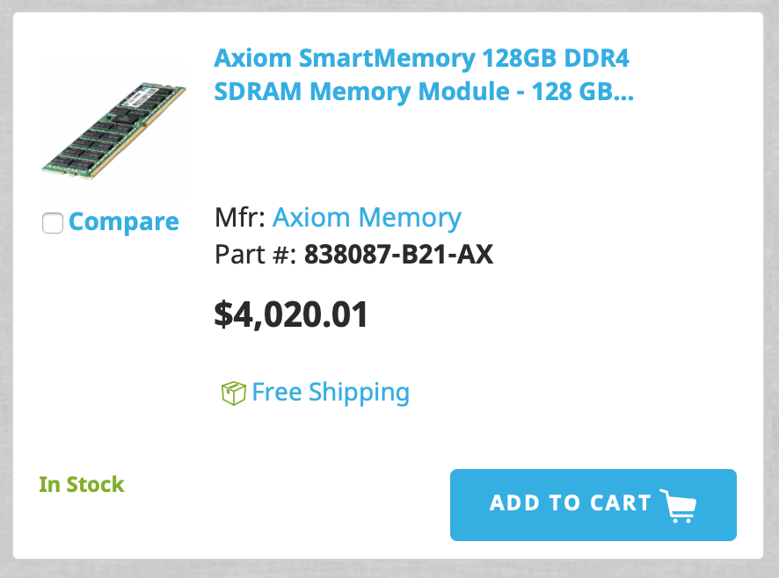
You can order it!
Comparing equivalently-sized DRAM modules
(smaller modules are much cheaper)
Anandtech.com
$13/GB
$15/GB
$31/GB
compsource.com

Slide 11
I got persistent memory. Let’s figure out what to do with it!

Slide 12
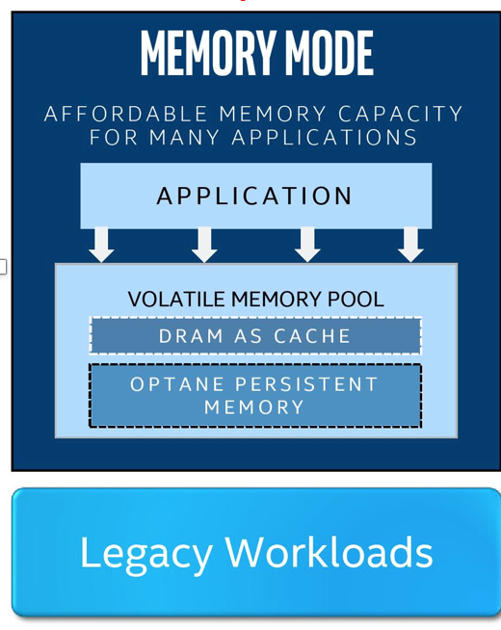
Memory mode
non-persistent
Optane memory is NOT persistent
DRAM acts as a cache (direct-mapped)
CPU memory controller manages the cache transparently
CPU/OS see a larger memory pool

Slide 13
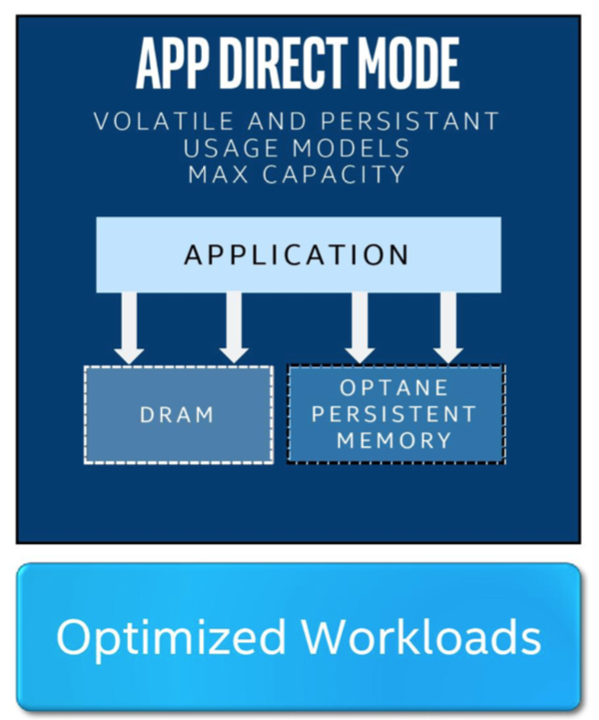
App-direct
persistent
Persistent mode
Sits side-by-side with DRAM

Slide 14
What does ”persistent” mean?
If the data reaches the memory controller it will survive a power failure
If the data sits in the CPU cache, it won’t.
Need to explicitly flush it using special instructions.
Survives power failure
Data gets lost
CPU cache
Memory controller
memory bus

Slide 15
PM is exposed as a regular device
Persistent memory shows us as a PMEM device
/dev/pmem0, dev/pmem1, etc…
You can mount a file system onto it

Slide 16
You Can Emulate PM in the Linux Kernel
$ sudo emacs -nw /etc/default/grub
$ sudo grub-mkconfig -o /boot/grub/grub.cfg
GRUB_DEFAULT=0
GRUB_TIMEOUT_STYLE=hidden
GRUB_TIMEOUT=2
GRUB_DISTRIBUTOR=`lsb_release -i -s 2> /dev/null || echo Debian`
GRUB_CMDLINE_LINUX_DEFAULT=""
GRUB_CMDLINE_LINUX="memmap=16G!12G
Add this line to your GRUB file.

Slide 17
File system support
ext4 and xfs have been modified to support PMEM
They use Direct-Access Mode (DAX), bypassing the buffer cache
Mount the file system on /dev/pmemX with the direct access (DAX) option
# mkdir /mnt/pmem
# mkfs.ext4 /dev/pmem0
# mount -o dax /dev/pmem0 /mnt/pmem

Slide 18
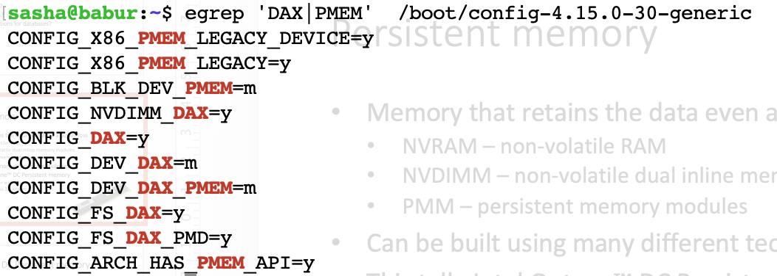
Support in Linux 4.3
PMEM – persistent memory device
DAX – file system support

Slide 19
The interface to persistent memory
Management Path
Configure / check persistent memory
Storage path
File system manages the persistent memory
Access using POSIX file interface
Memory path:
Mmap interface
Load/store instructions
Intel’s PMDK (persistent memory development kit) provides malloc/free interface.

Slide 20
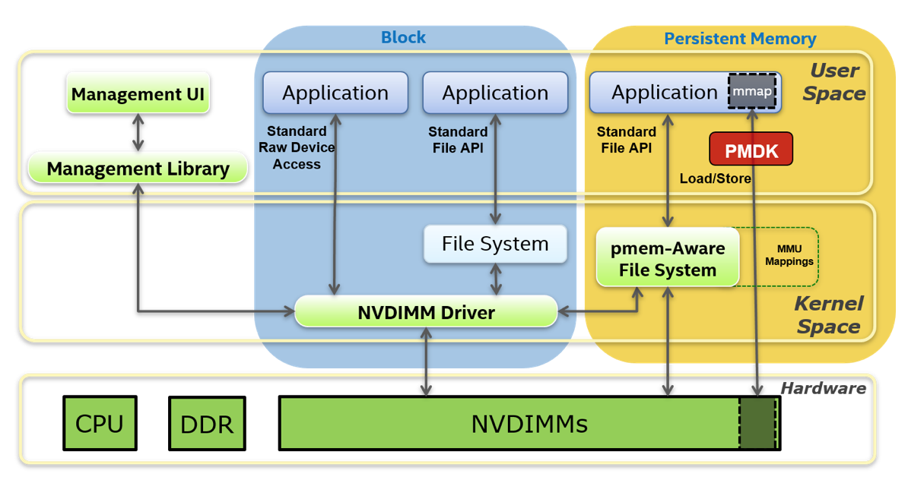
Storage path
Memory path
pmem.io
Source: pmem.io PMDK introduction

Slide 21
How to program?
EASY: Just use a file system interface
PROS: No changes to the application
CONS: Has overhead, must use file system interface (POSIX API)
HARD: Convert the application to use persistent memory
PROS: Can persist all kind of state and recover faster
CONS: Need to keep track of persistent memory allocations and use transactions / logging

Slide 22
Intel PMDK
Persistent Memory Development Kit
For C/C++
Basic access to persistent memory
Persistent pointers
Transactions and Logging

Slide 23
Examples:
Example 1: Use PM via a memory-mapped file
Example 2: Use a persistent object store
Example 3: Use transactions

Slide 24
Example 1: Use PM via a memory-mapped file
Source: pmdk.io

Slide 25
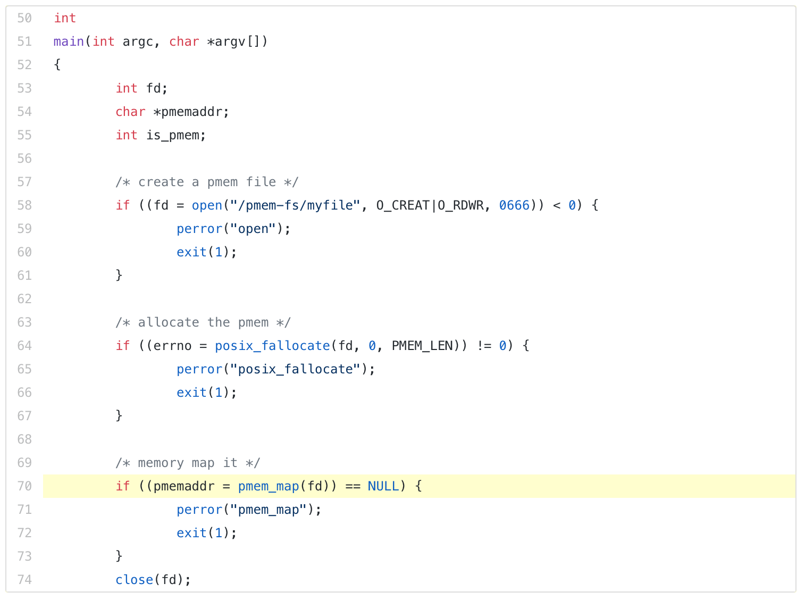
Example 1: Use PM via a memory-mapped file
Calling mmap() directly will work just fine – the main advantage of pmem_map() is that it tries to find an address where mapping is likely to use large page mappings, for better performance when using large ranges of pmem.
Source: pmdk.io

Slide 26
Example 1: Use PM via a memory-mapped file
Just like regular memory!
Is the string persistent after strcpy on line 80?
We don’t know!
Could be in the CPU cache (all or part of it), not on storage media
Some parts could have been pushed to the media as part of cache eviction
Instructions like ’SFENCE’ don’t work – they are for write visibility among threads.
MUST EXPLICITLY FLUSH MEMORY!
Source: pmdk.io

Slide 27
Example 1: Use PM via a memory-mapped file
Flushing memory to persistence:
This is just a wrapper around msync() that ensures that the arguments are aligned.
OK to use msync()directly.
pmem_persist() will, if possible, perform the flush directly from user space, without calling into the OS. This is made possible on the Intel platform using instructions like CLWB and CLFLUSHOPT.
OK to use msync()instead.
OK to use CLWB and CLFLUSHOPT directly.
Source: pmdk.io

Slide 28
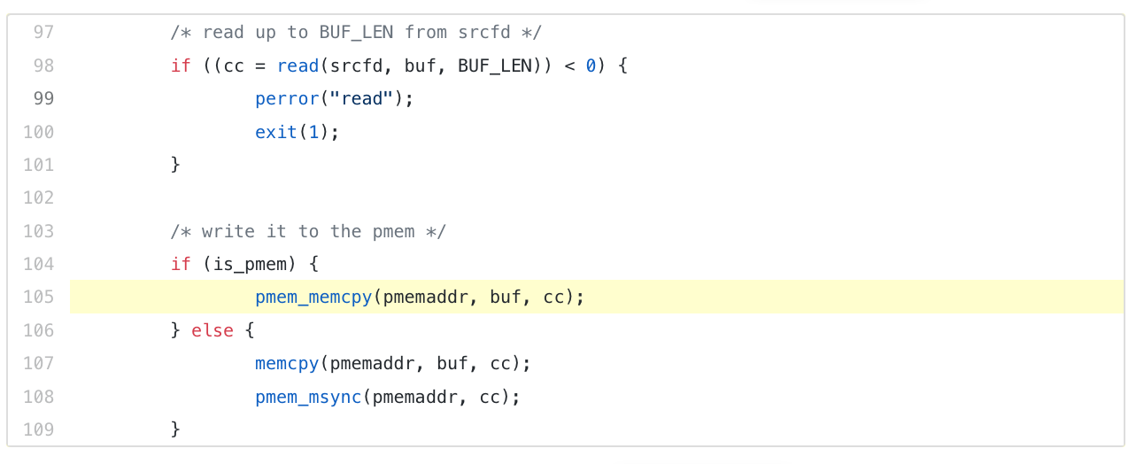
Example 1: Use PM via a memory-mapped file
Copying persistent memory
Optimized for copying to pmem. On the Intel platform, this is done using the non-temporal store instructions which bypass the processor caches.
Using memcpy will also work.
Source: pmdk.io

Slide 29
Examples:
Example 1: Use PM via a memory-mapped file
Example 2: Use a persistent object store
Example 3: Use transactions

Slide 30
libpmemobj
persistent pointers and a way to atomically manipulate them

Slide 31
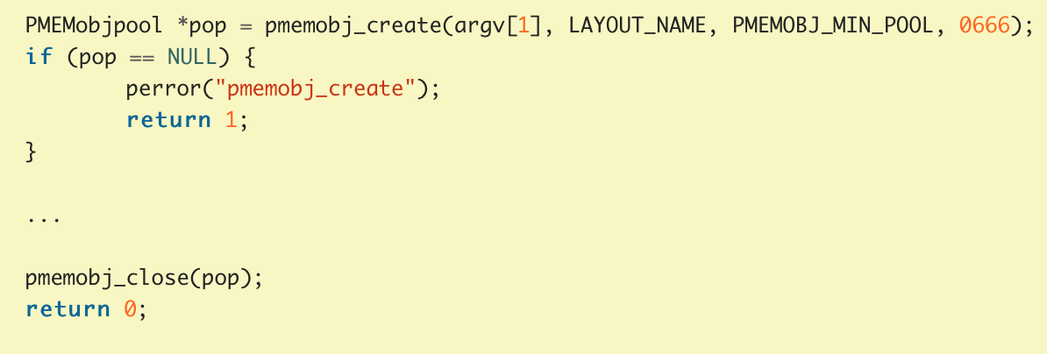
Example 2: Use a persistent object store
Creating a persistent memory pool
Transactional objects live in persistent memory pool
It’s just a file that holds data structures
Here is how you create one
Application defined string. Identifies an expected file format, e.g., MY_LIST.
Can be null.
Just a file name
Permissions, same as for creat().
Source: pmdk.io

Slide 32
Root Object
Entry point for all persistent objects allocated using the API.
There is exactly one root object per pool.
Example 2: Use a persistent object store
PMEM object ID (OID).
Create or resize the root object.
OBTAIN A DIRECT POINTER!
NOT A DIRECT POINTER!
Source: pmdk.io

Slide 33
Writing an object
Read data into a regular memory buffer
Set and persist the object size
Example 2: Use a persistent object store
Copy the data and persist to media.
pmemobj_persist:
Write changes to media.
Not transactional. Some changes could have been flushed earlier.
pmemobj_memcpy_persist:
Copies and persists the changes.
Not transactional.
Your could crash here and end up with inconsistent state.
Source: pmdk.io

Slide 34
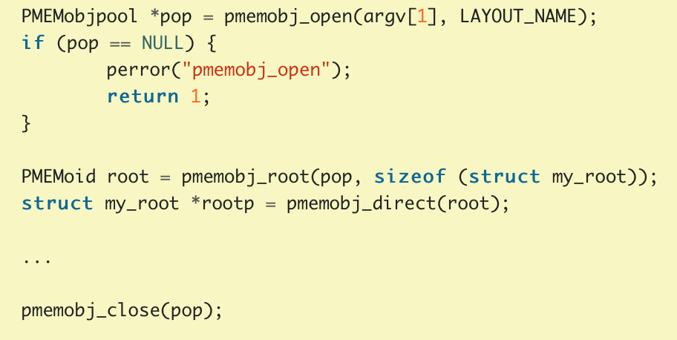
Read the object from a different process
Open with the same name and LAYOUT_NAME as specified at creation time.
Example 2: Use a persistent object store
Get the root object and the direct pointer.
Read as you would a regular pointer.

Slide 35
Examples:
Example 1: Use PM via a memory-mapped file
Example 2: Use a persistent object store
Example 3: Use transactions

Slide 36
Example 3: Use transactions
Set and persist the object size
Copy the data and persist to media.
We will use transactions to solve this!
Your could crash here and end up with inconsistent state.

Slide 37
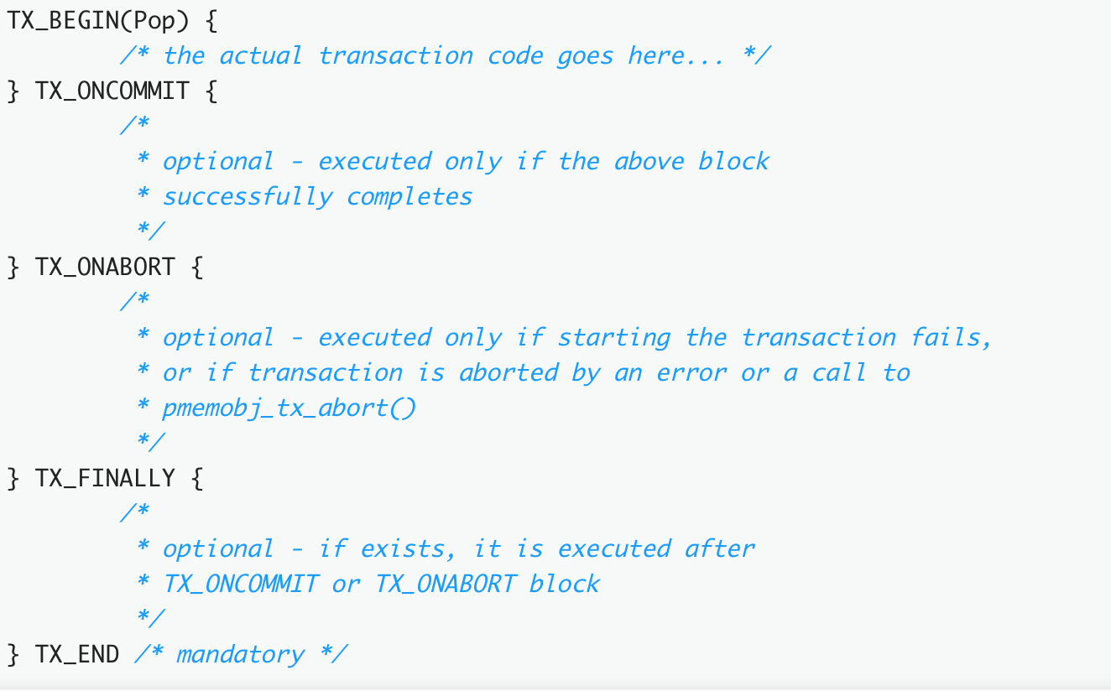
[OPTIONAL]
Example 3: Use transactions
<REQUIRED>

Slide 38
Problematic example:
Crash here and get into bad state
Example 3: Use transactions
Solve it with transactions:
“takes a “snapshot” of the memory block of given size, located at given offset off in the object specified by oid, and saves it to the undo log. The application is then free to directly modify the object in that memory range. In case of a failure or abort, all the changes within this range will be rolled back”

Slide 39
Properties of transactions in PMDK
Crash consistency
If you crash in the middle or abort, NONE of the changes are reflected in persistent memory.
Not atomic with respect to other threads (no isolation)
Other threads immediately see the changes in memory.
A few questions:
What happens if only some of the changes are persisted on commit?
Is there a recovery procedure?
Where is the log stored (in PM?)? If so, what’s the overhead of logging?
Example 3: Use transactions

Slide 40
DON’T TRY THIS AT HOME!

Slide 41
Outline
What is persistent memory?
How much does it cost?
How do I use it?
How does it perform?
What are the implications for databases?

Slide 42
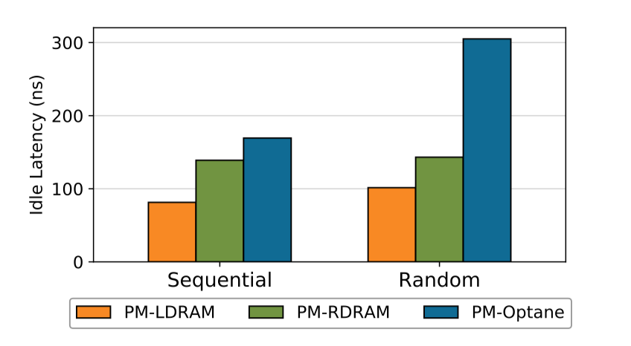
Read latency vs DRAM*
Take-away #1:
305 ns
PM gives us sub-microsecond latencies.
PM is ~2-3x slower than DRAM
The difference between sequential and random is ~2x
169 ns
Local DRAM
Remote DRAM
Same machine, different NUMA node
*Measured on individual reads, no caching, no prefetching
Source: Basic Performance Measurements of the Intel Optane DC Persistent Memory Module arXiv:1903.05714v2

Slide 43
Write latency vs DRAM
Take-away #2:
PM-Optane: 94ns
DRAM: 86ns
How it was measured:
Issue a write followed by a cache flush instruction and a fence
Not guaranteed to reach the media, but reaches the processor’s ADR (Asynchronous DRAM refresh domain).
Individual writes comparable to DRAM.
Because the write returns after we reach the memory controller
Source: Basic Performance Measurements of the Intel Optane DC Persistent Memory Module arXiv:1903.05714v2

Slide 44
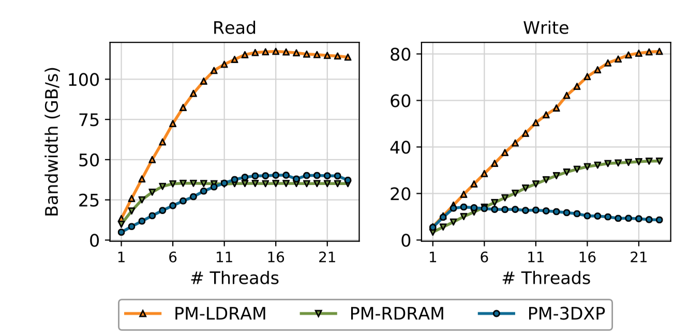
Sequential Read/Write Bandwidth vs DRAM
Reading PM is as fast as reading DRAM on a remote NUMA node!
Local DRAM
Remote DRAM
~40 GB/s for reads, ~14 GB/s for writes.
Source: Basic Performance Measurements of the Intel Optane DC Persistent Memory Module arXiv:1903.05714v2
* On six interleaved Optane DIMMs

Slide 45
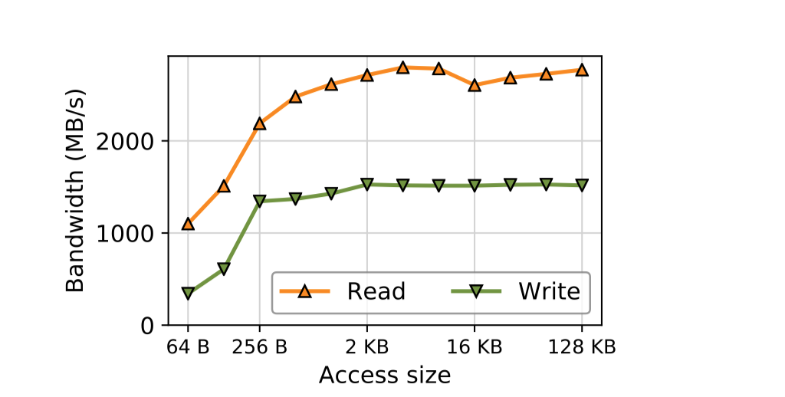
Random Read/Write Bandwidth (One Thread)
2.8 GB/s
(Sequential: 5 GB/s)
2-3x difference between sequential and random bandwidth with a single thread for both reads and writes
1.5 GB/s
(Sequential: 5.5 GB/s)
Non-interleaved region on a single DIMM
One thread
Source: Basic Performance Measurements of the Intel Optane DC Persistent Memory Module arXiv:1903.05714v2

Slide 46
Sequential vs Random BW with 16 Threads
Take-away #3:
Reads:
Sequential bw: 40 GB/s
Random bw: 11 GB/s
Writes:
Sequential bw: 10 GB/s
Random bw: 5 GB/s
On Optane PM the performance difference between sequential and random accesses is 2-4x
4x difference
2x difference
For SSDs: ~10x difference between sequential and random bandwidth
Source: Lies, Damn Lies And SSD Benchmark Test Result, Seagate.
Source: Basic Performance Measurements of the Intel Optane DC Persistent Memory Module arXiv:1903.05714v2

Slide 47
Latency of file operations
Take-away #4:
No clear advantage of using Optane PM for individual file operations with small data transfers
Software overhead and/or caching effects dominate
SSD with Optane technology
Unmodified
NVM-optimized file system from academia.
Direct access to media. No buffer cache.
Source: Basic Performance Measurements of the Intel Optane DC Persistent Memory Module arXiv:1903.05714v2

Slide 48
Throughput of file operations: Reads
Sequential 4K reads (1-16 threads)
Random 4K reads (1-16 threads)
5x
Raw bandwidth (16 threads) was:
~39 GB/s for sequential reads
~11 GB/s for random reads
Source: Basic Performance Measurements of the Intel Optane DC Persistent Memory Module arXiv:1903.05714v2

Slide 49
Throughput of file operations: Writes
Sequential 4K writes (1-16 threads)
Random 4K writes (1-16 threads)
Raw bandwidth (16 threads) was:
~10 GB/s for sequential writes
~5 GB/s for random writes

Slide 50
Take-away #4
Using PM-Optane as storage gives up to ~5x more throughput when equivalent technology is sitting in an SSD.
Software bottlenecks become pronounced.

Slide 51
Outline
What is persistent memory?
How much does it cost?
How do I use it?
How does it perform?
What are the implications for databases?

Slide 52
Implications (overview)
PM is faster than SSD, so software overheads are more noticeable
Implication: may have to retune performance
Difference between random and sequential is not that big
Hint: you don’t need to organize your data structures for sequential access
Bandwidth is much larger than that of a disk (65K I/O queues)
Question: how do you feed that bandwidth?
Atomicity unit is much smaller than disk (e.g., 256 bytes)
Implication: Might affect software correctness

Slide 53
Do we care about being sequential?
I/O overhead
Software overhead
Persistent memory:
I/O time becomes much smaller
Software overhead remains
10x difference
2-4x difference
total execution time
Much larger software overheads
Difference between sequential and random may become much less important
I/O much faster
Random Sequential
Random Sequential
SSD
PM-Optane
* hypothetical application

Slide 54
Don’t organize your data for sequential writes
Many systems sort their data for writing to achieve sequential writes
This generates CPU overhead!
Cut this out!
B. Leper, O. Balmau, K. Gupta, W. Zwaenepoel, KVell: the Design and Implementation of a Fast Persistent Key-Value Store, SOSP 2019
Jian Xu and Steven Swanson, University of California, San Diego, NOVA: A Log-structured File System for Hybrid Volatile/Non-volatile Main Memories, USENIX FAST 2016

Slide 55
Use multiple logs
Historically: single log, because
You want sequential writes
Mechanical disks have only one head
Don’t care about or want concurrency
Persistent memory:
Very large bandwidth and many I/O queues
Sequential performance is still better than random, but
Software overhead becomes more noticeable
Benefits of multiple logs
Utilize the bandwidth (need to feed multiple queues)
Achieve high concurrency (remove software overhead)
Jian Xu and Steven Swanson, University of California, San Diego, NOVA: A Log-structured File System for Hybrid Volatile/Non-volatile Main Memories, USENIX FAST 2016

Slide 56
Implement log as a linked list
Bad idea for disks:
We lose sequential access property
Better for persistent memory
Easier to allocate space
Easier to clean the log -- can do one page at a time
Easier to reclaim stale log pages
Jian Xu and Steven Swanson, University of California, San Diego, NOVA: A Log-structured File System for Hybrid Volatile/Non-volatile Main Memories, USENIX FAST 2016

Slide 57
Get rid of block interface?
Databases use block interface
Read from and write to disk in units of entire pages (e.g., 8KB)
For NVRAM: huge write amplification
Ideas from research community
Re-write the storage engine to use byte interface
Caveats (Keith Bostic, co-creator of WiredTiger):
Huge engineering effort
Staying away from block interface is not easy: compression/encryption.

Slide 58
Best practices of NVRAM adoption
Redesigning data structures for persistent memory is very hard
Fast path for adoption: use PM as a fast storage device
Avoid kernel overhead of file system access:
Use memory mapped files with DAX.
Flush with user-level instructions: pmem_persist, not msync.
Pre-allocate files to avoid journaling overhead when files grow piecemeal.
Use large pages (ext4 does this).
Jian Xu et al., Finding and Fixing Performance Pathologies in Persistent Memory Software Stacks , ASPLOS 2019

Slide 59
Summary
Persistent memory is here
It is about 2x cheaper than DRAM*
It is only 2-3x slower than DRAM
It is up to 5x faster than SSD for throughput-oriented workloads
The difference in performance between sequential and random accesses is a lot smaller than SSD
Software overheads are more pronounced than on SSD
Interesting implications for storage systems

Slide 60
Backup slides

Slide 61
Example 1: Use PM via a memory-mapped file
Flushing persistent memory
pmem_flush() = pmemp_persist() + pmem_drain()
Send data to hardware
Wait for hardware buffers to drain until data reaches the media.
Does nothing (empty function) on Intel platforms!
Source: pmdk.io

Slide 62
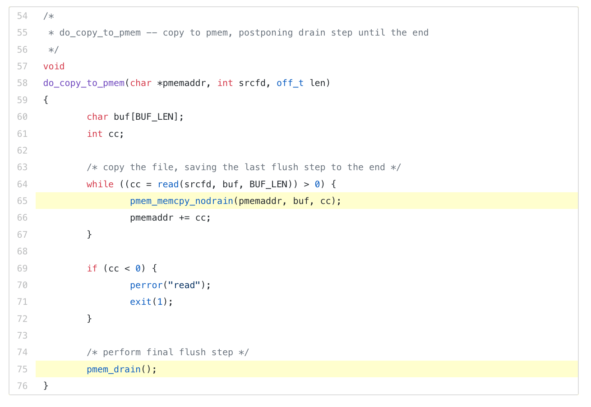
Example 1: Use PM via a memory-mapped file
Separating flush and drain steps
Source: pmdk.io

Slide 63
NOVA
Log structured, but only the metadata is written into the log
An alternative is journaling, but journaling writes the data twice
Hence, less write amplification than journaling.
Data is written directly into the media, and shadow paging is used for atomicity
Each inode has its own log
Concurrency, better bandwidth utilization
Log is implemented as a linked list
Easier and faster to clean
Jian Xu and Steven Swanson, University of California, San Diego, NOVA: A Log-structured File System for Hybrid Volatile/Non-volatile Main Memories, USENIX FAST 2016

Slide 64
Wear leveling
Like SSDs performs wear-leveling
Internal address translation
Bad block management

