Slide 1
Implementing System Calls
CPEN 331, UBC
Alexandra Fedorova

Slide 2
How does invoking a system call cause a trap?
It is a regular function that the processor interprets in a special way.
A system call includes a special instruction.
It’s a regular function that tries to access kernel memory – and that generates a trap.
None of the above.

Slide 3
What is a system call?
How is a system call different from a function call?

Slide 4
Crossing Protection Domain
User mode
Domain crossing into the kernel mode, or supervisor mode
Invoke system call
trap
What happens here?
Why do we need that?
Kernel mode

Slide 5
From user code to trap
Take a look at comments inside gensyscalls.sh
Then inside syscalls.S, somewhere in the src/build directory.
How does invoking a system call cause a trap?

Slide 6
How do traps work?

Slide 7
What happens in MIPS R3000 hardware on a trap
Update status register (CP0$12) with bits that: • turn off interrupts; • put processor in supervisor mode; • indicate prior state (interrupts on/off; user/supervisor mode)
Sets cause register (CP0$13) with: • what trap happened
Sets the exception PC (CP0$14) (address where execution is to resume after we handle the trap)
Sets the PC to the address of the exception handler.

Slide 8
MIPS R3000 Software
Read kern/arch/mips/locore/exception-mips1.S
This is the exception handling code where the processor jumps on all exceptions.
System calls generate a trap – traps are also exceptions!
Understand what happens there.

Slide 9
Why do we need to “get a kernel stack”?
Refer to kern/arch/mips/locore/exception-mips1.S
Code starting around line 100 finds a kernel stack if we are coming from user mode. Why does it need to find a kernel stack as opposed to using the stack that was available in user mode?
That memory is never available in the kernel
Using a user-level stack may be unsafe
This is just a decision made in OS161, but there is nothing wrong with using it
This is a resource sharing policy – we don’t want to occupy user memory during kernel activities unrelated to that program.

Slide 10
Trapframe?
Refer to kern/arch/mips/locore/exception-mips1.S
Understand the code between lines 139 and 230. And then at the code between lines 270 and 325. What could happen if we made a mistake in that code?
After the system call is done, we could return to a different location in the use code than the one that invoked the system call.
We could accidentally run a different process after we return to user mode.
Some user code may run incorrectly after we return from the system call.
A and C.
All of the above.

Slide 11
MIPS R3000: from trap to system call
Read the function mips_trap at kern/arch/mips/locore/trap.c
This is the C function called by the low-level exception handler that we just looked at.
The variable named ‘code’ is used to distinguish between a system call and another exception handler.
Where does the value in this variable comes from? Who sets it and when?

Slide 12
MIPS R3000: from trap to system call
From the function mips_trap find the code that actually invokes an implementation of a system call inside the OS.
Read that code and understand how it works.
Answer the following questions:
How does the kernel know which system call is invoked?
Where does the system call get the arguments?

Slide 13
How does the kernel know which system call is invoked?
The exception handling code gets it from one of the co-processor registers.
The system call number placed in a regular register.
The system call number is recorded on the user stack; the kernel would copy it in.

Slide 14
Where does the system call get the arguments? Identify the original source before the trap. .
From registers a0-a3
From the user stack
From co-processor registers
A and B
A, B and C.
trapframe is not the right answer.

Slide 15
Safety inside the kernel
The kernel has to be careful in handling memory while executing system calls.
The mechanisms it uses are implemented in copyin/copyout, setjmp, longjmp

Slide 16
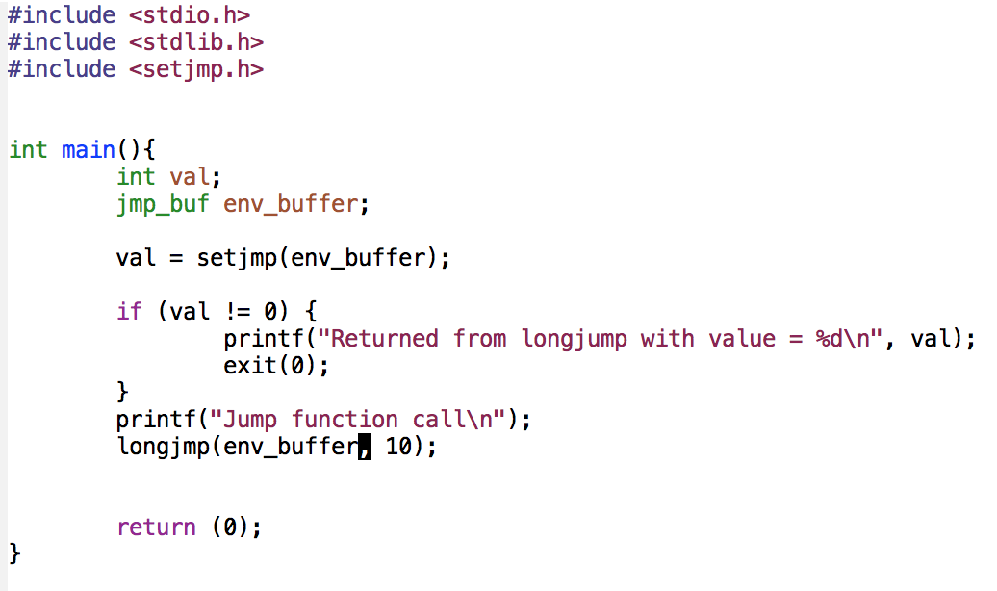
Read the man pages for setjmp and longjmp and answer the following
Assuming that the call to setjmp succeeds, what will be the output of this program?
“Jump function call”
“Jump function call” ”Returned from longjump with value = 10”
”Returned from longjump with value = 10” “Jump function call”
None of the above

Slide 17
Copyin/copyout
Read the code in kern/vm/copyinout.c
What is the purpose of this code?
Notes:
CLASS EXERCISE: Go over the code to understand how copyin/copyout works.

Slide 18
What to copyin?
The kernel needs to examine all values to execute a system call.
val0
val1
val2
val3
VALUES ARRAY
NULL
POINTERS ARRAY
ptr0
ptr1
ptr2
ptr3
ptr4
BASE ADDRESS OF ARRAY
User addresses
Kernel addresses
Passed to kernel as an argument in a register

Slide 19
What to copyin?
The kernel needs to examine all values to execute a system call.
val0
val1
val2
val3
VALUES ARRAY
NULL
POINTERS ARRAY
ptr0
ptr1
ptr2
ptr3
ptr4
BASE ADDRESS OF ARRAY
User addresses
Answer choices:
Values array
Pointers array
Both
Neither
Kernel addresses
Passed to kernel as an argument in a register

Slide 20
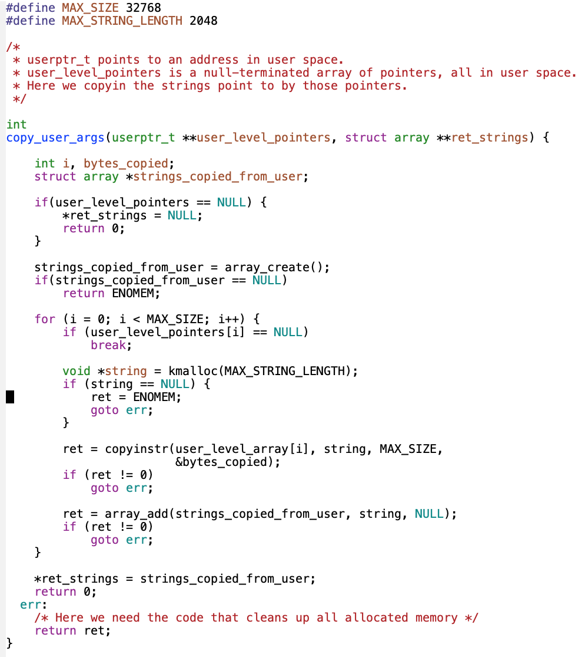
Does this code use copyin/copyout correctly?
This code is safe.
There is a missing copyin
There is a missing copyout
wget http://ece.ubc.ca/~os161/download/copyin-out.c

Slide 21
How do we get back to user mode? Use the most precise answer.
Same as we would return from a function – jump to the user mode PC.
First restore the user-level PC from the trapframe, then jump to it.
There is a special instruction that gets you back.
Restore architectural state and invoke a special instruction

Slide 22
How expensive are system calls?
You were hired by Unicorns United to create a super efficient operating system for a new teleportation device the company is manufacturing.
The boss called you to a special meeting with executives and is asking you to estimate exactly how expensive the system calls are relative to function calls.
You have to give your answer in 5 minutes; you have no time to measure anything (bosses have a short attention span)
Assume you don’t want to get fired. Present your answer.

Slide 23
Processes and Threads

Slide 24
What is a process?

Slide 25
What is a thread? How is a thread different from a process?

Slide 26
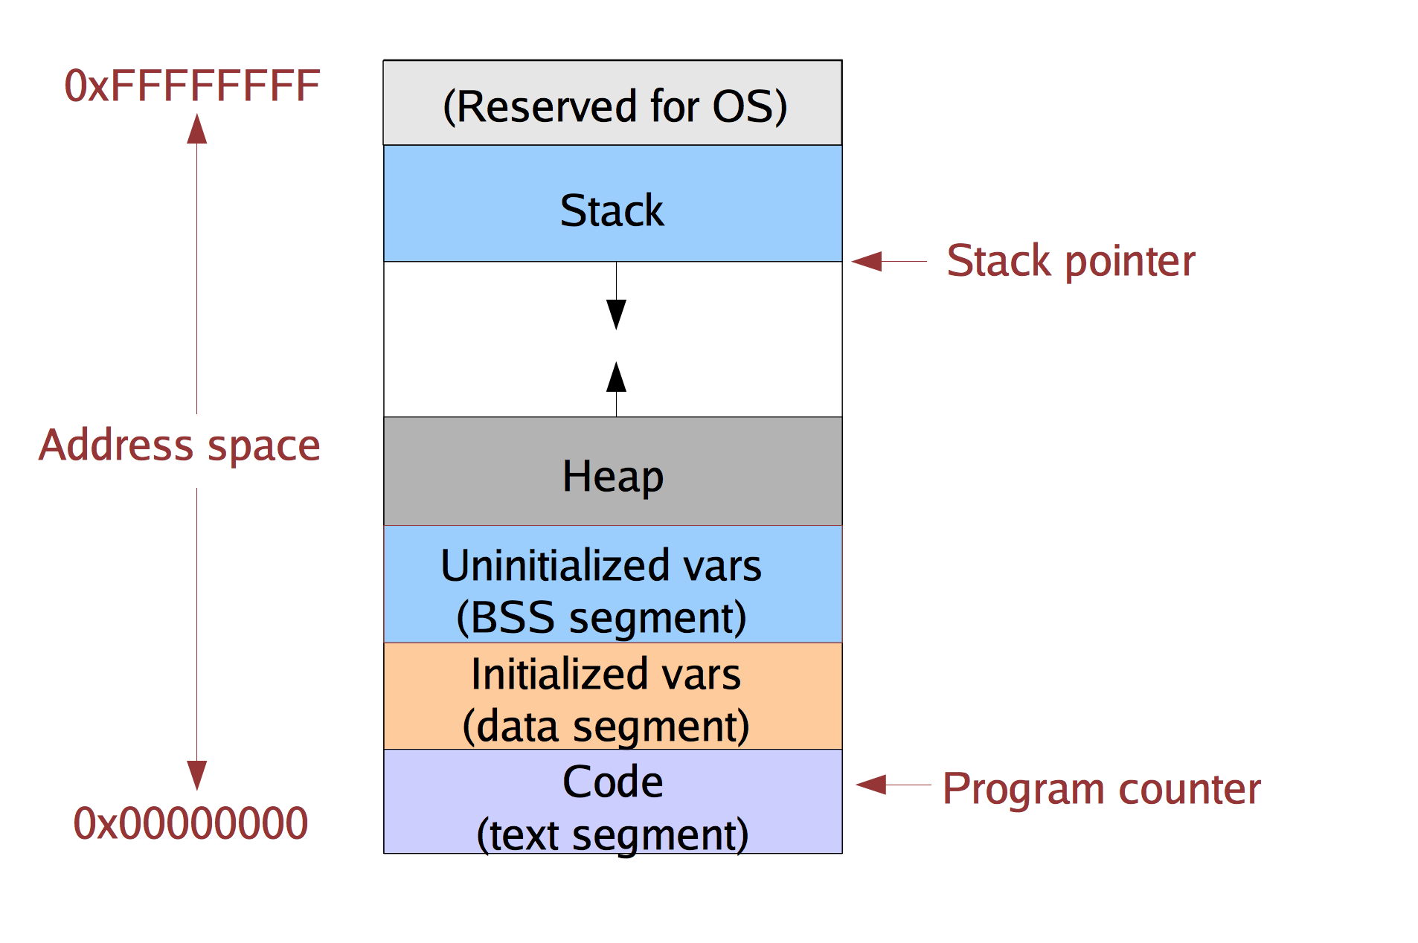
Single-threaded Address Space

Slide 27
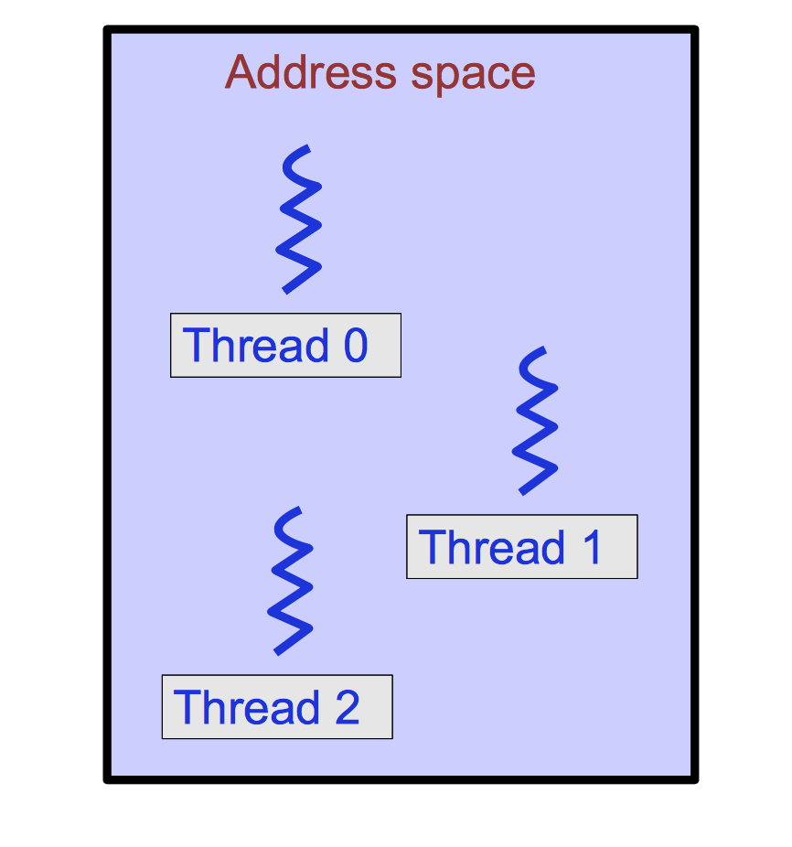
Multithreaded process

Slide 28
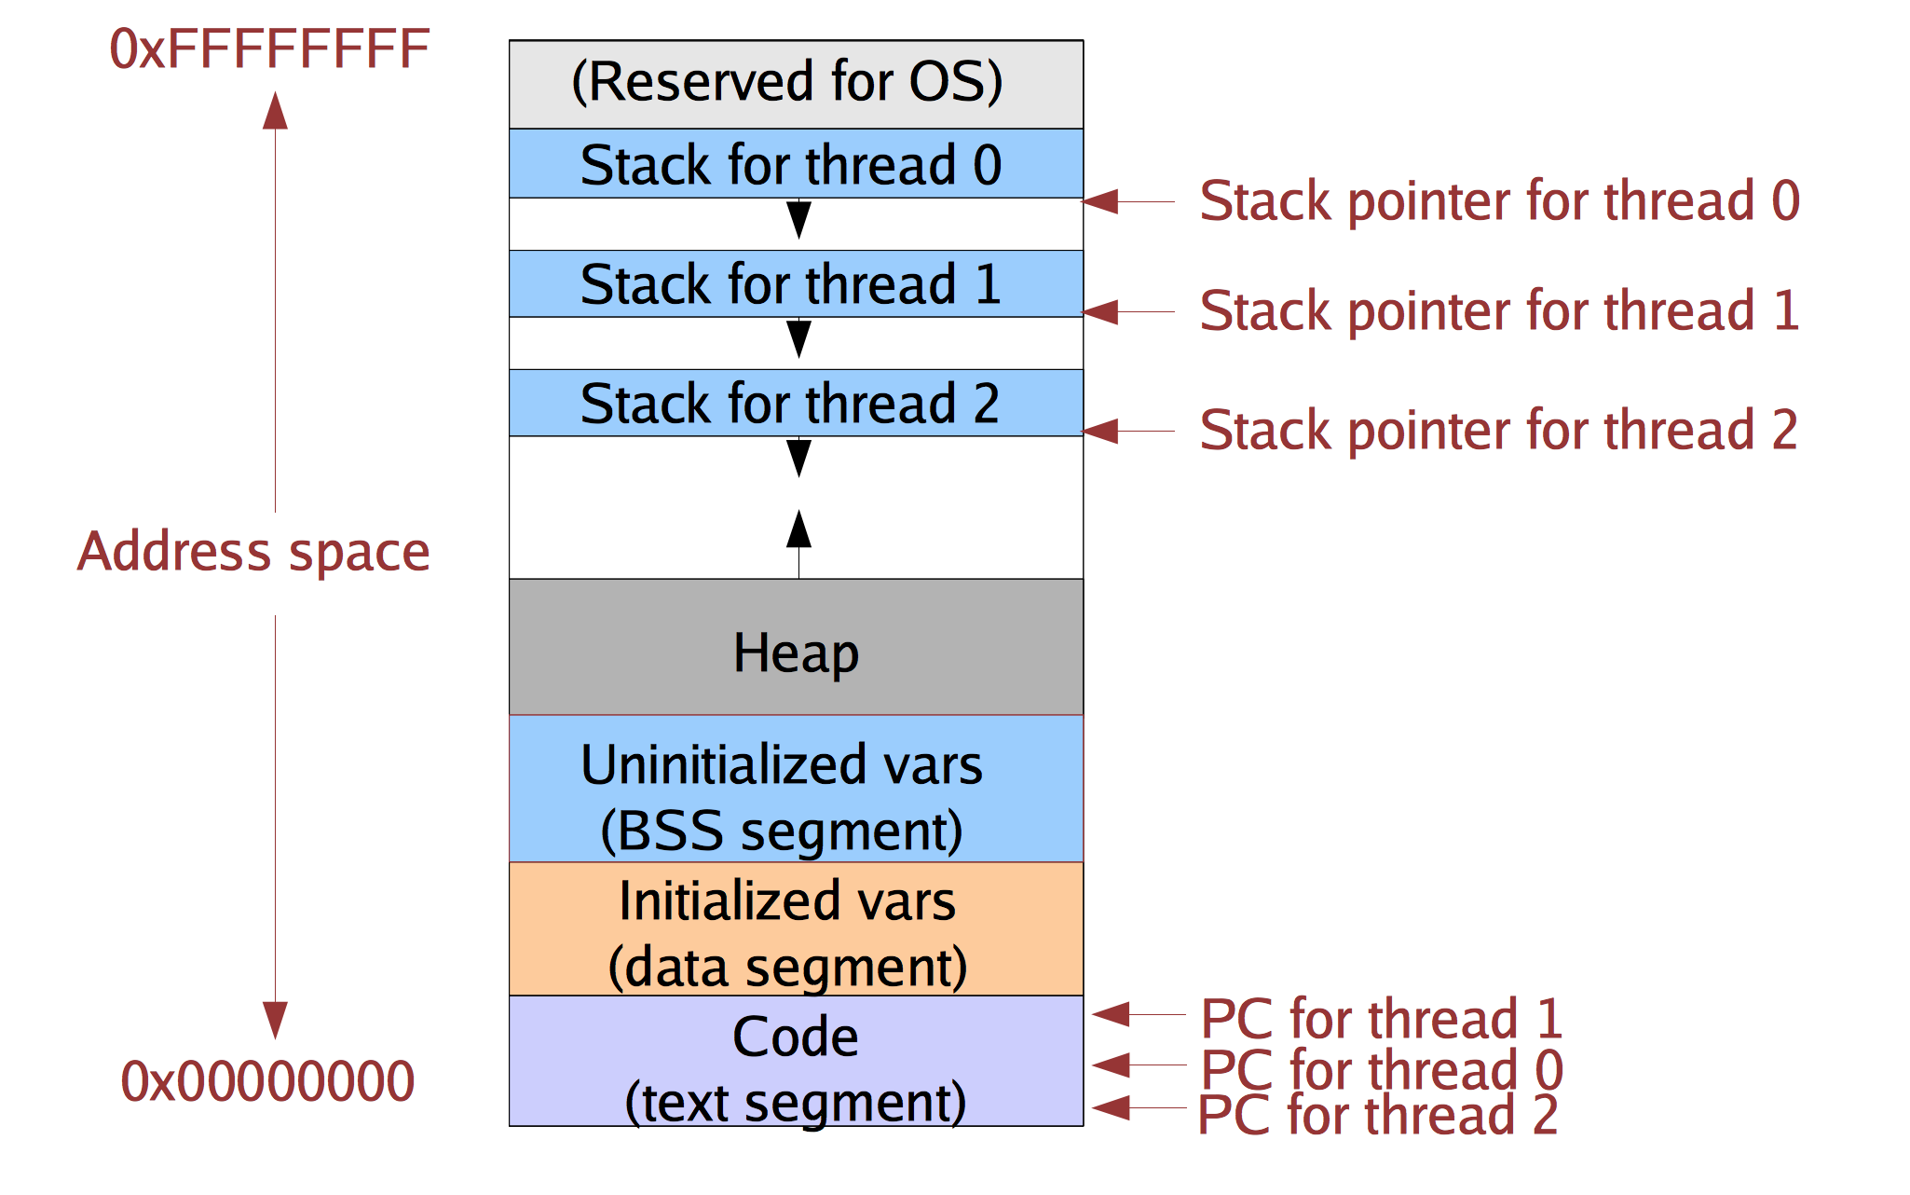
Multithreaded process address space

Slide 29
Implementing threads
Kernel-supported threads
The kernel is aware of the threads within the process
It keeps track of each thread’s stack and its processor state (registers, program counter)
Threads are a unit of scheduling. Each can be scheduled independently. Different threads can run concurrently on different CPUs.
User-level
The kernel unaware of the existence of threads
The user program creates stacks on its heap (via malloc)
The user program keeps track of the program counter and other context

Slide 30
Kernel-Supported Thread Switch
User address space
Kernel address space

Slide 31
Kernel-Supported Thread Switch
User address space
Kernel address space

Slide 32
User-Level Thread Switch
User address space
Kernel address space

Slide 33
User-Level Thread Switch
User address space
Kernel address space

Slide 34
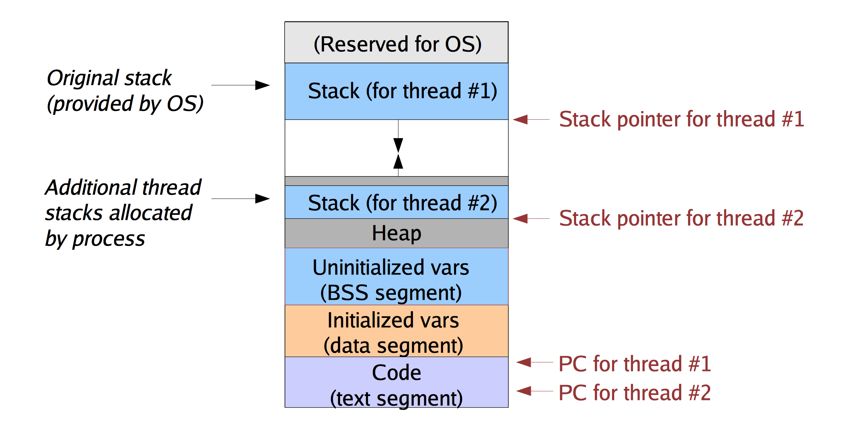
User-level Threads

Slide 35
User-level Thread Management
Stacks are allocated and managed by a user-level library
How to switch between user-level threads?
Need some way to swap CPU state.
This does not require any privileged instructions
Threads library can use the same instructions as the OS to change the PC and stackpointer (SP)
Why is it safe to do so?

Slide 36
Does a thread switch require trapping into the kernel?
Yes
No
Depends on the thread implementation

