Slide 1
Advanced Scheduling:
How attempts to make schedulers better made them even more complicated
CPEN 331, UBC
Alexandra Fedorova

Slide 2
Outline
Several concrete case studies in scheduling research
  Addressing shared resource contention
  Catering to NUMA systems
Linux scheduler
  Overview
  A Decade of Wasted Cores – how complexity led to painful performance bugs
Open research problems

Slide 3
HARDWARE
SOFTWARE
Does it matter on which core to run a thread?
Scheduling runqueue
System software and hardware
shared cache
shared cache
cache
cache
cache
cache
Core 0
Core 1
Core 2
Core 3
Tasks (threads)
Threads running on cores that share a cache may compete for the cache and various hardware queues
time

Slide 4
Contention for shared resources
Threads
shared cache
shared cache
cache
cache
cache
cache
Core 0
Core 1
Core 2
Core 3
soplex
sphinx
namd
gamess
Experiment 1: run each application alone on the machine
Run #1
measure the running time
measure the running time
Run #2
solo running time
Run #3
measure the running time
Run #4
measure the running time

Slide 5
Contention for shared resources
Threads
shared cache
shared cache
cache
cache
cache
cache
Core 0
Core 1
Core 2
Core 3
soplex
sphinx
namd
gamess
Experiment 2: run threads together, co-scheduled in different ways
Run #1
measure the running time
Run #2
measure the running time
Contended running time
Run #3
measure the running time
Contended running times differ. We find the BEST and the WORST overall co-schedule.
We record the running time in that co-schedule for each application.

Slide 6
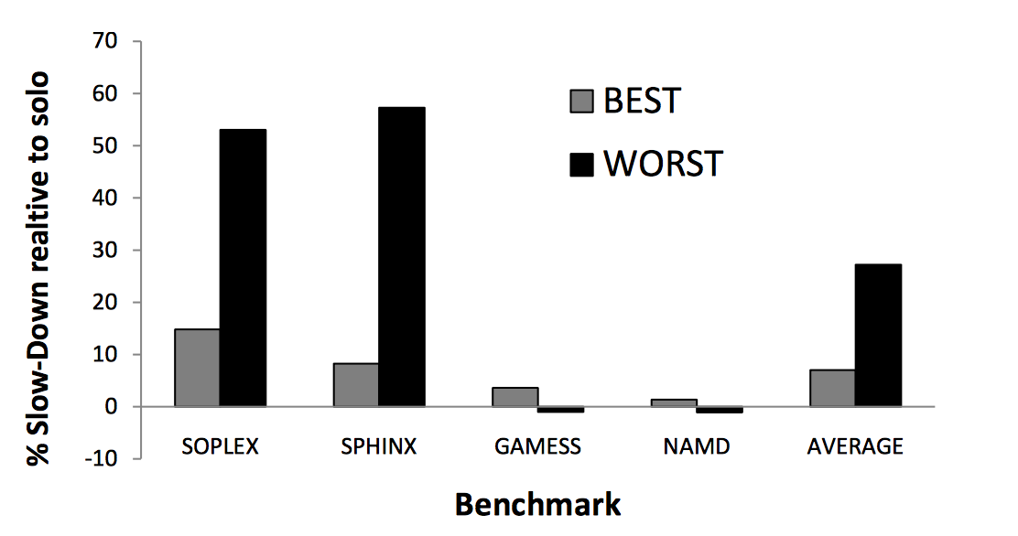
How much slowdown in co-scheduled runs?
How much slower the app runs when contending compared to running alone
BEST co-schedule: lowest average runtime for all apps.
WORST co-schedule: highest average runtime for all apps.

Slide 7
How to schedule threads to minimize contention (interference)?
Threads
shared cache
shared cache
cache
cache
cache
cache
Core 0
Core 1
Core 2
Core 3
soplex
sphinx
namd
gamess
We learned from the previous slide that threads don’t interfere in the same way
Some interfere more than others
Run #1
This run is a lot worse than…
Run #2
Run #3
…this run

Slide 8
Problem statement and assumptions
Problem:
  Given an arbitrary set of threads, assign them to cores so as to minimize the interference
Assumption:
  You know nothing about the threads before they begin running
Constraint:
  You have to make decisions and schedule threads optimally on the fly
How would you tackle this problem?

Slide 9



Here is what first attempts were like…
But figuring out how threads use the cache is HARD!
We need to model how threads compete for cache space
So, let’s measure/estimate how they use cache and build a model
How to predict which threads will interfere?

Slide 10
Our approach
Background:
CPUs have hardware counters
They measure various events in the hardware:
  Cache hits/misses
  Retired instructions
  Etc.
Virtually no overhead
shared cache
shared cache
cache
cache
cache
cache
Core 0
Core 1
Core 2
Core 3
IDEA:
Let’s see if we can use hardware counters as inputs to the cache interference model!
Insight: Hardware counter inputs are easier to obtain than data required for the previously proposed methods.
Run threads
Measure hardware counters
Feed them into the model
Get the prediction of who will interfere
Challenge: Will the model be accurate enough with these imperfect inputs?

Slide 11
After months of:
Unexpected results
Frustration
Agony
We found that…

Slide 12
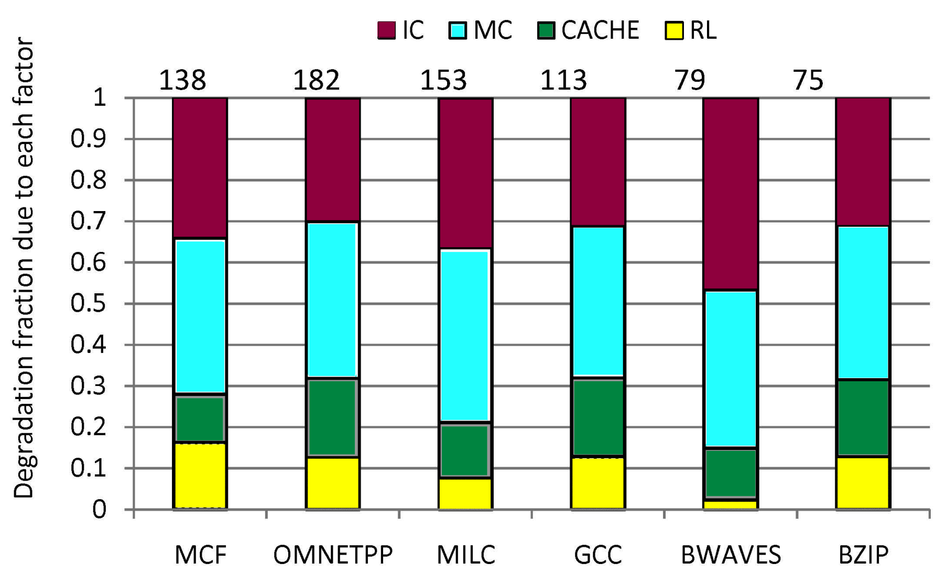
Surprise: Cache contention not dominant!
Memory interconnect
Memory controller
Last-level cache
Others
Application benchmarks

Slide 13
Contention for memory channels is key!
What are the implications?
Pressure on memory channels is easy to measure
Relatively easy to predict which threads will compete
More pressure → more interference
No need for complicated models
Just measure the hardware counter data and schedule away!
Memory
controller
System request
queue
shared cache
shared cache
cache
cache
cache
cache
Core 0
Core 1
Core 2
Core 3

Slide 14
Our (simplified!) approach
shared cache
shared cache
cache
cache
cache
cache
Core 0
Core 1
Core 2
Core 3
These hardware counters are readily available on most processors
Run threads
Measure hardware counters
Feed them into the model
Get the prediction of who will interfere
New insight made it easy to develop an accurate model
Challenge: Will the model be accurate enough with these imperfect inputs?

Slide 15
Our (simplified!) approach
shared cache
shared cache
cache
cache
cache
cache
Core 0
Core 1
Core 2
Core 3
5,000,000
50,000
10,000,000
5,000
Measure the number of memory requests per time unit
Threads with lots of requests are memory-intensive
The scheduler avoids scheduling memory-intensive threads on the same shared cache

Slide 16
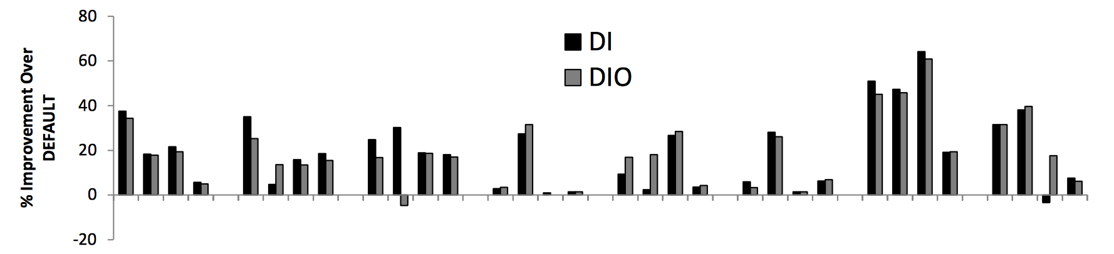
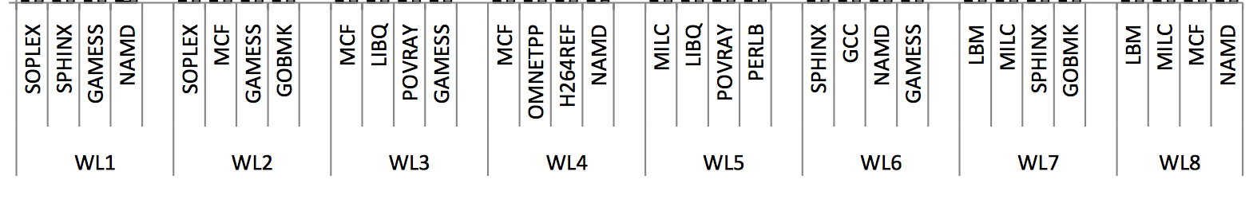
Performance results
Our schedulers
How much better applications ran with our schedulers than with the default Linux scheduler
Workloads and applications they consist of

Slide 17
So we published a paper about this work:
Sergey Zhuravlev, Sergey Blagodurov and Alexandra Fedorova, Addressing Shared Resource Contention in Multicore Processors via Scheduling, in Proceedings of the Fifteenth International Conference on Architectural Support for Programming Languages and Operating Systems (ASPLOS 2010)
Then we ran our algorithm on a NUMA system

Slide 18




Why did performance suck on a NUMA system?
~200 cycles
no delays
threads
We schedule memory intensive threads apart
But if their data is still on the same node…
They compete for the memory controller and the interconnect…
And one thread experiences remote latency
data
Both memory-intensive
~300 cycles
no delays
You have to schedule not only threads, but place their memory appropriately!

Slide 19








The ‘Long Commute’ Problem
A
B
Why does commute take a long time?
The destination is far away
They are stuck in traffic

Slide 20
The NUMA Performance problem
~200 cycles
no delays
threads
data
Memory controller and interconnect congestion?
~300 cycles
no delays
Remote latency delay?

Slide 21
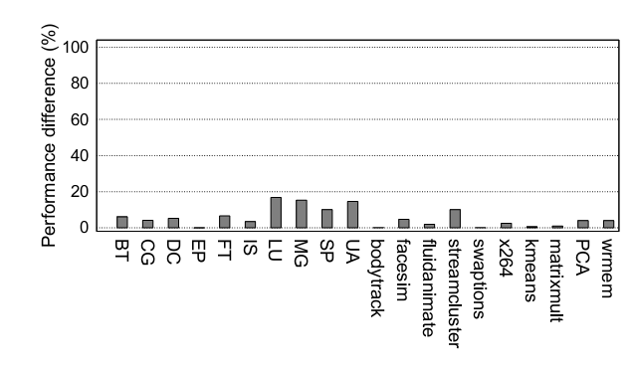
Remote latency has a measurable effect
<20% performance
impact
How much worse we run when all data is remote

Slide 22
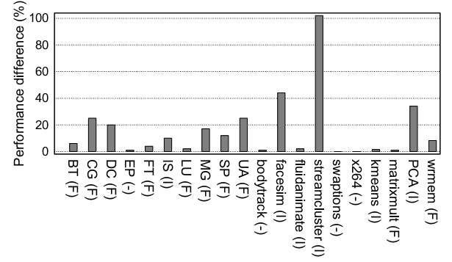
But congestion can be really devastating!
How much slower we run when there is congestion relative to when there is none

Slide 23
Carrefour: our algorithm
CONTINUOUSLY MEASURE TRAFFIC
REPLICATE
YES
IS PAGE SHARED?
IS IT READ-ONLY?
Implemented in the Linux kernel
Runs ”online”
Has negligible overhead
YES
NO
NO
CO-LOCATE WITH THE ACCESSING THREAD
PLACE ON RANDOM NODE
Notes:
Why do we replicate on read-only?
Algorithm is simple
Engineering was tricky
Measurement has overhead. Getting enough samples is hard
Read-only is crucial, but cannot know this for sure.
Have to be very conservative

Slide 24




Carrefour: Performance Results
Mohammad Dashti, Alexandra Fedorova, Justin Funston, Fabien Gaud, Renaud Lachaize, Baptiste Lepers, Vivien Quema and Mark Roth, Traffic Management: A Holistic Approach to Memory Placement on NUMA Systems, Eightieenth International Conference on Architectural Support for Programming Languages and Operating Systems (ASPLOS), 2013
https://github.com/Carrefour‎
With our algorithm
Unchanged Linux
37% better
38% better
60% better
58% better
Running time
Face simulation
Data Classification
Face Recognition
Data Analytics

Slide 25
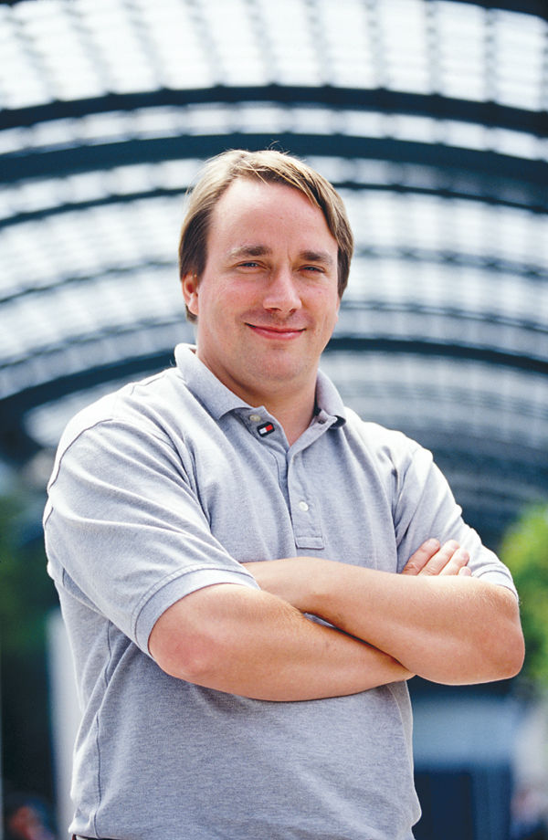
“And you have to realize that there are not very many things that have aged as well as the scheduler. Which is just another proof that scheduling is easy.”
Linus Torvalds, 2001
The scheduler became very very complicated…
“The scheduler simply isn’t that important.”
Linus Torvalds, 2001
Since 2001 scheduling became very important
Linus Torvalds

Slide 26
A Decade of Wasted Cores
How scheduler complexity led to atrocious performance bugs
Jean-Pierre Lozi, Baptiste Lepers, Justin Funston, Fabien Gaud, Alexandra Fedorova and Vivien Quema. The Linux Scheduler: A Decade of Wasted Cores. Eleventh European Conference on Computer Systems (EuroSys), 2016.

Slide 27
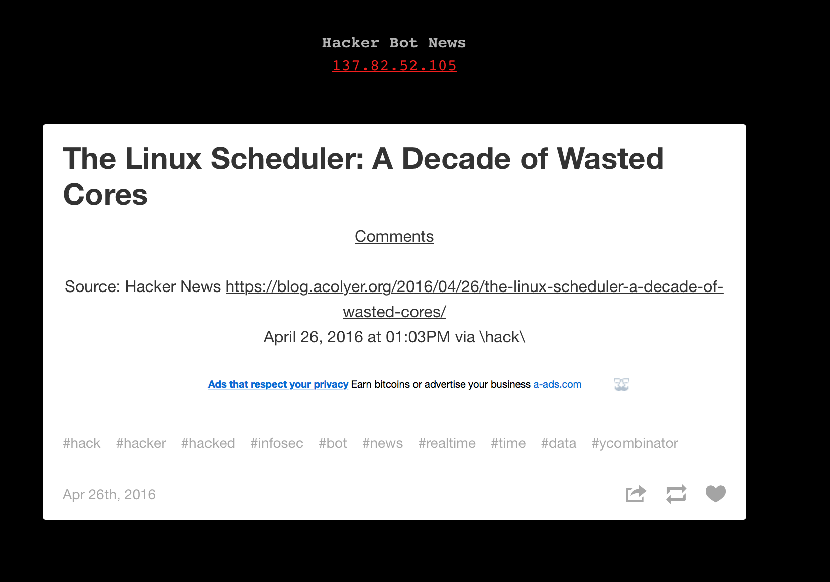

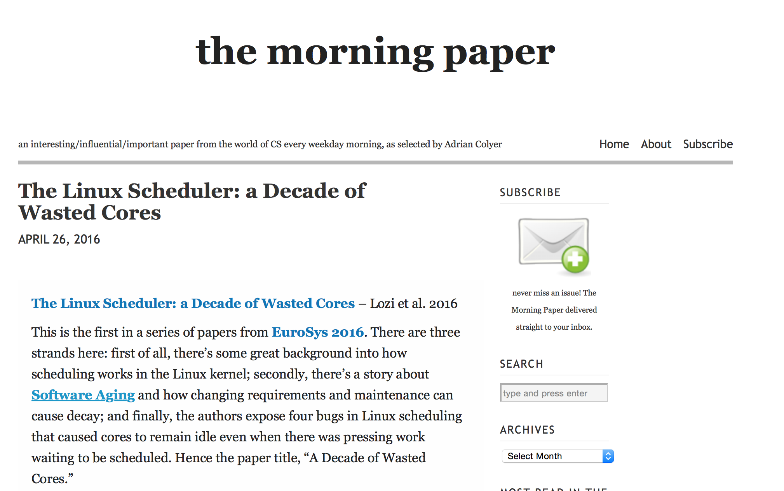


Slide 28
But first, an overview of the Linux Completely Fair Scheduler
Slides designed by Jean-Pierre Lozi
University of Nice Sophia-Antipolis and Oracle

Slide 29
The COMPLETELY FAIR SCHEDULER (CFS): Concept
When a thread is done running
for its timeslice : enqueued again
One runqueue where threads
are globally sorted by runtime
R = 112
R = 103
Cores get their next task
from the global runqueue
R = 82
R = 24
Some tasks have a lower niceness
and thus have a longer timeslice
(allowed to run longer)
Of course, cannot work with a single
runqueue because of contention
R = 18
R = 12
Core 0
Core 1
Core 2
Core 3

Slide 30
CFS: in practice
One runqueue per core to avoid contention
CFS periodically balances average loads of all
tasks in the runqueue:
load(task) = weight¹ x % cpu use²
¹The lower the niceness, the higher the weight
²We don’t want a high-priority thread that
sleeps a lot to take a whole CPU for itself
and then mostly sleep!
Since there can be many cores: hierarchical approach!
W=1
W=6
W=1
W=1
W=1
W=1
W=1
Core 0
Core 1

Slide 31
CFS In Practice : Hierarchical load balancing
AVG(L)=3000
AVG(L)=2500
AVG(L)=3500
AVG(L)=3000
L=2000
Balanced!
L=3000
L=3000
L=3000
L=6000
L=4000
L=1000
L=3000
Balanced!
Balanced!
L=1000
L=1000
L=1000
L=1000
L=3000
L=1000
L=1000
L=1000
L=1000
L=1000
L=1000
L=1000
L=1000
Core 0
Core 1
Core 2
Core 3

Slide 32
CFS In Practice : Hierarchical load balancing
Note that only the average load of groups is considered
If for some reason the lower-level load-balancing fails, nothing happens at a higher level:
Wait, does that work?
AVG(L)=3000
AVG(L)=3000
L=0
L=6000
Balanced!
L=3000
L=3000
L=1000
!!!
L=1000
L=1000
L=3000
L=1000
L=1000
L=1000
L=1000
L=1000
L=1000
Core 0
Core 1
Core 2
Core 3

Slide 33
CFS IN PRACTICE: MORE HEURISTICS
Load calculations are actually more complicated, use more heuristics.
One of them aims to increase fairness between “sessions”.
Objective: making sure that launching lots of threads from one terminal doesn’t prevent other processes on the machine (potentially from other users) from running.
  Otherwise, easy to use more resources than other users by spawning many threads...

Slide 34
CFS IN PRACTICE: MORE HEURISTICS
Load calculations are actually more complicated, use more heuristics.
One of them aims to increase fairness between “sessions”.
50% of a
CPU
L=1000
Session (tty) 1
Unfair!
L=1000
L=1000
L=1000
L=1000
L=1000
150%
L=1000
L=1000
Session (tty) 2
L=1000
L=1000

Slide 35
CFS IN PRACTICE: MORE HEURISTICS
Load calculations are actually more complicated, use more heuristics.
Solution: divide the load of a task by the number of threads in its tty...
100% of a
CPU
L=1000
Session (tty) 1
Wait, does that work?
L=250
L=1000
L=250
L=250
100% of a
CPU
L=250
L=250
L=250
L=250
Session (tty) 2
L=250

Slide 36
Bug 1/4: Group imbalance
L=1000
Load(thread) = %cpu × weight / #threads
= 100 × 10 / 1
= 1000
Session (tty) 1
Load(thread) = %cpu × weight / #threads
= 100 × 10 / 8
= 125
L=125
L=125
L=125
L=125
L=125
L=125
L=125
L=125
Session (tty) 2

Slide 37
Bug 1/4: Group imbalance
AVG(L)=500
AVG(L)=500
L=0
L=1000
Balanced!
L=500
L=500
Balanced!
Balanced!
L=1000
!!!
L=125
L=125
L=125
L=125
L=125
L=125
L=125
L=125
Fundamental issue
with the load metric...
Core 0
Core 1
Core 2
Core 3

Slide 38
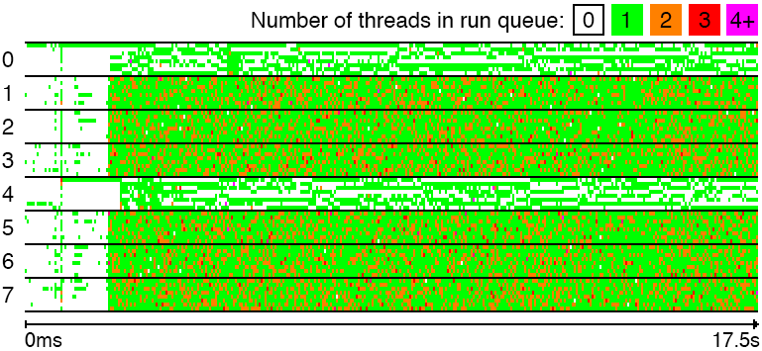
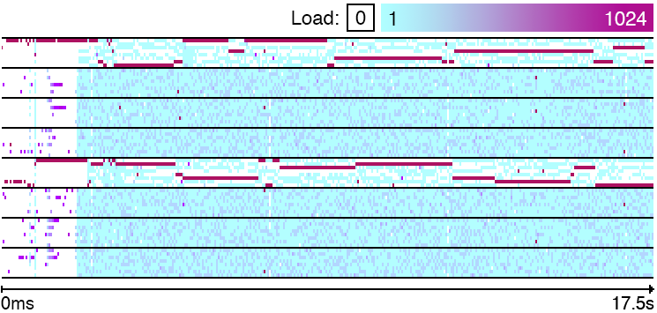
BUG 1/4: GROUP IMBALANCE
Another example, on a 64-core machine, with load balancing:
  First between pairs of cores (Bulldozer architecture, a bit like hyperthreading)
  Then between NUMA nodes
User 1 launches :
ssh <machine> R &
ssh <machine> R &
User 2 launches :
ssh <machine> make –j 64 kernel
The bug happens at two levels :
  One core in a pair of cores is idle
  Other cores on NUMA node less busy...

Slide 39
Linux wastes cores while threads are waiting
Application performance drops by >2X!
NUMA node ID
8 cores per node
Threads waiting in runqueues
Idle cores!

Slide 40
Other examples of wasted cores

Slide 41
A Parallel Scientific Workload Runs 137 Times Slower!
Threads waiting to run
Idle cores!
NUMA node ID
8 cores per node

Slide 42
A Widely Used Commercial Database Takes a 25% Performance Hit
NUMA node ID
8 cores per node

Slide 43
Summary: Open Research Problems
Summary:
The hardware becomes more and more complex
System use cases become more and more varied
Developers are working hard to make one scheduler work for all use cases
The scheduler becomes increasingly complex and rife with bugs
Open problems:
How to combine multiple optimizations in a single system?
How to make the scheduler more robust?

