Slide 1
Writes Hurt: Lessons in Cache Design for Optane NVRAM
Alexandra Fedorova, Keith A. Smith, Keith Bostic, Susan LoVerso, Michael Cahill and Alex Gorrod

Slide 2
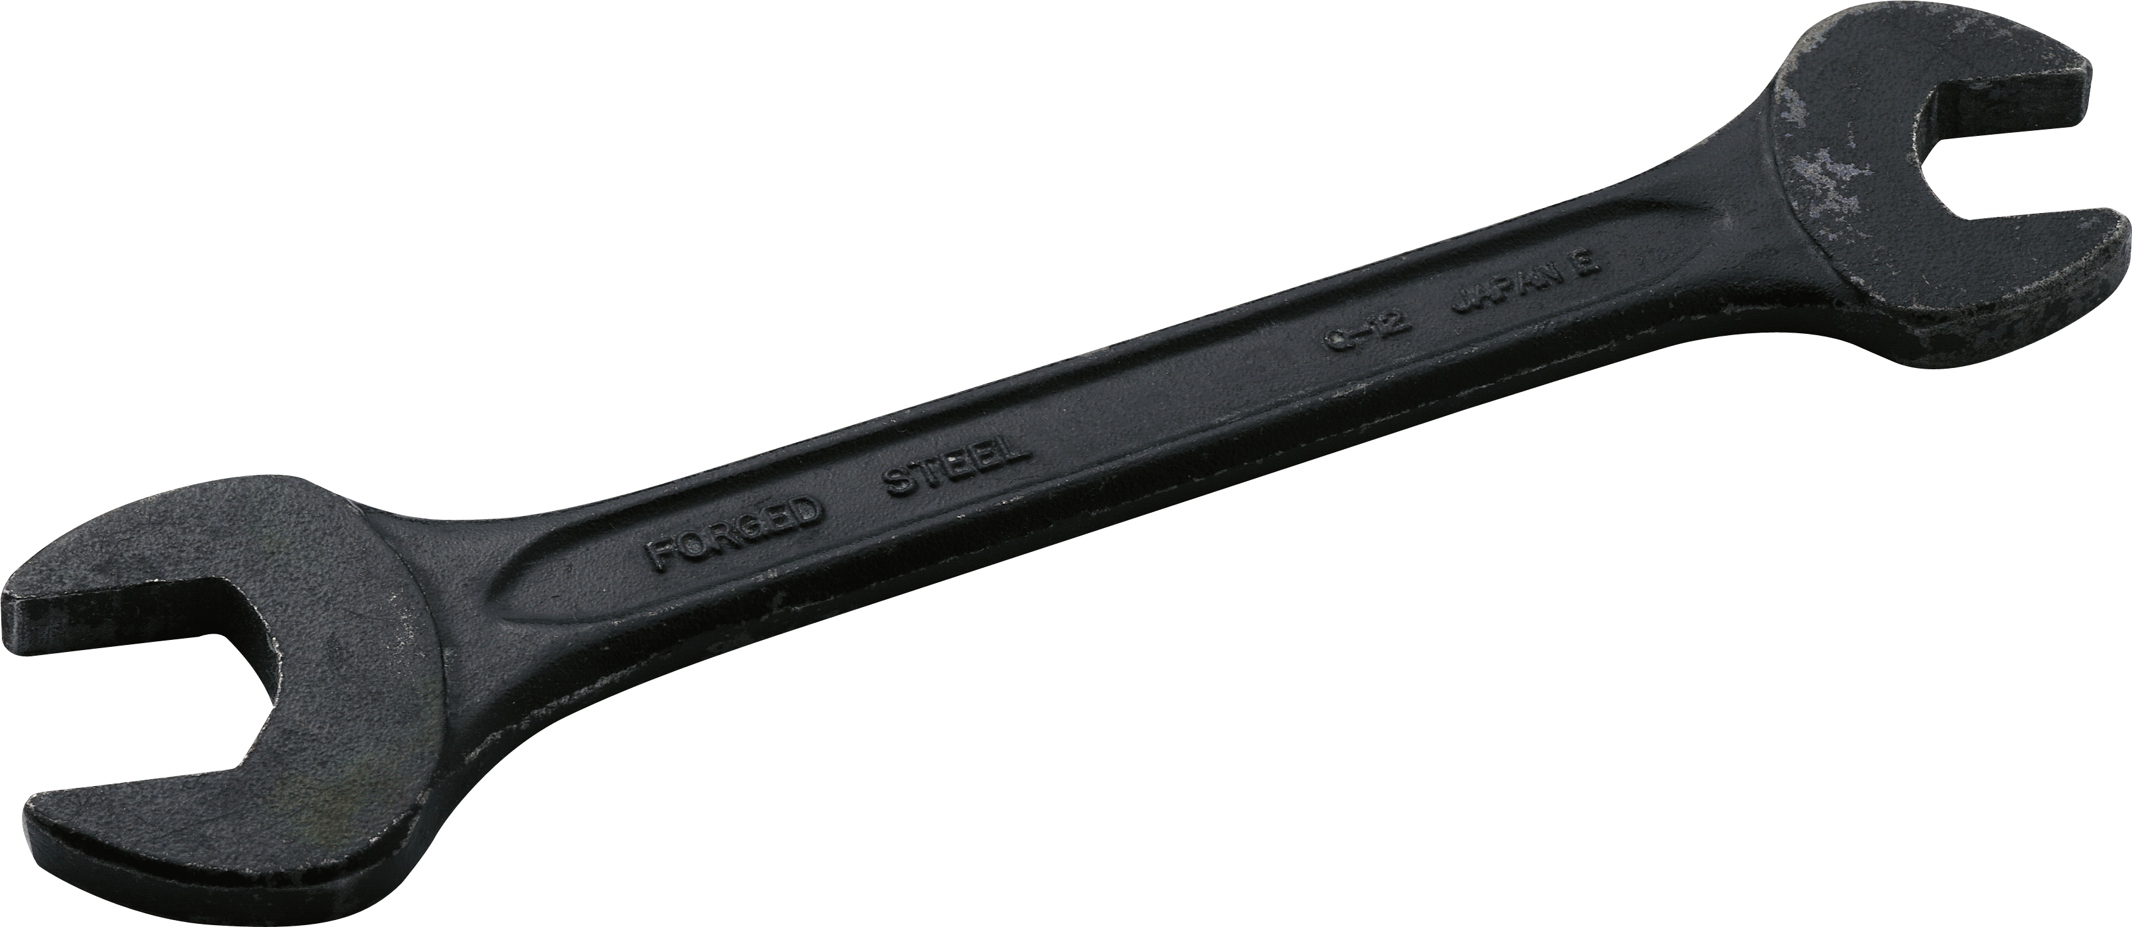
A cache that lives in Optane NVRAM*
Just another cache?
Throwing spanner in the works
NVRAM revolts…
-- Famous Japanese Haiku, unknown author
*Non-volatile memory

Slide 3
Limited write throughput
Optane SSD
Optane NVRAM
Well known phenomenon:
Yang et al. An Empirical Guide to the Behavior and Use of Scalable Persistent Memory, FAST’20

Slide 4
Writes hurt reads
DRAM
Optane NVRAM
Concurrent writers

Slide 5
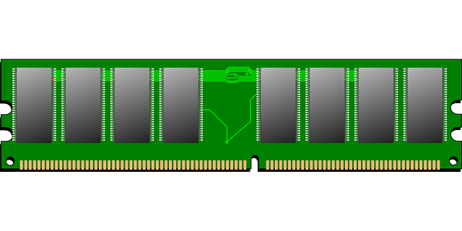
Cache must ration the writes
LOOKUP DATA
READ
WRITE
ADMIT NEW DATA
NVRAM CACHE
APPLICATION MEMORY

Slide 6
Overhead Bypass heuristic (OBP)
ADMIT
NO
ADMIT DATA INTO CACHE?
OBP THRESHOLD EXCEEDED?
DO NOT ADMIT
YES
COST
BENEFIT
OBP captures dynamic workload properties

Slide 7
How to set OBP threshold?
WRITES REALLY HURT? LOW THRESHOLD
WRITES DON’T HURT? HIGH THRESHOLD

Slide 8
OBP protects from the pain of writes
An experiment where caching has no benefit (small datasets and/or lots of writes)
WiredTiger -- the MongoDB storage engine
Caching should have zero effect on performance
Higher numbers are worse
admit all

Slide 9
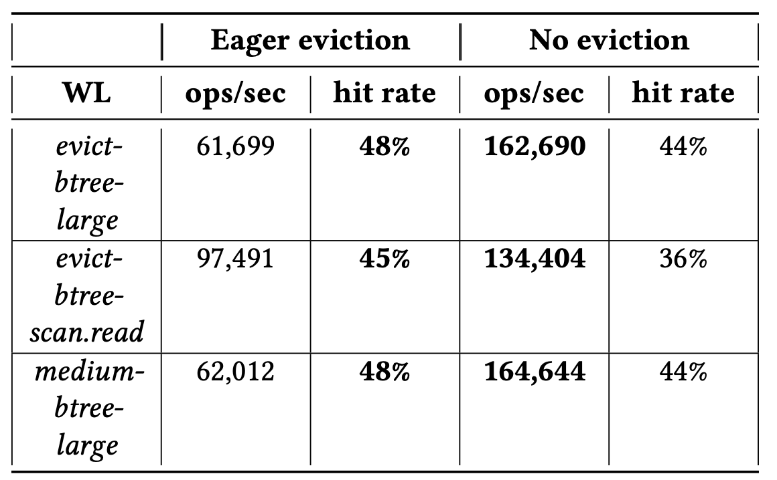
OBP needed for read-only workloads too
Higher is better
No OBP in this experiment
Eager eviction admits more data
Generates more writes

Slide 10
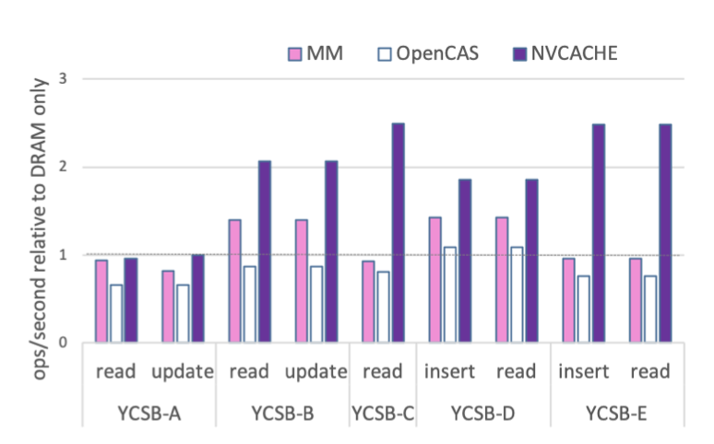
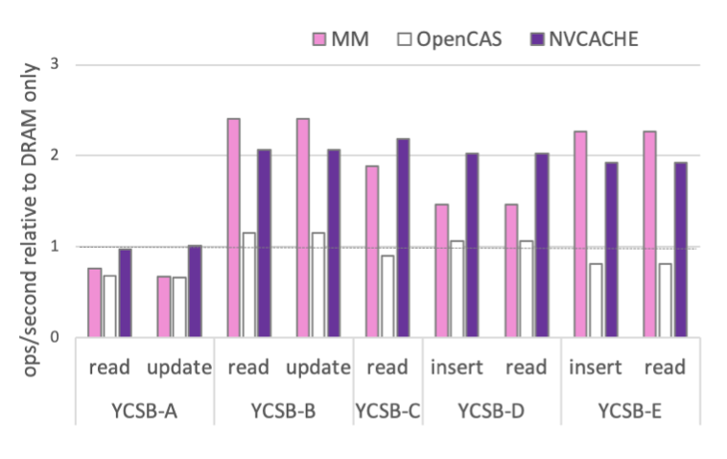
More predictable than Memory Mode
64 GB NVRAM
252 GB NVRAM
YCSB over WiredTiger – the MongoDB storage engine
Higher numbers are better
MM = Intel Memory Mode (NVRAM is an extension of DRAM)
OpenCAS = a cache for file systems in Linux kernel

Slide 11
Summary
Writes hurt reads on Optane NVRAM
Cache admission policy must ration writes
Overhead Bypass threshold implements write rationing
Useful for any memory technology, where writes significantly hurt reads

