Slide 1
PredictUS: A Method to Extend the Resolution Precision Trade-off in Quantitative Ultrasound Image Reconstruction
Farah Deeba, Robert Rohling
The University of British Columbia, Vancouver, British Columbia, Canada

Slide 2
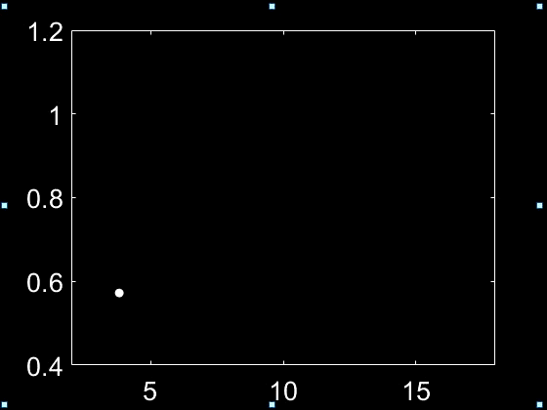

Attenuation Coefficient Estimate (ACE)
A promising clinical tool to detect and monitor fatty liver;
C:\k-WAVE\k-Wave\miccai\IUS\IUS Oral
$$r =0.95$$
Deeba, F., et al.: SWTV-ACE: spatially weighted regularization based attenuation
coefficient estimation method for hepatic steatosis detection. In: International Conference on Medical Image Computing and Computer-Assisted Intervention (2019)
ACE
Fat Fraction (%)

Slide 3
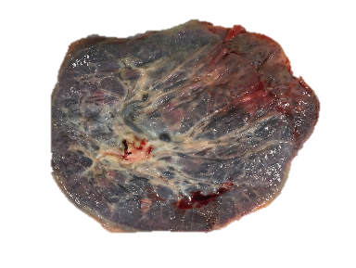
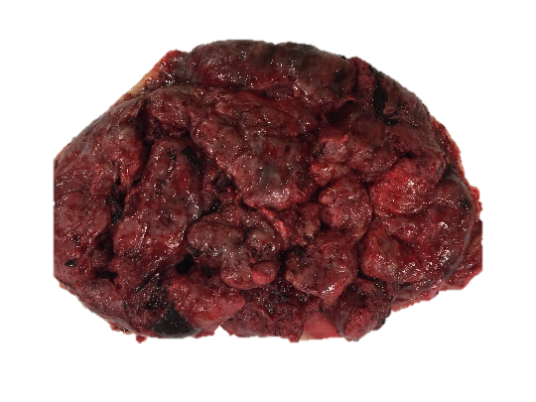
Attenuation Coefficient Estimate (ACE)
A promising clinical tool to detect and monitor fatty liver
Potential for placental tissue characterization;
C:\k-WAVE\k-Wave\miccai\IUS\IUS Oral
Fetal
Maternal
ACE
Deeba, F., et al.: Attenuation coefficient estimation of normal placentas. Ultrasound Med. Biol. 45(5), 1081–1093 (2019)

Slide 4


ACE Computation
$$\hat{x}=\arg{\min_{x}{{\left\|y−Ax\right\|}_{2}^{2}}}$$
$y$ = Power Spectral Density (PSD) Term
𝒙=[𝛼 𝛽];
$α$= Attenuation Coefficient Estimate
$β$ = Backscatter Coefficient
$A$ = System Matrix

Slide 5
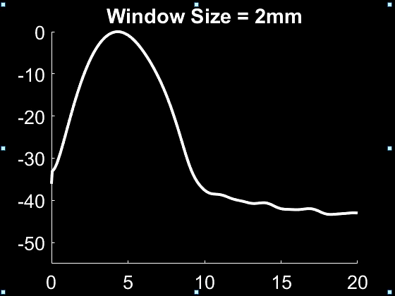


ACE Computation: The Fundamental Trade-off
Ultrasound RF Data
Estimated PSD
PSD Estimation
2 cm
PSD (dB)
Frequency (MHz)
$$\hat{x}=\arg{\min_{x}{{\left\|y−Ax\right\|}_{2}^{2}}}$$

Slide 6

ACE Computation: The Fundamental Trade-off
Spectral based Method
C:\k-WAVE\k-Wave\miccai\IUS\IUS Oral
Window Size = 3 mm
Window Size = 2 mm
Window Size = 4 mm
Window Size = 5 mm
Window Size = 6 mm
Window Size = 7 mm
Window Size = 8 mm
Accuracy & Precision
Resolution
ACE Error
2 cm
Axial Window Size (mm)
$$\hat{x}=\arg{\min_{x}{{\left\|y−Ax\right\|}_{2}^{2}}}$$

Slide 7
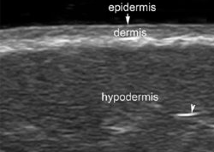
Why not choose the largest window?
Poor resolution will limit the clinical uptake for
Heterogeneous tissue (e.g. placenta);
Thin tissue (e.g. dermis with 1-2 mm thickness)
C:\k-WAVE\k-Wave\miccai\IUS\IUS Oral

Slide 8
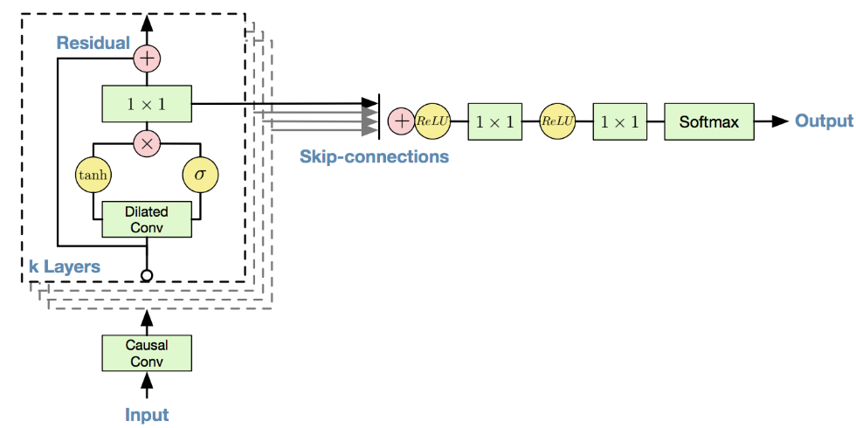
Proposed Solution: PredictUS
100 RF samples (original)
Axial Window Size =2 mm
(100 RF samples)
50 RF samples (predicted)

Slide 9
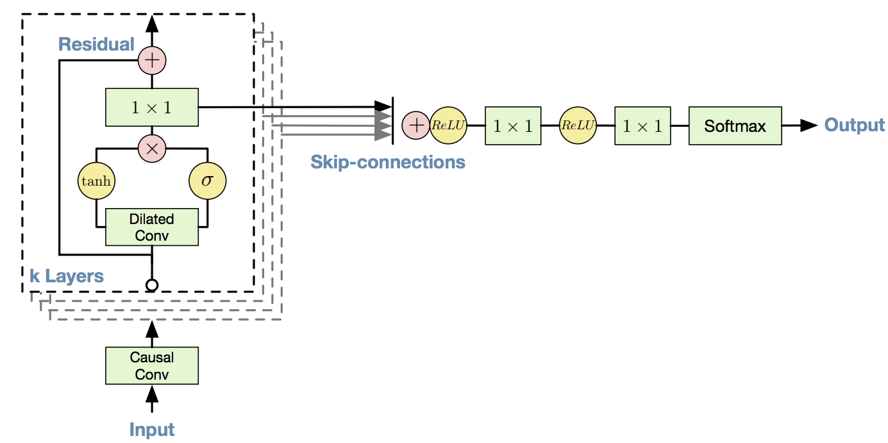
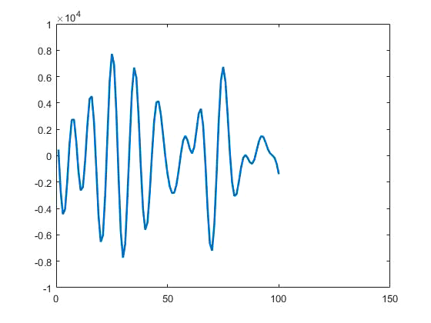
WaveNet Model based Sequence-to-Sequence Convolution Neural Network
Testing Stage
Training Stage
Linear
1-step ahead prediction
n-step ahead prediction

Slide 10
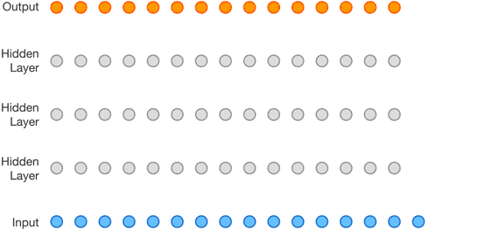



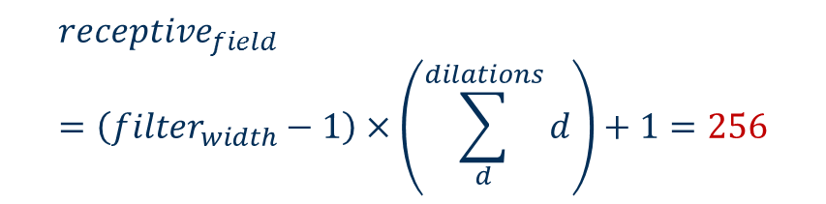

















Receptive Field
Dilation Factors, $d$
$$2^{0}$$
$$2^{1}$$
$$2^{2}$$
$$2^{3}$$
$$2^{4}$$
$$2^{5}$$
$$2^{6}$$
$$d=2^{3}$$
$$d=2^{2}$$
$$2^{0}$$
$$2^{1}$$
$$2^{2}$$
$$2^{3}$$
$$2^{4}$$
$$2^{5}$$
$$2^{6}$$
$$d=2^{1}$$
$$receptive_{field}=\left(filter_{width}−1\right)×\left(\sum_{d}^{dilations}{d}\right)+1=256$$
$$d=2^{0}$$
$$≈13λ$$

Slide 11
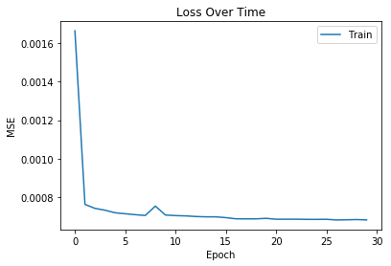
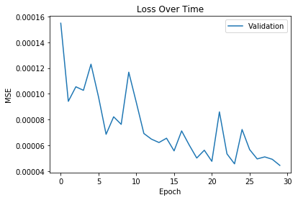
Data and Experiment
Training examples: 106,496 data segments (ACE = 0.1 dB/cm/MHz - 1.65 dB/cm/MHz).
Test examples: 550 data segments (ACE = 0.1 dB/cm/MHz - 1.5 dB/cm/MHz)
Notes:
Our proposed RNN setup is able to accurately learn how to model normal traffic. Figure 3 illustrates the average loss value of the training and validation dataset during the process of learning. It is worth noticing that the training loss is higher than the validation loss, contrary to intuition, as the loss function for validation does not use regularization and the learning process uses three times more data, resulting in higher average loss values. After each batch of training, the weights of the network are adjusted and the average loss of all batches is reported. The RNN is able to learn, in only few epochs, an accurate representation of normality, as can be appreciated from the low loss in the validation data.

Slide 12
Result: Ultrasound RF Data Prediction
Input Predicted Target

Slide 13
Result: Ultrasound RF Data Prediction
n =15 step prediction
n =16

Slide 14
Result: ACE Computation
For resolution comparison, we define an axial dimension of 10λ to be the optimum.
Liu, W., Zagzebski, J.A.: Trade-offs in data acquisition and processing parameters for backscatter and scatterer size estimations. IEEE Trans. Ultrason. Ferroelectr. Freq. Control 57(2), 340–352 (2010)
We consider following three cases with same axial size (10λ) with varying input and predicted data length. The input data length for the three cases are:
  Case I: 7.5λ
  Case II: 5λ
  Case III: 2.5λ

Slide 15
Result: ACE Computation
Case I: Input window Length 7.5λ
Input Predicted Target
Small Window PredictUS Window Large Window

Slide 16
Result: ACE Computation
Case II: Input window Length 5λ
Input Predicted Target
Small Window PredictUS Window Large Window

Slide 17
Result: ACE Computation
Case III: Input window Length 2.5λ
Input Predicted Target
Small Window PredictUS Window Large Window

Slide 18
Conclusion
We conduct a simulation based proof-of-study to extend the trade-off between resolution and ACE measurement quality.
A resolution improvement up to 50% (input axial dimension was reduced from 5λ from the optimal requirement of 10λ) was attained with comparable measurement quality.
Future work includes extension of the method to other Quantitative Ultrasound parameters and application on physical phantom and biological tissue.

Slide 19
Appendix

Slide 20
Training: 1-step Ahead Prediction
Walk-Forward Split Mode
Predict
Encode
Training
Predict
Encode
Validation

Slide 21
Testing: n-step Ahead Prediction
Predict
Encode
Predict
Encode
Testing
…
Predict
Encode

