Slide 1
Smart Cards

Slide 2
ISO/IEC 14443
Basic Overview
Clock Frequency: 13.56 MHz
Load Frequency: 847.5 kHz
Modulation Card: AM/NRZ
Modulation Reader: BPSK
Data Rate: 106 kbit
Communication mode: Half Duplex
Notes:
Mode a uses 100% AM, while theyp B uses 10%AM to create a NRZ code

Slide 3
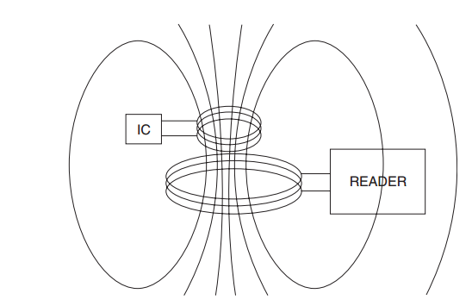
ISO/IEC 14443
Diagram of the antenna loop
Notes:
Both the power and the clock signal are transmitted though the antenna

Slide 4
Type A
Card
100% AM
Modified Miller encoded
Reader
On/Off Keying Modulation
Manchester encoding
Notes:
Type A signaling utilizes 100% amplitude modulation of the RF field for communication
from the reader to the card with Modified Miller encoded data (see Figure 2).
847.5 kHz transmissions uses On/Off Keying Modulation of the subcarrier requires the system
To be able to handle receiving no power for short periods of time
with Manchester encoded data (see Figure 3). In Type A signaling, the RF
field is turned off for short periods of time when the reader is transmitting. The integrated
circuit must store enough energy on internal capacitors to continue functioning while the
RF field is momentarily off during field modulation.

Slide 5
Type B
Card
10% AM
Non-Return to Zero encoding
Reader
Binary Phase Shift Keying Modulation
Non-Return to Zero encoding
Notes:
Amplitude Shift Keying Modulation
Type B signaling utilizes 10% amplitude modulation of the RF field for communication
from the reader to the card with NRZ encoded data. Communication from card to reader
utilizes BPSK modulation of an 847.5 kHz subcarrier with NRZ-L encoded data. The RF
field is continuously on for Type B communications.

Slide 6
Reader Transmission
Byte Format
Start of Frame
End of Frame
Notes:
Data communication between the card and reader is performed using an LSB-first data
Format
Despite the fact that data transmissions occur LSB-first, all of the commands and data in
ISO/IEC 14443 are listed in the conventional manner, with MSB on the left and LSB on
the right.
Frame Format Data transmitted by the PCD or PICC is sent as frames. The default frame consists of
the Start of Frame (SOF), several characters, and the End of Frame (EOF). The SOF
and EOF requirements are illustrated in Figure 10.
132.16useonds before tnasmite

Slide 7
Card Transmission
Notes:
Part 2 of ISO/IEC 14443 specifies that the PICC waits silently for a command from the
PCD after being activated by the RF field.
After receiving a valid command from the PCD, the PICC will turn on the subcarrier only if it intends to transmit a response. The
PICC response consists of TR1, SOF, several characters of data followed by a two-byte
2 ETUs after the EOF.
TR0 max of 32 ETUs
TR1 max of 25 ETUs
CRC_B, and the EOF. The subcarrier must be turned off no later than The subcarrier is turned on and remains unmodulated for a time period known as the
synchronization time (TR1). The phase of the subcarrier during TR1 defines logical “1”
and permits the PCD demodulator to lock on to the subcarrier signal. The subcarrier
must remain on until after the EOF transmission is complete.
When the card is transmitting there Reader still transmits the Carrier, but in an undulated form
Elementary Time Unit = 128 Carrier Cycles (9.4395 µS) = 8 Subcarrier Units
One the card has stopeed tansmitting there is a final garud time of 14 ETUs before the reader can transmite again

Slide 8
Questions?

