Slide 1
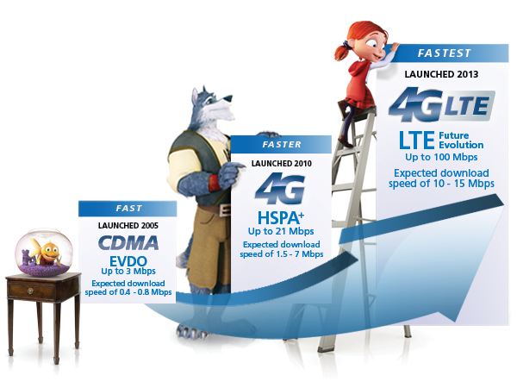
LTE – Long Term Evolution
Presented by: Ron Doria
ELEX 7860 – Wireless Systems
British Columbia Institute of Technology
Notes:
Latest standard in the mobile network technology sector
It aims to provide seamless Internet Protocol (IP) connectivity between
user equipments (UE) and the packet data network (PDN) without any
disruption to the end users’applications duringmobility.

Slide 2
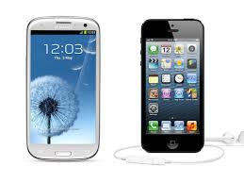
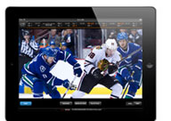
Purpose (End User)
+
Developing Hardware
FASTER Network
=
Better Applications
Notes:
HIGH DEFINITION LIVE STREAMS, or 1080P Movies (TV Shows and Movies on HD), also with Cloud Systems we are always streaming movies, pictures from our media drives. We want to be able to download the files or stream the files at MAXIMUM BANDWIDTH

Slide 3
What LTE Offers
High Spectral Efficiency
Information rate that can be transmitted over a given bandwidth (OFDMA)
MIMO and OFDMA – Impact on Spectral Efficiency
High Peak Data Rates
Capability of transmitting more information between equipment (Uplink/Downlink)
Short Round Trip Time
Length of time it takes a signal to be sent out + time of acknowledgment
And Frequency Flexibility
Low-cost implementation
Notes:
LTE capabilities include:
Downlink peak data rates up to 326 Mbps with 20 MHz bandwidth
Uplink peak data rates up to 86.4 Mbps with 20 MHz bandwidth
Operation in both TDD and FDD modes
Scalable bandwidth up to 20 MHz, covering 1.4 MHz, 3 MHz, 5 MHz, 10 MHz, 15 MHz, and 20 MHz in the study phase
Increased spectral efficiency over Release 6 HSPA by two to four times
Reduced latency, up to 10 milliseconds (ms) round-trip times between user equipment and the base station, and to less than 100 ms transition times from inactive to active

Slide 4
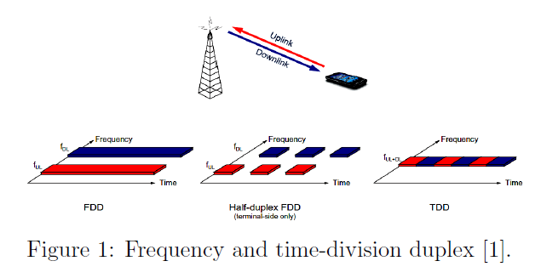
General Information
SMARTPHONE
(LTE Enabled Devices)
BlackBerry Z10
Samsung Galaxy Note II N7100
Apple iPhone 5
Nokia Lumia 920
Samsung Galaxy Camera GC100
Samsung Galaxy Note N7000
HTC DROID DNA
AND MUCH MORE….
Faster Uplink and Downlink compared to other standards
The standards is developed by the 3GPP (3rd Generation Partnership Project)
Notes:
BASIC SYSTEM ARCHITECHTURE Without getting into details, the system revolves around the users Smartphone or 4G Enabled device BlackBerry Z10
Samsung Galaxy Note II N7100
Apple iPhone 5
Nokia Lumia 920
Samsung Galaxy Camera GC100
Samsung Galaxy Note N7000
HTC DROID DNA
Samsung I9305 Galaxy S III
Sony Xperia T LTE
Samsung Galaxy Axiom R830
Nokia Lumia 820
Sony Xperia V
HTC One X+
Samsung Galaxy S IV
HTC Windows Phone 8X
Samsung Galaxy Premier I9260
Sony Xperia ion LTE
LG Optimus G E973
Motorola DROID RAZR MAXX HD
Apple iPad mini Wi-Fi + Cellular
Nokia Lumia 822
Apple iPad 4 Wi-Fi + Cellular
Motorola Electrify M XT905
Samsung Galaxy Stratosphere II I415
Motorola DROID RAZR HD
Asus PadFone 2
HTC One SV
LG Optimus G LS970
HTC One XL
Apple iPad 3 Wi-Fi + Cellular
Samsung Galaxy Note I717
LG Optimus G E970
Samsung Galaxy Tab 2 7.0 I705
HTC One VX
Motorola RAZR HD XT925
Nokia Lumia 900 AT&T
Samsung Galaxy Express I437
Samsung Galaxy S II Skyrocket HD I757
HTC Windows Phone 8X CDMA
HTC Deluxe
Motorola DROID RAZR XT912
Samsung Galaxy S III I747
LG Optimus Vu II F200
BlackBerry 4G LTE PlayBook
Sony Xperia SX SO-05D
Samsung Galaxy Rugby Pro I547
Motorola DROID RAZR MAXX
Samsung Galaxy S II HD LTE
Motorola DROID RAZR M
HTC Vivid
LG Optimus Vu F100S
Samsung Galaxy Victory 4G LTE L300
HTC Evo 4G LTE
Motorola ATRIX HD MB886
Samsung Galaxy S III CDMA
LG Spectrum II 4G VS930
HTC One SV CDMA
LG Optimus LTE LU6200
Samsung Galaxy S II Skyrocket i727
Sony Xperia GX SO-04D
Samsung Galaxy Nexus LTE L700
HTC Rezound
HTC DROID Incredible 4G LTE
Samsung Galaxy Tab 8.9 4G P7320T
HTC One X AT&T
Samsung Galaxy S II LTE I9210
Pantech Vega R3 IM-A850L
Samsung Galaxy Tab 7.7 LTE I815
Motorola Photon Q 4G LTE
Samsung Galaxy Nexus i515
LG Optimus LTE2

Slide 5
Market
Equipment Sales: 1.75 Million * $500 = $ 875 million dollars/year
Service: 1.75 Million * $40 = $ 70 million dollars/year
**We only look at 2012 sales for mobile technology because
these devices for sure have LTE Capability.

Slide 6
Wireless Standards
Data Rate (Theoretical):
Uplink = 170 Mbps – Utilizes SC-FDMA
Downlink = 300 Mbps – Utilizes OFDMA
Multiple Access Techniques:
Orthogonal Frequency Division Multiple Access (OFDMA)
MIMO (Multiple Input Multiple Output)
Frequency Bands & Channelization:
Frequency-division duplex (FDD) and time-division duplex (TDD)
Large allocated frequency bands (Possible Options)
In North America 700, 800, 1900 and 1700/2100 MHz
Flexible and Large Bandwidths:
1.4 MHz, 3 MHz, 5 MHz, 10 MHz, 15 MHz, and 20 MHz (Later provides highest LTE Data Rates)
Modulation: 64 QAM
Notes:
LTE supports both frequency-division duplex (FDD) and time-division duplex (TDD), as well as a wide range of system bandwidths in order to operate in a large number of different spectrum allocations
MIMO – offers significant increases in data throughput
MIMO technology has attracted attention in wireless communications, because it offers significant increases in data throughput and link range without additional bandwidth or increased transmit power. It achieves this goal by spreading the same total transmit power over the antennas to achieve an array gain that improves the spectral efficiency (more bits per second per hertz of bandwidth) and/or to achieve a diversity gain that improves the link reliability (reduced fading).
Orthogonal frequency-division multiplexing Access –
(OFDM), with data transmitted on a large number of parallel, narrow-band subcarriers, is the
core of the LTE downlink radio transmission
Multiple Antennas
LTE capabilities include:
Downlink peak data rates up to 326 Mbps with 20 MHz bandwidth
Uplink peak data rates up to 86.4 Mbps with 20 MHz bandwidth
Operation in both TDD and FDD modes
Scalable bandwidth up to 20 MHz, covering 1.4 MHz, 3 MHz, 5 MHz, 10 MHz, 15 MHz, and 20 MHz in the study phase
Increased spectral efficiency over Release 6 HSPA by two to four times
Reduced latency, up to 10 milliseconds (ms) round-trip times between user equipment and the base station, and to less than 100 ms transition times from inactive to active

Slide 7
Security
http://www.ieee-globecom.org/2012/private/T10F.pdf
5-Security Levels
Network access security (i)
Network domain security (ii)
User domain security (iii)
Application domain Security (iv)
Non 3GPP domain security (v)
5 Network access security Levels
LTE cellular security
LTE handover security
IMS security
HeNB security
MTC security
Notes:
There are 5 security levels:
– Network accesssecurity (I):
• The set ofsecurity featuresthat providesthe UEs with secure accessto the
EPCand protect against various attacks on the radio link.
– Network domain security (II):
• The set of security features that protects against attacks on the wire line
network and enable nodes to exchange signalling data and user data in a
secure manner
– User domain security (III):
• The set of security features that provides a mutual authentication between
the USIM and the ME before the USIM accessto the ME.
– Application domain security (IV):
• The set of security features that enables applications in the UE and in the
provider domain to securely exchange messages.
– Non 3GPPdomain security (V):
• The set of features that enables the UEs to securely access to the EPC via
non-3GPP access networks and provides security protection on the radio
accesslink.

Slide 8
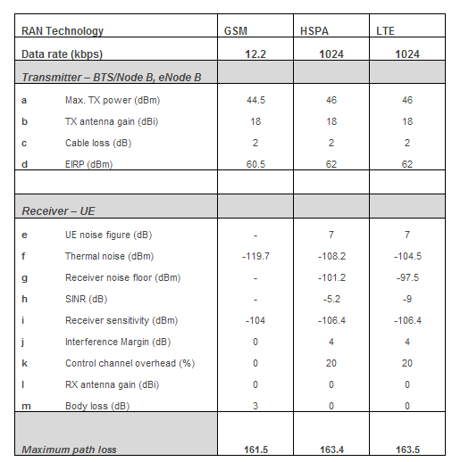
Link Budget
UPLINK DOWNLINK
MA
https://sites.google.com/site/lteencyclopedia/lte-radio-link-budgeting-and-rf-planning/lte-link-budget-comparison
Notes:
TX Power, Antenna Gain, Cable and Body Loss and EIRP (Equivalent Isotropically Radiated Power)
Noise Figure, Thermal Figure, Receiver noise floor, SINR, RX Sensitivity, Interface margin, Cable loss, Antenna gain, body loss, fast fade margin,

Slide 9
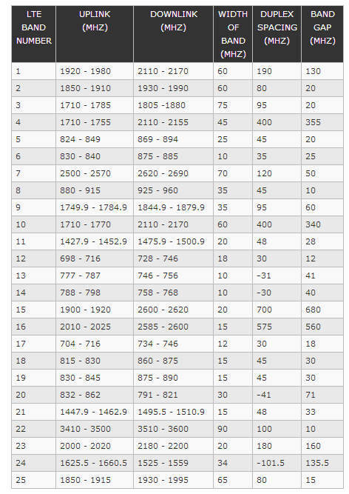
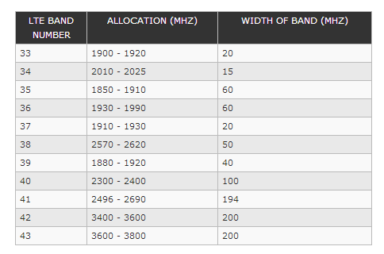
Appendix
FDD LTE frequency band allocations
TDD LTE frequency band allocations

Slide 10
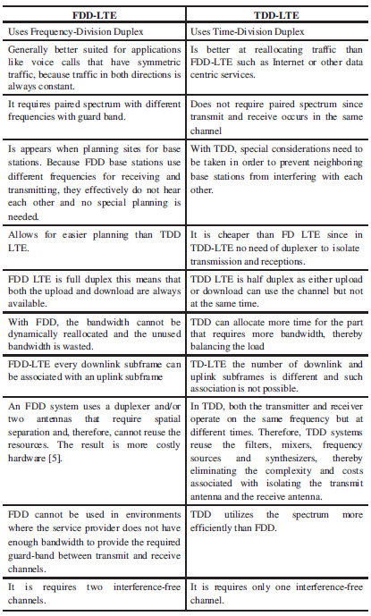
Appendix
Comparison of FDD and TDD LTE

Slide 11
References
Basic Understanding of LTE
http://en.wikipedia.org/wiki/LTE_(telecommunication)
http://www.4gamericas.org/index.cfm?fuseaction=page&sectionid=249
Comparing Wireless Standards
http://projects.comelec.enst.fr/EW2007/Documents/Comparison_LTE_WiMax_BALL_EW2007.pdf
Transmission Scheme (Spectrum Flexibility)
http://www.comsoc.org/files/Publications/Tech%20Focus/pdf/2010/jan-sample/6.pdf
Sponsoring Organization
http://www.3gpp.org/LTE
Understanding LTE System and Architecture
http://www.ee.washington.edu/research/ieee-comm/event_may_19_2009_files/LTE_overview_titus.pdf
Frequency Band Allocations
http://www.radio-electronics.com/info/cellulartelecomms/lte-long-term-evolution/lte-frequency-spectrum.php
Security Investigation for LTE
http://www.ieee-globecom.org/2012/private/T10F.pdf
Link Budget:
https://sites.google.com/site/lteencyclopedia/lte-radio-link-budgeting-and-rf-planning/lte-link-budget-comparison
[1] H.Holma & A.Toskala, “WCDMA for UMTS: HSPA Evolution and LTE”, John Wiley & Sons, 2010
[2] H.Holma & A.Toskala, “LTE for UMTS: OFDMA and SC-FDMA based radio access”, John Wiley & Sons, 2009

