Slide 1
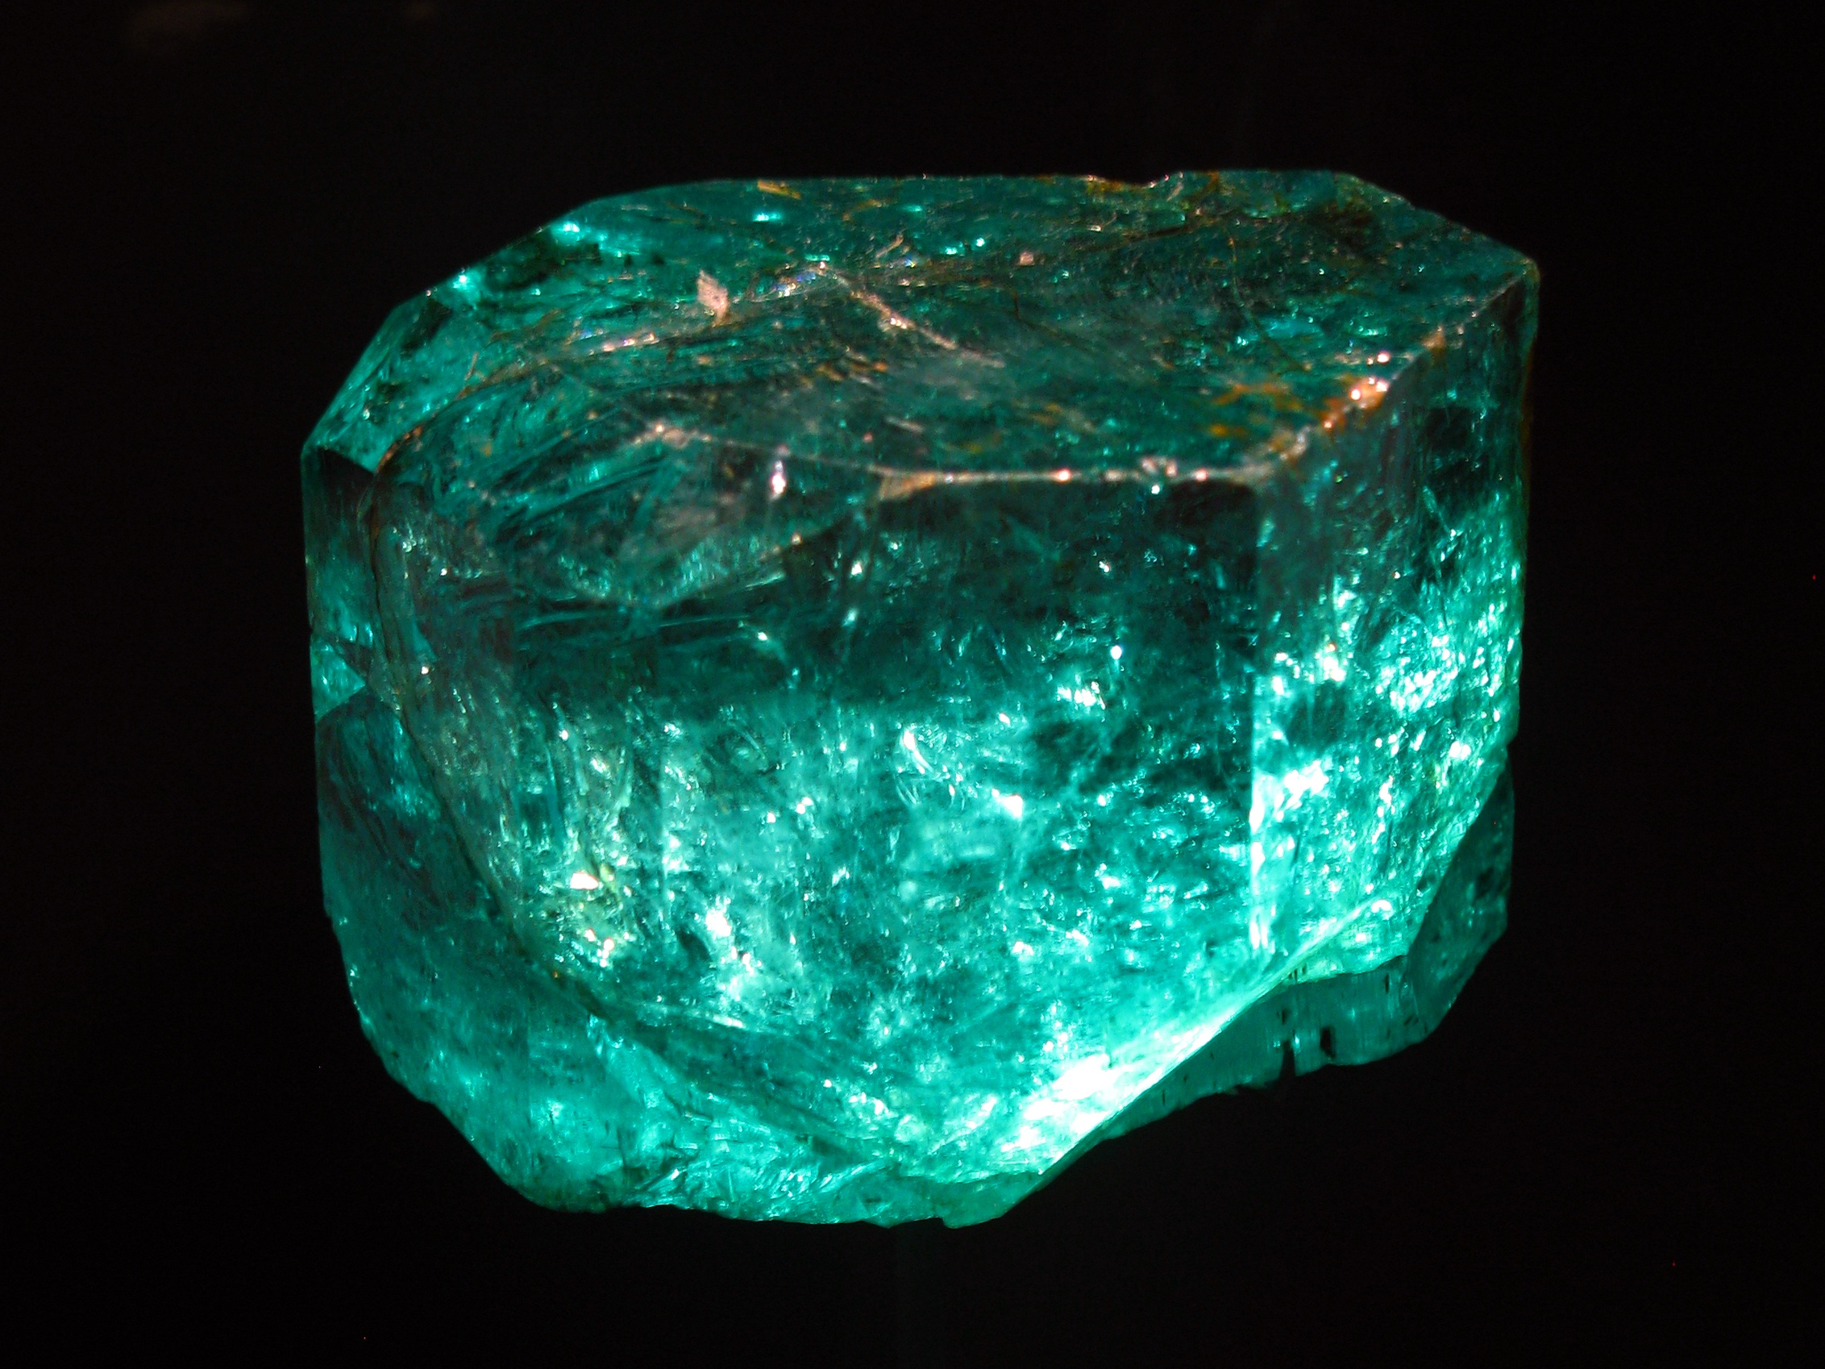
Emerald: graphics Modeling for soc Systems
Ayub A. Gubran and Tor M. Aamodt
University of British Columbia

Slide 2
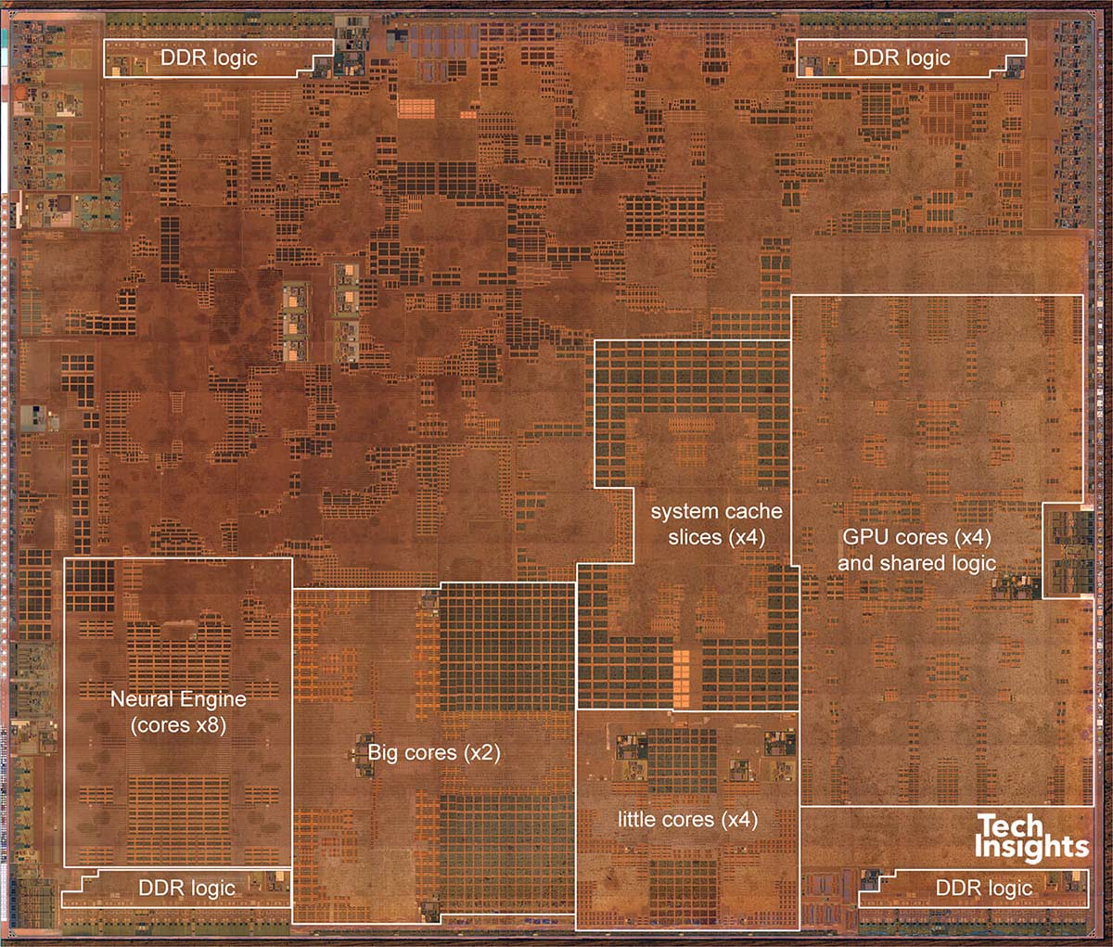
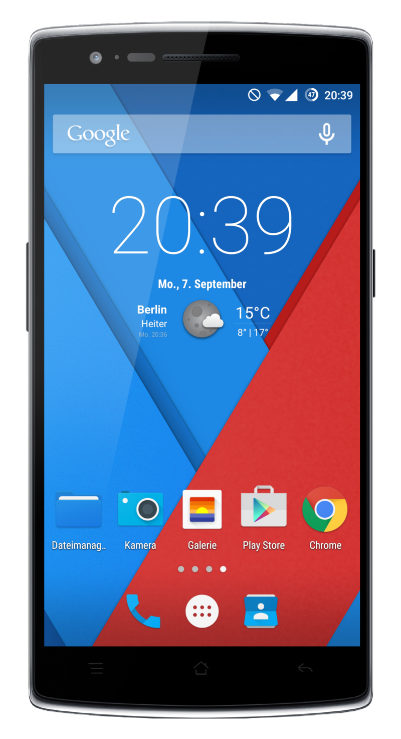
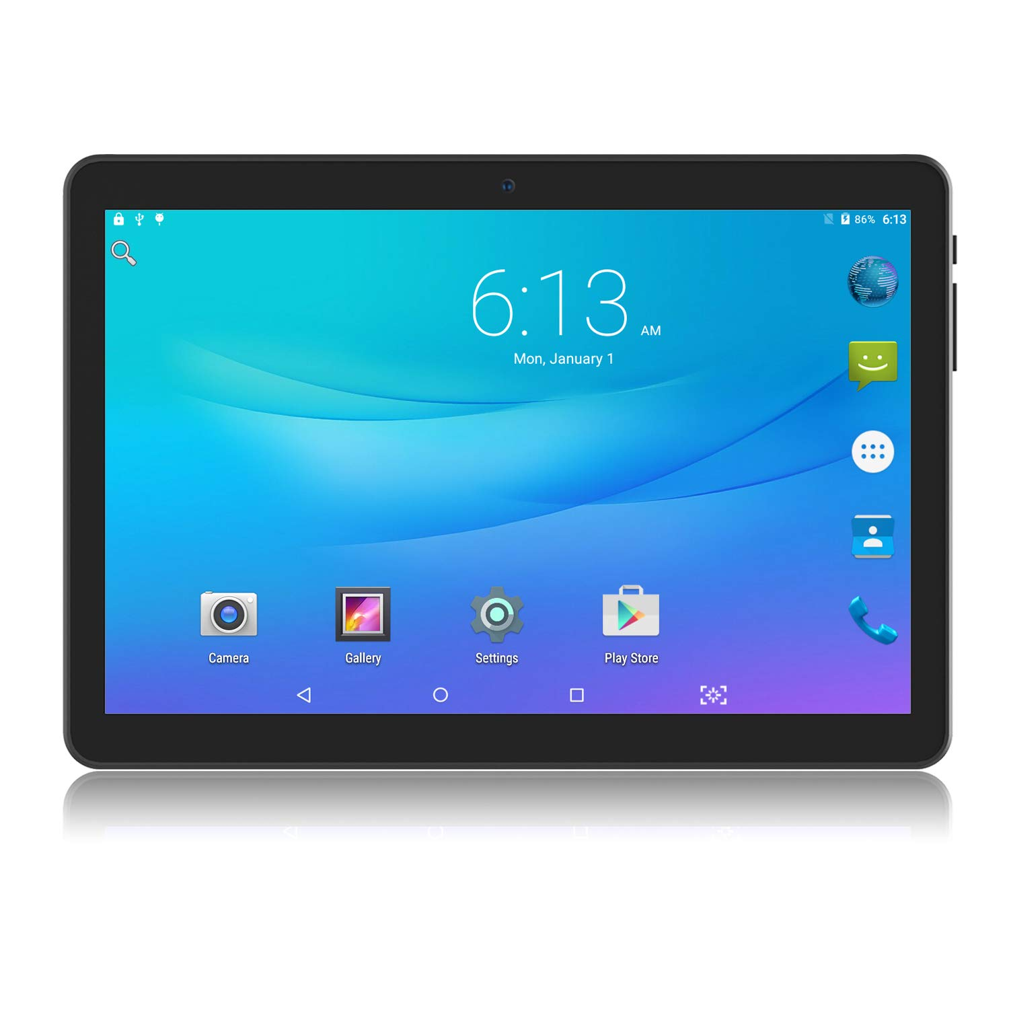
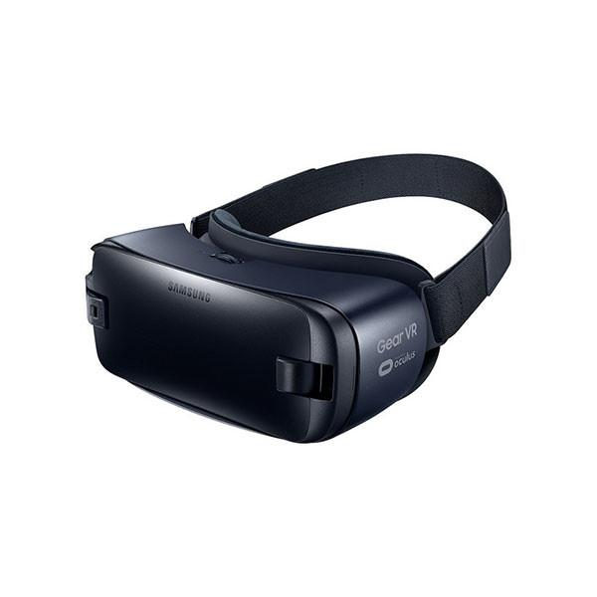
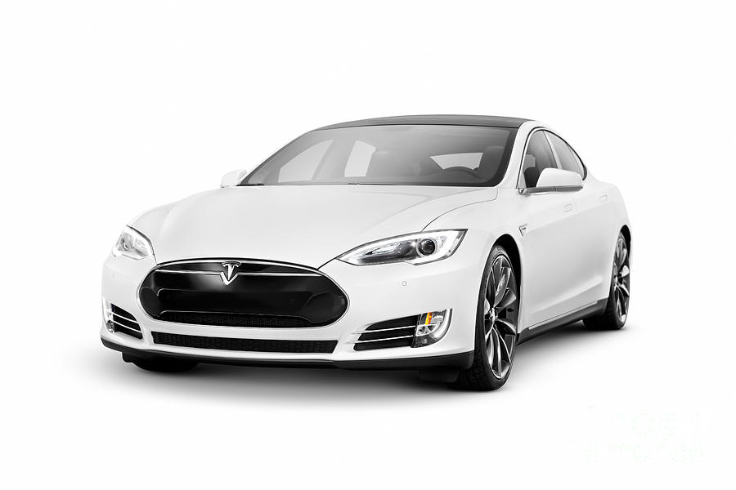
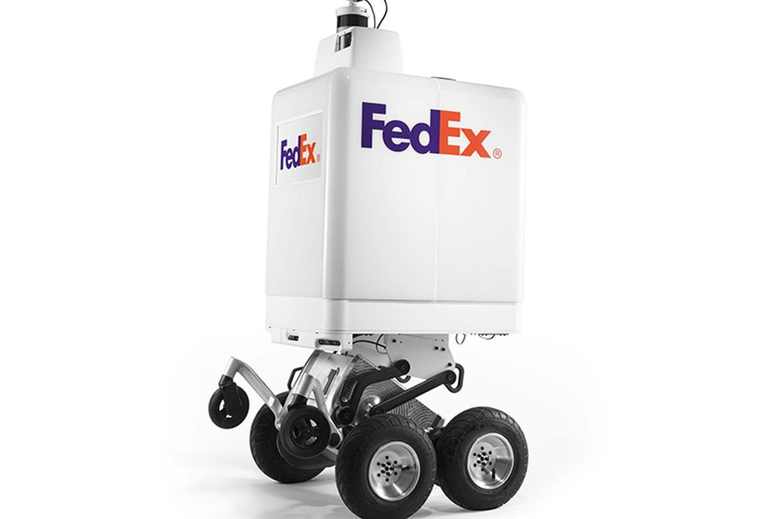
Systems-on-chip (SoC)
An amalgamation of specialized IPs.
GPU
CPUs
AI
ISP
Modem
Audio
Display
GPS
…..
Apple’s iPhone X A12 Bionic Chip
(Source: TechInsights)
Notes:
So first, what do we mean with an SoC? Today’s SoC chips consist of many specialized IPs put together.
Industry is putting a lot of resources into understanding how SoC components interact.

Slide 3
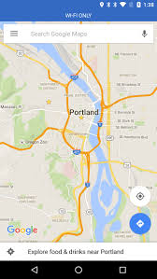
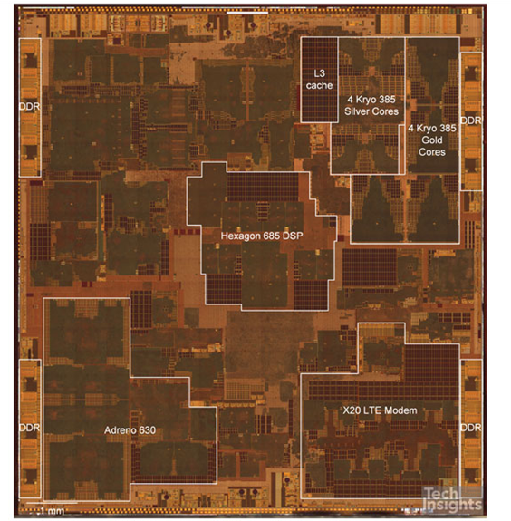
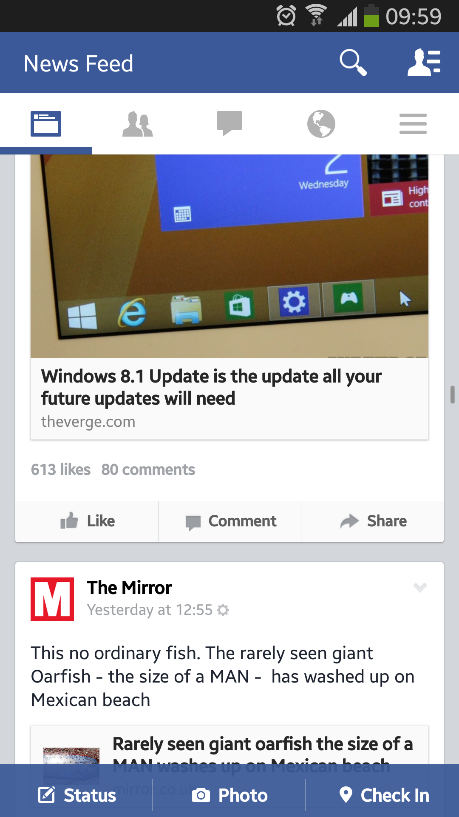
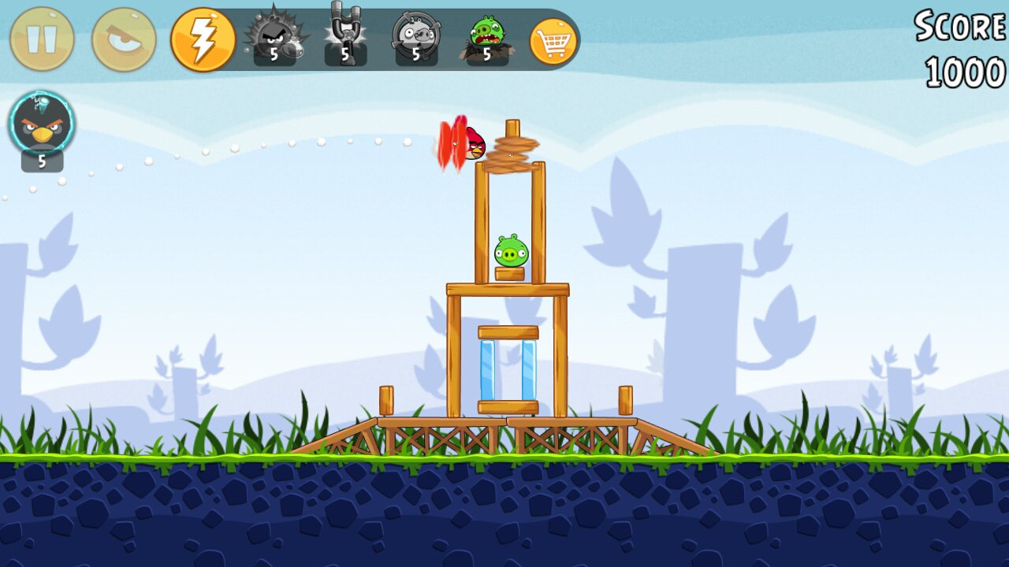
Motivation: THE GPU
Almost every application uses graphics.
Essential to study SoCs.
GPU
Notes:
The GPU is one of the pillars of today’s SoCs.
By definition, every mobile app has a GUI.
If we look to today’s chips, the area occupied by GPUs is comparable to that of CPUs.

Slide 4
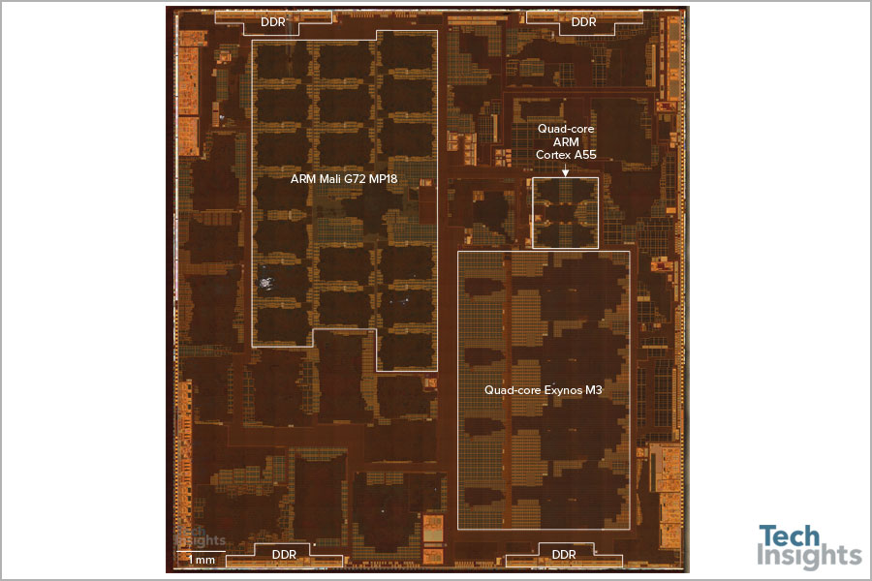
Motivation: THE GPU
Almost every application uses graphics.
Essential to study SoCs.
GPU (~17%)
CPU (~8%)
Chip area breakdown
GPU (~19%)
CPU (~17%)
GPU
GPU
HiSilicon Kirin 970
Samsung Exynos 9810
(Source: TechInsights)
Notes:
The GPU is one of the pillars of today’s SoCs.
By definition, every mobile app has a GUI.
If we look to today’s chips, the area occupied by GPUs is comparable to that of CPUs.

Slide 5
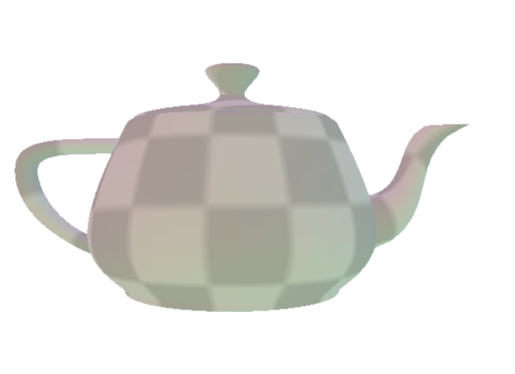
Motivation: THE GPU
How graphics previously were modeled for SoCs?
CPU
i.e., gem5+Mesa3D ➔ adds noise!
i.e., gem5+NoMali ➔ totally ignore the GPU
Notes:
Currently the GPU is either emulated using the CPU model, or just ignored (e.g., NoMali).

Slide 6
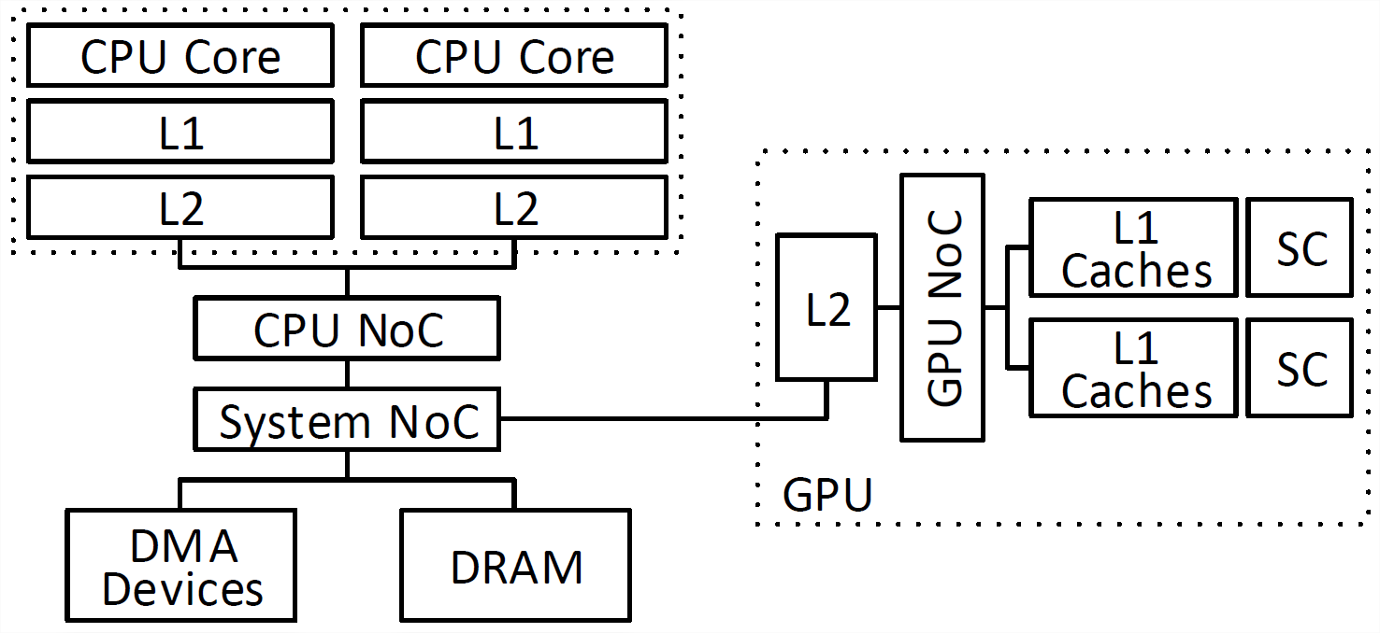
Emerald: overview
Emerald facilitates studying:
Graphics hardware.
SoC systems.
For GPGPU: gem5-gpu, Multi2Sim, AMD GCN3
Emerald: +graphics
gem5
Marss-x86
GPGPU-Sim
Attila
Notes:
- Other tools so far provided full-system abilities.
Graphics have been always missing.
Emerald is filling the gap here.

Slide 7
Emerald: overview
Emerald facilitates studying:
Graphics hardware.
SoC systems.
Name | Simulation Model | GPU Model |  | Full-system simulation
 |  | GPGPU | Graphics
gem5 | Execution Driven | no | no | yes
GemDroid | Trace Driven | no | yes | no*
gem5-gpu/ GCN3 | Execution Driven | yes | no | yes
Attila | Execution Driven | no | yes | no
Emerald | Execution Driven | yes | yes | yes
Notes:
- Other tools so far provided full-system abilities.
Graphics have been always missing.
Emerald is filling the gap here.

Slide 8
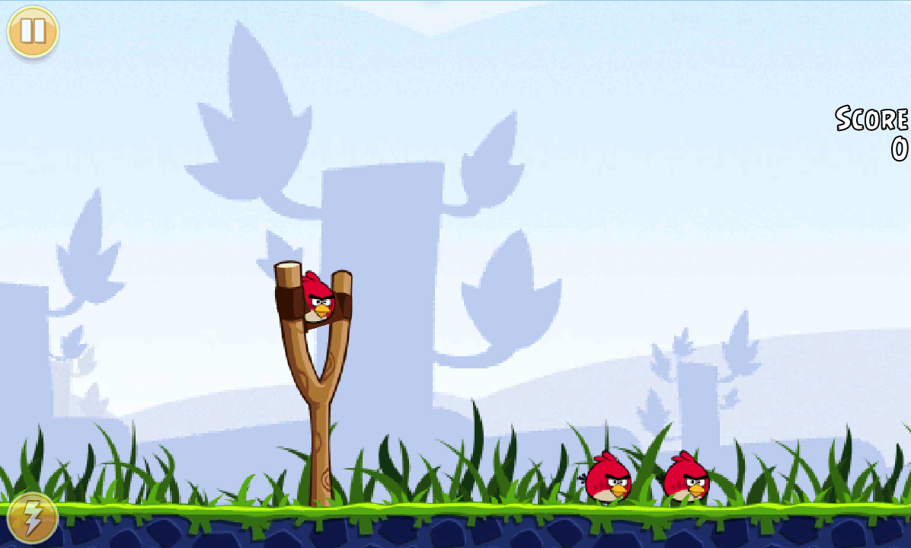
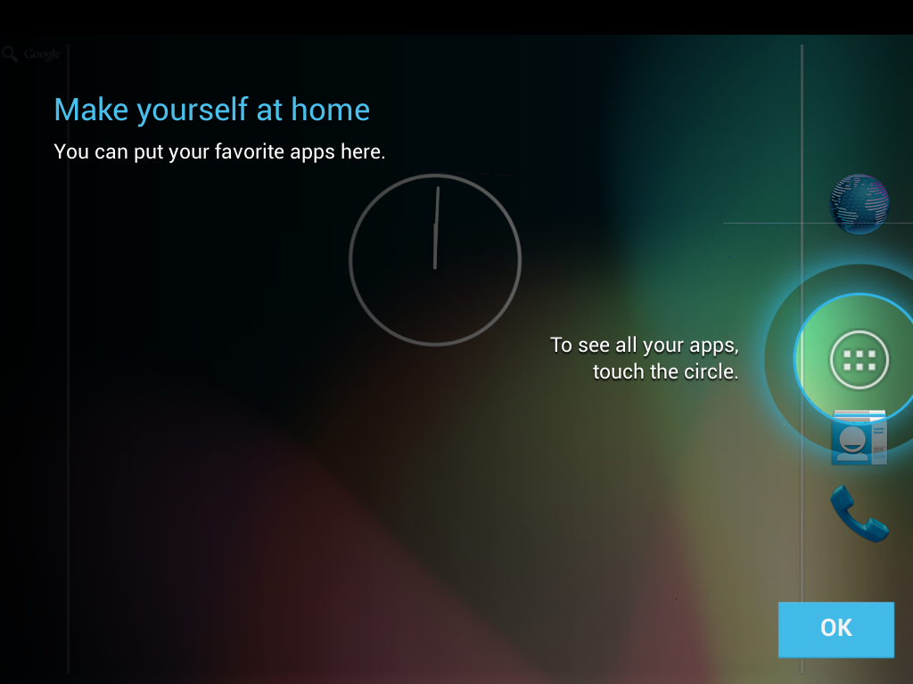
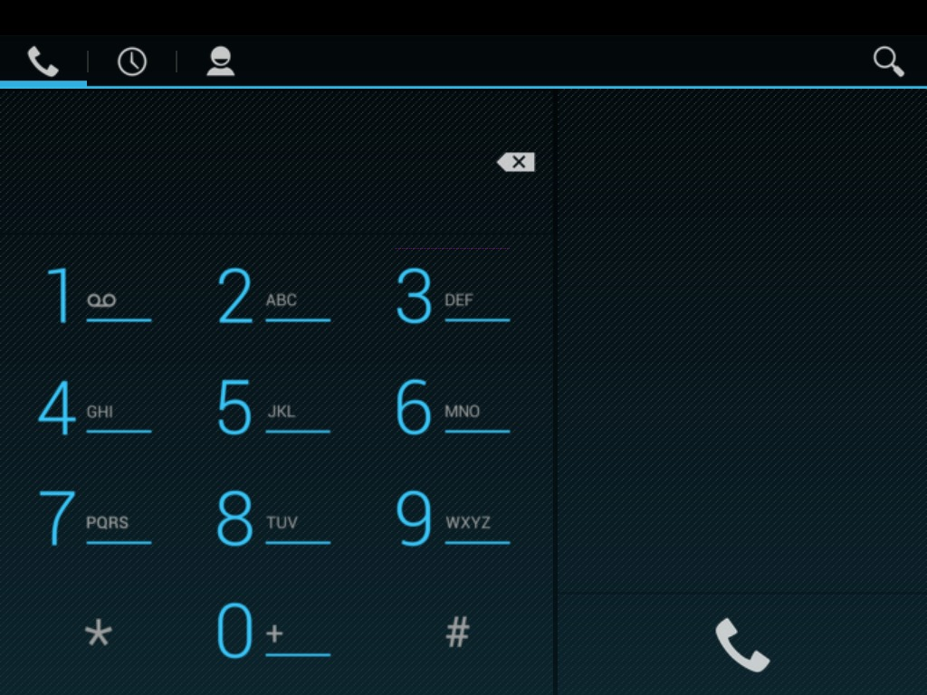
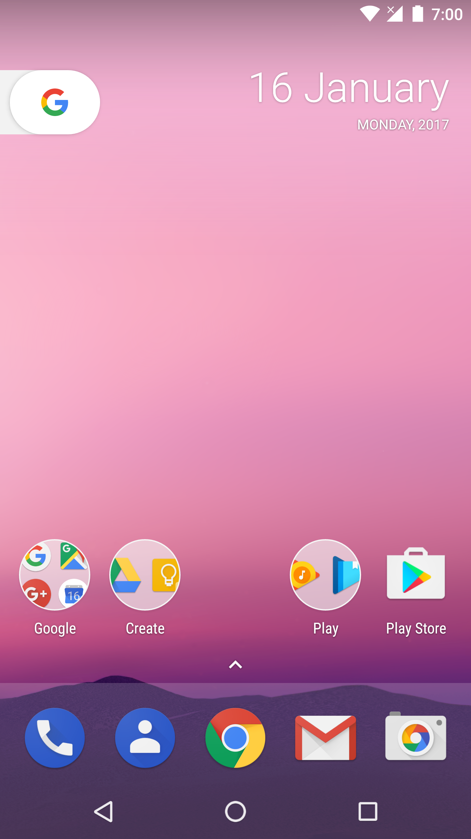
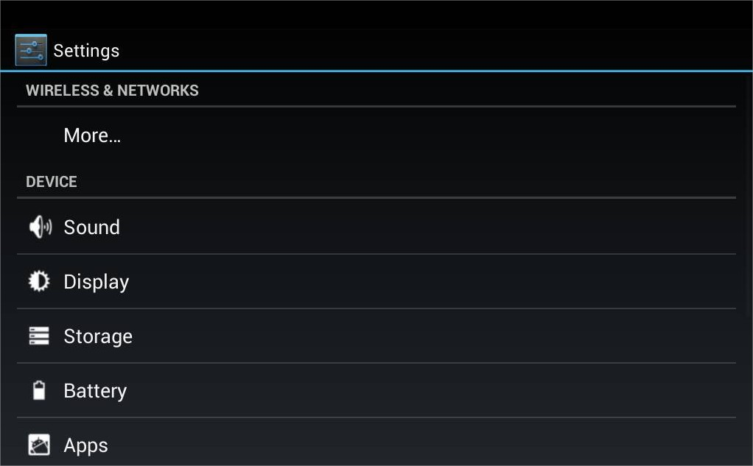
Emerald: overview
Supports Android (tested on JB & Nougat).
Builds on a number of existing tools.
Two execution modes:
Standalone.
Full-System.

Slide 9
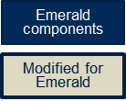
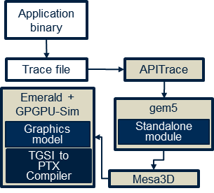
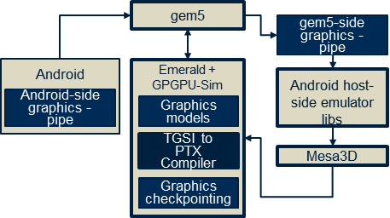
Emerald: Execution modes
+Fast-forwarding
Handling Android OpenGL
State and API handling
+ part of the functional model
Draw calls
Draw calls
Graphics state
Standalone mode
Full-system mode

Slide 10
Emerald: Graphics Architecture
Choice: immediate mode vs. tile-based.
Immediate mode
Tiled Rendering
Hybrid approach
Nvidia: “Tiled Caching”
AMD: “Draw-Stream Binning”
Memory bandwidth
Geometry
Pixels
Geometry
Pixels
Geometry
Pixels
Notes:
There are some drawbacks of using tiled-rendering over immediate mode (i.e., extra geometry processing). A hybrid approach is adopted by Nvidia and AMD use “on the fly binning”.

Slide 11
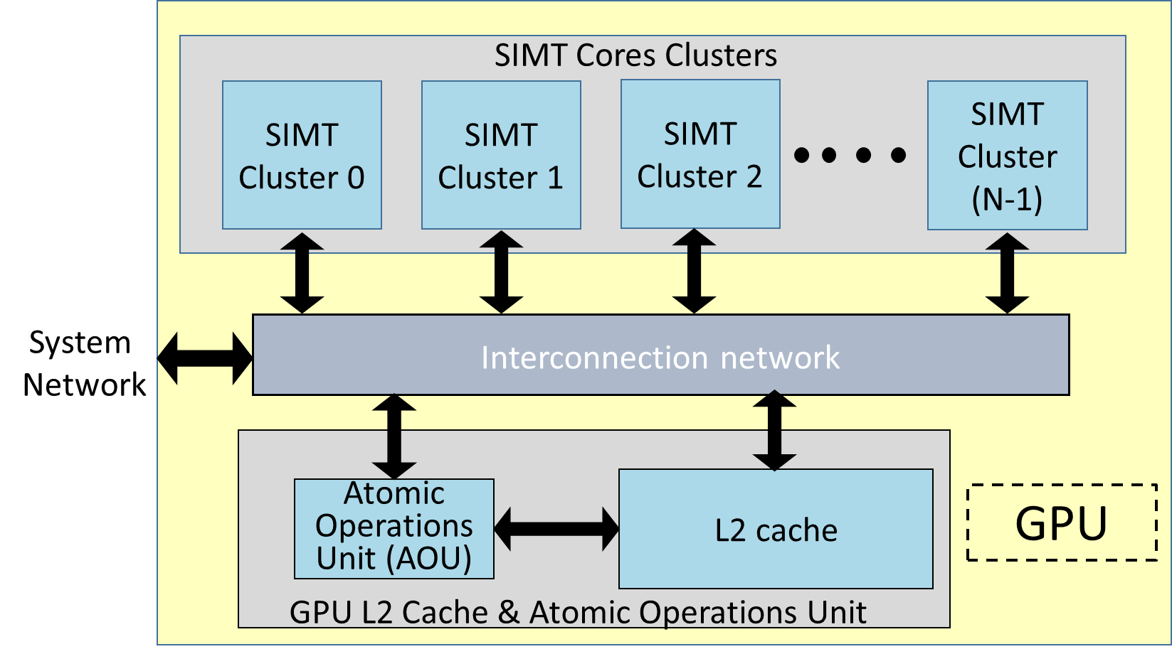
Emerald: Graphics Architecture
Hybrid approach.
Inspired by NVIDIA’s architecture.
Distributed vertex and fragment shading.

Slide 12
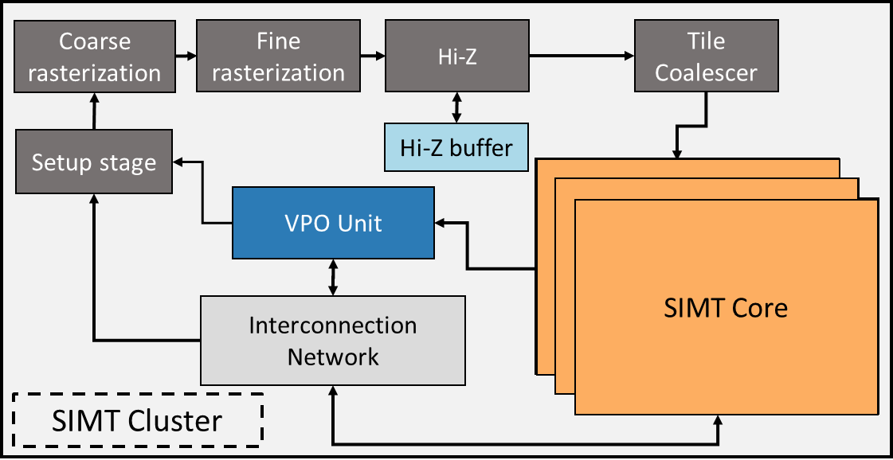
Emerald: Graphics Architecture
Draw call
Vertex data
Vertices assigned to cores in batches
Fetch vertex attributes
Notes:
We start from a draw call where vertices are distributed to SIMT clusters for vertex shading.
Each core fetches relevant vertex attributes from memory and vertex shading takes place.

Slide 13
Emerald: Graphics Architecture
Position attributes
Writeback output attributes
Vertex shading
Fetch vertex attributes
Notes:
Once vertex shading is over, output vertex data are then written back to the L2 directly through the interconnection network.
In addition to that, position attributes are handed to the VPO unit which determines which clusters are responsible of rendering which primitives (according to their position data).

Slide 14
Emerald: Graphics Architecture
Position attributes

Slide 15
Emerald: Graphics Architecture
Determines which clusters render which primitives
Communicate masks
Screen space
Cluster0
v₁
Cluster1
P₂
v₀
P₀
v₂
P₁
Cluster2
Cluster3
{P₀,P₁,P₂}
Cluster0 mask = {1,0,1}
Cluster1 mask = {1,0,0}
Cluster2 mask = {0,1,1}
Cluster3 mask = {0,1,0}
Notes:
Coverage masks are used to communicate coverage data between cores.

Slide 16
Emerald: Graphics Architecture
Process masks according to draw call order
Screen space
Cluster0
v₁
Cluster1
P₂
v₀
P₀
v₂
P₁
Cluster2
Cluster3
{P₀,P₁,P₂}
Cluster0 mask = {1,0,1}
Cluster1 mask = {1,0,0}
Cluster2 mask = {0,1,1}
Cluster3 mask = {0,1,0}
Fetch attributes for P₀ vertices (v₀, v₁ and v₂)
Cluster0
Notes:
Once masks are communicated, the remaining stages take place. Each cluster process the corresponding primitives according the coverage masks.

Slide 17
Emerald: Graphics Architecture
Screen space
Cluster0
v₁
Cluster1
P₂
v₀
P₀
v₂
P₁
Cluster2
Cluster3
{P₀,P₁,P₂}
Cluster0 mask = {1,0,1}
Cluster1 mask = {1,0,0}
Cluster2 mask = {0,1,1}
Cluster3 mask = {0,1,0}
Fetch attributes for P₀ vertices (v₀, v₁ and v₂)
Cluster0

Slide 18
Emerald: Graphics Architecture
Launch fragment shaders
Screen space
Cluster0
v₁
Cluster1
P₂
v₀
P₀
v₂
P₁
Cluster2
Cluster3
{P₀,P₁,P₂}
Cluster0 mask = {1,0,1}
Cluster1 mask = {1,0,0}
Cluster2 mask = {0,1,1}
Cluster3 mask = {0,1,0}

Slide 19
Emerald: Graphics Architecture
Launch fragment shaders
Screen space
Cluster0
v₁
Cluster1
P₂
v₀
P₀
Fragment shading
v₂
P₁
Cluster2
Cluster3
Write fragment data
{P₀,P₁,P₂}
Cluster0 mask = {1,0,1}
Cluster1 mask = {1,0,0}
Cluster2 mask = {0,1,1}
Cluster3 mask = {0,1,0}

Slide 20
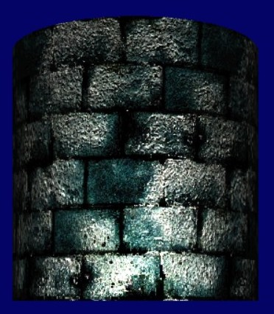
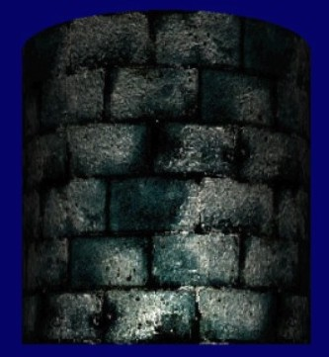
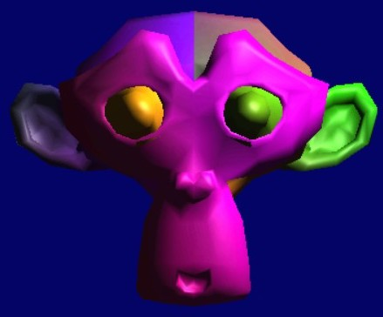
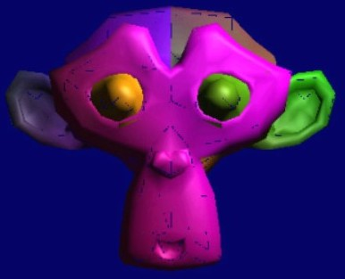
Model validation: Functional
Compare against Mesa’s implementation.
Mesa Emerald
Mesa Emerald

Slide 21
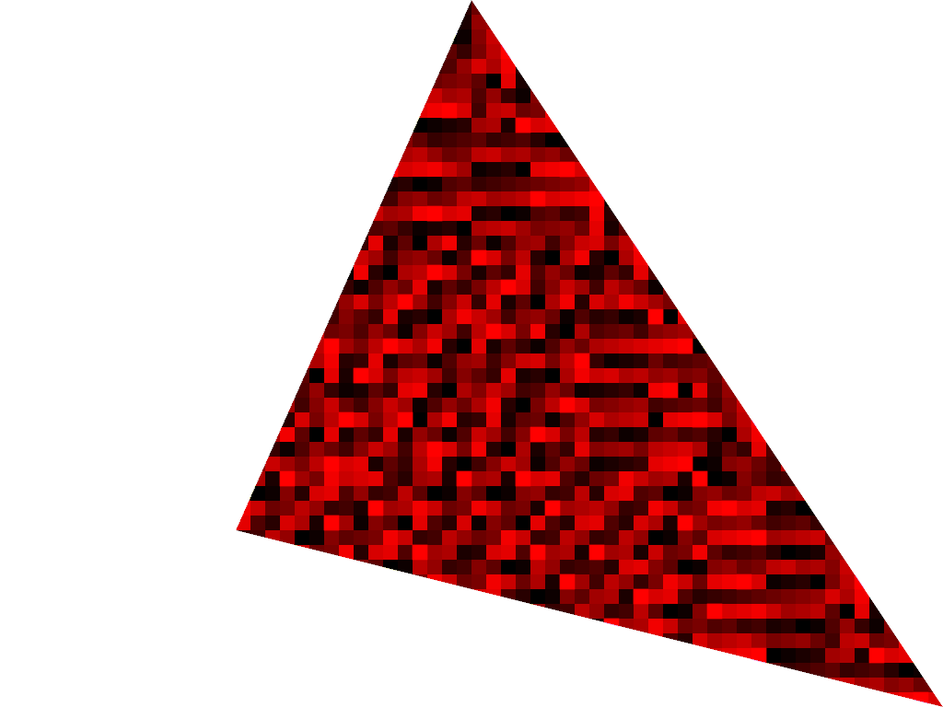
Model validation: MODEL
Methodology: OpenGL microbenchmarks.
Confirm vertex batching and overlapping.
Confirm fragment processing distribution.
v₃
v₆
GL_LINE_STRIP
Each tile is 16x16 pixels that is assigned to a certain cluster
v₀
…
Line strip overlapping vertex execution
W0(v0 – v3)
W1(v3 – v6)
W2(v6 – v9)
Execute on different cores/clusters
Notes:
To understand the reason for vertex overlapping, we see here an example with a line strip where each vertex except the first and the last ones is used to draw two lines.
To process these vertices we package them in warps, in this example we use a warp size of four.
Each warp can be processed on a different core on a different cluster.
We want each warp to be able to contain full primitives, however, line strips share vertices so overlapping has to take place to allow warps to present full lines.

Slide 22
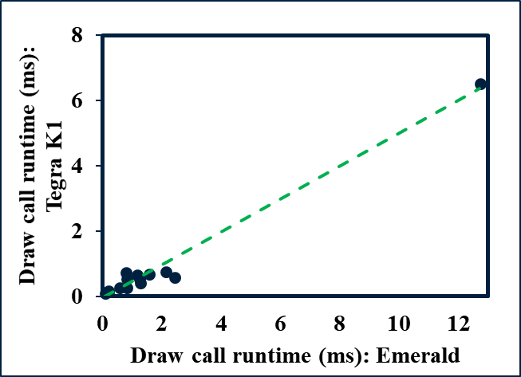
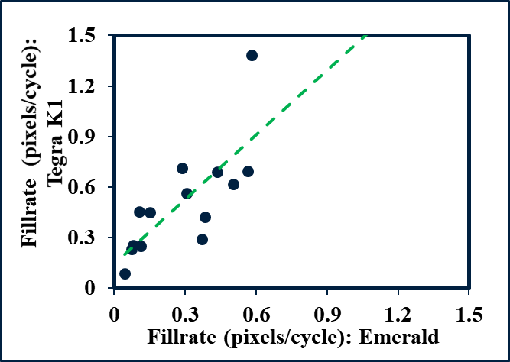
Model validation: Performance
Performance vs. hardware.
14 workloads (10 unique 3D models).
Execution time: 98%
Pixels per cycle: 76.5%
Mean absolute error: 32.2%
Mean absolute error: 33%

Slide 23
Case studies
Case Study I (SoC systems): SoC memory management.
Case Study II (Graphics): Dynamic fragment shading load-balancing (DFSL) on GPU cores.

Slide 24
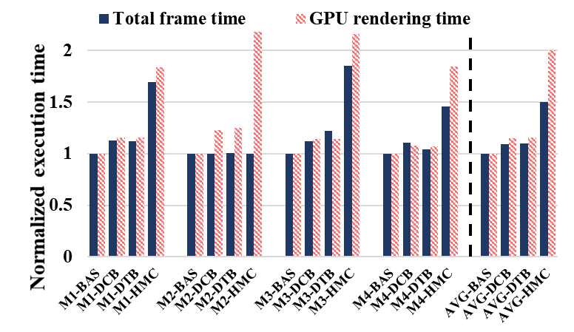
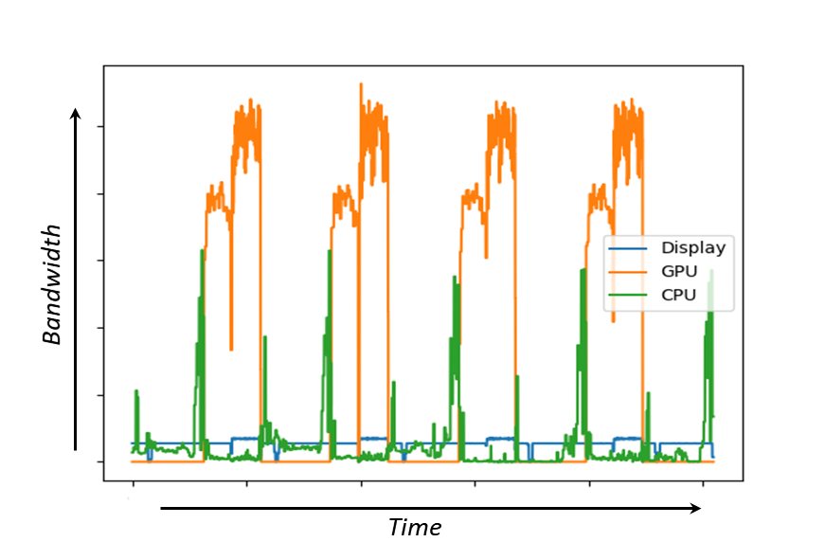
CASE STUDY I: Soc memory management
Re-evaluate techniques for memory organization and scheduling under full-system simulation.
Highlight the importance of modeling system-wide interactions.
Traffic is unbalanced between channels over time.
Our GPU memory traffic is non-sequential, not to what HMC is expecting.

Slide 25
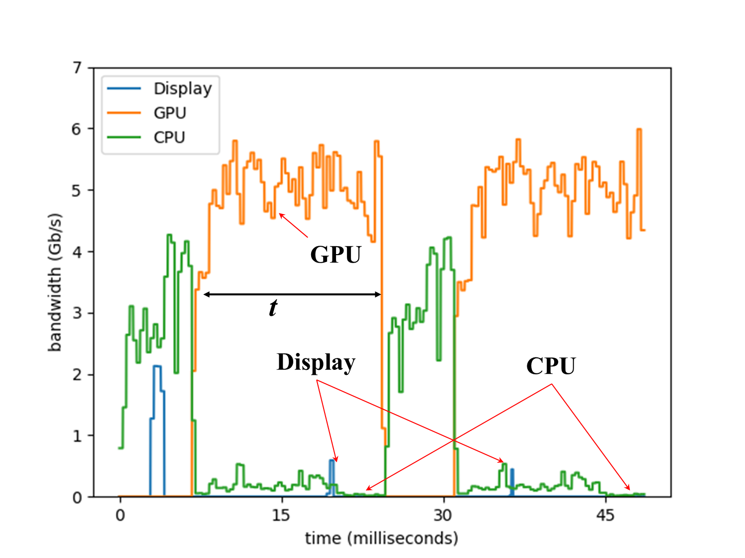
CASE STUDY I: Soc memory management
Re-evaluate techniques for memory organization and scheduling under full-system simulation.
Highlight the importance of modelling system-wide interactions.
DASH often prioritize CPU over GPU.
However, due to dependency between the CPU and the GPU there was no advantage in doing that.

Slide 26
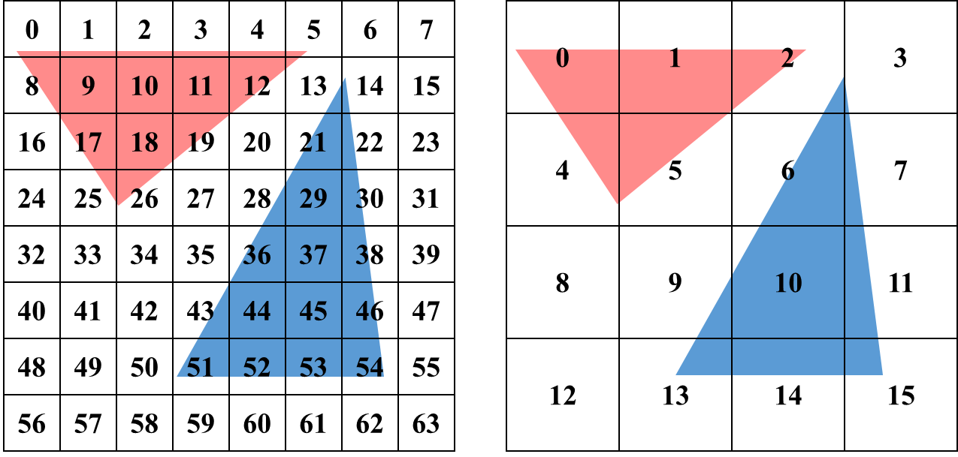
Case STUDY II: DFSL
How to distribute screen-space fragment processing.
Trade-off balance vs. locality.
Small tiles
Large tiles
Distributing screen-space tiles to SIMT cores, locality vs. balance

Slide 27
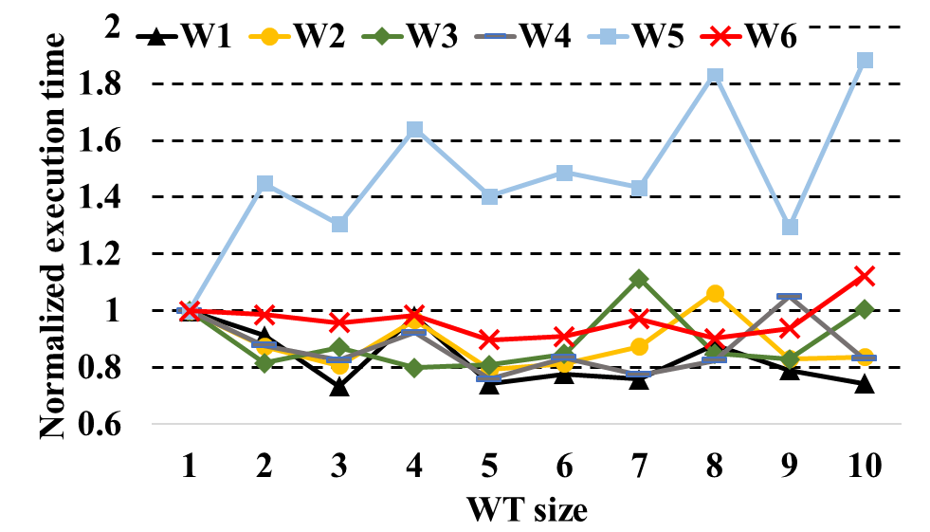
Case STUDY II: DFSL
The best granularity varies with the workload.
DFSL exploits temporal coherence.
Evaluate & run.
Energy rather than performance.
Work tile size

Slide 28
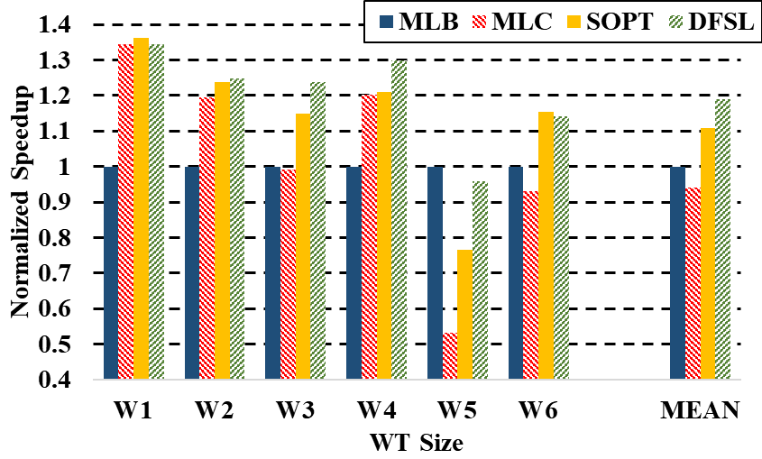
Case STUDY II: DFSL
Compare against small tiles (MLB), large tiles (MLC) and best size on average (SOPT).
DFSL outperformed MLB by 19%, MLC by 29%, and OPT by 7.3%.

Slide 29
Limitations and Future work
Emerald’s to-do list:
Adding details to the graphics model: e.g., texturing & compression.
Creating SoC workloads suite.
Modeling power (GPUWattch).
Supporting geometry and tessellation shaders (for high-end games).

Slide 30
Conclusion
Enabling studying SoC systems with graphics support.
Modern graphics architecture.
Our repo resides @ github.com/gem5-graphics (instructions & documentation coming soon!).
Contributions are welcomed!
¿Questions?

