Slide 1


Embedded Supercomputing in FPGAs
with the VectorBlox
MXP Matrix Processor
Aaron Severance, UBC
VectorBlox Computing
Prof. Guy Lemieux, UBC
CEO VectorBlox Computing
http://www.vectorblox.com

Slide 2
Typical Usage and Motivation
Embedded processing
  FPGAs often control custom devices
    Imaging, audio, radio, screens
  Heavy data processing requirements
FPGA tools for data processing
  VHDL too difficult to learn and use
  C-to-hardware tools too “VHDL-like”
  FPGA-based CPUs (Nios/MicroBlaze) too slow
Complications
  Very slow recompiles of FPGA bitstream
  Device control circuits may have sensitive timing requirements
© 2012 VectorBlox Computing Inc.
Notes:
FPGAs are used today in many embedded tasks
Signal processing, multimedia
Soft processor systems are becoming more common, simplifies development
According to a 2007 survey by Embedded.com, 36% of respondents use soft processor in FPGA design
Although Nios/MB highly optimized

Slide 3
A New Tool
MXP™ Matrix Processor
  Performance
    100x – 1000x over Nios II/f, MicroBlaze
  Easy to use, pure software
    Just C, no VHDL/Verilog !
  No FPGA recompilation for each algorithm change
    No bitstream changes
    Save time (FPGA place+route can take hours, run out of space, etc)
  Correctness
    Easy-to-debug, e.g. printf() or gdb
    Simulator runs on PC, eg regression testing
    Run on real FPGA hardware, eg real-time testing
© 2012 VectorBlox Computing Inc.

Slide 4
Background: Vector Processing
Data-level parallelism
Organize data as long vectors
Vector instruction execution
  Multiple vector lanes (SIMD)
  Hardware automatically repeats SIMD operation over entire length of vector
4 SIMD Vector Lanes
Vector
Assembly
C Code
for ( i=0; i<8; i++ )
a[i] = b[i] * c[i];
set vl, 8
vmult a, b, c
Source
Vectors
Destination
Vector
© 2012 VectorBlox Computing Inc.
Notes:
Long vectors of 32 and above
Vector addressing
Efficient way to gather data
Eliminates pack/unpack instructions
Will be discussed more on the next slide

Slide 5
Why Vector Processing?
Efficient for embedded computation
  E.g. VIRAM for embedded media apps
Maps well to FPGAs
  Different tradeoffs than ASICs
  Uses parallel, deep pipelines
  Streams data through execution units
  Distributed memories for registers/scratchpad
  Avoids tight coupling, forwarding networks

Slide 6
Preview: MXP Internals

Slide 7
SYSTEM DESIGN WITH MXP™
© 2012 VectorBlox Computing Inc.

Slide 8
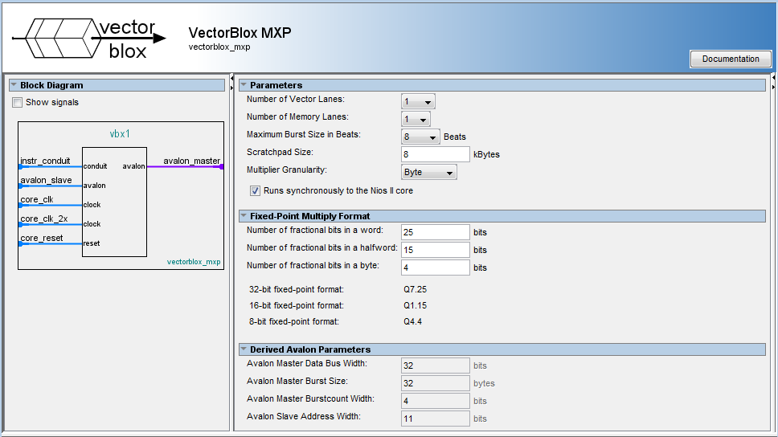
MXP™ Processor: Configurable IP
© 2012 VectorBlox Computing Inc.

Slide 9
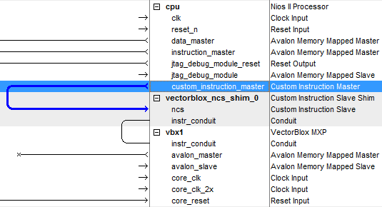
Integrates into Existing Systems
© 2012 VectorBlox Computing Inc.

Slide 10
Typical System

Slide 11
Programming MXP
Libraries on top of vendor tools
  Eclipse based IDEs, command line tools
  GCC, GDB, etc.
Functions and Macros extend C, C++
  Vector Instructions
    ALU, DMA, Custom Instructions
Same software for different configurations
  Wide MXP -> higher performance

Slide 12
Example: Adding 3 Vectors
#include “vbx.h”
int main()
{
const int length = 8;
int A[length] = {1,2,3,4,5,6,7,8};
int B[length] = {10,20,30,40,50,60,70,80};
int C[length] = {100,200,300,400,500,600,700,800};
int D[length];
vbx_dcache_flush_all();
const int data_len = length * sizeof(int);
vbx_word_t *va = (vbx_word_t*)vbx_sp_malloc( data_len );
vbx_word_t *vb = (vbx_word_t*)vbx_sp_malloc( data_len );
vbx_word_t *vc = (vbx_word_t*)vbx_sp_malloc( data_len );
vbx_dma_to_vector( va, A, data_len );
vbx_dma_to_vector( vb, B, data_len );
vbx_dma_to_vector( vc, C, data_len );
vbx_set_vl( length );
vbx( VVW, VADD, vb, va, vb );
vbx( VVW, VADD, vc, vb, vc );
vbx_dma_to_host( D, vc, data_len );
vbx_sync();
vbx_sp_free();
}
© 2012 VectorBlox Computing Inc.

Slide 13
Algorithm Design on FPGAs
HW and SW development is decoupled
Select HW parameters and go
  No VHDL required for computing
  Only resynthesize when requirements change
Design SW with these main concepts
  Vectors of data
  Scratchpad with DMA
  Same software can run on any FPGA
© 2012 VectorBlox Computing Inc.

Slide 14
MXP™ Matrix Processor
© 2012 VectorBlox Computing Inc.

Slide 15
MXP™ System Architecture
1. Scalar
CPU
2. Concurrent
DMA
3-way
Concurrency
3. Vector SIMD

Slide 16
MXP Internal Architecture (1)
© 2012 VectorBlox Computing Inc.

Slide 17
Scratchpad Memory
Multi-banked, parallel access
  Addresses striped across banks, like RAID disks
 |  |  |  |  |  | C | 8 | 4 | 0
Data is
Striped
Across
Memory
Banks
 |  |  |  |  |  | D | 9 | 5 | 1
 |  |  |  |  |  | E | A | 6 | 2
 |  |  |  |  |  | F | B | 7 | 3
© 2012 VectorBlox Computing Inc.

Slide 18
Scratchpad Memory
Multi-banked, parallel access
  Vector can start at any location
 |  |  |  |  |  | C | 8 | 4 | 0
Data is
Striped
Across
Memory
Banks
 |  |  |  |  |  | D | 9 | 5 | 1
 |  |  |  |  |  | E | A | 6 | 2
Vector starts here
 |  |  |  |  |  | F | B | 7 | 3
© 2012 VectorBlox Computing Inc.

Slide 19
Scratchpad Memory
Multi-banked, parallel access
  Vector can start at any location
  Vector can have any length
 |  |  |  |  |  | C | 8 | 4 | 0
Vector starts here
Data is
Striped
Across
Memory
Banks
 |  |  |  |  |  | D | 9 | 5 | 1
Vector of length 10
 |  |  |  |  |  | E | A | 6 | 2
 |  |  |  |  |  | F | B | 7 | 3
© 2012 VectorBlox Computing Inc.

Slide 20
Scratchpad Memory
Multi-banked, parallel access
  Vector can start at any location
  Vector can have any length
  One “wave” of elements can be read every cycle
 |  |  |  |  |  | C | 8 | 4 | 0
 |  |  |  |  |  | C | 8 | 4 | 0
One
clock
cycle:
Parallel
access
to one full
“wave”
of vector
elements
Data is
Striped
Across
Memory
Banks
 |  |  |  |  |  | D | 9 | 5 | 1
 |  |  |  |  |  | D | 9 | 5 | 1
 |  |  |  |  |  | E | A | 6 | 2
 |  |  |  |  |  | E | A | 6 | 2
 |  |  |  |  |  | F | B | 7 | 3
 |  |  |  |  |  | F | B | 7 | 3
© 2012 VectorBlox Computing Inc.

Slide 21
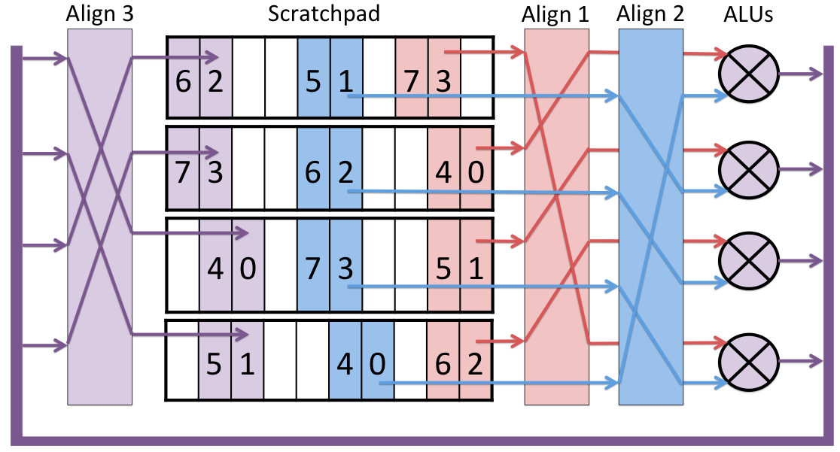
Scratchpad-based Computing
vbx_word_t *vdst, *vsrc1, *vsrc2;
vbx( VVW, VADD, vdst, vsrc1, vsrc2 );
© 2012 VectorBlox Computing Inc.

Slide 22
Scratchpad-based Computing
vbx_word_t *vdst, *vsrc1, *vsrc2;
vbx( VVW, VADD, vdst, vsrc1, vsrc2 );
© 2012 VectorBlox Computing Inc.

Slide 23
Scratchpad-based Computing
vbx_word_t *vdst, *vsrc1, *vsrc2;
vbx( VVW, VADD, vdst, vsrc1, vsrc2 );
© 2012 VectorBlox Computing Inc.

Slide 24
Scratchpad-based Computing
vbx_word_t *vdst, *vsrc1, *vsrc2;
vbx( VVW, VADD, vdst, vsrc1, vsrc2 );
© 2012 VectorBlox Computing Inc.

Slide 25
MXP Internal Architecture (2)
.

Slide 26
Custom Vector Instructions

Slide 27
MXP Internal Architecture (3)

Slide 28
Rich Feature Set
Feature | MXP
Register file | 4kB to 2MB
# Vectors (registers) | unlimited
Max Vector Length | unlimited
Max Element Width | 32b
Sub-word SIMD | 2 x 16b, 4 x 8b
Automatic Dispatch/Increment | 2D/3D
Parallelism | 1 to 128 (x4 for 8b)
Clock speed | Up to 245 MHz
Latency-hiding | Concurrent 1D/2D DMA
Floating-point | Optional via Custom Instructions
User-configurable | DMA, ALUs, Multipliers, S/G Ports

Slide 29
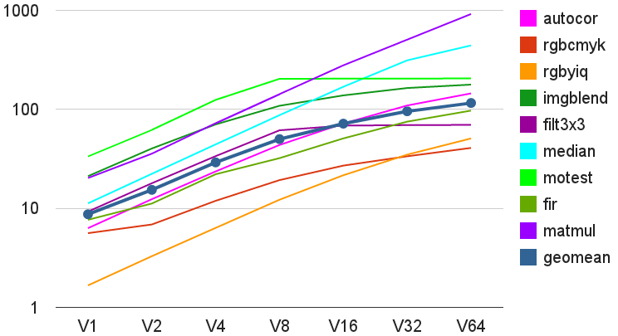


Performance Examples
Application
Kernels
Speedup
(factor)
VectorBlox MXPTM Processor Size
© 2012 VectorBlox Computing Inc.

Slide 30
Chip Area Requirements
 | Nios II/f | V1 4k | V4 16k | V16 64k | V32 128k | V64 256k | Stratix IV-530
ALMs | 1,223 | 3,433 | 7,811 | 21,211 | 46,411 | 80,720 | 212,480
DSPs | 4 | 12 | 36 | 132 | 260 | 516 | 1,024
M9Ks | 14 | 29 | 39 | 112 | 200 | 384 | 1,280
 | Nios II/f | V1 4k | V4 16k | V16 64k | V32 128k | Cyclone IV-115
LEs | 2,898 | 4,467 | 11,927 | 45,035 | 89,436 | 114,480
DSPs | 4 | 12 | 48 | 192 | 388 | 532
M9Ks | 21 | 32 | 36 | 97 | 165 | 432
© 2012 VectorBlox Computing Inc.

Slide 31
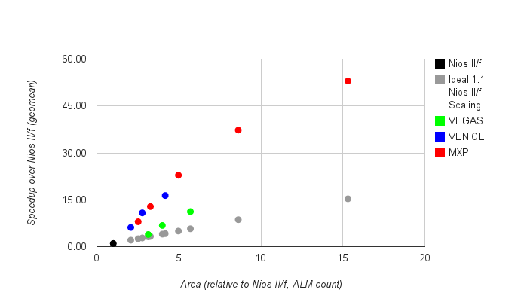
Average Speedup vs. Area
(Relative to Nios II/f = 1.0)
© 2012 VectorBlox Computing Inc.

Slide 32
Sobel Edge Detection
MXP achieves high utilization
  Long vectors keep data streaming through FU’s
  In pipeline alignment, accumulate
  Concurrent vector/DMA/scalar alleviate stalling

Slide 33
Current/Future Work
Multiple operand custom instructions
  Custom RTL performance, vector control
Modular Instruction Set
  Application Specific Vector ISA Processor
C++ object programming model

Slide 34
Conclusions
Vector processing with MXP on FPGAs
  Easy to use/deploy
  Scalable performance (area vs speed)
    Speedups up to 1000x
  No hardware recompiling necessary
    Rapid algorithm development
    Hardware purely ‘sandboxed’ from algorithm
© 2012 VectorBlox Computing Inc.

Slide 35
The VectorBlox MXP™
Matrix Processor
Scalable performance
Pure C programming
Direct device access
No hardware design
Easy to debug
RTL

Slide 36
Application Performance
Comparison to Intel i7-2600
(running on one 3.4GHz core, without SSE/AVX instructions)
CPU | Fir | 2Dfir | Life | Imgblend | Median | Motion Estimation | Matrix Multiply
Intel i7-2600 | 0.05s | 0.36s | 0.13s | 0.09s | 9.86s | 0.25s | 50.0s
MXP | 0.05s | 0.43s | 0.19s | 0.50s | 2.50s | 0.21s | 15.8s
Speedup | 1.0x | 0.8x | 0.7x | 0.2x | 3.9x | 1.7x | 3.2x
© 2012 VectorBlox Computing Inc.

Slide 37
Benchmark Characteristics
© 2012 VectorBlox Computing Inc.

