Slide 1
Reducing the Cost of Floating-Point Mantissa Alignment and Normalization in FPGAs
Yehdhih Ould Mohammed Moctar¹
Nithin George² Hadi Parandeh-Afshar²
Paolo Ienne² Guy G.F. Lemieux³ Philip Brisk¹
¹University of California Riverside
²Ecole Polytechnique Fédérale de Lausanne (EPFL)
³University of British Columbia
International Symposium on Field Programmable Gate Arrrays
Monterey, CA, USA, February 22-24, 2012

Slide 2
Floating-point on FPGAs
Best practice for HPC
Convert application into a deep, parallel pipeline
Altera’s floating-point datapath compiler
Maxeler Technologies
ROCCC 2.0 (UC Riverside)
Optimize for throughput, not latency
Reduce area
Fit more operators onto a fixed-size device
Shifters are a big bottleneck
1/32

Slide 3
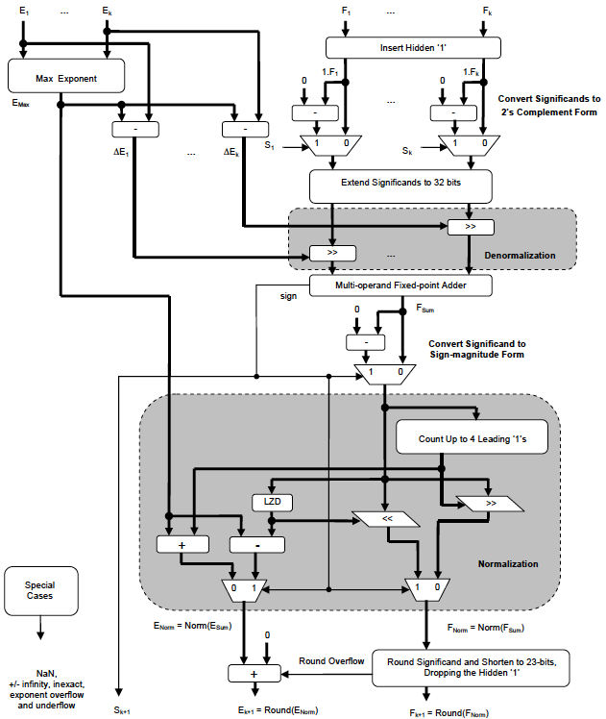
Floating-point Addition Cluster
[Verma et al. FPL 2010]
Similar to Altera’s FP datapath compiler
Add 2-16 single-precision FP operands at once
Denormalize in parallel up-front
Normalize the result at the end
Shifters are the area bottleneck when synthesized on an FPGA
2/32

Slide 4
FPGA Architecture (1/3)
Basic Logic Element (BLE)
3/32

Slide 5
FPGA Architecture (2/3)
Versatile Place and Route (VPR) CLB Architecture
4/32

Slide 6
FPGA Architecture (3/3)
5/32

Slide 7
Focus on Multiplexers
Shifters are built from multiplexers
FPGAs have lots of multiplexers
Focus on C-block and intra-cluster routing
Static Multiplexer
(Standard FPGA)
Static-or-Dynamic Multiplexer
(Patented by Xilinx—Alireza Kaviani)
6/32

Slide 8
Static vs. Dynamic Control
7/32

Slide 9
Example: Conditional Swap
8/32

Slide 10
Example: Conditional Swap
9/32

Slide 11
Let’s (Not) Try the C-Block
Must route each signal on ONTO SPECIFIC SEGMENTS IN THE ROUTING CHANNEL!
10/32

Slide 12
Let’s Try the Intra-cluster Routing
11/32

Slide 13
Strict Ordering Imposed on Signals Routed to CLB Inputs
12/32

Slide 14
Interconnect Topology Issues (1/2)
Both muxes implement the same logic function
13/32

Slide 15
Interconnect Topology Issues (2/2)
Changing the topology fixes the problem
14/32

Slide 16
Example: 4-bit Left Shift
15/32

Slide 17
Programmable Inversion
The LUT cannot correct the shift amount!
Bit to be shifted may arrive inverted
Program the LUT to correct the inversion
16/32

Slide 18
Routing Challenges (1/2)
Traditional FPGAs provide a lot of flexibility to the router
C-block muxes
Intra-cluster routing muxes
Equivalence of LUT inputs
17/32

Slide 19
Routing Challenges (2/2)
SD-Mux flexibility in the intra-cluster routing?
C-block muxes provide normal flexibility
Must route each net to a specific Intra-cluster routing mux input (CLB input)
LUTs offer no flexibility
18/32

Slide 20
Macro-Cells
Pre-place the layer of logic immediately before the shifter
Pre-route connections between the two layers
Routes must reach
pre-specified CLB inputs!
Lock down CLBs and routing resources during P&R
like a soft IP core
Can move macro-cells during placement!
All or nothing
19/32

Slide 21
Main Result
The macro-cell routed successfully!
For a 27-bit shifter
Routed all nets from normal CLB layer to pre-specified CLB inputs in the SD-Mux Enhanced layer
20/32

Slide 22
FPGA with Macro-cells (1/3)
Enhanced CLB
21/32

Slide 23
FPGA with Macro-cells (2/3)
Enhanced CLB
22/32

Slide 24
FPGA with Macro-cells (3/3)
Enhanced CLB
23/32

Slide 25
Floating-point Addition Clusters
[Verma et al., FPL 2010]
24/32

Slide 26
Experimental Setup
VPR 5.0
Project started several years ago
Assumes intra-cluster routing is full-crossbar
We abstract away internal topology issues
Significant modifications to P&R
Compute routes for the macro-cells
P&R large circuits with macro-cells
25/32

Slide 27
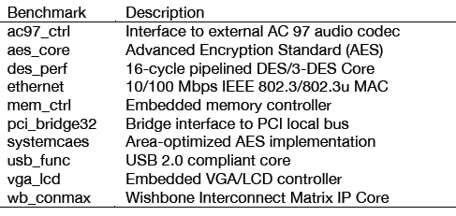
IWLS Benchmarks
10 largest benchmarks chosen
Much larger than MCNC, ISCAS, etc.
Modified each netlist to add macro-cells
Macro-cells were kept off the critical paths
26/32

Slide 28
Benchmark Overview
27/32

Slide 29
No Impact on Routing Delay!
Locked-down resources (obstacles due to non-critical macro-cells) do not affect the critical path!
28/32

Slide 30
Impact on Min-channel Width
VPR generates a larger FPGA
29/32

Slide 31
Router Runtime (not in paper)
30/32

Slide 32
Limitations
Real FPGAs use sparse crossbars for intra-cluster routing
Muxes may be smaller than 27:1
Did not model internal connections
Did not model…
Area overhead of extra muxes, configuration bits, programmable inversion, etc. in the CLB
FP adder cluster frequency/latency
Energy consumption
DSP blocks can shift too
… but a precious resource for many HPC apps
31/32

Slide 33
Conclusion
Use the intra-cluster routing to perform shifting
Motivation: floating-point
Outcome: ~30% reduction in area per operator
Macro-cells address the major CAD challenges
We can route nets to pre-specified CLB inputs within a macro-cell
P&R treats macro-cells like soft IP
P&R cannot optimize across macro-cell boundaries
No negative impact on P&R results
32/32

