Slide 1

Real-time Object Detection in Software with Custom Vector Instructions and Algorithmic Changes
The University of British Columbia
Joe Edwards
Guy Lemieux
Notes:
Today I will be presenting my work on Real time object detection in software
Our approach primarily uses a software develop/debug cycle
Additional hardware instructions are later added to accelerate performance bottlenecks
I will also discuss some changes to the algorithm that were made to aid vectorization.

Slide 2
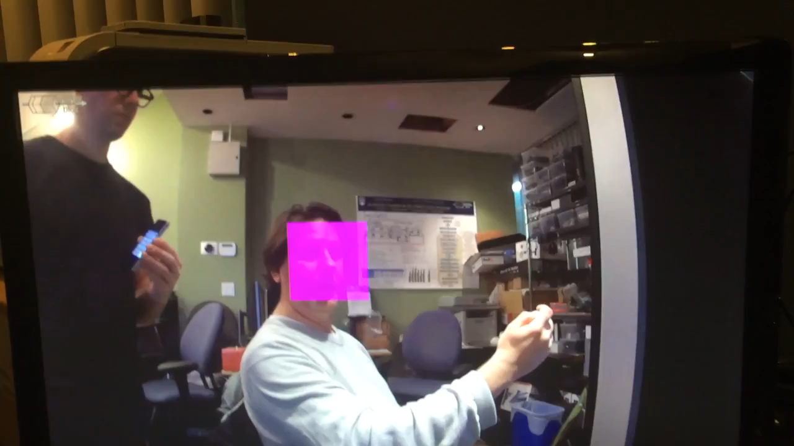
Notes:
Short clip showing our system in action.
Our approach and how it is different.
overview of the algorithm and discuss how we accelerate it
present our results and how we compare to prior work

Slide 3
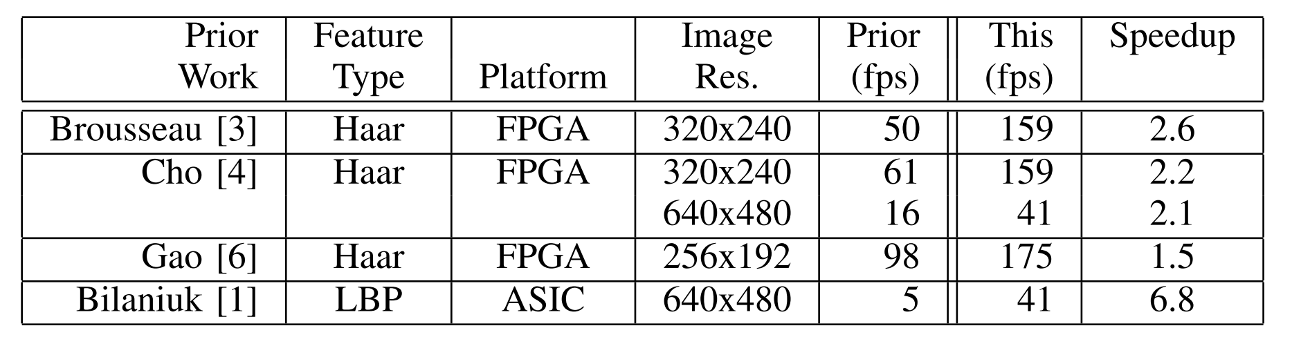
Prior art
Primarily Haar features
Custom SIMD hardware engines
Early exit limits scaling
Notes:
In this paper we accelerate a variation of a Viola Jones face detector.
When looking at prior work , we found most systems used Haar features,
most design implemented in FPGAs
and were Custom SIMD hardware engines
Because of the early exit nature of the algorithm, which discussed later on,
scaling the number of PE in these solutions seeming limited

Slide 4
Our paper
LBP features
Primarily software accelerated on soft-core vector processor
Custom hardware leverages the vector processor
Early exit amenable to vector masking
Use mainly 8-bit data
Notes:
In our paper we use LBP features
As mention in the title, the acceleration is mainly done in software
The custom hardware we do add leverages the vector processor, as its implemented as tightly integrated CVI
We found the early exit problem is amenable to vector masking
We also focus on using small datatypes throughout the computation

Slide 5
Machine Learning Toolkits
Traditional (uses engineered features)
  OpenCV
Deep Learning (uses learned features)
  Caffe – UC Berkeley
  Theano – U Montreal
  CNTK – Microsoft
  TensorFlow – Google
Notes:
The Viola Jones face detector is a traditional machine learning algorithm,
which uses engineered features,
- where the features used, are hand picked for being discriminative for a given task.
This is in contrast to feature learning, employed in deep learning methods,
- where features used, are learned directly from input data.
The general approach I discuss today, applies well to deep learning algorithms,
- but we’ focus on accelerating this classic algorithm

Slide 6

A Face
Notes:
Our example detector is trying to find faces. How do we proceed?
As we are using engineered features, it’s easy to describe what we need to calculate

Slide 7
A Face
Notes:
What we are looking for is the cropped region highlighted in the image.
Moving across an image, we need to look in a given window, and evaluate if a face is present or not.

Slide 8
A Face
Notes:
In a single feature window, which is typically around 20 x 20 pixels,
we check if our object is present by evaluating a series of features (or weak classifiers)

Slide 9
A Feature
Xoffset2
Xdelta2
Yoffset
Ydelta
Xoffset1
Xdelta1
Notes:
Different kinds of features may be used..
The examples in the following slides show haar features, as they easy to visualize..
To evaluate a Haar feature, we check that the pixels in the dark regions are, darker than those in the bright regions.
If this relationship is true, a feature’s pass value is returned, otherwise, its fail value. Is returned.
SPACE x3
Each feature has a unique position and shape within the window.
Evaluating a feature is the central computation in the algorithm.

Slide 10
Multiple Features
Most discriminative features grouped into stages.
Notes:
By combining these features (or weak classifiers together), we create a robust face detector.
SPACE x4
During training, all potential features are ranked by how discriminative they are.
SPACE
These ranked features are grouped into stages
- Stages that must be passed in successive order.
If any stage fails, the window does not contain the target.

Slide 11
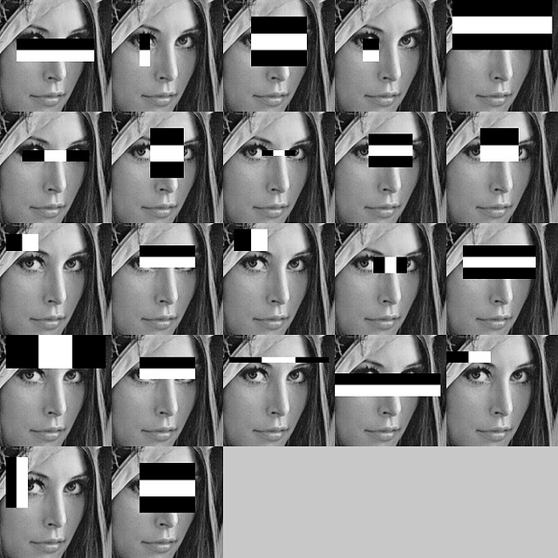
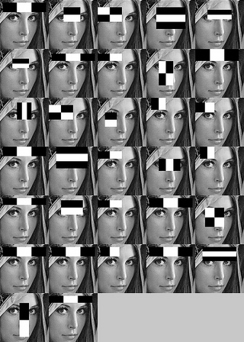
Cascade
Stage 1
Stage 2
Stage 3
Early termination of cascade
when a stage fails
Notes:
An example cascade of Haar features is shown.
Only If all stages pass we say the object is found.
Exiting early is what made the original Viola Jones algorithm so successful,
a minimal number of features are computed at each location, allowing it to run relatively quickly on hardware that was available
This variable execution is also what makes parallelism difficult.

Slide 12
Sliding Window
Notes:
SPACE
To find faces at all locations
SPACE
We slide our feature window across the image where at each location, we evaluate the cascade

Slide 13
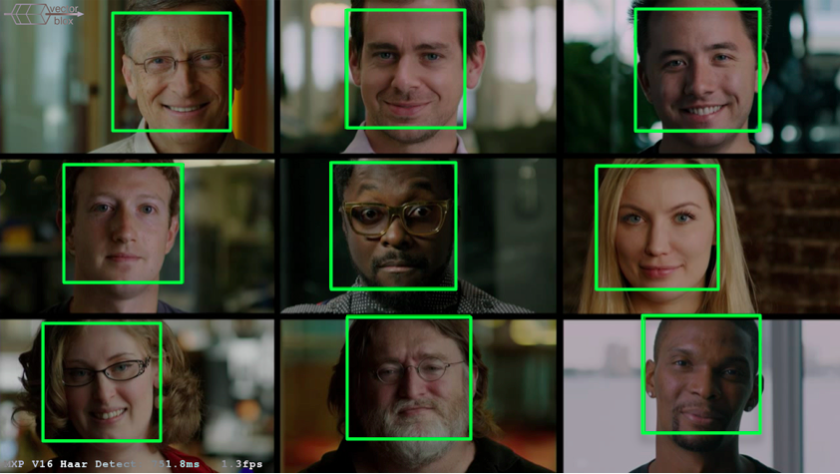
Example
Notes:
Here we find face (of approximately the same size), across the image.

Slide 14
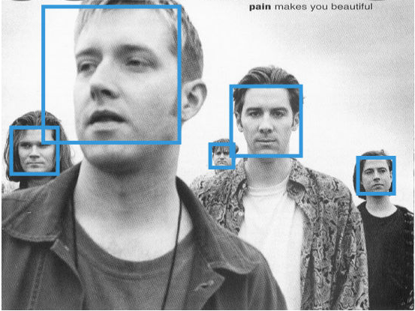
Different Face Sizes
Notes:
SPACE
To find faces of all sizes,
SPACE x4
we need to scale our image, and run the sliding window across each image in the pyramid.
This makes up the outermost loop

Slide 15
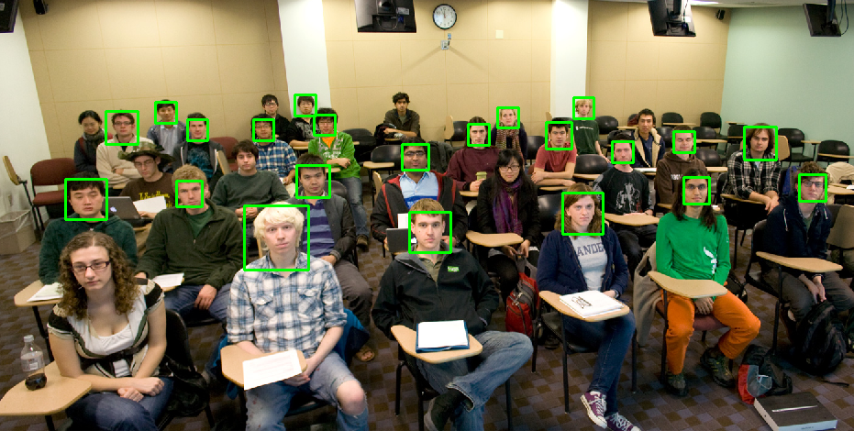
Example
Notes:
We can then find faces of all sizes at all locations

Slide 16
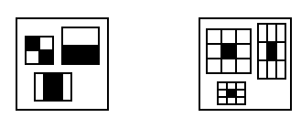
Haar Features
LBP Features
Notes:
For our implementation we use multi-block Local Binary Pattern features.
LBP features are chosen as the operations need to calculate a given feature, map well to embedded systems.
Similar to Haar features, LBP features involve the comparison of brightness of regions..

Slide 17
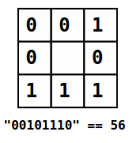
LBP Computation
LBP Features
3 x 3 grid of cells
Xoffset, Yoffset
Cell is average of H x W pixels
8 comparisons to center cell
Produces 8-bit result
“00101110” = 56
Notes:
Calculating an LBP feature consists of two steps:
First an LBP pattern is computed,
SPACE x5
This pattern is generated by comparing the average brightness of each neighboring cell to the center cell, and recording a 0 or 1 if brighter or not.
Second, this 8 bit pattern is used as an index into the features 256 entry look up table, which returns it’s a pass or fail value.
Again, this is the core computation we need to accelerate.

Slide 18

Database
(about 10,000 faces)
(also need non-faces)
Notes:
gathered a small database of ~10, 000 cropped frontal faces
equal amount of non-face images.
To generate our detector, we used OpenCV Train cascade function.
We made an additional restriction to the possible LBP cell sizes, to powers of 2, which made calculating features significantly easier.

Slide 19
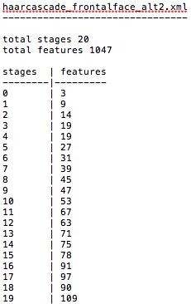
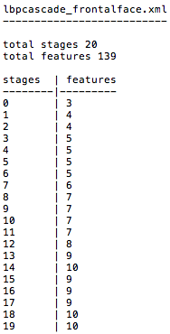
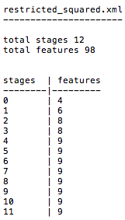
OpenCV Cascades
Our Cascade
Haar Features
LBP Features
LBP Features
Notes:
SPACE x2
We show OpenCV’s default front face cascades with a breakdown of stages and number of features,
SPACEx2
Typically, LBP features are more discriminative than Haar features, so less are needed
SPACEx2
Our trained cascade.is presented for comparison
.

Slide 20
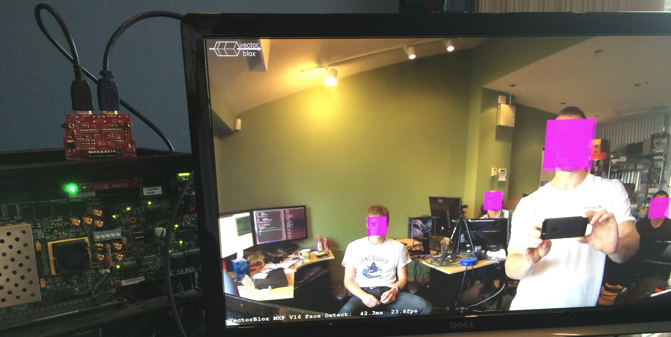
Our system
ZC706 development board + Avnet HDMI card
ARM A9 host processor + VectorBlox MXP accelerator
Notes:
We produce a complete end to end demo
We use ZC706 development board and attached HDMI video card capable of 1080p IO @ 60 fps
The FPGA is a Zinq 7045 SoC device which contain a hard ARM A9 processor which runs at 667 Mhz.
A soft vector processor, VectorBlox MXP, attaches this host processor and is used to accelerate the alogorthm
On our next slide I’ll show the system more detail

Slide 21
Our system
ARM runs C/C++ code
  MXP runs vector intrinsics or C++ Objects
DDR3
Memory
AXI Bus
MXP Matrix Processor
ARM
DMA
Engine
Scratchpad
Memory
Notes:
The vector processor is implement in the fabric and attached to the AXI bus
The vector processor uses a scratchpad memory and all data it operates on must be DMA’d from the DRAM.
All the code runs on the host arm processor which deposits vector instructions into the MXP to do DMA and computations.

Slide 22
Inside the MXP
AXI Bus
DMA Engine
Instruction & DMA Queue
Custom Vector Instructions
Notes:
MXP processes two input, single output SIMD instructions.
Vectors length is variable, and the instructions proceed one wavefront at time, where wavefronts correspond to number of vector lanes or ALUs
The processor supports subword SIMD operations using fracturable ALUs. This providing 2x and 4x speedup when operating on halfwords and bytes respectively.
MXP is parameterizable in term of the number of vector lanes and scratchpad size
MXP provides simple integration for streaming pipelines as Custom Vector Instructions
Once added, these operations are called like any other vector instruction.

Slide 23
Using the MXP
4 Vector Lanes
Data-level parallelism
1D, 2D, 3D vectors
(matrices)
for ( i=0; i<8; i++ )
a[i] = b[i] * c[i];
set_vl, 8
vmult a, b, c
Source
vector
registers
Destination
vector
register
b[]
c[]
a[]
Notes:
A programmer needs to
-move the operands into the scratchpad,
-Set the vector length,
-And call the operations
The above code shows how we would vectorize two array being multiplied together.
To maximize performance, keeping the vector engine fed,
We ideally want to process long vectors, which can overlap with any DMA transfers. and keep data types small
With the system defined, we proceed with the baseline implementation

Slide 24
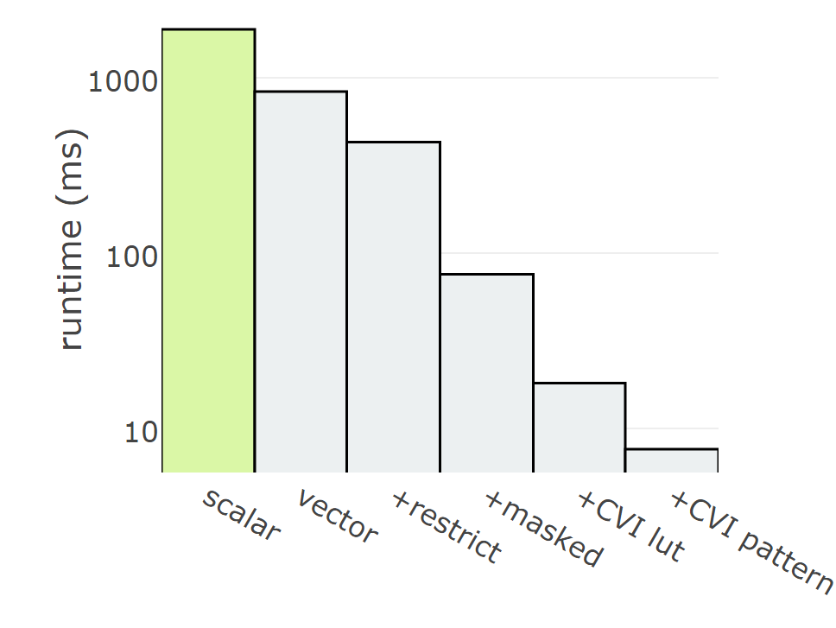
Baseline
for each Image size
Scale Image
for each <row, column>
for each Stage
for each Feature in Stage
Compute LBP Pattern
Table Lookup if Stage FAIL break
if PASS save FACE
Notes:
We start with scalar implementation on the ARM processor which serves as a functional baseline.
The pseudo code on the right show the algorithm being computed
This version of the code runs in 1.9 seconds, not meeting our real-time target.
This version is useful as many operations which are needed for a complete demo, such as merging all the faces found, consume little run time and don’t’ need to be accelerated.
We then start our acceleration effort. By vectorizing the code

Slide 25
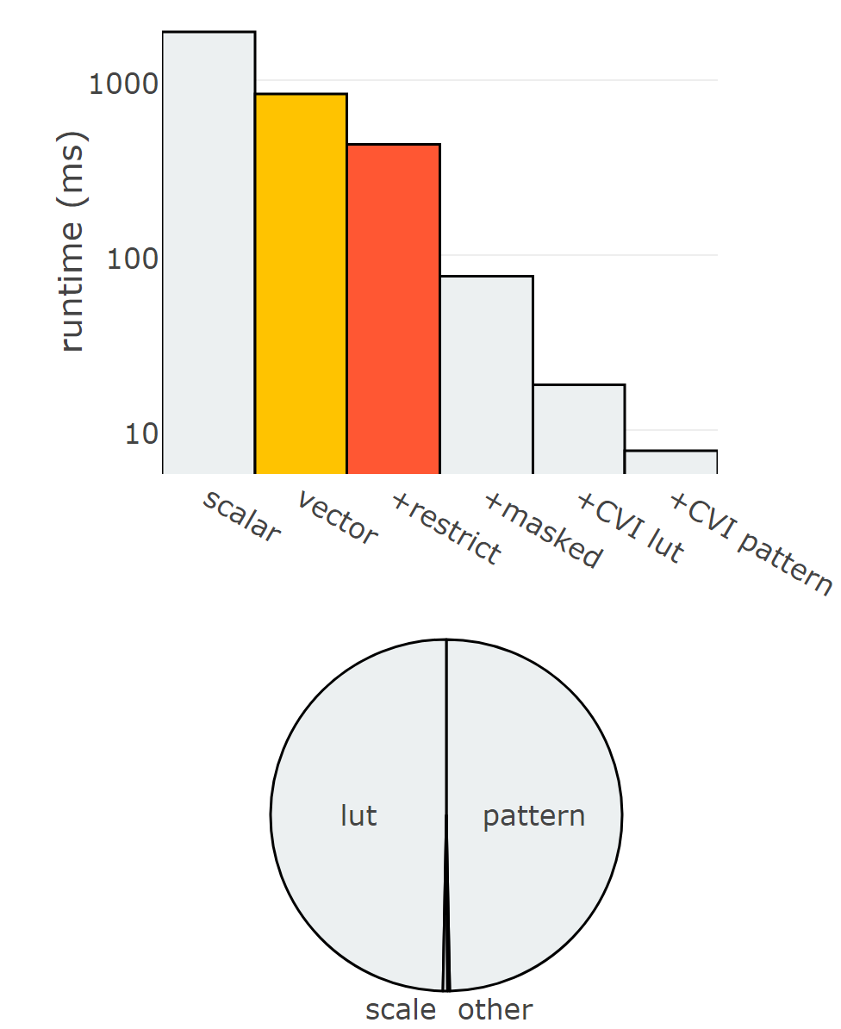
Vectorization
for each Image size
Scale Image
for each Feature
for each <row,column>
Precompute LBP Pattern
for each <row, column>
for each Stage
for each Feature in Stage Table Lookup
if Stage FAIL break
if PASS save FACE
Notes:
As vectorization. Is done in software, development is fairly rapid
The yellow bar shows our initial vectiorization. It runs in 831 ms, a speedup of 2.3
The pie chart below show the breakdown of runtime.
Initially, both LBP pattern computation and table lookup are done together in the inner most loop, accounting for 98% of the runtime.
A major algorithmic change, is to hoist the pattern computation out of the inner loop, as a precomputer step..
The orange bar represent the runtime when we precompute the restricted features.
The algorithm now runs in 453 ms.
The modified pseudo code reflects this precomputation.
Most of the time is still spent in the inner loop, doing table lookups.
To speed this up, we must look at the problem of exiting early that was mentions earlier

Slide 26
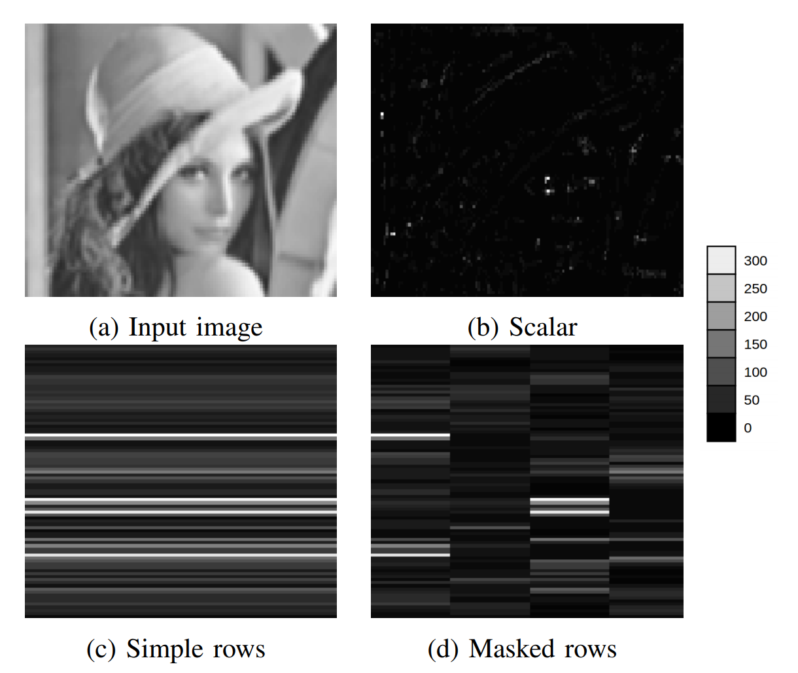
Masking
Notes:
Given an input image,, labeled a, we must compute features at each location, until a stage fails.
We can see how effective this was for Viiolla Jones, by looking at figure B, This map shows how many feature had to be computerd at each location. Before existing.
In figure c we show the effects vectoring a row at time rows, the simplest way to proceeed, we can’t exit until all features in a row can exit. This mean far more features need to be computerd than necessary
Our vector processor solves this by supporting masking,
When masked, entire wavefronts of the vector are skipped, if all elements in the wavefront have exited.
This brings us back closer to the amount of computation needed in the scalar solution.
From a programmers point of view, this feature is simple to make use of a mask needs to be updated at each stage, and the original vector instruction need to be substitured for their masked verions..

Slide 27
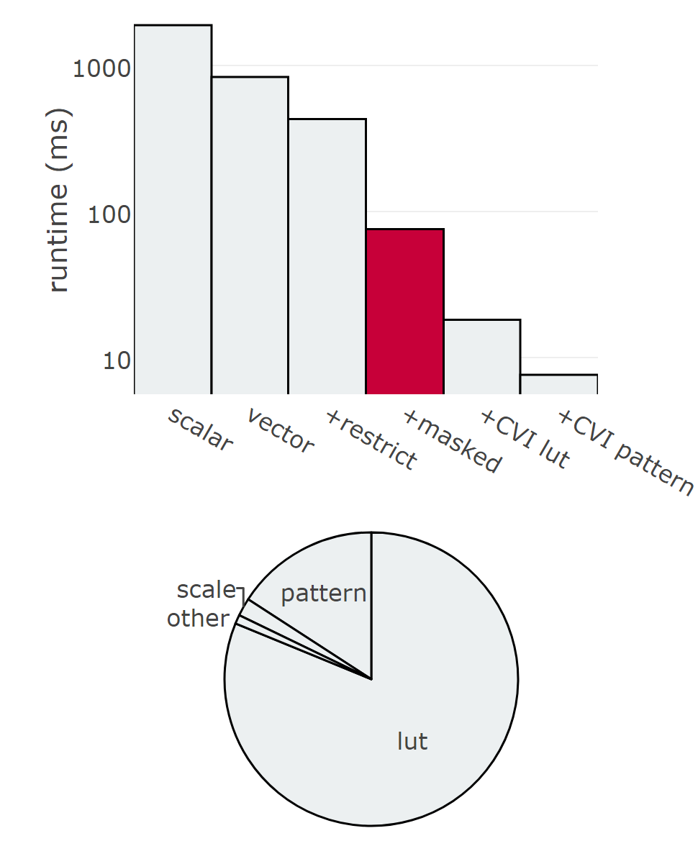
Masking
for each Image size
Scale Image
for each Feature
for each <row,column>
Precompute LBP Pattern
for each <row, column>
for each Stage
for each Feature in Stage Masked(Table Lookup)
if Stage FAIL break
if PASS save FACE
Notes:
Our pseudo code shows use of masking the inner computation
The runtime is now 75.6 ms, indicated by the red bar, This closer to our realtime target,
Again all these steps have been software only, allowing us to flexible with implementation details.
An updated breakdown shows that precomputation and table lookiup still consuming the bulk of the runtime, as expected.
Our code is now in a position to benefit from custom hardware in the form of two Custom Vector Instructions. We look at each in the next slide.

Slide 28
Custom Vector Instructions
Instruction 2
Table Lookup
Instruction 1
8-way Compare
if( TABLE[LBP_ID][56] )
STAGE_SUM += PASS;
else
STAGE_SUM += FAIL;
Notes:
The operations need for each custom instructions is shown in the slide
The pattern computation, requires calculating the average brightness, and produing the 8bit pattern
The second instruction is a two stage LUT,, where a feature and index are passed in and the pass or fail value returned.
We write these two operations s as custom vectors instructions which integrate into the vector processor,
These instructions behave as any other vector instruction, making it easy to replace the previous vector intrusions with these accelerated ones
Both operations combined require < 800 lines of RTL , focusing the RTL design effort, and keeping it to a minimum
.

Slide 29
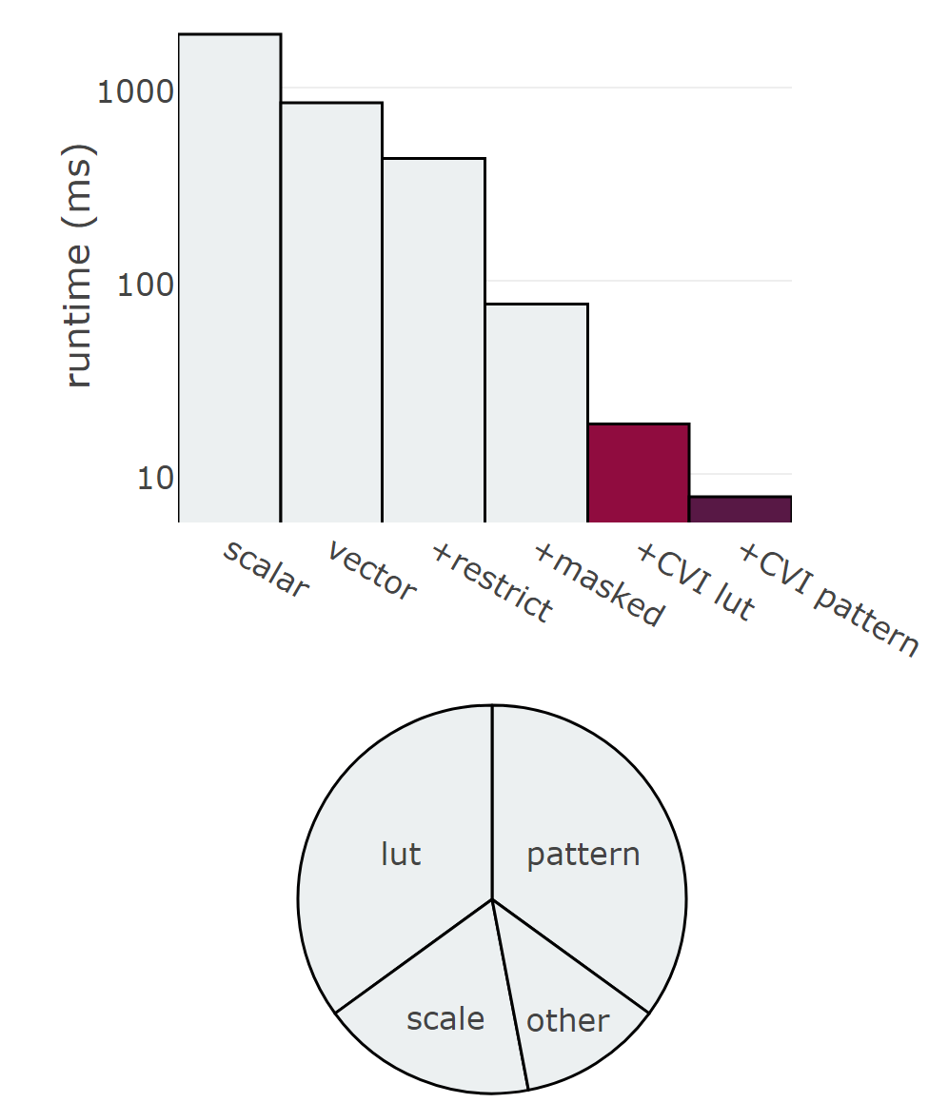
Custom Vector Instructions
for each Image size
Scale Image
for each Feature
for each <row,column>
Precompute LBP Pattern
for each <row, column>
for each Stage
for each Feature in Stage Masked(Table Lookup)
if Stage FAIL break
if PASS save FACE
Notes:
The black bolded operations in our pseudo code use the custom vector instuctions in place of the existing vector operation.
Our final result, using both custom instructions can be seen in the final purple bar.
Running @ 7.6 ms, we now meet our real-time goals.

Slide 30
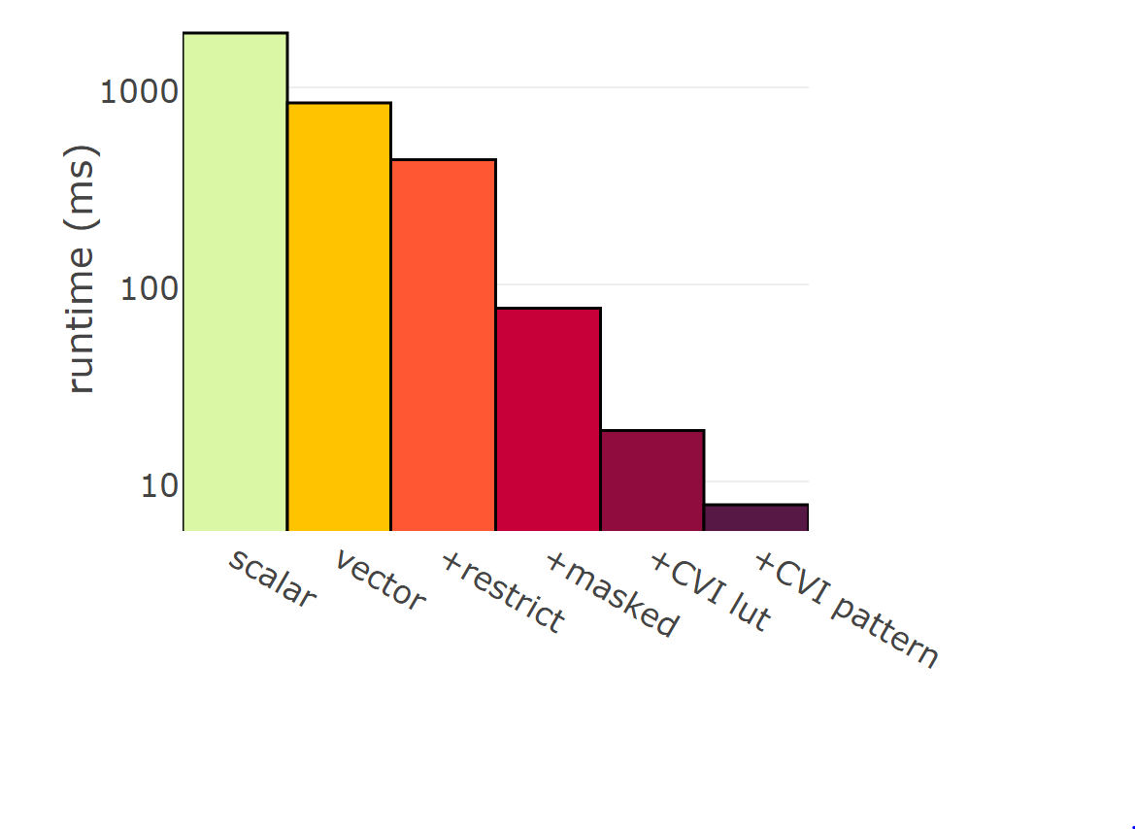
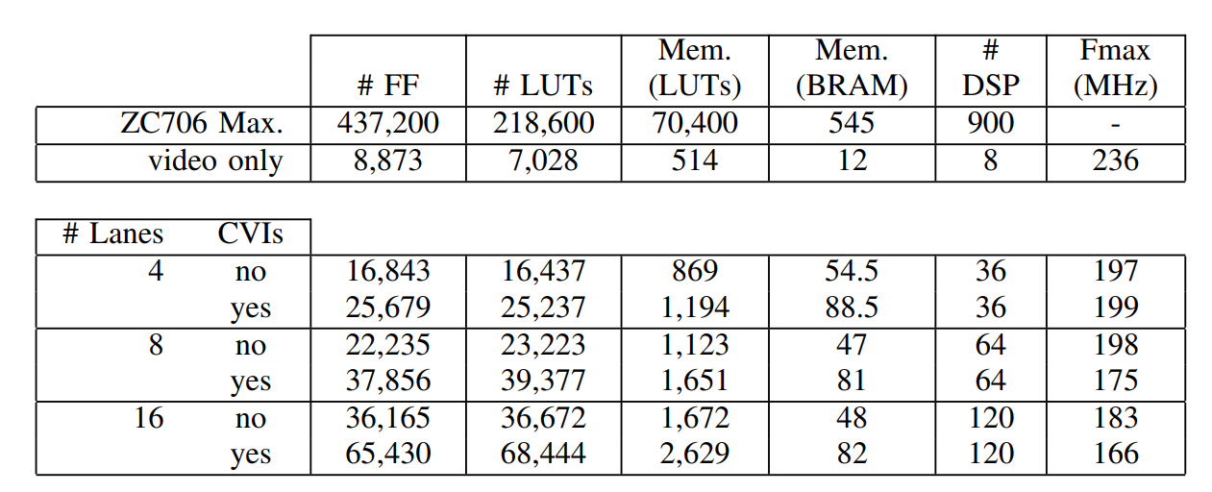
Results
Notes:
A stepwise approach, consisting of vectorizing our baseline, then adding targeted instructions leads to our final result, achieving 248x over the ARM processor.
Masking allowing Wavefront skipping and the LUT custom vector instruction boost performance the most.
With all optimizations in place, diminishing returns with respect to vector length become apparent, showing a limit to our SIMD approach. For additional performance gains, a multicore implementation would be required.

Slide 31
Prior art
Notes:
Previous work presented their results using different resolutions and parameter settings.
We adjusted our parameters to match and we got these results.
As a rough comparison, the face detection system developed by Brousseau [3] runs at 125MHz on a Stratix IV 530
and uses similar area to our largest configuration.

Slide 32
Conclusions
Soft-vector processor provides flexibility with good performance (24.9x ARM)
Custom Vector Instructions focus domain specific hardware (<800 lines of VHDL) and provides excellent performance (248x ARM)
Use small data types if possible

Slide 33
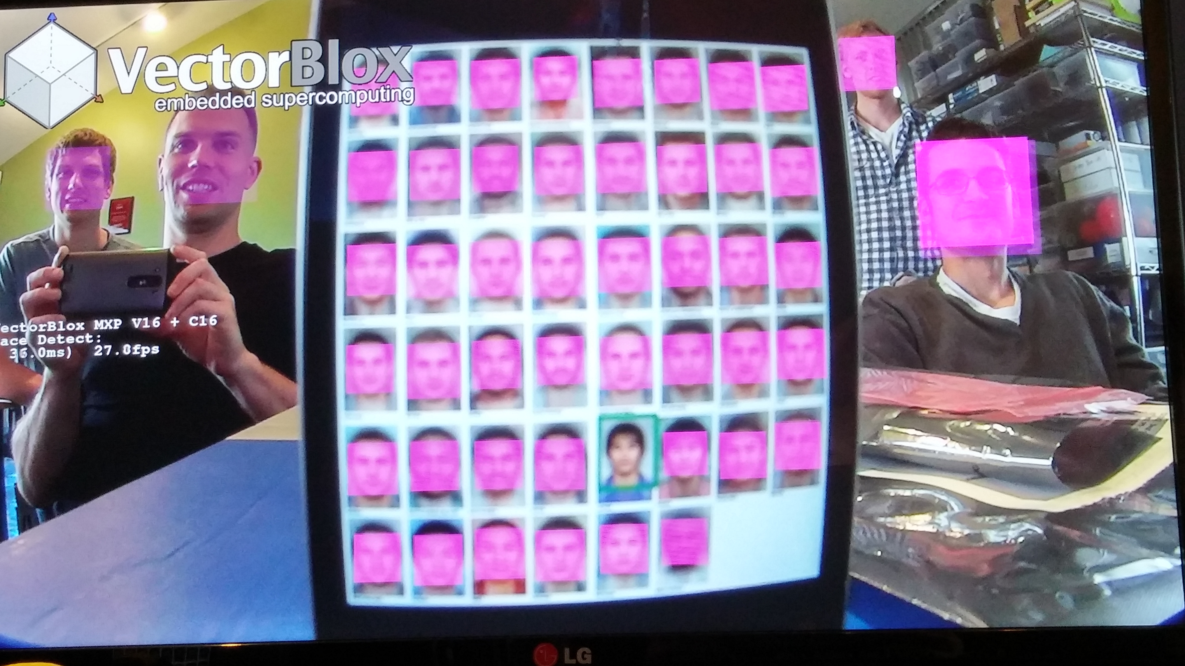

Slide 34
Thank you…

Slide 35
Extra Slides

Slide 36
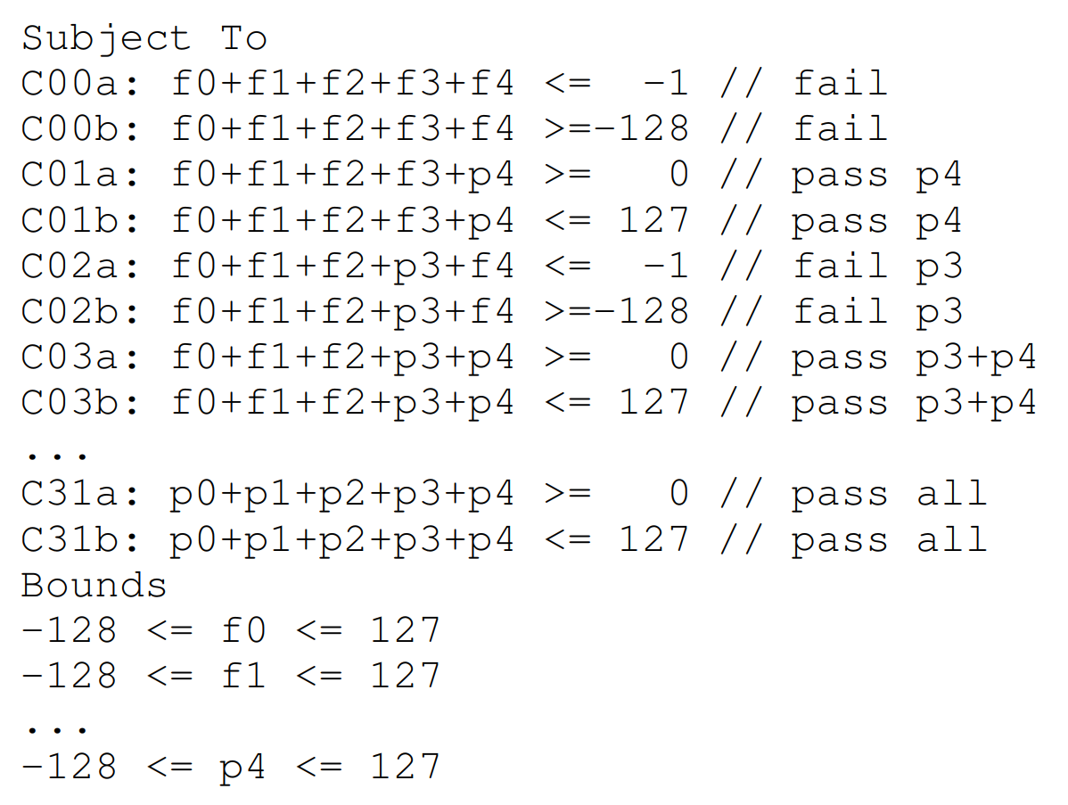
ILP Constraints

Slide 37
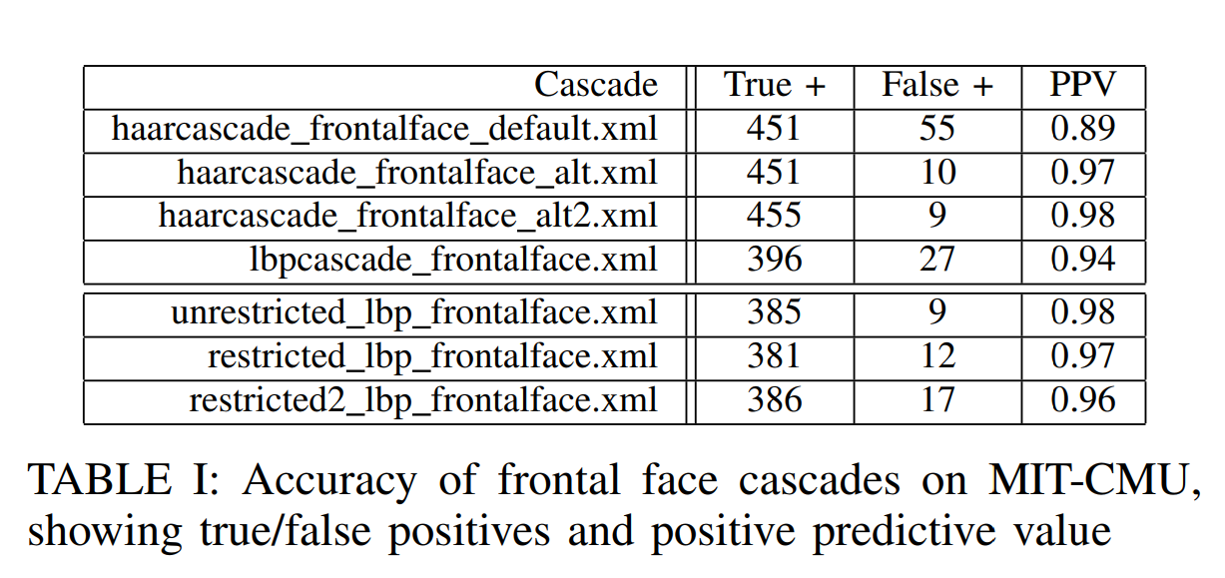
Cascade
Notes:
A stepwise approach of vectorizing, then adding targeted instructions minimizes and focuses RTL development.
Our final solution achieves 200x over ARM A9 processor.

Slide 38
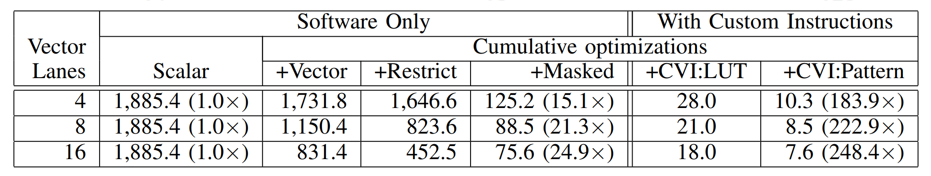
Scaling
Notes:
A stepwise approach of vectorizing, then adding targeted instructions minimizes and focuses RTL development.
Our final solution achieves 200x over ARM A9 processor.

Slide 39
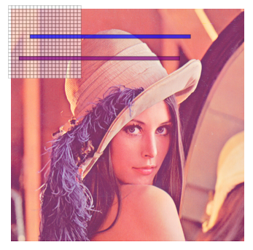
Custom
For each ImageSize
Downsample image
For each Feature
For each <row,column>
Precompute LBP Pattern
For each <row, column>
For each Stage
For each Feature in Stage Masked(TableLookup)
If Stage FAIL break
If PASS save FACE
Notes:
Our final solution can be summarized in the given pseudo code.
The black, bolded underlined sections represent where the two custom instructions were added.

Slide 40
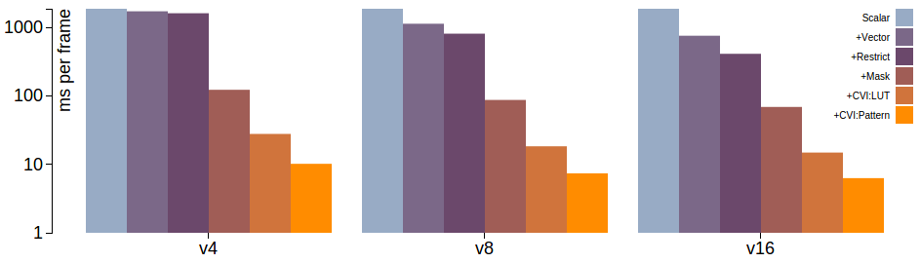
Results
Purely Software
ARM A9
+Vector
+Restrict
+Mask
+CVI:Table
+CVI:Compare
~800 lines of VHDL
Notes:
A stepwise approach of vectorizing, then adding targeted instructions minimizes and focuses RTL development.
Our final solution achieves 200x over ARM A9 processor.

Slide 41
Conclusions
Machine learning: Adaboost features
  Weak classifiers, easy to compute
  Performance critical, early termination
FPGA advantage: Inference mode
  Embedded / real-time / power constraints
  Reduced precision, cost
Vector processor: Software methodology
  Software-style debug
  Algorithm changes: Haar vs LBP, restricted cell sizes, masked
  Minimal hardware for custom instructions
  248x performance, 45x performance-per-area
Notes:
Our solution

Slide 42
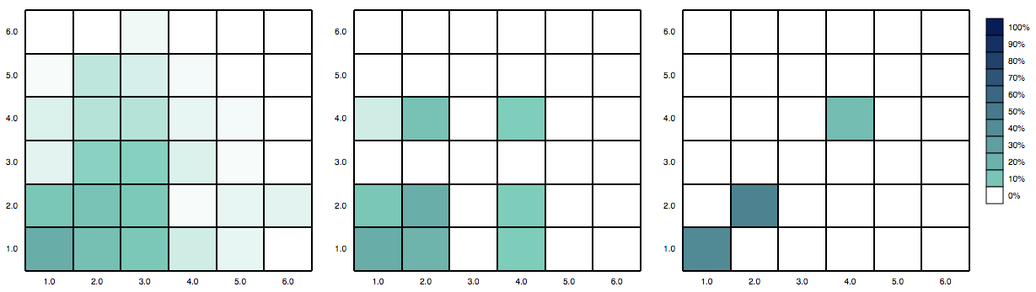
Histogram of
Cell Size (H x W)
6
6
6
5
5
5
4
4
4
3
3
3
2
2
2
1
1
1
1 2 3 4 5 6
1 2 3 4 5 6
1 2 3 4 5 6
Unrestricted
(OpenCV)
Restricted
Power of 2
Restricted
Square
Reduced Computation

Slide 43
Contributions
Using a hybrid software/hardware approach to achieve hardware level performance.
Using an ILP formulation for stage quantization.
Notes:
Our main contributions are
-using a hybrid software/hardware approach to achieve hardware level performance (which minimizes RTL design)
-using a novel ILP formulation for quantizing stages, (which using a minimal number of bits)
I will be presenting our approach.
- discuss the ML algorithm we accelerate.
- discuss our system and steps we take to accelerate our baseline implementation.
- compare our results to previous work

Slide 44
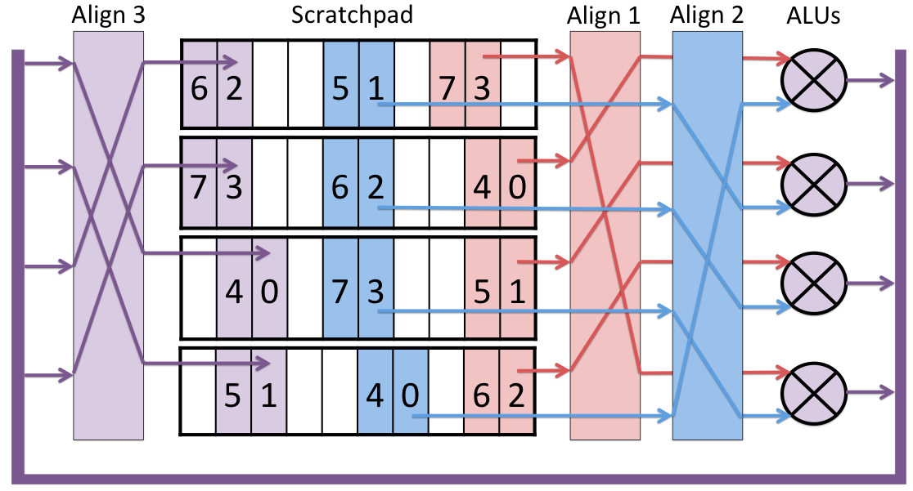
Scratchpad-based Computing
vbx_word_t *vdst, *vsrc1, *vsrc2;
vbx( VVW, VADD, vdst, vsrc1, vsrc2 );
Vector<vbx_word_t> vdst(100); vdst = vsrc1 + vsrc2;

Slide 45
Inside the MXP
Memory
(DDR3)
AXI/Avalon Fabric
ARM/Nios
I$
D$
Altera
AXI /
Custom Instr.
Slave
Master
DMA Engine
- Saturates DDR3
Vector Engine
- Integer and fixed-pt ALUs
- Scratchpad
VectorBlox MXP™ Matrix Processor
MXP™ DMA Engine
Instruction & DMA Queue
Vector-
Blox
MXP™ Vector Engine

Slide 46
How Does MXP Get
10x Speedup with just 1 ALU?
Example: FIR filter (double-nested loop)
1. Generic RISC code
2. Accelerated VectorBlox code
2cc: movi r6,0
2d0: add r5,r11,r8
2d4: mov r4,r6
2d8: add r1,r7,r4
2dc: ldw r3,(r5+0)
2e0: ldw r2,(r1+0)
2e4: addi r4,r4,4
2e8: addi r5,r5,4
2ec: mul r2,r2,r3
2f0: add r6,r6,r2
2f4: bne r4,r9,2d8 <fir+0x30>
2f8: add r1,r10,r8
2fc: stw (r1+0),r6
300: addi r8,r8,4
304: bne r8,r12,2cc <fir+0x24>
2cc: ldw r2,(r4+36)
2d0: ldw r3,(r4+32)
2d4: sub r3,r3,r2
2d8: mov r4,r2
2dc: v1set r4
2e0: mov r4,r3
2e4: movi r5,4
2e8: mov r6,r5
2ec: mov r7,r0
2f0: v2setdst r4,r5
2f4: v2setsrc r5,r6
2f8: v2mac r8,r9,r10
Nested-
loop
set-up
code
Advantage:
Double-nested loop is 1 instruction
Overhead:
2 ldw instructions (+ cache miss delays)
2 addi instructions (addr generation)
Mul+add (could be 1 instruction)
Branch (+ any misprediction penalty)

Slide 47
Custom Instruction Example:
Deeply Pipelined Computation
User-Defined Custom Instruction
15 Operators
75 Clock Cycles Deep
~ 10,000x speedup over Nios

Slide 48
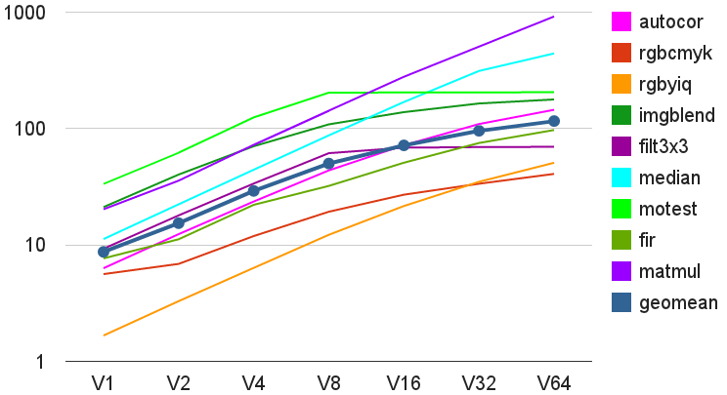


MicroBenchmarks
Speedup
(factor)
Application
Kernels
VectorBlox MXP CPU Size

Slide 49
Machine Learning
Learning (done once)
  More compute intensive
  Offline, not speed critical
  Higher precision
Inference (continuous)
  Less compute intensive
  Online, embedded / real-time / memory constraints
  Reduced precision
  Cost sensitive
Notes:
There are also two modes for a given machine learning algorithm
The learning phase, where we train our solution, and Inference, where we run our trained model.
The Learing phase is often done in large batches over a large training set.
Here precision is important as we weighting different features, or computing gradients.
Typically, a given model only needs to be trained once, so it is often not as performance critical or cost sensitive
Inference is more typically associated with real-time embedded constraints,
where power and cost matters, as the model may be deployed many times over.
Our solution implements the latter.

