Slide 1
Pre-Equalization for DS-UWB Systems
with Spectral Mask Constraints
Amir-Hamed Mohsenian-Rad, Jan Mietzner,
Robert Schober, and Vincent W.S. Wong
University of British Columbia
Vancouver, BC, Canada
{hamed, rschober, vincentw}@ece.ubc.ca
jan.mietzner@ieee.org
ICC’10, Cape Town, South Africa
May 2010

Slide 2
Introduction
Ultra-Wideband (UWB)
Emerging spectral underlay technology for high-rate short-range transmission (e.g., WPANs)
Extremely large bandwidth (typically > 500 MHz)
Interference to incumbent wireless services usually limited by tight constraints on transmitted power spectral density (PSD)

Slide 3
Introduction
Ultra-Wideband (UWB)
Emerging spectral underlay technology for high-rate short-range transmission (e.g., WPANs)
Extremely large bandwidth (typically > 500 MHz)
Interference to incumbent wireless services usually limited by tight constraints on transmitted power spectral density (PSD)
Pre-Rake Combining
Due to large bandwidth dense multipath components can be resolved using Rake combining → Fading mitigation
Typically large number of Rake fingers required to limit intersymbol interference (ISI) → Complex receiver
Exploiting UWB channel reciprocity complexity can be moved to more powerful transmitter → Pre-Rake combining

Slide 4
Introduction
Pre-Equalization
Due to long channel impulse responses (CIRs) in UWB pure pre-Rake combining entails high error floors
Performance can be improved by means of additional pre-equalization filter (PEF) → simple receiver feasible

Slide 5
Introduction
Pre-Equalization
Due to long channel impulse responses (CIRs) in UWB pure pre-Rake combining entails high error floors
Performance can be improved by means of additional pre-equalization filter (PEF) → simple receiver feasible
Spectral Mask Constraints
Existing papers include only constraints on overall transmit power but not on transmitted PSD
→ Large power back-offs required in practice to meet
imposed spectral masks (e.g., FCC)
→ Designs can be far from optimal
Our contribution: Novel optimization-based PEF design with explicit consideration of spectral mask constraints

Slide 6
Outline
System Model
Problem Formulation and Solution
Numerical Results
Conclusions

Slide 7
System Model: Direct Sequence UWB
zc[k]
a[n]
s[k]
f[n]
N
c[k]
g[k]
h[k]
Tx
o[k]
r[n]
^
N
c[N-1-k]
a[n-n0]
Rx
f[n]: PEF of Tx (length Lf) → Residual ISI mitigation (no equalizer!)
g[k]: Pre-Rake filter → Energy concentration & combining gains

Slide 8
System Model
Discrete-time received signal (after downsampling)
b[.] contains combined effects of
– Spreading (N , c[k]) – UWB CIR h[k]
– PEF f[n] – Despreading (N , c[N-1-k])
– Pre-Rake filter g[k]

Slide 9
System Model
Discrete-time received signal (after downsampling)
b[.] contains combined effects of
– Spreading (N , c[k]) – UWB CIR h[k]
– PEF f[n] – Despreading (N , c[N-1-k])
– Pre-Rake filter g[k]
Matrix-vector form

Slide 10
Outline
System Model
Problem Formulation and Solution
Numerical Results
Conclusions

Slide 11
Problem Formulation
PEF Design Aspects
– Obey spectral mask limitations to avoid power back-offs
– Focus CIR energy in single tap to avoid error floors
– Limit transmit power (e.g., due to hardware constraints)

Slide 12
Problem Formulation
PEF Design Aspects
– Obey spectral mask limitations to avoid power back-offs
– Focus CIR energy in single tap to avoid error floors
– Limit transmit power (e.g., due to hardware constraints)
Spectral Mask Constraints
– Imposed spectral mask m(Ω) (e.g. FCC: flat -41dBm/MHz)
– Spectral mask constraint for discrete frequency Ωμ:
(emissions usually measured with resolution bandwidth 1 MHz)

Slide 13
Problem Formulation
CIR Energy Concentration
– Rewrite received signal as three terms:
→ Maximize energy of desired tap while limiting ISI

Slide 14
Problem Formulation
CIR Energy Concentration
– Rewrite received signal as three terms:
→ Maximize energy of desired tap while limiting ISI
Transmit Power Constraint
– Maximum transmit power Pmax:

Slide 15
Solution of Optimization Problem
Final Problem Structure
→ Reformulate as real-valued problem:

Slide 16
Solution of Optimization Problem
Final Problem Structure
→ Reformulate as real-valued problem:
– Non-concave quadratic maximization problem
→ standard gradient-based methods cannot be used
– Many non-linear constraints → closed-form solution not feasible
– Main difficulty: Rank constraint

Slide 17
Solution of Optimization Problem
Relaxed Problem Structure
→ Reformulate as real-valued problem:
– Non-concave quadratic maximization problem
→ standard gradient-based methods cannot be used
– Many non-linear constraints → closed-form solution not feasible
– Main difficulty: Rank constraint → Idea: Relax problem!

Slide 18
Solution of Optimization Problem
PEF Design Algorithm
– Relaxed problem: Semi-definite programming (SDP) problem
→ Several efficient solvers (e.g., SeDuMi Toolbox)
– For PEF Design perform the following steps
(i) Solve SDP problem for optimum matrix W*
(ii) If rank(W*)=1 obtain optimum PEF vector f* via
eigenvalue decomposition (EVD) of W*
(iii) If rank(W*)>1 obtain near-optimum PEF vector f* via
random approach based on EVD of W*
– PEFs will meet spectral-mask constraints per design
→ No power back-offs required
– Optimality bound shows near-optimality of approach

Slide 19
Solution of Optimization Problem
PEF Design Algorithm
– Relaxed problem: Semi-definite programming (SDP) problem
→ Several efficient solvers (e.g., SeDuMi Toolbox)
– For PEF Design perform the following steps
(i) Solve SDP problem for optimum matrix W*
(ii) If rank(W*) = 1 obtain optimum PEF vector f* via
eigenvalue decomposition (EVD) of W*
(iii) If rank(W*) > 1 obtain near-optimum PEF vector f* via
random approach based on EVD of W*
– PEFs will meet spectral-mask constraints per design
→ No power back-offs required
– Optimality bound shows near-optimality of approach

Slide 20
Solution of Optimization Problem
PEF Design Algorithm
– Relaxed problem: Semi-definite programming (SDP) problem
→ Several efficient solvers (e.g., SeDuMi Toolbox)
– For PEF Design perform the following steps
(i) Solve SDP problem for optimum matrix W*
(ii) If rank(W*) = 1 obtain optimum PEF vector f* via
eigenvalue decomposition (EVD) of W*
(iii) If rank(W*) > 1 obtain near-optimum PEF vector f* via
random approach based on EVD of W*
– PEFs will meet spectral-mask constraints per design
→ No power back-offs required
– Optimality bound shows near-optimality of approach

Slide 21
Outline
System Model
Problem Formulation and Solution
Numerical Results
Conclusions

Slide 22
Numerical Results
Simulation Parameters
– System bandwidth 1 GHz
– Flat spectral mask (K=1001 constraints)
– PEF length Lf = 10, spreading factor N = 6
– IEEE 802.15.3a channel model CM1 for UWB
Comparison of proposed PEF design with
– pure pre-Rake combining (incl. power back-offs)
– Minimum-mean-squared-error (MMSE) PEF design
with average transmit power constraint
→ Both schemes require power back-offs to meet spectral mask

Slide 23
Numerical Results
Simulation Parameters
– System bandwidth 1 GHz
– Flat spectral mask (K=1001 constraints)
– PEF length Lf = 10, spreading factor N = 6
– IEEE 802.15.3a channel model CM1 for UWB
Comparison of Proposed PEF Design with
– pure pre-Rake combining
– Minimum-mean-squared-error (MMSE) PEF design
with average transmit power constraint
→ Both schemes require power back-offs to meet spectral mask

Slide 24
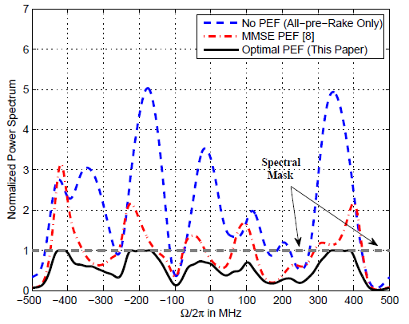
Numerical Results
Transmitted PSD
before applying
power back-off
→ PSD of optimal PEF scheme less peaky & closer to spectral mask

Slide 25
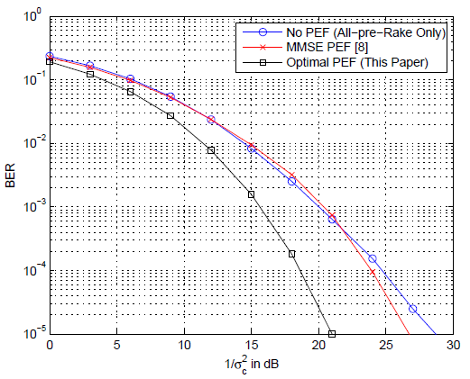
Numerical Results
Bit-Error-Rate (BER) Performance
Optimal PEF scheme outperforms other schemes significantly

Slide 26
Conclusions
 Proposed novel optimization-based PEF design for
DS-UWB systems with pre-Rake combining
 Explicit consideration of UWB spectral mask constraints and
avoidance of inefficient power back-offs
 Significant performance gains over existing PEF schemes
✗ Complexity reduction possible by including only subset of spectral mask constraints without degrading performance (not in the paper)

