Slide 1
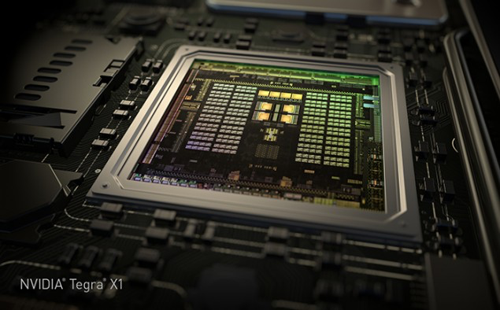
EECE 571T: Compute Accelerator Architectures
Spring 2019
Slide Set #4: GPGPU-Sim
/
Instructor: Dr. Tor M. Aamodt
aamodt@ece.ubc.ca
NVIDIA Tegra X1 die photo

Slide 2
Reading for next week
Wang, et al., Dynamic thread block
launch: A lightweight execution mechanism to support irregular applications on GPUs.
ISCA 2016.
Power, et al. Heterogeneous system coherence for integrated CPU-GPU systems. MICRO 2013.

Slide 3
Learning Objectives
After this lecture you should be able to:
  Explain the difference between timing and functional simulation.
  Explain how timing simulators are used in computer architecture research.
  Describe the steps involved in installing GPGPU-Sim and running a CUDA enabled application on it.
  Describe the software architecture of GPGPU-Sim

Slide 4
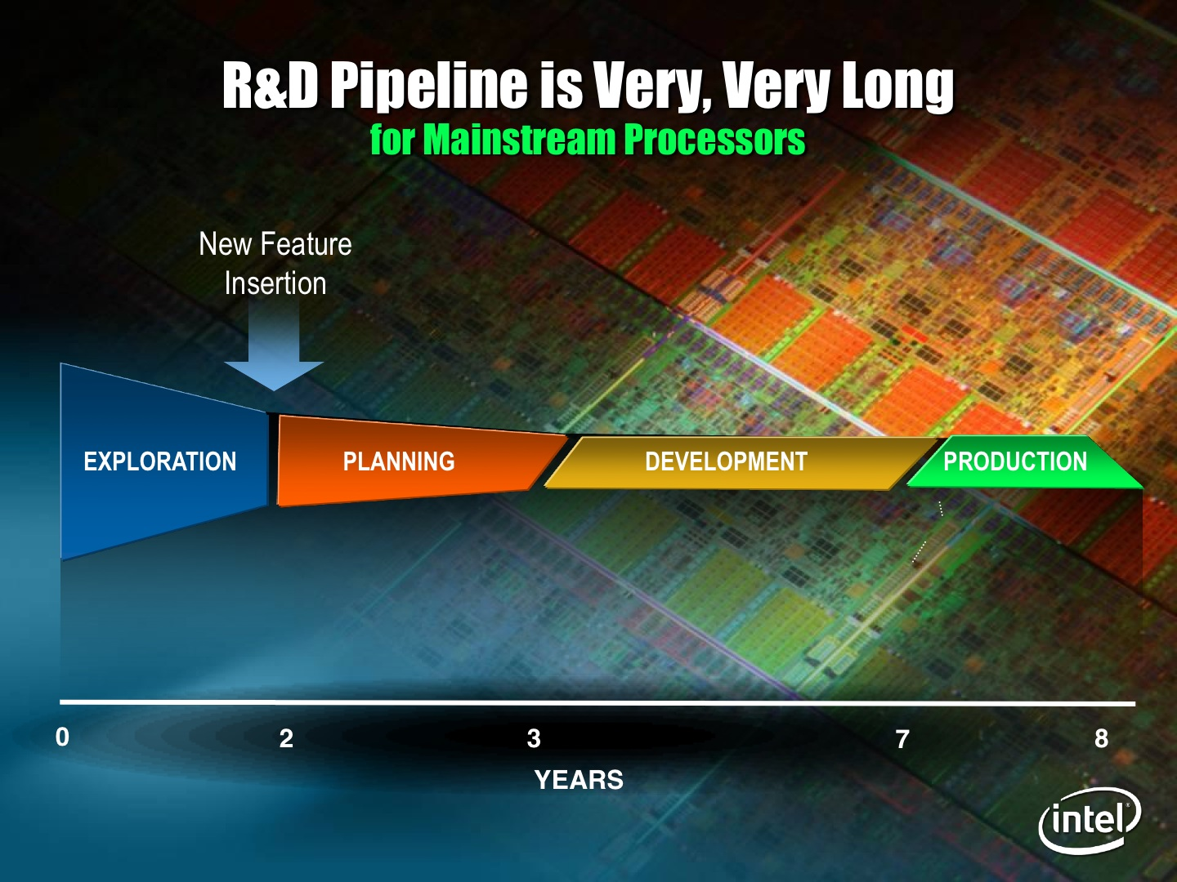
Why use “C++” to model hardware?
Hardware description
language (VHDL, Verilog,
iHDL), and/or full custom
design here.
C (or C++)
performance
models used
here
Two tasks involved in bringing a new design to market:
  Proposing an architecture
  Implementing that architecture
Two ways to do first task:
  Reason about performance (perhaps using analytical models; e.g., processor performance equation).
  Simulate design proposals to find ideas that work best
Today, companies that build high performance processors do #2
Challenge: How to quickly yet accurately make major design decisions for a chip with 20 billion transistors?

Slide 5
Key to easy simulation: ISA boundary
Applications
Operating
System
Compiler
Firmware
Instruction Set
Architecture (ISA)
Instr. Set Proc.
I/O system
Microarchitecture
Digital Design
Circuit Design
Layout & fab
Semiconductor Materials
Coordination of many levels of abstraction
Under a rapidly changing set of forces
Design, Measurement, and Evaluation
Notes:
5

Slide 6
Recall: Fundamental Execution Cycle
Memory
Instruction
Fetch
Obtain instruction from program storage
Processor
program
Instruction
Decode
Determine required actions and instruction size
regs
F.U.s
Data
Operand
Fetch
Locate and obtain operand data
Execute
Compute result value or status
von Neuman Architecture
(stored program computer)
Result
Store
Deposit results in storage for later use
Next
Instruction
Determine successor instruction
NOTE: Defines ISA. Simple to model. No timing considerations.

Slide 7
Functional Simulation
The heart of most architecture simulators.
Emulates the instruction set architecture (ISA) without any consideration of timing.
Might seem easy, but modern ISAs can be very complex and tracking down bugs in a functional simulator is very difficult (millions of instructions may execute before bug symptom appears).
Functional simulators often used for validating software before hardware exists (when introducing new ISA). Also heart of emulators for cross plaform development (e.g., iPhone, Android)

Slide 8
Recall: Measurement and Evaluation
Architecture design is an iterative process
-- searching the space of possible designs
-- at all levels of computer systems
Design
Analysis
Creativity
Cost /
Performance
Analysis
Good Ideas
Mediocre Ideas
Bad Ideas
Notes:
8

Slide 9
Performance Simulation
Architects in industry and academia model their ideas using C/C++ simulators that model the timing of instruction execution. These are called performance simulators.
Purpose of simulator is to weed out bad ideas and refine good ideas before committing to design at the circuit level.
A performance simulator does NOT simulate every detail of the hardware. Only consider details that affect number of clock cycles. Even then, might use simpler models to reduce complexity of simulator (i.e., lines of code).
Design
Analysis

Slide 10
What is a “Performance Simulator”?
  Functional simulator + event based timing simulation.
  Measures total cycles it takes to run a benchmark.
  Does not measure clock frequency or area
Functional simulator tells timing model the next instruction, (correct) next PC, dependencies.
Event timing model “asks” functional simulator for next instruction to execute on “correct path”
program input
Benchmark Program
(e.g., written in CUDA)
Functional
Simulation
Event Timing Model
(Microarchitecture)
Basic statistics (uarch indepdent)
- # of branch instructions
# of load instructions
# of ALU operations
Microarchitecture statistics:
# of cycles
# of stalls
# of cache misses
SIMD utilization
Normal output from
CUDA program when
run on real GPU

Slide 11
Example: Simulate five stage pipeline
 | Clock Number
 | 1 | 2 | 3 | 4 | 5 | 6 | 7 | 8 | 9
LD R1,0(R2) | IF | ID | EX | MEM | WB
DSUB R4,R1,R5 |  | IF | stall | ID | EX | MEM | WB
AND R6,R8,R7 |  |  |  | IF | ID | EX | MEM | WB
OR R8,R2,R9 |  |  |  |  | IF | ID | EX | MEM | WB

Slide 12
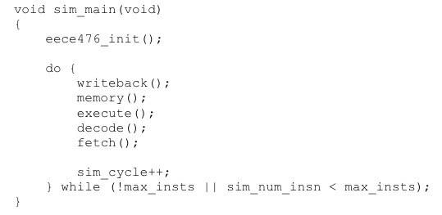
Simulator for five stage pipeline
(NOTE: this is not GPGPU-Sim)
inst_t *g_piperegister[PIPEDEPTH];
…
MEM/WB
EX/MEM
ID/EX
IF/ID
LD
NULL
DSUB
Simulate stages “backwards”!
Code for functional simulation is often entirely in “decode()”; sometimes “fetch()”.

Slide 13
GPGPU-Sim
http://www.gpgpu-sim.org

Slide 14
What GPGPU-Sim Simulates
Functional model for PTX/SASS
  PTX = Parallel Thread eXecution
    A scalar low-level, data-parallel virtual ISA defined by Nvidia
  SASS = Native ISA for Nvidia GPUs
  Not DirectX, Not shader model N, Not AMD’s ISA,
  Not x86, Not Larrabee. Only PTX or SASS.
  We are developing a simulator called Emerald that supports OpenGL and is based upon GPGPU-Sim: https://github.com/gem5-graphics
Timing model for the compute part of a GPU
  Not for CPU or PCIe
  Only model microarchitecture timing relevant to
  GPU compute
Power model for the compute parts
  Other parts idle when GPU is running compute kernels

Slide 15
Why should you learn about functional simulation?
GPGPU-Sim runs many existing GPU workloads:
  “ISPASS 2009”
  RODINIA
  CUDA SDK
Functional features implemented on demand:
  When they are needed by an application that we are interested in studying
  If you find something missing, then add it!

Slide 16
Why should you learn about functional simulation?
As researchers, we are interested in enhancing GPUs for future workloads.
  Some of them will not work on GPGPU-Sim out-of-the-box.
At some point, you may need to extend the function simulator in GPGPU-Sim to run your research workloads.

Slide 17
Our Experience
Thread Block Compaction (HPCA 2011)
  Implemented low-level CUDA API for
  ray-tracing workload
  Allow GPU to access CPU memory space directly for VisBench
Hardware Transactional Memory for
GPU Architectures (MICRO 2011)
  Extended functional simulator to
  support transactions

Slide 18
Functional Model (PTX)
Low-level, data-parallel virtual machine by Nvidia
  Instruction level
  Unlimited registers
  Parallel threads running in blocks; barrier synchronization instruction
Scalar ISA
  SIMT execution model
Intermediate representation in CUDA tool chain:
G80
.cu
NVCC
GT200
PTX
ptxas
Fermi
.cl
OpenCL Drv
Kepler

Slide 19
Functional Model (PTX)
// some initialization code omitted
$Lt_0_6146:
bar.sync 0;
setp.le.s32 %p3, %r7, %r1;
@%p3 bra $Lt_0_6402;
ld.shared.f32 %f3, [%rd9+0];
add.s32 %r9, %r7, %r1;
cvt.s64.s32 %rd18, %r9;
mul.lo.u64 %rd19, %rd18, 4;
add.u64 %rd20, %rd6, %rd19;
ld.shared.f32 %f4, [%rd20+0];
setp.gt.f32 %p4, %f3, %f4;
@!%p4 bra $Lt_0_6914;
st.shared.f32 [%rd9+0], %f4;
$Lt_0_6914:
$Lt_0_6402:
shr.s32 %r10, %r7, 31;
mov.s32 %r11, 1;
and.b32 %r12, %r10, %r11;
add.s32 %r13, %r12, %r7;
shr.s32 %r7, %r13, 1;
mov.u32 %r14, 0;
setp.gt.s32 %p5, %r7, %r14;
@%p5 bra $Lt_0_6146;
for (int d = blockDim.x; d > 0; d /= 2)
{
__syncthreads();
if (tid < d) {
float f0 = shared[tid];
float f1 = shared[tid + d];
if (f1 < f0)
shared[tid] = f1;
}
}
Scalar PTX ISA
Scalar control flow (if-branch, for-loops)
Parallel Intrinsic (__syncthreads())
Register allocation not done in PTX
Notes:
Shown kernel code = Parallel Reduction in CUDA
19

Slide 20
Functional Model (PTX)
Low-level, data-parallel virtual machine by Nvidia
  Instruction level
  Unlimited registers
  Parallel threads running in blocks; barrier synchronization instruction
Scalar ISA
  SIMT execution model
Intermediate representation in CUDA tool chain:
Fermi
.cu
NVCC
Pascal
PTX
ptxas
Volta
.cl
OpenCL Drv
Turing

Slide 21
Functional Model (SASS)
SASS = Native ISA for Nvidia GPUs
  Better correlation with HW GPU
  “SASS” is what NVIDIA’s cuobjdump calls it – note some NVIDIA SM architects are unaware of this ☺
Scalar ISA
For simplicity GPGPU-Sim uses assembly syntax that can represent both SASS and PTX. Called PTXPlus.
SASS mapped 1:1 into PTXPlus instructions.
CUDA
Executable
cuobjdump
SASS
conversion
PTXPlus

Slide 22
When to use PTXPlus?
PTXPlus support is a bit dated right now (GT200 SASS). Functional correctness has been verified with shortened versions of Rodinia benchmarks extended by our group to include correctness checking code.
If you want to modify ISA then likely PTX is better option (NVIDIA now makes PTX front end available in LLVM and did so previously using Open64)
If mechanism you study is sensitive to instruction scheduling:
  ptxas reschedules instructions after converting PTX to SASS to increase computation-memory overlap.
  It also converts short branches into predicated instructions.
  In SASS (for Quadro FX 5800), shared memory and constant memory can be accessed directly as an operand of an instruction. Not necessarily true on later architectures.

Slide 23
Timing Model for
Compute Parts of a GPU
Gfx DRAM
GPGPU-Sim models timing for:
  SIMT Core (SM, SIMD Unit)
  Caches (Texture, Constant, …)
  Interconnection Network
  Memory Partition
  Graphics DRAM
It does NOT model timing for:
  CPU, PCIe
  Graphics Specific HW (Rasterizer, Clipping, Display… etc.)
GPU
Interconnect
Cache
Mem Part.
SIMT Cores
Gfx HW
PCIe
Raster…
CPU

Slide 24
Timing Model for
GPU Micro-architecture
GPGPU-Sim simulates the timing model of a GPU running each launched CUDA kernel.
  Reports # cycles spent running the kernels.
  Exclude any time spent on data transfer on PCIe bus.
  CPU may run concurrently with asynchronous kernel launches.
CPU
Async. Kernel Launch
GPU HW
GPGPU-Sim
Done
GPU HW
GPGPU-Sim
Blocking
Done
CPU
Sync. Kernel Launch
GPU HW
GPGPU-Sim
Done
CPU
Time

Slide 25
Timing Model for
GPU Micro-architecture
GPGPU-Sim is a detailed cycle-level simulator:
  Cycle-level model for each part of the microarchitecture
  Research focused
    Ignoring rare corner cases to reduce complexity
  CUDA manual provides some hints. NVIDIA IEEE Micro articles provide other hints. In most cases we can only guess at details. Guesses “informed” by studying patents and microbenchmarking.
GPGPU-Sim w/ SASS is ~0.98 correlated to the real HW.

Slide 26
New: Power Model GPUWattch
Estimate power consumed by the GPU according to the timing behavior
Ideal for evaluating fine-grained power management mechanisms
Validated with power measurements from a real GTX 480
uArch Activities
(Perf. Counters)
GPGPU-Sim
Timing Model
GPUWattch
Power Model
(McPAT++)
Power Estimation

Slide 27
Interfacing GPGPU-Sim to Applications
GPGPU-Sim compiles into a shared runtime library and implements the API:
  libcudart.so ← CUDA runtime API
  libOpenCL.so ← OpenCL API
Static Linking no longer supported.
Modify your LD_LIBRARY_PATH to run your CUDA app on GPGPU-Sim (See Manual)
  Need a config file (gpgpusim.config), an interconnection config file and a McPAT config as well
We provide the config files for modeling:
Quadro FX 5800 (GT200)
Geforce GTX 480 and Tesla C2050 (Fermi)

Slide 28
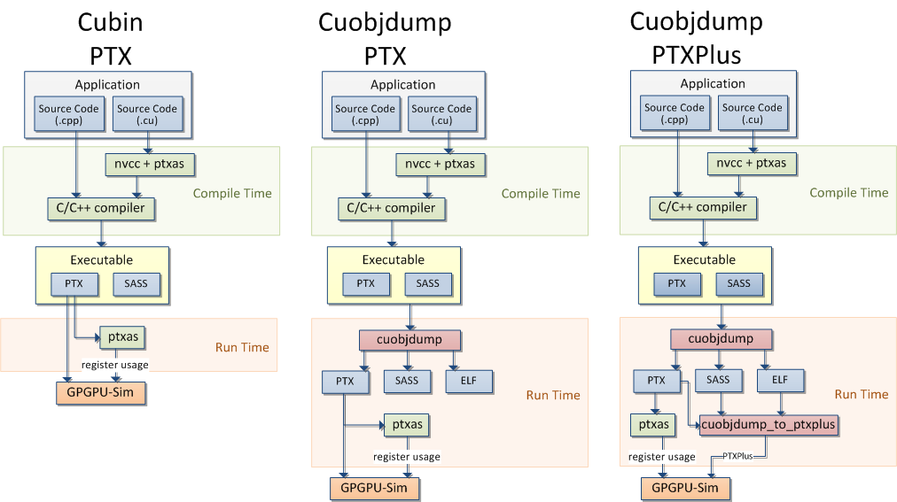
GPGPU-Sim Runtime Flow
CUDA 3.1
CUDA 4.0 and Later

Slide 29
Debugging and Visualization
GPGPU-Sim provides tools to debug and visualize simulated GPU behavior.
  GDB macros:
  Cycle-level debugging
  AerialVision:
  High-level performance dynamics
Notes:
Microarchitecture simulator strength: Visibility ← Allow deep understanding of performance

Slide 30
Building GPGPU-Sim
Get GPGPU-Sim:
  $ git clone https://github.com/gpgpu-sim/gpgpu-sim_distribution.git
  $ cd gpgpu-sim_distribution
  $ git checkout dev
Configure your environment:
  Setup CUDA_INSTALL_PATH
  $ source setup_environment release
Compile:
  make

Slide 31
Running GPGPU-Sim
Copy config_fermi_islip.icnt gpgpusim.config gpuwattch_gtx480.xml from configs/tested-cfgs/SM2_GTX480 to the directory containing your CUDA or OpenCL application binary. Note, other models do not have GPUWattch support (yet)… working on this “now” with researchers from Northwestern and Purdue.
Configure environment (if new terminal)
  source setup_environment
Run the benchmark!!

Slide 32
GPGPU-Sim Internals

Slide 33
Modules Overview
PTX Emulator
(CUDA-Sim)
CUDA/OpenCL
API Library
Interface
GPGPU-Sim
Entrypoint
Abstract
HW Model
Timing
Model
Power
Model:
GPUWattch
CUDA/OpenCL API library interface
PTX instruction set emulator
Timing model
Power model
Notes:
33

Slide 34
Interface to CUDA/OpenCL
API Interface
How GPGPU-Sim starts
PTX Loading / Parsing
Stream Manager

Slide 35
Interface to CUDA/OpenCL
CUDA and OpenCL applications:
  Include code that runs on the host (CPU)
  Use an API to communicate with GPU
  API is defined in various header files
  Implementation in shared library
GPGPU-Sim:
  Runs host code on CPU
  Functionally emulates API
  I.e., if you run GPGPU-Sim on a Core i7 machine, the host code runs natively on your Core i7 processor (is not simulated as part of timing model)
Modeling CPU+GPU?
  A few years ago researchers at Wisconsin integrated GPGPU-Sim with Gem5 (a CPU simulator)… gem5-gpu.
  Also, AMD Research now has an open source simulator that models their APUs (so far I’m told it is hard to use, but they are setting up some sort of container to make it easier to use out of the box).

Slide 36
Interface to CUDA/OpenCL API
We implement versions of OpenCL / CUDA interface calls in a new DLL.
Adjust LD_LIBRARY_PATH and CUDA/OpenCL application runs on simulator rather than GPU hardware.
Given our research focus, we have implemented only what was required to get applications we were interested in running.
CUDA
Runtime Library
CUDA
Application
libcudart.so
GPGPU-Sim

Slide 37
Interface to CUDA API
Example of interface code between host and simulator. This is the code that actually starts running the functional and timing models. Call to cudaLaunch is generated by nvcc from “<<<>>>” notation.
__host__ cudaError_t CUDARTAPI cudaLaunch( const char *hostFun )
{
CUctx_st* context = GPGPUSim_Context();
char *mode = getenv("PTX_SIM_MODE_FUNC");
if( mode )
sscanf(mode,"%u", &g_ptx_sim_mode);
gpgpusim_ptx_assert( !g_cuda_launch_stack.empty(), "empty launch stack" );
kernel_config config = g_cuda_launch_stack.back();
struct CUstream_st *stream = config.get_stream();
printf("\nGPGPU-Sim PTX: cudaLaunch for 0x%p (mode=%s) on stream %u\n", ... );
kernel_info_t *grid = gpgpu_cuda_ptx_sim_init_grid(hostFun,config.get_args(),
config.grid_dim(),
config.block_dim(),context);
std::string kname = grid->name();
dim3 gridDim = config.grid_dim();
dim3 blockDim = config.block_dim();
printf("GPGPU-Sim PTX: pushing kernel \'%s\' to stream %u, ... );
stream_operation op(grid,g_ptx_sim_mode,stream);
g_stream_manager->push(op);
g_cuda_launch_stack.pop_back();
return g_last_cudaError = cudaSuccess;
}

Slide 38
GPGPU-Sim Startup Details
Some CUDA code called before main() during initialization of global variables. __cudaRegisterFunction, __cudaRegisterVar
These provide information about device code
(and how to call it).
First call to any CUDA API function triggers
simulator initialization (gpgpu_ptx_sim_init_perf()).
  Read environment variables (debug info, sim mode)
  Parse option files
  Initialize GPU uArch Model, Stream Manager
First call to __cudaRegisterFatBinary()
  Load/parse PTX kernels, determine post-dominators

Slide 39
Loading PTX
CUDA 3.1: Fatbin
  Overload __cudaRegisterFatBinary() to extract PTX from executable
CUDA 4.0 and later: cuobjdump
  Call cuobjdump to obtain PTX/SASS
  Executable must be compiled with
  CUDA 4.0 or later
Multiple versions of kernel PTX
  Default: Use PTX with highest SM version
This past summer: Changed some of the lower level details… now dump out all PTX sections in separate files (for supporting cuDNN).

Slide 40
PTX Parsing,
Post-Dominator Detection
GPGPU-Sim has a flex+bison parser to read in PTX
  Default: Read PTX text embedded within binary
Same parser is used for SASS (PTXPlus)
Why flex+bison? Flexibility.
  When NVIDIA updates their PTX syntax,
  we can update our parser quite easily.
Post-dominators
  Handle warp divergence in simulation
  Determined with standard control flow analysis

Slide 41
Parsing PTX
Next two slides illustrate snippets of code from lexer and parser

Slide 42
cuda-sim/ptx.l – find tokens
abs TC; ptx_lval.int_value = ABS_OP; return OPCODE;
add TC; ptx_lval.int_value = ADD_OP; return OPCODE;
and TC; ptx_lval.int_value = AND_OP; return OPCODE;
…
\.align TC; return ALIGN_DIRECTIVE;
\.byte TC; return BYTE_DIRECTIVE;
\.const\[[0-9]+\] TC; return CONST_DIRECTIVE;
…
"%tid" TC; ptx_lval.int_value = TID_ID; return SPECIAL_REGISTER;
…
\.u32 TC; return U32_TYPE;
\.u64 TC; return U64_TYPE;
\.f16 TC; return F16_TYPE;
\.f32 TC; return F32_TYPE;
…
\.equ TC; return EQU_OPTION;
\.neu TC; return NEU_OPTION;
\.ltu TC; return LTU_OPTION;
…
"]" TC; return RIGHT_SQUARE_BRACKET;
"<" TC; return LEFT_ANGLE_BRACKET;
">" TC; return RIGHT_ANGLE_BRACKET;
"(" TC; return LEFT_PAREN;
…

Slide 43
cuda-sim/ptx.y – read instructions
…
%token <string_value> STRING
%token <int_value> OPCODE
%token ALIGN_DIRECTIVE
%token BYTE_DIRECTIVE
…
%%
input: /* empty */
| input directive_statement
| input function_defn
| input function_decl
;
…
instruction: opcode_spec LEFT_PAREN operand RIGHT_PAREN { set_return(); } COMMA operand COMMA LEFT_PAREN operand_list RIGHT_PAREN
| opcode_spec operand COMMA LEFT_PAREN operand_list RIGHT_PAREN
| opcode_spec operand_list
| opcode_spec
;
…

Slide 44
Stream Manager + Abstract GPU
Host CPU
GPGPU-Sim Thread
  gpgpu_sim_thread_concurrent()
  do {
  Wait for streamOp;
  do {
  Obtain streamOp;
  Perform streamOp;
  gpu->cycle();
  active = gpu->active() or
  streamMgr->empty();
  if (gpu->finished_kernel())
  gpu->print_stats();
  } while (active);
  } while (!gpu_done);
CUDA
API
Stream 0
Sync
CUDA
Memcpy
Kernel
Launch
GPGPU-Sim Thread

Slide 45
Functional Simulator
Key Objects in Module
Three main aspects
  How are threads simulated?
  How are instructions simulated?
  How are values communicated between threads?
Memory Space Buffer
Pure Functional Simulator

Slide 46
Inside Functional Simulation:
Key Objects
gpgpu_t
core_t
SIMT Stacks
kernel_info
ptx_cta_info
ptx_thread_info
ptx_thread_info
ptx_thread_info
Grid/Block Dim
Barrier
Thread IDs
Registers
Program Counters
Call stack
Launch Status
Shared Memory
Param Memory
Local Memory
function_info
PC(0x0)
ptx_instruction
Symbol Table
Global Memory
PC(0x8)
ptx_instruction
Control Flow
Analysis
GPU Memory
Management
PC(0x10)
ptx_instruction

Slide 47
How are threads simulated
(functionally)?
Thread = program counter +
set of registers +
set of local memory locations
CTA (block) = set of threads with access to a shared memory + barrier
Expose notion of “warp” in functional simulator
Supports undocumented barrier behavior
Notes:
Subtle consequence of exposing warp in functional simulator:
- Has to support for warp divergence as well

Slide 48
How are instructions simulated (functionally)?
Code for simulating instructions in
cuda-sim/instruction.cc
  1:1 mapping opcode → implementation function
  Mapping in opcode.def
Threads initialized during launching of blocks.
Functional execution at issue stage of timing pipeline:
  Calls ptx_thread_info::ptx_exec_inst()
  Inside: “giant switch statement” simulation approach (emulation)
Lookup instruction “object” corresponding to program counter
  PTX: Assume 8-byte per instruction

Slide 49
How are values communicated between threads?
Threads can communicate through
  Global memory
  Shared memory
We simulate all instructions as they reach
issue stage of pipeline
  This includes loads and stores that access memory.
  Except for atomics: We simulate them functionally once atomic operation exits the memory partition in timing model.
    atom_impl() calculates effective memory address and setups callback function
Most CUDA code avoids intra-kernel communication through global memory
  Relaxed memory ordering

Slide 50
Memory Space Buffer
Functionally implements various
memory spaces
  Map of memory address → pages
  Each memory space buffer may contain
  arbitrary number # pages
Global, texture, constant memory spaces share the same buffer
Each block has a shared memory buffer
Each thread has a local memory buffer
Implementation in cuda-sim/memory.[h,cc]

Slide 51
Pure Functional Simulator
Great for:
  Profiling application behavior
  Prototyping new instructions
Mostly contained in a single class: functionalCoreSim
Execute one thread block at a time
  Execute warps in round-robin

Slide 52
GPGPU-Sim: Timing Model

Slide 53
Abstract HW Model
Interface between functional simulation and timing simulation
Abstract Model
Timing Model
gpgpu_t
gpgpu_sim
core_t
shader_core_ctx
ptx_instruction_t
warp_inst_t
inst_t

Slide 54
Microarchitecture Model (Revisitied)
GPU
SIMT Core Cluster
SIMT Core Cluster
SIMT Core Cluster
SIMT
Core
SIMT
Core
SIMT
Core
SIMT
Core
SIMT
Core
SIMT
Core
Interconnection Network
Memory
Partition
Memory
Partition
Memory
Partition
GDDR3/GDDR5
GDDR3/GDDR5
Off-chip DRAM
GDDR3/GDDR5

Slide 55
Timing Model
(Software Overview)
gpgpu_sim
simt_core_cluster
simt_core_cluster
simt_core_cluster
shader_core_ctx
shader_core_ctx
shader_core_ctx
shader_core_ctx
shader_core_ctx
shader_core_ctx
Interconnection Network (intersim)
memory_partition_unit
memory_partition_unit
memory_partition_unit
GDDR3/GDDR5
GDDR3/GDDR5
Off-chip DRAM
GDDR3/GDDR5

Slide 56
Timing Model: gpgpu_sim
Top Level Object
A virtual GPU with timing model
  Contains all components for timing simulation
Specific responsibilities:
  Initialization
  Kernel Launch
  Clock Domain
  Main Simulation Loop
Implemented in gpgpu-sim/gpu-sim.[h,cc]

Slide 57
Timing Model:
Initialization
gpgpu_sim::gpgpu_sim()
  Allocate and initialize microarchitecture model and statistic collection structures
  Called in gpgpu_ptx_sim_init_perf()
    At the first CUDA API call
  Only one global instance: g_the_gpu

Slide 58
Timing Model:
Main Simulation Loop
do {
Wait for streamOp;
do {
Obtain streamOp;
if (streamOp == Launch)
gpu->launch();
gpu->cycle();
active = gpu->active() or
streamMgr->empty();
if (gpu->finished_kernel())
gpu->print_stats();
} while (active);
} while (!gpu_done);
Push a kernel into
GPU launch queue
Simulate a cycle
in GPU
Probe GPU Activity:
Running a kernel
Accessing memory
General Stats Log
Notes:
Recall the GPGPU-Sim thread we showed you earlier? Here is now the gpgpu_sim class interfaces with it.

Slide 59
Clock domains
Simulate independent clock domains for
  SIMT cores
    GT200: Set to ¼ of shader clock to compensate for using SIMD width of 32 instead of 8
    Fermi: Set to ½ of shader clock to compensate for using SIMD width of 32 instead of 16
  Interconnection network
  L2 cache (if enabled)
  DRAM
    This is real clock (command clock)
    Effective clock is 2x this clock due to DDR
Notes:
59

Slide 60
Clock Domain Crossing
We simulate send and receive buffers at clock crossing boundaries
The buffers are filled and drained in different clock domains
E.g. consider the buffer from interconnect to memory partition
  Filled at interconnect clock rate
  Drained at DRAM clock rate

Slide 61
Timing Model:
Main Simulation Loop
Inside gpgpu_sim::cycle():
  Check all clock domains
    if (clock_mask & CORE) { … }
  Execute the ones that are ready
  Currently, 4 domains:
    CORE – SIMT Core + Thread Block Issue
    ICNT – Interconnection Network
    DRAM – DRAM + Request Scheduler
    L2 – L2 Cache in Memory Partition

Slide 62
Timing Model:
Thread Block Issue
gpgpu_sim::issue_block2core():
  Issue new thread blocks to core
    Limit calculated with shader_core_config::max_cta()
  Initializes the threads inside the new blocks
    Calls interface to functional model: ptx_sim_init_thread()
  Hierarchical Block Distribution
    Top Level → SIMT Core Clusters → SIMT Cores
Cluster 0
Cluster 1
Cluster 2
B0
B3
B6
B1
B4
B2
B5
SC 0
SC 1
SC 2
SC 3
SC 4
SC 5

Slide 63
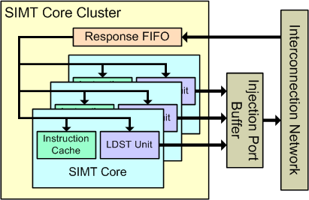
Timing Model: simt_core_cluster
Collection of SIMT cores
  core_cycle(): simulation a cycle in each core
Interface them with interconnect
icnt_cycle()
icnt_inject_request_packet()
shader_memory_interface

Slide 64
Timing Model:
SIMT Core
Class shader_core_ctx in
gpgpu-sim/shader.[h,cc]
  Derived from core_t
  Contains the state of a SIMT Core
Major components in separate classes
  scheduler_unit
  scoreboard
  opndcoll_rfu_t (Operand Collector)
  simd_function_unit
  ldst_unit (Memory Unit)

Slide 65
Timing Model:
SIMT Core
shader_core_ctx::cycle()
fetch()
decode()
issue()
read_operand()
execute()
writeback()
Branch Target PC
Fetch
SIMT-Stack
ALU
Valid[1:N]
Active
ALU
I-Buffer
Pred.
ALU
Mask
ALU
I-Cache
Decode
Issue
Operand
Collector
Score
MEM
Board
Done (WID)
Call Order (Order of Stall Propagation)
Notes:
The components are organized into stages.
The reverse order calling is a classic trick used by other cycle-level simulators as well.

Slide 66
Timing Model:
Pipeline Connection
shd_warp_t
Timing state of a warp
I-Buffer Entry for each warp
shd_warp_t
Timing state of a warp
I-Buffer Entry for each warp
core_t
shd_warp_t
Timing state of a warp
I-Buffer Entries for warp
SIMT Stack
SIMT Stack
SIMT Stack
warp_inst_t
v
ptx_thread_info
warp_inst_t
v
ptx_thread_info
warp_inst_t
v
ptx_thread_info
ptx_thread_info
ptx_thread_info
Branch Target PC
Fetch
SIMT-Stack
ALU
Valid[1:N]
Active
ALU
I-Buffer
Pred.
ALU
Mask
ALU
I-Cache
Decode
Issue
Operand
Collector
Score
MEM
Board
Done (WID)
ifetch_buffer_t
warp_inst_t
(grouped in register_set)

Slide 67
Timing Model:
Warp Instruction
warp_inst_t
A dynamic “SIMD” instruction executed by a warp
Pipeline Register
Implements access coalescing logic
  Groups individual accesses from threads into wider/bank-conflict-free accesses
  Per-thread info → mem_access_t
  See warp_inst_t::generate_mem_accesses()
warp_inst_t
active mask
per_thread_info
  dram_callback_t
access_q
inst_t
Static Info
ptx_instruction
Func Exec

Slide 68
Timing Model:
Memory Access
mem_access_t
Coalesced memory access from a warp
Consumed in ldst_unit
mem_fetch
Memory request structure that is passed to the cache model and modules in the memory sub-system.
Has a copy of the warp_inst_t + mem_access_t that created the request
  No need for tracker inside SIMT Core
  Access to atom_callback via warp_inst_t
Generated in ldst_unit::cycle()
Destroyed in ldst_unit::writeback() for reads and inside memory_partition_unit for writes
SIMT Core
Mem Unit
Writeback
warp_inst_t
mem_access_t
mem_fetch
Cache
mem_fetch
mem_fetch
Memory Subsystem:
Interconnect
L2
DRAM

Slide 69
Timing Model:
Fetch Stage
Checks for warps that completed execution
  Release resource
Selected a warp via m_last_warp_fetched and access I-cache
  Hit: Send to decode stage
  Miss: Send instruction fetch request off core, try again after I-cache is filled

Slide 70
Timing Model:
Decode Stage
Obtain instruction (warp_inst_t) from functional simulator
  Calls ptx_fetch_inst(pc)
Push into I-Buffer of the corresponding warp
  Calls shd_warp_t::ibuffer_fill()
  Can push up to 2 instructions per-cycle
Notes:
ptx_fetch_inst(pc) returns a pointer to ptx_instruction. which is cast into warp_inst_t*.

Slide 71
Timing Model:
Issue Stage
Calls scheduler_unit::cycle() for every instance of scheduler_unit
Calls shader_core_ctx::issue_warp() for each warp selected by the scheduler unit
  Perform functional execution:
  Calls func_exec_inst() → execute_warp_inst_t()
  Coalesce memory accesses and push them into m_access_q in warp_inst_t:
  Calls warp_inst_t::generate_mem_accesses()
  Update SIMT Stack for warp
  Lock output register(s) in scoreboard
  Send instruction to operand collector

Slide 72
Timing Model:
Scheduler Unit
scheduler_unit in gpgpu-sim/shader.[h,cc]
  add_supervised_warp_id()
  cycle()
Scheduler for a subset of warps
  Model dual scheduler in Fermi
Warp can be issued if:
  Valid instruction in I-Buffer
  Instruction does not read/write locked register (Scoreboard)
  Execution unit is available
W0
W1
W2
W3
W4
W6
...
...
Sched 0
Sched 1
Operand Collector

Slide 73
Timing Model:
Scoreboard
Scoreboard in gpgpu-sim/scoreboard.[h,cc]
reserveRegister(): Lock register for instruction
releaseRegister(): Unlock register
checkCollision():
Check if instruction accesses any locked register
See also:
Mishkin et al., “Write-after-Read Hazard Prevention in GPGPUsim”, WDDD 2016.

Slide 74
Timing Model:
SIMT Stack
simt_stack in abstraction_model.[h,cc]
  launch()
  get_active_mask()
  update()
Interaction with shader_core_ctx only in issue():
In scheduler_unit::cycle()
  Calls get_active_mask()
In shader_core_ctx::issue_warp() → core_t::updateSIMTStack()
  Calls update() after functional execution

Slide 75
Timing Model:
Register Read Stage
Scheduler Units
Scheduler Units
m_dispatch_port
[ID_OC_SP]
m_dispatch_port
[ID_OC_SFU]
m_dispatch_port
[ID_OC_MEM]
Operand Collector
(opndcoll_rfu_t m_operand_collector)
m_issue_port
[OC_EX_SP]
m_issue_port
[OC_EX_SFU]
m_issue_port
[OC_EX_MEM]
m_sp_unit
m_sfu_unit
m_ldst_unit

Slide 76
Timing Model:
Operand Collector
opndcoll_rfu_t in gpgpu-sim/shader.[h,cc]
Set of subclasses
Name | Description
arbiter_t | Arbitrate accesses to the register file banks
op_t | A read/write to a single register
allocation_t | Link op_t to an allocated access in arbiter_t
input_port_t | Input to operand collector
collector_unit_t | Collector Unit - One for each warp instruction
dispatch_unit_t | Dispatch a warp instruction with all operands fetched to the corresponding unit

Slide 77
Timing Model:
Operand Collector
opndcoll_rfu_t::step() ← Cycle function
For each input port, allocate_cu()
  Allocate a free collector unit for the warp instruction
  Push its register reads into queues in the arbiter unit
allocate_reads()
  Process reads that have no bank conflict
dispatch_ready_cu()
  Each dispatch unit selects a collector unit with fetched operands
  Sends its instruction to output port
opndcoll_rfu_t::writeback()
  Allocate bank for writes to registers
  (has priority over reads)

Slide 78
Timing Model:
Execution Stage
Calls cycle() for every functional unit
  ALU Units (SP, SFU)
  Memory Unit
Implements a result bus reservation system for groups of ALU units that shares a common writeback bus
  Prevent stalling inside the units

Slide 79
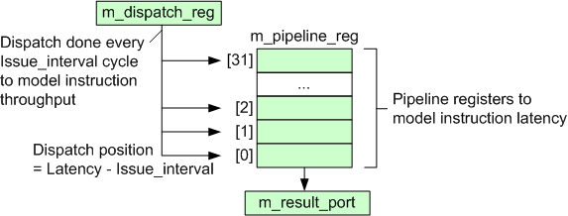
Timing Model:
ALU Pipeline
pipelined_simd_unit
SP unit and SFU unit
Instruction-dependent BW and Latency

Slide 80
Timing Model:
Memory Unit
ldst_unit
Instantiates and operates on all in-core memories
  Texture cache: m_L1T
  Constant cache: m_L1C
  Data cache: m_L1D
  Shared memory: m_pipeline_reg
Off-core interface: m_icnt
Mem_fetch allocator: m_mf_allocator
Operates at a clock_multipler() rate
  Model half-warps

Slide 81
Timing Model:
Memory Unit
ldst_unit::cycle()
Process memory responses from m_response_fifo
Service instruction at m_dispatch_reg
  One access (mem_access_t) / cycle
  Stall until every access in instruction’s m_access_q is processed
  shared_cycle()
  constant_cycle()
  texture_cycle()
  memory_cycle()
ldst_unit::writeback()
Writeback for one of the component (client)
  Optional: Fill caches
  Writeback data to register via operand collector
  Signal scoreboard to unlock register(s)
process_memory_access_queue()
Access cache
m_dispatch_reg
m_access_q:
mem_access_t
mem_access_t
mem_access_t

Slide 82
Timing Model:
Cache Models
See gpgpu-sim/gpu-cache.[h,cc]
Common Components:
tag_array: Cache Line States, Replacement
mshr_table: Queues of Pending Requests
No data array – Data is stored in functional simulator
Hierarchy of Models:
cache_t: General Interface
baseline_cache: Non-blocking cache with request served out-of-order
read_only_cache: Read accesses only
data_cache: Allow read and write accesses
l1_cache and l2_cache: Different Policies
texture_cache: Read accesses in FIFO
Each instance has a reference to a memory interface (m_memport) for cache requests/writebacks

Slide 83
Timing Model:
Cache Models
Common interface:
access(mem_fetch *mf)
  Probe the tag_array (no state change)
  New: Call event handler according to policy
    Read Hit
    Read Miss
    Write Hit
    Write Miss
cycle()
  Move mem_fetch from m_miss_queue to m_memport
fill()
  Update cache block status
  Mark entry in mshr_table as ready

Slide 84
Timing Model:
Cache Models
Handler | Action
rd_hit_base | Access the tag_array (Update LRU stack, line state)
rd_miss_base | Try to allocate resource to handle miss A cache line for replacement Entry in mshr_table Entry in m_miss_queue Fail to allocate → Return Resource Failure
wr_hit_wb | Mark line as modified
wr_hit_wt | Mark line as modified + Send write request
wr_hit_we | Evict line + Send write_request
wr_hit_global_we_local_wb | Global Memory Space: wr_hit_we Local Memory Space: wr_hit_wb
wr_miss_wa | Read missed line into cache + Mark line as modified
wr_miss_nowa | No Write-Allocate: Send write request

Slide 85
Timing Model:
Interfaces
SIMT Core
  mem_fetch_interface:
  Generic interface used by cache models
    full(unsigned int size, bool write)
    push(mem_fetch *mf)
  shader_memory_interface: To SIMT Core Cluster/Interconnection Network
  perfect_memory_interface: Direct loop back to model zero latency + infinite bandwidth

Slide 86
Interconnection Network Model
Intersim (Booksim) a flit level simulator
  Topologies (Mesh, Torus, Butterfly, …)
  Routing (Dimension Order, Adaptive, etc. )
  Flow Control (Virtual Channels, Credits)
We simulate two separate networks
  From SIMT cores to memory partitions
    Read Requests, Write Requests
  From memory partitions to SIMT cores
    Read Replies, Write Acks
Notes:
86

Slide 87
Topology Examples
Notes:
There are a diverse range of topologies that can be used to transfer memory requests in a many-core architecture.
In Nvidia’s GPUs, it looks something like a crossbar except multiple SIMT cores share input ports.
Intel’s Larrabee looks like a ring.
In our ISPASS paper we found that a mesh was viable as well.
87

Slide 88
Interconnection Network Config
Booksim has its own config file
  Topology (topology, k ,n )
  Virtual channels (num_vcs)
  Buffers per VC (vc_buf_size)
  Routing (routing _function)
  Speedups (input_speedup, internal_speedup)
  Allocators (vc_allocator, sw_allocator)
Specific to GPGPU-sim
  Channel Width (flit_size)
  Setting memory partition locations (use_map)
Notes:
88

Slide 89
Interconnect Injection Interfaces
SIMT Core
Router
1 Packet / Cycle
1 Flit / Cycle
Core Clock Domain
Interconnect Clock Domain
Clock Boundary

Slide 90
Interconnect Injection Interfaces
Memory Partition
Router
1 Packet / Cycle
1 Flit / Cycle
DRAM Clock Domain
Interconnect Clock Domain
Clock Boundary

Slide 91
Interconnect Injection Interfaces
L2 Cache
Router
1 Packet / Cycle
1 Flit / Cycle
L2 Clock Domain
Interconnect Clock Domain
Clock Boundary

Slide 92
Interconnect Ejection Interfaces
1 Ejection/boundary buffer per VC (1 flit / cycle)
A credit is sent back to router as a flit goes from ejection to boundary buffer
# of VCs
1 Packet / Cycle
(Round Robin)
1 Flit / Cycle
Ejection Buffers
Boundary Buffers
Router
SIMT
Core
1 Flit / Cycle
1 Credit / Cycle
Credit return buffer
Interconnect Clock Domain
Core Clock Domain
Clock Boundary
Notes:
We have one ejection buffer and one boundary buffer for each VC.
Why? If all VCs share the same set of buffers then the flits from different packet get mixed together so when
SIMT core tries to pop a packet per cycle and remove its corresponding flits from the buffer the flits are not together.
Also for each VC there is one ejection buffer and one boundary buffer. The reason for this is that we need to send a credit back to the router as a flit gets out of the ejection buffer. If we only had a single buffer then the interconnect would be forced to operate at Shader core domain since credits would be sent when the shader pops the packet. So to isolate the clock domains we have two buffers. In this design a credit is sent back to router as a flit goes from ejection to boundary buffer.
92

Slide 93
Timing Model:
Interfaces
Interconnection Network:
  icnt_has_buffer(): Check for input buffer space
  icnt_push(): Push packet into network
  icnt_pop(): Pop packet from network
  icnt_transfer(): Run network for a cycle

Slide 94
Timing Model:
Interfaces
Memory Partition (L2 + DRAM):
  full(): Queues in memory partition full?
  push(): Push request into memory partition
  pop(): Obtain info for completed request
  top(): Pop completed request
Flow Control
mem_req = m_mem_partition[x]->top();
if (icnt_has_buffer(mem_req.info)) {
icnt_push(mem_req);
m_mem_partition[x]->pop();
}

Slide 95
Timing Model:
Memory Partition
memory_partition_unit in gpgpu_sim/l2cache.[h,cc]
Memory Partition
Off-Chip DRAM Channel
L2→ICNT Queue
DRAM→L2 Queue
Atomic
Operation
Execution
L2
Cache
Bank
DRAM
Access
Scheduler
DRAM
Timing
Model
Interconnection Network
ICNT→L2 Queue
L2→DRAM Queue
DRAM Latency Queue
ROP Queue

Slide 96
Timing Model:
Memory Partition
Memory Partition
cache_cycle()
dram_cycle()
top()
pop()
Off-Chip DRAM Channel
m_L2_icnt_queue
m_dram_L2_queue
Atomic
Operation
Execution
m_L2cache
m_dram
m_dram
full()
push()
m_icnt_L2_queue
m_L2_dram_queue
m_dram_latency
_queue
m_rop

Slide 97
Timing Model:
Memory Partition
L2 Cache = data_cache
  The same model for L1
Atomic operation executed in pop()
  Calls mem_fetch::do_atomic()
  Calls atom_callback() for each thread
DRAM Access Schedule + Timing
= dram_t

Slide 98
Timing Model:
Memory Partition
Flow Control:
Queues = fifo_pipeline
  Limited Capacity: Model flow control (bandwidth)
ROP Queue and DRAM Latency Queue
  Model empty pipe latency
  At Push:
  Obtain ready_cycle = current_cycle + min_latency
  At Pop: Wait until current_cycle == ready_cycle
full() checks this
ICNT→L2 Queue
push() into this
ROP Queue

Slide 99
Timing Model:
DRAM Model
DRAM Scheduler:
frfcfs_scheduler in dram_sche.[h/cc]
  Models a First-Ready-First-Come-First-Serve Access Scheduler (Rixner et al.)
DRAM Timing Model:
dram_t in dram.[h/cc]
  Models the DRAM access timing
    Detail GDDR3/GDDR5 spec
  Contains a FIFO scheduler

Slide 100
Timing Model:
DRAM Model
Modeling Detail GDDR3/GDDR5 Timing:
Set of Constraints → Counters
Each action has a set of constraints
  Delay action until all constraints met
  (i.e. all corresponding counters == 0)
  Action creates new constraints for other actions
  (i.e. reset counters to timing parameter)
All counters are decremented every cycle

Slide 101
Timing Model:
DRAM Model
Inside dram_t::cycle()
...
if (RRDc == 0 and
bank[j]->state == BANK_IDLE and
bank[j]->RPc == 0 and
bank[j]->RCc == 0)
{
Activate Row for bank[j];
RRDc = m_config->tRRD;
bank[j]->RCDc = m_config->tRCD;
bank[j]->RASc = m_config->tRAS;
bank[j]->RCc = m_config->tRC;
}
...
if (RRDc > 0) RRDc--;
if (bank[j]->RCDc > 0) bank[j]->RCDc--;
...
Check
Timing
Constraint
Update
Timing
Constraint
Decrement Counters

Slide 102
Configuration Organization
Each major module has its own configuration structure
  Hooked up to the global option parser
gpgpu_t
gpgpu_functional_sim_config
gpgpu_sim
gpgpu_sim_config
shader_core_ctx
shader_core_config
memory_partition
memory_config

Slide 103
Adding Configuration Options
Use option_parser module
  Automatically parses options to linked variables
  option_parser_register(opp, …)
  link options to variables
See gpgpu_sim_config::reg_options() in gpu-sim.cc for examples

Slide 104
Summary
In this slide set we discussed the internal software design of GPGPU-Sim.
GPGPU-Sim has been used in 100’s of research papers in the past 10 years. It is evolving to keep up with changes to GPUs.

