Slide 1
Rapid Overlay Builder
for Xilinx FPGAs
Michael Yue¹, Dirk Koch², Guy Lemieux¹
¹University of British Columbia, ²University of Manchester
1

Slide 2
Motivation
Design productivity barrier: place-and-route (PAR) process
Traditional techniques to accelerate PAR process:
Parallel compilation
Netlist preservation
Trading circuit performance
Speedup obtainable is still limited
2

Slide 3
Motivation
focus of this paper
Design flow using overlay architectures
HDL Code
Programmer-friendly Languages
Fast
High-level Synthesis
Overlay Architecture
LONG PAR PROCESS!
PAR Process
FPGA Substrate
FPGA Substrate
traditional design flow
new design flow
3

Slide 4
Contributions
This paper developed a component-based design methodology that:
Obtains scalable speedups in building overlay designs
Achieves high logic utilization level with scalable speedups
Maintains higher and more consistent clock rates compared to ISE
4

Slide 5
CGRA Architecture – PE
32-bit input/output bus
5-bit personalization bus
Nearest-neighbor communication
Integer operations
Shifting
Addition/subtraction
Comparison
Multiplication
Bit manipulation
PE
PE
PE
PE
PE
5

Slide 6
CGRA Architecture – FPGA Driver
Communication:
DDR3
Ethernet
PCIe
Purposes:
Streaming application data
Personalization
Partial reconfiguration
HOST
PLATFORM
FPGA Driver
6

Slide 7
ROB Methodology
Step 1 - Resource budgeting
Step 2 - Floorplanning
Step 3 - Building initial PE variants
Step 4 - Extracting PE tiles
Step 5 - Relocating PE tiles
Step 6 - Establishing interconnects
7

Slide 8
Step 1 - Resource Budgeting
Preliminary understanding of the size of one PE tile
Implementation without applying any physical constraints
Different synthesis options
Logic-only
Logic and DSP block
Logic and BRAM block
Logic, DSP and BRAM block
8

Slide 9
Step 2 - Floorplanning
Physically constraining each PE tile in the CGRA
Floorplan
Alternative #1
Floorplan
Alternative #2
Floorplan
Alternative #3
9
6 PEs
8 PEs
7 PEs

Slide 10
Step 3 - Building Initial PE Variants
PE Variants
Same functionality
Different underlying resource footprints
Determined by the floorplan
Built to be replicated across the device
10

Slide 11
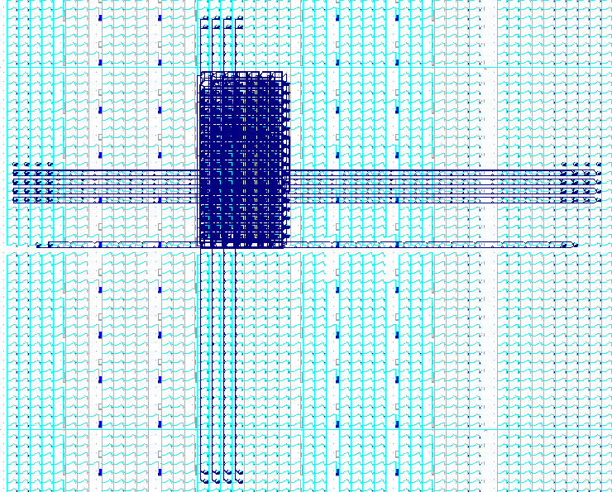
Step 3 - Building Initial PE Variants
Placed and routed PE variant
11

Slide 12
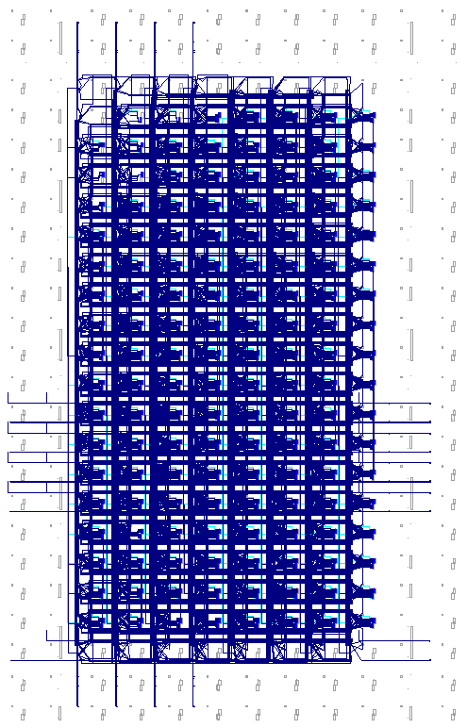
Step 4 - Extracting PE Tiles
Discarding connection anchors
Script:
ClearSelection;
AddBlockToSelection
UpperLeftTile=INT_X1YI LowerRightTile=INT_X2Y2;
ExtractModule
XDL_Input=pe_variant.xdl XDL_Output=pe_tile.xdl;
12

Slide 13
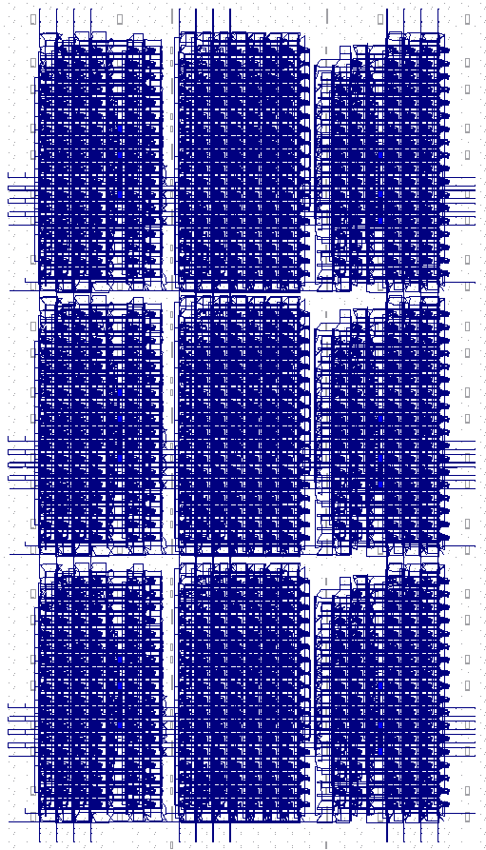
Step 5 - Relocating PE Tiles
Script:
# Instantiating the left PE column
Set Variable=PE_top Value="220";
SetLabel LabelName=LoopHead_1;
AddBlockToSelection UpperLeftTile=INT_X9Y[%PE_top%-1] LowerRightTile=INT_X9Y[%PE_top%-1];
Set Variable=PE_top Value=[%PE_top%-20];
GotoLabel LabelName=LoopHead_1 Condition=%PE_top%>170;
AddInstantiationInSelectedTiles = PE_Tile_1;
13

Slide 14
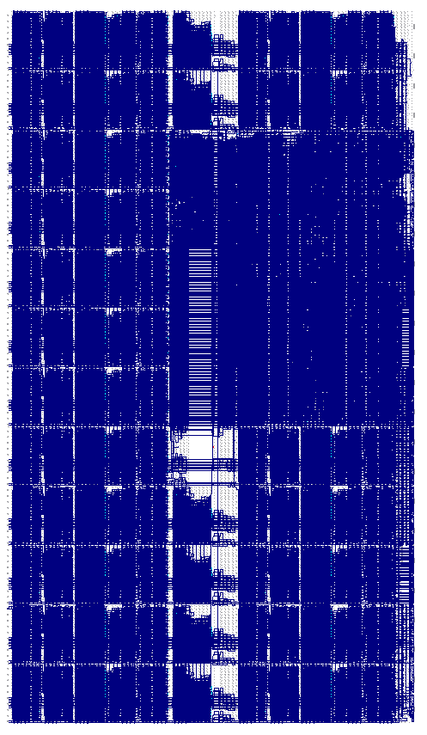
Step 6 - Establishing interconnects
Script:
FuseNets
NetlistName=CGRA PrintProgress=True;
FuseNets
NetlistName=FPGA_Driver PrintProgress=True;
14

Slide 15
Results
Two use cases were evaluated:
* XDL netlist conversion is entirely done using Xilinx tools.
CGRA Size | ROB Methodology Time (seconds) |  |  |  | Speedup
 | Initial PE Building | Stitching | XDL Conversion* | Total Time | Use Case 1 | Use Case 2
18 PEs | 1080 | 40 | 69 | 1189 | 2.0x | 22.0x
41 PEs | 1080 | 56 | 210 | 1346 | 2.7x | 13.7x
49 PEs | 1080 | 78 | 277 | 1435 | 3.1x | 12.4x
57 PEs | 1080 | 81 | 377 | 1538 | 3.7x | 12.5x
65 PEs | 1080 | 88 | 449 | 1617 | 3.5x | 10.4x
77 PEs | 1080 | 106 | 695 | 1881 | 5.2x | 12.2x
89 PEs | 1080 | 113 | 844 | 2037 | 4.8x | 10.1x
101 PEs | 1080 | 125 | 1054 | 2259 | 4.9x | 9.3x
15

Slide 16
Results
Utilization and Fmax results comparison
16

Slide 17
Conclusion
This paper developed the ROB methodology that utilizes (1)module relocation, (2)module variants, and (3)zipping to:
Obtain scalable speedups in building overlay designs
Achieve high logic utilization level with scalable speedups
Maintain higher and more consistent clock rates compared to ISE
17

Slide 18
Thank you
18

