Slide 1

Scalable and Deterministic
Timing-Driven Parallel Placement for FPGAs
Chris Wang
Supervisor: Dr. Guy Lemieux
October 20, 2011
Notes:
Show standard deviation instead of Error bars
Absolute determinism can be achieved by pre-divide the entire grid into many regions, then assigning a few regions to each processor
Serial equivalence can be achieved by allowing one proc to step through the grid sequentially, the issue is with keeping the state of every processor -> memory burden

Slide 2
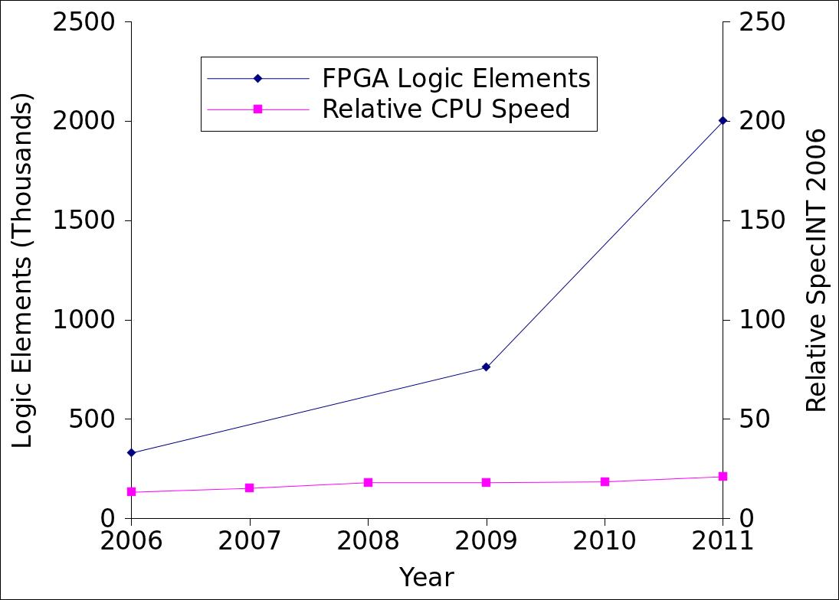
3.8X gap over the past 5 years
Motivation
6X
1.6X

Slide 3
Solution
Trend suggests multicore processors versus faster processors
Employ parallel algorithms to utilize multicore CPUs speed up FPGA CAD algorithms
Specifically, this thesis targets the parallelization of simulated-annealing based placement algorithm

Slide 4
Thesis Contributions
Parallel Placement on Multicore CPUs
  Implemented in VPR5.0.2 using Pthreads
Deterministic
  Result reproducible when same # of threads used
Timing-Driven
Scalability
  Runtime: scales to 25 threads
  Quality: independent of the number of threads used
  161X speed up over VPR with 13%, 10% and 7% in post-routing min. channel width, wirelength, and critical-path delay
  Can scale beyond 500X with <30% quality degradation
Notes:
Deterministic – extremely useful for debugging
I’ll first show the basic algorithm, then show how it runs in parallel

Slide 5
Publications
[1] C. C. Wang and G.G.F. Lemieux. Scalable and deterministic timing-driven parallel placement for FPGAs. In FPGA, pages 153-162, 2011
  Core parallel placement algorithm presented in this thesis
  Best paper award nomination (top 3)
[2] C.C. Wang and G.G.F. Lemieux. Superior quality parallel placement based on individual LUT placement. Submitted for review.
  Placement of individual LUTs directly and avoid clustering to improve quality
Related work inspired by [1]
J.B. Goeders, G.G.F. Lemieux, and S.J.E. Wilton. Deterministic timing-driven parallel placement by simulated annealing using half-box window decomposition. To appear in ReConFig, 2011

Slide 6
Overview
Motivation
Background
Parallel Placement Algorithm
Result
Future Work
Conclusion

Slide 7
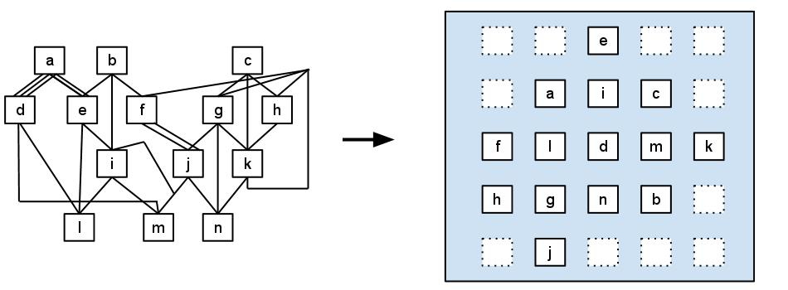
Background
FPGA Placement: NP-complete problem

Slide 8
Background - continued
FPGA placement algorithms choice:
“… simulated-annealing based placement would still be in dominate use for a few more device generations … ”
-- H. Bian et al. Towards scalable placement for FPGAs. FPGA 2010
Versatile Place and Route (VPR) has became the de facto simulated-annealing based academic FPGA placement tool

Slide 9
Background - continued
k
e
i
c
1. Random Placement
f
l
n
m
h
g
d
b
j
a

Slide 10
Background - continued
k
e
i
c
2. Propose swap
f
l
n
m
h
g
d
b
j
a

Slide 11
Background - continued
k
e
i
c
f
l
n
m
h
g
d
b
j
a

Slide 12
Background - continued
k
e
i
c
f
l
n
m
h
g
d
b
j
a

Slide 13
Background - continued
k
e
i
c
3. Evaluate swap
f
l
n
m
h
g
d
b
j
a

Slide 14
Background - continued
k
e
i
c
f
l
n
m
h
g
d
b
If rejected …
j
a

Slide 15
Background - continued
k
e
i
c
f
l
n
m
h
g
d
b
If accepted…
j
a
And repeat for another block…

Slide 16
Background - continued
Swap evaluation
  Calculate change in cost (Δc)
    Δc is a combination of targeting metrics
  Compare random(0,1) > e^{(-Δc/T)} ?
    where Temperature has a big influence on the acceptance rate
    If Δc is negative, it’s a good move, and will always be accepted

Slide 17
Background - continued
Simulated-anneal schedule
  Temperature correlates directly to acceptance rate
  Starts at a high temperature and gradually lowers
  Simulated-annealing schedule is a combination of carefully tuned parameters: initial condition, exit condition, temperature update factor, swap range
  … etc
  A good schedule is essential for a good QoR curve

Slide 18
Background - continued
Important FPGA placement algorithm properties:
  1. Determinism:
    For a given constant set of inputs, the outcome is identical regardless of the number of time the program is executed.
    Reproducibility – useful for code debugging, bug reproduction/customer support and regression testing.
  2. Timing-driven (in addition to area-driven):
    42% improvement in speed while sacrificing 5% wire length. Marquardt et al. Timing-driven placement for FPGAs. FPGA 2000

Slide 19
Background - continued
Name (year) | Hardware | Determ-inistic? | Timing-driven? | Result
Casotto (1987) | Sequent Balance 8000 | No | No | 6.4x on 8 processors
Kravitz (1987) | VAX 11/784 | No | No | < 2.3x on 4 processors
Rose (1988) | National 32016 | No | No | ~4 on 5 processors
Banerjee (1990) | Hypercube MP | No | No | ~8 on 16 processors
Witte (1991) | Hypercube MP | Yes | No | 3.3x on 16 processors
Sun (1994) | Network of machines | No | No | 5.3x on 6 machines
Wrighton (2003) | FPGAs | No | No | 500x-2500x over CPUs
Smecher (2009) | MPPAs | No | No | 1/256 less swaps needed with 1024 cores
Choong (2010) | GPU | No | No | 10x on NVIDIA GTX280
Ludwin (2008/10) | MPs | Yes | Yes | 2.1x and 2.4x on 4 and 8 processors
This work | MPs | Yes | Yes | 161x using 25 processors

Slide 20
Background - continued
k
e
i
c
Main difficulty with parallelizing FPGA placement
is to avoid conflicts
f
l
n
m
h
g
d
b
j
a

Slide 21
Background - continued
k
e
i
c
f
l
n
m
h
g
d
b
j
a

Slide 22
Background - continued
k
e
i
c
f
l
n
m
h
g
d
b
j
a

Slide 23
Background - continued
k
e
i
c
Hard-conflict – must be avoided
f
l
l
n
m
h
g
d
b
j
a

Slide 24
Background - continued
k
e
i
c
f
l
n
m
h
g
d
b
j
a

Slide 25
Background - continued
k
e
i
c
f
l
n
m
h
g
d
b
j
a

Slide 26
Background - continued
k
e
i
c
f
l
n
m
h
g
d
b
j
a

Slide 27
Background - continued
k
e
l
i
g
Soft-conflict – allowed but degrades quality
f
n
m
h
c
d
b
j
a

Slide 28
Overview
Motivation
Background
Parallel Placement Algorithm
Result
Future Work
Conclusion

Slide 29
Parallel Placement Algorithm
 | ↕ | ↕ | ↕ | ↕ | ↕ | ↕ | ↕ | ↕ | ↕ | ↕ | ↕ | ↕ | ↕ | ↕
↔ | • | • | • | • | • | • | • | • | • | • | • | • | • | • | ↔
↔ | • | • | • | • | • | • | • | • | • | • | • | • | • | • | ↔
↔ | • | • | • | • | • | • | • | • | • | • | • | • | • | • | ↔
↔ | • | • | • | • | • | • | • | • | • | • | • | • | • | • | ↔
↔ | • | • | • | • | • | • | • | • | • | • | • | • | • | • | ↔
↔ | • | • | • | • | • | • | • | • | • | • | • | • | • | • | ↔
↔ | • | • | • | • | • | • | • | • | • | • | • | • | • | • | ↔
↔ | • | • | • | • | • | • | • | • | • | • | • | • | • | • | ↔
↔ | • | • | • | • | • | • | • | • | • | • | • | • | • | • | ↔
↔ | • | • | • | • | • | • | • | • | • | • | • | • | • | • | ↔
↔ | • | • | • | • | • | • | • | • | • | • | • | • | • | • | ↔
↔ | • | • | • | • | • | • | • | • | • | • | • | • | • | • | ↔
↔ | • | • | • | • | • | • | • | • | • | • | • | • | • | • | ↔
↔ | • | • | • | • | • | • | • | • | • | • | • | • | • | • | ↔
 | ↕ | ↕ | ↕ | ↕ | ↕ | ↕ | ↕ | ↕ | ↕ | ↕ | ↕ | ↕ | ↕ | ↕
• CLB
↔ I/O

Slide 30
Parallel Placement Algorithm
 | ↕ | ↕ | ↕ | ↕ | ↕ | ↕ | ↕ | ↕ | ↕ | ↕ | ↕ | ↕ | ↕ | ↕
↔ | • | • | • | • | • | • | • | • | • | • | • | • | • | • | ↔
↔ | • | • | • | • | • | • | • | • | • | • | • | • | • | • | ↔
↔ | • | • | • | • | • | • | • | • | • | • | • | • | • | • | ↔
↔ | • | • | • | • | • | • | • | • | • | • | • | • | • | • | ↔
↔ | • | • | • | • | • | • | • | • | • | • | • | • | • | • | ↔
↔ | • | • | • | • | • | • | • | • | • | • | • | • | • | • | ↔
↔ | • | • | • | • | • | • | • | • | • | • | • | • | • | • | ↔
↔ | • | • | • | • | • | • | • | • | • | • | • | • | • | • | ↔
↔ | • | • | • | • | • | • | • | • | • | • | • | • | • | • | ↔
↔ | • | • | • | • | • | • | • | • | • | • | • | • | • | • | ↔
↔ | • | • | • | • | • | • | • | • | • | • | • | • | • | • | ↔
↔ | • | • | • | • | • | • | • | • | • | • | • | • | • | • | ↔
↔ | • | • | • | • | • | • | • | • | • | • | • | • | • | • | ↔
↔ | • | • | • | • | • | • | • | • | • | • | • | • | • | • | ↔
 | ↕ | ↕ | ↕ | ↕ | ↕ | ↕ | ↕ | ↕ | ↕ | ↕ | ↕ | ↕ | ↕ | ↕
Partition for 4 threads
• CLB
↔ I/O

Slide 31
Parallel Placement Algorithm
 | ↕ | ↕ | ↕ | ↕ | ↕ | ↕ | ↕ | ↕ | ↕ | ↕ | ↕ | ↕ | ↕ | ↕
↔ | • | • | • | • | • | • | • | • | • | • | • | • | • | • | ↔
↔ | • | • | • | • | • | • | • | • | • | • | • | • | • | • | ↔
↔ | • | • | • | • | • | • | • | • | • | • | • | • | • | • | ↔
↔ | • | • | • | • | • | • | • | • | • | • | • | • | • | • | ↔
↔ | • | • | • | • | • | • | • | • | • | • | • | • | • | • | ↔
↔ | • | • | • | • | • | • | • | • | • | • | • | • | • | • | ↔
↔ | • | • | • | • | • | • | • | • | • | • | • | • | • | • | ↔
↔ | • | • | • | • | • | • | • | • | • | • | • | • | • | • | ↔
↔ | • | • | • | • | • | • | • | • | • | • | • | • | • | • | ↔
↔ | • | • | • | • | • | • | • | • | • | • | • | • | • | • | ↔
↔ | • | • | • | • | • | • | • | • | • | • | • | • | • | • | ↔
↔ | • | • | • | • | • | • | • | • | • | • | • | • | • | • | ↔
↔ | • | • | • | • | • | • | • | • | • | • | • | • | • | • | ↔
↔ | • | • | • | • | • | • | • | • | • | • | • | • | • | • | ↔
 | ↕ | ↕ | ↕ | ↕ | ↕ | ↕ | ↕ | ↕ | ↕ | ↕ | ↕ | ↕ | ↕ | ↕
• CLB
↔ I/O

Slide 32
Parallel Placement Algorithm
T1
T2
 | ↕ | ↕ | ↕ | ↕ | ↕ | ↕ | ↕ | ↕ | ↕ | ↕ | ↕ | ↕ | ↕ | ↕
↔ | • | • | • | • | • | • | • | • | • | • | • | • | • | • | ↔
↔ | • | • | • | • | • | • | • | • | • | • | • | • | • | • | ↔
↔ | • | • | • | • | • | • | • | • | • | • | • | • | • | • | ↔
↔ | • | • | • | • | • | • | • | • | • | • | • | • | • | • | ↔
↔ | • | • | • | • | • | • | • | • | • | • | • | • | • | • | ↔
↔ | • | • | • | • | • | • | • | • | • | • | • | • | • | • | ↔
↔ | • | • | • | • | • | • | • | • | • | • | • | • | • | • | ↔
↔ | • | • | • | • | • | • | • | • | • | • | • | • | • | • | ↔
↔ | • | • | • | • | • | • | • | • | • | • | • | • | • | • | ↔
↔ | • | • | • | • | • | • | • | • | • | • | • | • | • | • | ↔
↔ | • | • | • | • | • | • | • | • | • | • | • | • | • | • | ↔
↔ | • | • | • | • | • | • | • | • | • | • | • | • | • | • | ↔
↔ | • | • | • | • | • | • | • | • | • | • | • | • | • | • | ↔
↔ | • | • | • | • | • | • | • | • | • | • | • | • | • | • | ↔
 | ↕ | ↕ | ↕ | ↕ | ↕ | ↕ | ↕ | ↕ | ↕ | ↕ | ↕ | ↕ | ↕ | ↕
T3
T4
• CLB
↔ I/O

Slide 33
Parallel Placement Algorithm
 | ↕ | ↕ | ↕ | ↕ | ↕ | ↕ | ↕ | ↕ | ↕ | ↕ | ↕ | ↕ | ↕ | ↕
↔ | • | • | • | • | • | • | • | • | • | • | • | • | • | • | ↔
↔ | • | • | • | • | • | • | • | • | • | • | • | • | • | • | ↔
↔ | • | • | • | • | • | • | • | • | • | • | • | • | • | • | ↔
↔ | • | • | • | • | • | • | • | • | • | • | • | • | • | • | ↔
↔ | • | • | • | • | • | • | • | • | • | • | • | • | • | • | ↔
↔ | • | • | • | • | • | • | • | • | • | • | • | • | • | • | ↔
↔ | • | • | • | • | • | • | • | • | • | • | • | • | • | • | ↔
↔ | • | • | • | • | • | • | • | • | • | • | • | • | • | • | ↔
↔ | • | • | • | • | • | • | • | • | • | • | • | • | • | • | ↔
↔ | • | • | • | • | • | • | • | • | • | • | • | • | • | • | ↔
↔ | • | • | • | • | • | • | • | • | • | • | • | • | • | • | ↔
↔ | • | • | • | • | • | • | • | • | • | • | • | • | • | • | ↔
↔ | • | • | • | • | • | • | • | • | • | • | • | • | • | • | ↔
↔ | • | • | • | • | • | • | • | • | • | • | • | • | • | • | ↔
 | ↕ | ↕ | ↕ | ↕ | ↕ | ↕ | ↕ | ↕ | ↕ | ↕ | ↕ | ↕ | ↕ | ↕
• CLB
↔ I/O

Slide 34
Parallel Placement Algorithm
Swap from
Swap to
Swap from
Swap to
 | ↕ | ↕ | ↕ | ↕ | ↕ | ↕ | ↕ | ↕ | ↕ | ↕ | ↕ | ↕ | ↕ | ↕
↔ | • | • | • | • | • | • | • | • | • | • | • | • | • | • | ↔
↔ | • | • | • | • | • | • | • | • | • | • | • | • | • | • | ↔
↔ | • | • | • | • | • | • | • | • | • | • | • | • | • | • | ↔
↔ | • | • | • | • | • | • | • | • | • | • | • | • | • | • | ↔
↔ | • | • | • | • | • | • | • | • | • | • | • | • | • | • | ↔
↔ | • | • | • | • | • | • | • | • | • | • | • | • | • | • | ↔
↔ | • | • | • | • | • | • | • | • | • | • | • | • | • | • | ↔
↔ | • | • | • | • | • | • | • | • | • | • | • | • | • | • | ↔
↔ | • | • | • | • | • | • | • | • | • | • | • | • | • | • | ↔
↔ | • | • | • | • | • | • | • | • | • | • | • | • | • | • | ↔
↔ | • | • | • | • | • | • | • | • | • | • | • | • | • | • | ↔
↔ | • | • | • | • | • | • | • | • | • | • | • | • | • | • | ↔
↔ | • | • | • | • | • | • | • | • | • | • | • | • | • | • | ↔
↔ | • | • | • | • | • | • | • | • | • | • | • | • | • | • | ↔
 | ↕ | ↕ | ↕ | ↕ | ↕ | ↕ | ↕ | ↕ | ↕ | ↕ | ↕ | ↕ | ↕ | ↕
Swap to
Swap to
Swap from
Swap from
• CLB
↔ I/O

Slide 35
Parallel Placement Algorithm
Swap from
Swap from
 | ↕ | ↕ | ↕ | ↕ | ↕ | ↕ | ↕ | ↕ | ↕ | ↕ | ↕ | ↕ | ↕ | ↕
↔ | • | • | • | • | • | • | • | • | • | • | • | • | • | • | ↔
↔ | • | • | • | • | • | • | • | • | • | • | • | • | • | • | ↔
↔ | • | • | • | • | • | • | • | • | • | • | • | • | • | • | ↔
↔ | • | • | • | • | • | • | • | • | • | • | • | • | • | • | ↔
↔ | • | • | • | • | • | • | • | • | • | • | • | • | • | • | ↔
↔ | • | • | • | • | • | • | • | • | • | • | • | • | • | • | ↔
↔ | • | • | • | • | • | • | • | • | • | • | • | • | • | • | ↔
↔ | • | • | • | • | • | • | • | • | • | • | • | • | • | • | ↔
↔ | • | • | • | • | • | • | • | • | • | • | • | • | • | • | ↔
↔ | • | • | • | • | • | • | • | • | • | • | • | • | • | • | ↔
↔ | • | • | • | • | • | • | • | • | • | • | • | • | • | • | ↔
↔ | • | • | • | • | • | • | • | • | • | • | • | • | • | • | ↔
↔ | • | • | • | • | • | • | • | • | • | • | • | • | • | • | ↔
↔ | • | • | • | • | • | • | • | • | • | • | • | • | • | • | ↔
 | ↕ | ↕ | ↕ | ↕ | ↕ | ↕ | ↕ | ↕ | ↕ | ↕ | ↕ | ↕ | ↕ | ↕
Create local copies
of global data
Swap from
Swap from
• CLB
↔ I/O
Notes:
Local data, stale data right here

Slide 36
Parallel Placement Algorithm
Swap from
Swap from
 | ↕ | ↕ | ↕ | ↕ | ↕ | ↕ | ↕ | ↕ | ↕ | ↕ | ↕ | ↕ | ↕ | ↕
↔ | • | • | • | • | • | • | • | • | • | • | • | • | • | • | ↔
↔ | • | • | • | • | • | • | • | • | • | • | • | • | • | • | ↔
↔ | • | • | • | • | • | • | • | • | • | • | • | • | • | • | ↔
↔ | • | • | • | • | • | • | • | • | • | • | • | • | • | • | ↔
↔ | • | • | • | • | • | • | • | • | • | • | • | • | • | • | ↔
↔ | • | • | • | • | • | • | • | • | • | • | • | • | • | • | ↔
↔ | • | • | • | • | • | • | • | • | • | • | • | • | • | • | ↔
↔ | • | • | • | • | • | • | • | • | • | • | • | • | • | • | ↔
↔ | • | • | • | • | • | • | • | • | • | • | • | • | • | • | ↔
↔ | • | • | • | • | • | • | • | • | • | • | • | • | • | • | ↔
↔ | • | • | • | • | • | • | • | • | • | • | • | • | • | • | ↔
↔ | • | • | • | • | • | • | • | • | • | • | • | • | • | • | ↔
↔ | • | • | • | • | • | • | • | • | • | • | • | • | • | • | ↔
↔ | • | • | • | • | • | • | • | • | • | • | • | • | • | • | ↔
 | ↕ | ↕ | ↕ | ↕ | ↕ | ↕ | ↕ | ↕ | ↕ | ↕ | ↕ | ↕ | ↕ | ↕
Swap from
Swap from
• CLB
↔ I/O
Notes:
Local data, stale data right here

Slide 37
Parallel Placement Algorithm
Swap from
Swap from
 | ↕ | ↕ | ↕ | ↕ | ↕ | ↕ | ↕ | ↕ | ↕ | ↕ | ↕ | ↕ | ↕ | ↕
↔ | • | • | • | • | • | • | • | • | • | • | • | • | • | • | ↔
↔ | • | • | • | • | • | • | • | • | • | • | • | • | • | • | ↔
↔ | • | • | • | • | • | • | • | • | • | • | • | • | • | • | ↔
↔ | • | • | • | • | • | • | • | • | • | • | • | • | • | • | ↔
↔ | • | • | • | • | • | • | • | • | • | • | • | • | • | • | ↔
↔ | • | • | • | • | • | • | • | • | • | • | • | • | • | • | ↔
↔ | • | • | • | • | • | • | • | • | • | • | • | • | • | • | ↔
↔ | • | • | • | • | • | • | • | • | • | • | • | • | • | • | ↔
↔ | • | • | • | • | • | • | • | • | • | • | • | • | • | • | ↔
↔ | • | • | • | • | • | • | • | • | • | • | • | • | • | • | ↔
↔ | • | • | • | • | • | • | • | • | • | • | • | • | • | • | ↔
↔ | • | • | • | • | • | • | • | • | • | • | • | • | • | • | ↔
↔ | • | • | • | • | • | • | • | • | • | • | • | • | • | • | ↔
↔ | • | • | • | • | • | • | • | • | • | • | • | • | • | • | ↔
 | ↕ | ↕ | ↕ | ↕ | ↕ | ↕ | ↕ | ↕ | ↕ | ↕ | ↕ | ↕ | ↕ | ↕
Swap from
Swap from
• CLB
↔ I/O

Slide 38
Parallel Placement Algorithm
Swap from
Swap from
 | ↕ | ↕ | ↕ | ↕ | ↕ | ↕ | ↕ | ↕ | ↕ | ↕ | ↕ | ↕ | ↕ | ↕
↔ | • | • | • | • | • | • | • | • | • | • | • | • | • | • | ↔
↔ | • | • | • | • | • | • | • | • | • | • | • | • | • | • | ↔
↔ | • | • | • | • | • | • | • | • | • | • | • | • | • | • | ↔
↔ | • | • | • | • | • | • | • | • | • | • | • | • | • | • | ↔
↔ | • | • | • | • | • | • | • | • | • | • | • | • | • | • | ↔
↔ | • | • | • | • | • | • | • | • | • | • | • | • | • | • | ↔
↔ | • | • | • | • | • | • | • | • | • | • | • | • | • | • | ↔
↔ | • | • | • | • | • | • | • | • | • | • | • | • | • | • | ↔
↔ | • | • | • | • | • | • | • | • | • | • | • | • | • | • | ↔
↔ | • | • | • | • | • | • | • | • | • | • | • | • | • | • | ↔
↔ | • | • | • | • | • | • | • | • | • | • | • | • | • | • | ↔
↔ | • | • | • | • | • | • | • | • | • | • | • | • | • | • | ↔
↔ | • | • | • | • | • | • | • | • | • | • | • | • | • | • | ↔
↔ | • | • | • | • | • | • | • | • | • | • | • | • | • | • | ↔
 | ↕ | ↕ | ↕ | ↕ | ↕ | ↕ | ↕ | ↕ | ↕ | ↕ | ↕ | ↕ | ↕ | ↕
Swap from
Swap from
• CLB
↔ I/O

Slide 39
Parallel Placement Algorithm
Swap from
Swap from
 | ↕ | ↕ | ↕ | ↕ | ↕ | ↕ | ↕ | ↕ | ↕ | ↕ | ↕ | ↕ | ↕ | ↕
↔ | • | • | • | • | • | • | • | • | • | • | • | • | • | • | ↔
↔ | • | • | • | • | • | • | • | • | • | • | • | • | • | • | ↔
↔ | • | • | • | • | • | • | • | • | • | • | • | • | • | • | ↔
↔ | • | • | • | • | • | • | • | • | • | • | • | • | • | • | ↔
↔ | • | • | • | • | • | • | • | • | • | • | • | • | • | • | ↔
↔ | • | • | • | • | • | • | • | • | • | • | • | • | • | • | ↔
↔ | • | • | • | • | • | • | • | • | • | • | • | • | • | • | ↔
↔ | • | • | • | • | • | • | • | • | • | • | • | • | • | • | ↔
↔ | • | • | • | • | • | • | • | • | • | • | • | • | • | • | ↔
↔ | • | • | • | • | • | • | • | • | • | • | • | • | • | • | ↔
↔ | • | • | • | • | • | • | • | • | • | • | • | • | • | • | ↔
↔ | • | • | • | • | • | • | • | • | • | • | • | • | • | • | ↔
↔ | • | • | • | • | • | • | • | • | • | • | • | • | • | • | ↔
↔ | • | • | • | • | • | • | • | • | • | • | • | • | • | • | ↔
 | ↕ | ↕ | ↕ | ↕ | ↕ | ↕ | ↕ | ↕ | ↕ | ↕ | ↕ | ↕ | ↕ | ↕
Swap from
Swap from
• CLB
↔ I/O

Slide 40
Parallel Placement Algorithm
 | ↕ | ↕ | ↕ | ↕ | ↕ | ↕ | ↕ | ↕ | ↕ | ↕ | ↕ | ↕ | ↕ | ↕
↔ | • | • | • | • | • | • | • | • | • | • | • | • | • | • | ↔
↔ | • | • | • | • | • | • | • | • | • | • | • | • | • | • | ↔
↔ | • | • | • | • | • | • | • | • | • | • | • | • | • | • | ↔
↔ | • | • | • | • | • | • | • | • | • | • | • | • | • | • | ↔
↔ | • | • | • | • | • | • | • | • | • | • | • | • | • | • | ↔
↔ | • | • | • | • | • | • | • | • | • | • | • | • | • | • | ↔
↔ | • | • | • | • | • | • | • | • | • | • | • | • | • | • | ↔
↔ | • | • | • | • | • | • | • | • | • | • | • | • | • | • | ↔
↔ | • | • | • | • | • | • | • | • | • | • | • | • | • | • | ↔
↔ | • | • | • | • | • | • | • | • | • | • | • | • | • | • | ↔
↔ | • | • | • | • | • | • | • | • | • | • | • | • | • | • | ↔
↔ | • | • | • | • | • | • | • | • | • | • | • | • | • | • | ↔
↔ | • | • | • | • | • | • | • | • | • | • | • | • | • | • | ↔
↔ | • | • | • | • | • | • | • | • | • | • | • | • | • | • | ↔
 | ↕ | ↕ | ↕ | ↕ | ↕ | ↕ | ↕ | ↕ | ↕ | ↕ | ↕ | ↕ | ↕ | ↕
Broadcast placement changes
Continue to next
swap from/to region…
• CLB
↔ I/O
Notes:
Broadcast change eliminates stale

Slide 41
Parallel Placement Algorithm
Swap from
Swap to
Swap from
Swap to
 | ↕ | ↕ | ↕ | ↕ | ↕ | ↕ | ↕ | ↕ | ↕ | ↕ | ↕ | ↕ | ↕ | ↕
↔ | • | • | • | • | • | • | • | • | • | • | • | • | • | • | ↔
↔ | • | • | • | • | • | • | • | • | • | • | • | • | • | • | ↔
↔ | • | • | • | • | • | • | • | • | • | • | • | • | • | • | ↔
↔ | • | • | • | • | • | • | • | • | • | • | • | • | • | • | ↔
↔ | • | • | • | • | • | • | • | • | • | • | • | • | • | • | ↔
↔ | • | • | • | • | • | • | • | • | • | • | • | • | • | • | ↔
↔ | • | • | • | • | • | • | • | • | • | • | • | • | • | • | ↔
↔ | • | • | • | • | • | • | • | • | • | • | • | • | • | • | ↔
↔ | • | • | • | • | • | • | • | • | • | • | • | • | • | • | ↔
↔ | • | • | • | • | • | • | • | • | • | • | • | • | • | • | ↔
↔ | • | • | • | • | • | • | • | • | • | • | • | • | • | • | ↔
↔ | • | • | • | • | • | • | • | • | • | • | • | • | • | • | ↔
↔ | • | • | • | • | • | • | • | • | • | • | • | • | • | • | ↔
↔ | • | • | • | • | • | • | • | • | • | • | • | • | • | • | ↔
 | ↕ | ↕ | ↕ | ↕ | ↕ | ↕ | ↕ | ↕ | ↕ | ↕ | ↕ | ↕ | ↕ | ↕
Swap from
Swap to
Swap from
Swap to
• CLB
↔ I/O

Slide 42
Parallel Placement Algorithm
 | ↕ | ↕ | ↕ | ↕ | ↕ | ↕ | ↕ | ↕ | ↕ | ↕ | ↕ | ↕ | ↕ | ↕
↔ | • | • | • | • | • | • | • | • | • | • | • | • | • | • | ↔
↔ | • | • | • | • | • | • | • | • | • | • | • | • | • | • | ↔
↔ | • | • | • | • | • | • | • | • | • | • | • | • | • | • | ↔
↔ | • | • | • | • | • | • | • | • | • | • | • | • | • | • | ↔
↔ | • | • | • | • | • | • | • | • | • | • | • | • | • | • | ↔
↔ | • | • | • | • | • | • | • | • | • | • | • | • | • | • | ↔
↔ | • | • | • | • | • | • | • | • | • | • | • | • | • | • | ↔
↔ | • | • | • | • | • | • | • | • | • | • | • | • | • | • | ↔
↔ | • | • | • | • | • | • | • | • | • | • | • | • | • | • | ↔
↔ | • | • | • | • | • | • | • | • | • | • | • | • | • | • | ↔
↔ | • | • | • | • | • | • | • | • | • | • | • | • | • | • | ↔
↔ | • | • | • | • | • | • | • | • | • | • | • | • | • | • | ↔
↔ | • | • | • | • | • | • | • | • | • | • | • | • | • | • | ↔
↔ | • | • | • | • | • | • | • | • | • | • | • | • | • | • | ↔
 | ↕ | ↕ | ↕ | ↕ | ↕ | ↕ | ↕ | ↕ | ↕ | ↕ | ↕ | ↕ | ↕ | ↕
Swap from
Swap to
Swap from
Swap to
Swap from
Swap to
Swap from
Swap to
• CLB
↔ I/O

Slide 43
Parallel Placement Algorithm
Swap to
Swap from
Swap from
Swap to
 | ↕ | ↕ | ↕ | ↕ | ↕ | ↕ | ↕ | ↕ | ↕ | ↕ | ↕ | ↕ | ↕ | ↕
↔ | • | • | • | • | • | • | • | • | • | • | • | • | • | • | ↔
↔ | • | • | • | • | • | • | • | • | • | • | • | • | • | • | ↔
↔ | • | • | • | • | • | • | • | • | • | • | • | • | • | • | ↔
↔ | • | • | • | • | • | • | • | • | • | • | • | • | • | • | ↔
↔ | • | • | • | • | • | • | • | • | • | • | • | • | • | • | ↔
↔ | • | • | • | • | • | • | • | • | • | • | • | • | • | • | ↔
↔ | • | • | • | • | • | • | • | • | • | • | • | • | • | • | ↔
↔ | • | • | • | • | • | • | • | • | • | • | • | • | • | • | ↔
↔ | • | • | • | • | • | • | • | • | • | • | • | • | • | • | ↔
↔ | • | • | • | • | • | • | • | • | • | • | • | • | • | • | ↔
↔ | • | • | • | • | • | • | • | • | • | • | • | • | • | • | ↔
↔ | • | • | • | • | • | • | • | • | • | • | • | • | • | • | ↔
↔ | • | • | • | • | • | • | • | • | • | • | • | • | • | • | ↔
↔ | • | • | • | • | • | • | • | • | • | • | • | • | • | • | ↔
 | ↕ | ↕ | ↕ | ↕ | ↕ | ↕ | ↕ | ↕ | ↕ | ↕ | ↕ | ↕ | ↕ | ↕
Swap from
Swap to
Swap to
Swap from
• CLB
↔ I/O

Slide 44
Overview
Motivation
Background
Parallel Placement Algorithm
Result
Future Work
Conclusion

Slide 45
Result
7 synthetic circuits from Un/DoPack flow
Clustered with T-Vpack 5.0.2
Dell R815 4-sockets, each with an 8-core AMD Opteron 6128, @ 2.0 GHz, 32GB of memory
Baseline: VPR 5.0.2 –place_only
Only placement time
  Exclude netlist reading…etc

Slide 46
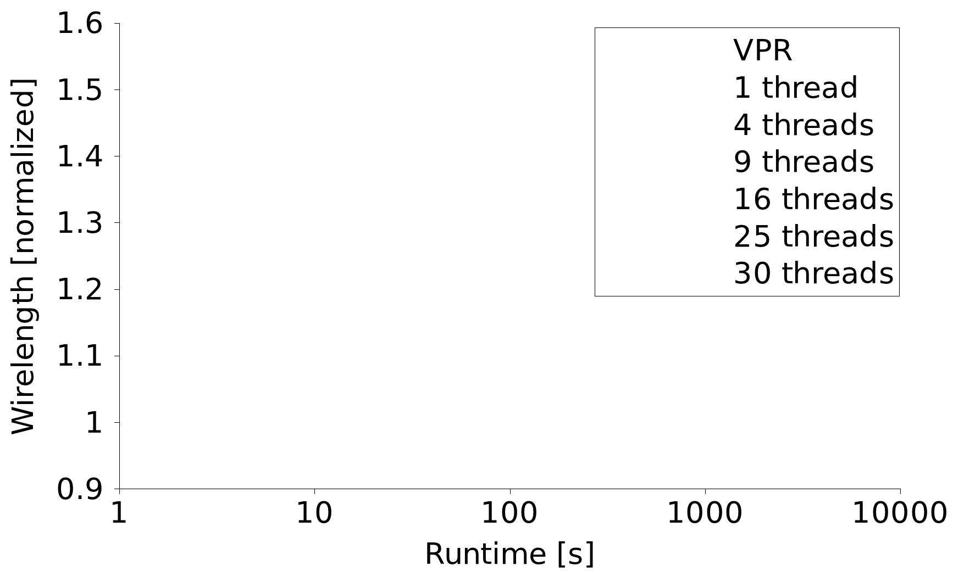
Quality – Post Routing Wirelength
Notes:
Rightmost point is VPR, then VPR fast
VPR curve is created by changing inner_num, and I have generated my curves In a similar fashion

Slide 47
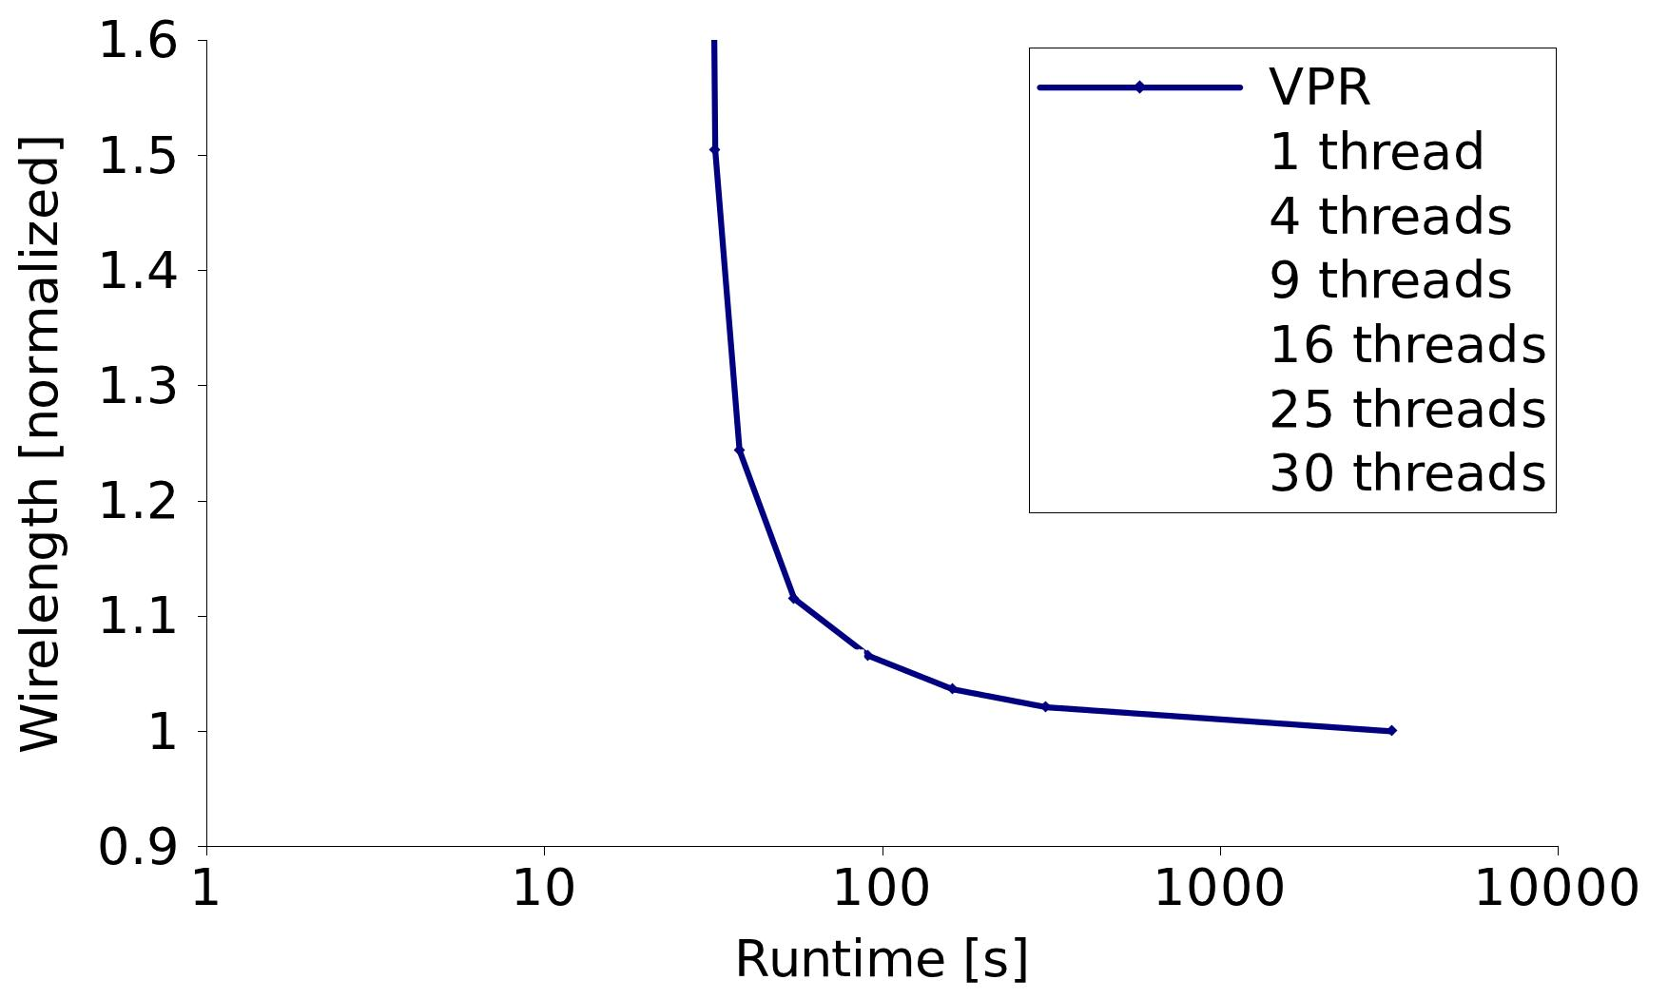
Quality – Post Routing Wirelength
Notes:
Rightmost point is VPR, then VPR fast
VPR curve is created by changing inner_num, and I have generated my curves In a similar fashion

Slide 48
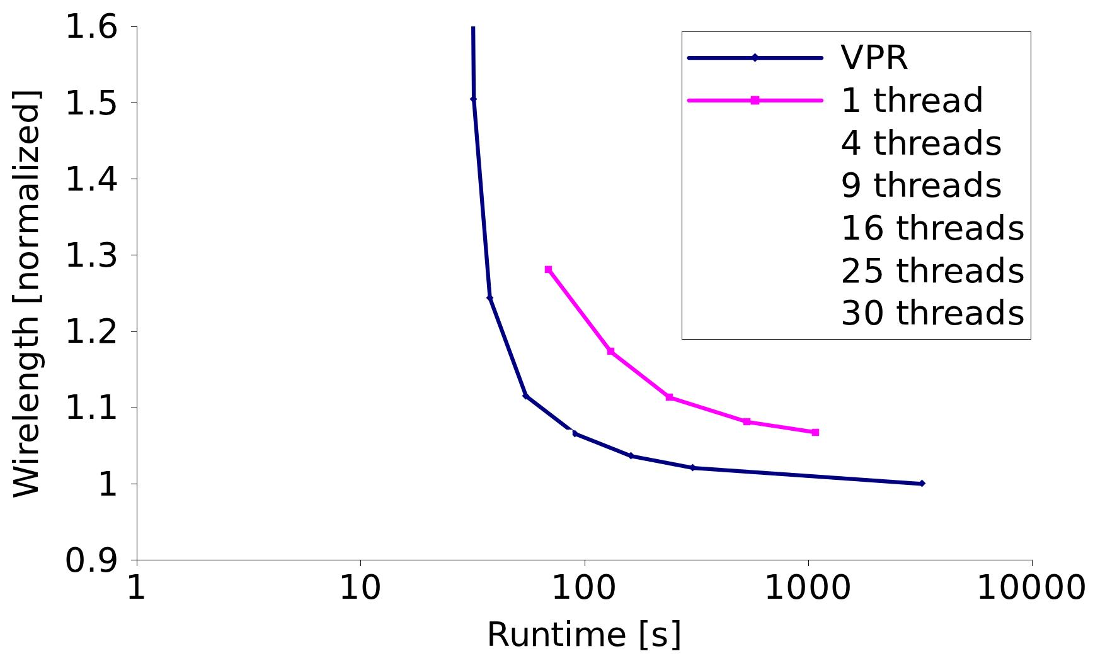
Quality – Post Routing Wirelength
Notes:
Rightmost point is VPR, then VPR fast
VPR curve is created by changing inner_num, and I have generated my curves In a similar fashion

Slide 49
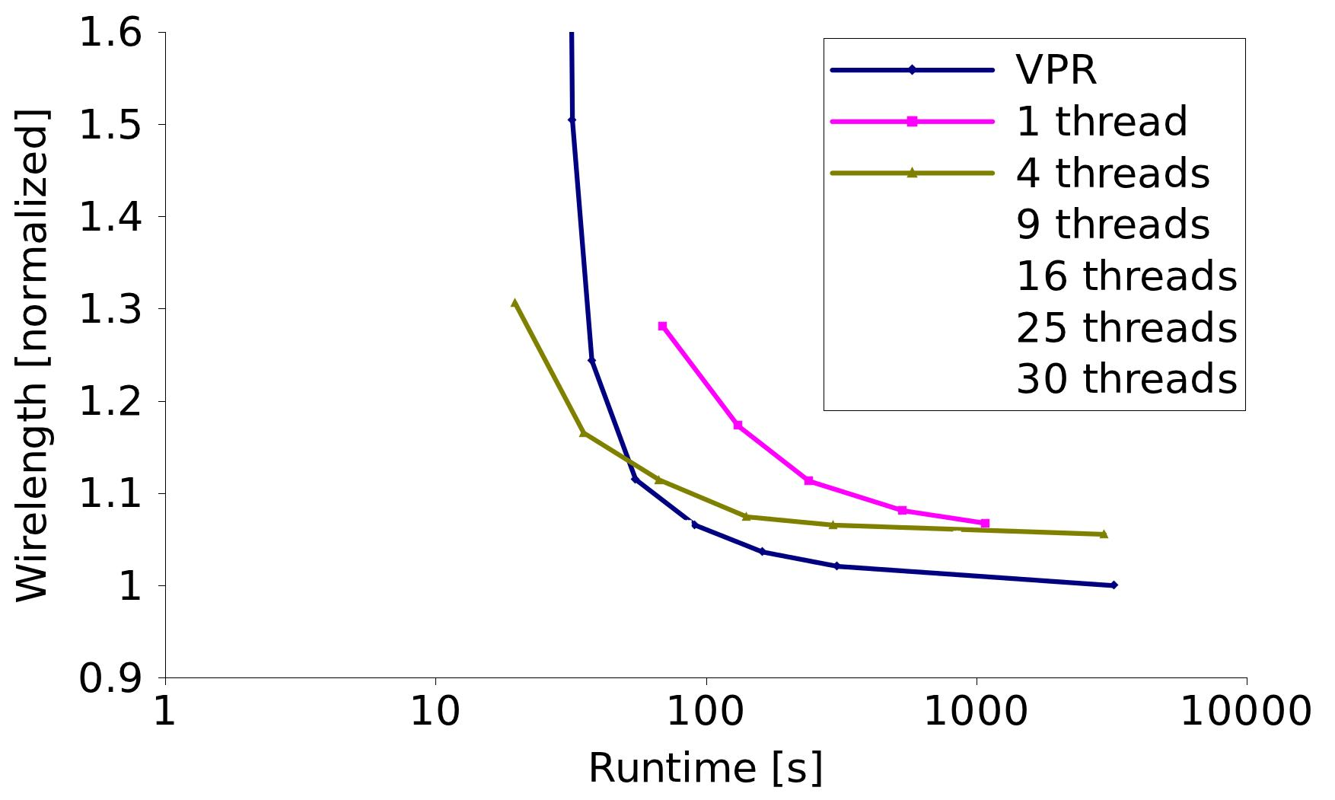
Quality – Post Routing Wirelength
Notes:
Rightmost point is VPR, then VPR fast
VPR curve is created by changing inner_num, and I have generated my curves In a similar fashion

Slide 50
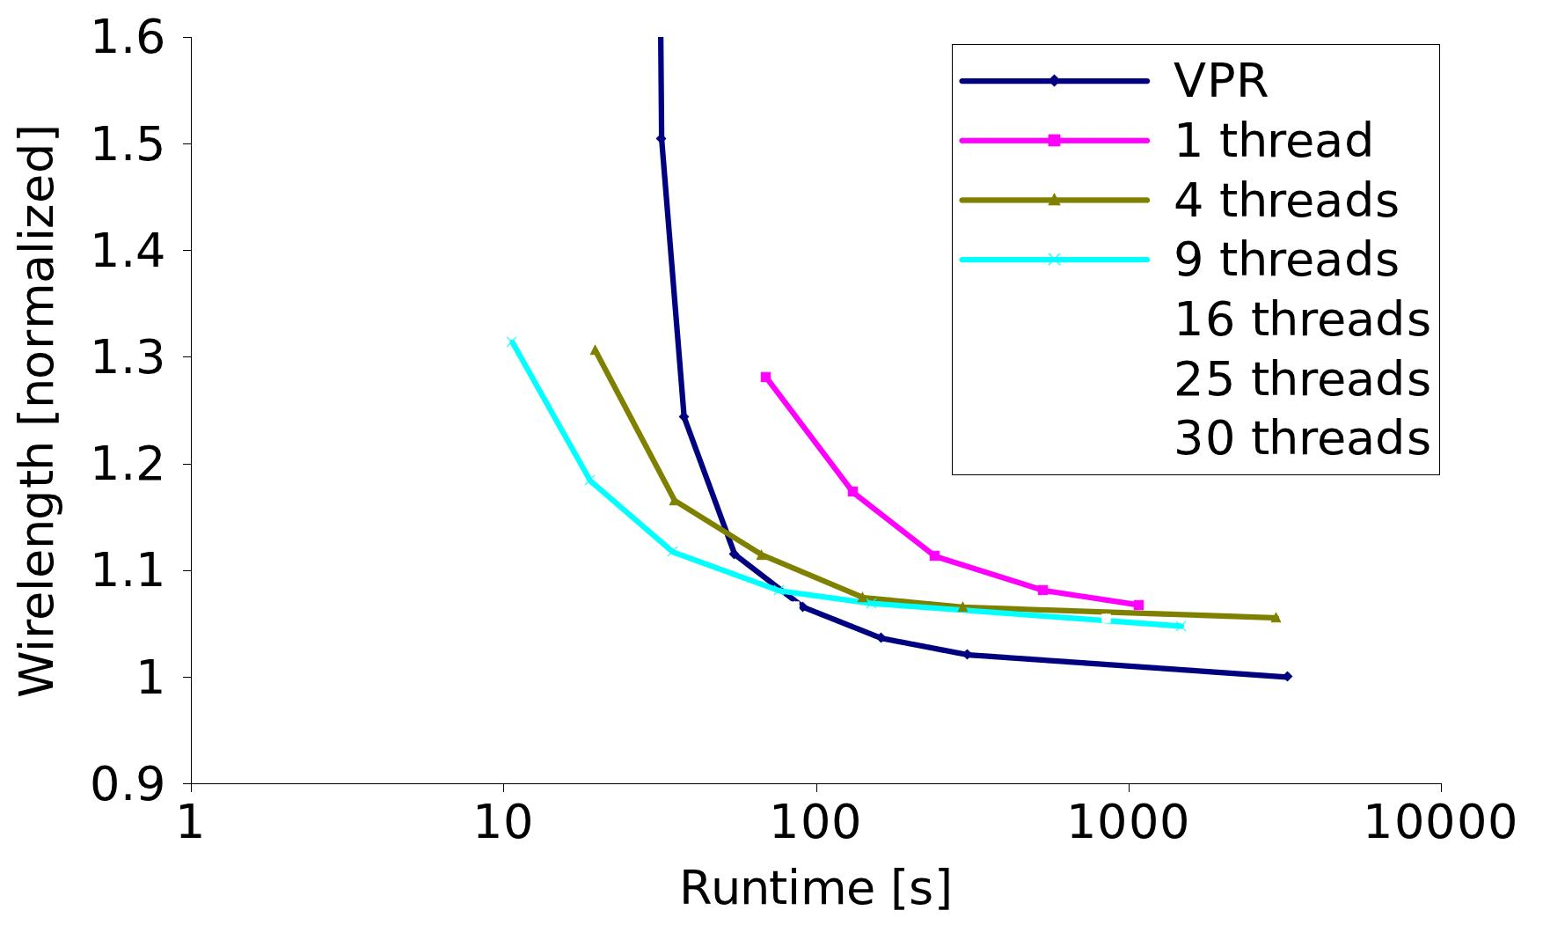
Quality – Post Routing Wirelength
Notes:
Rightmost point is VPR, then VPR fast
VPR curve is created by changing inner_num, and I have generated my curves In a similar fashion

Slide 51
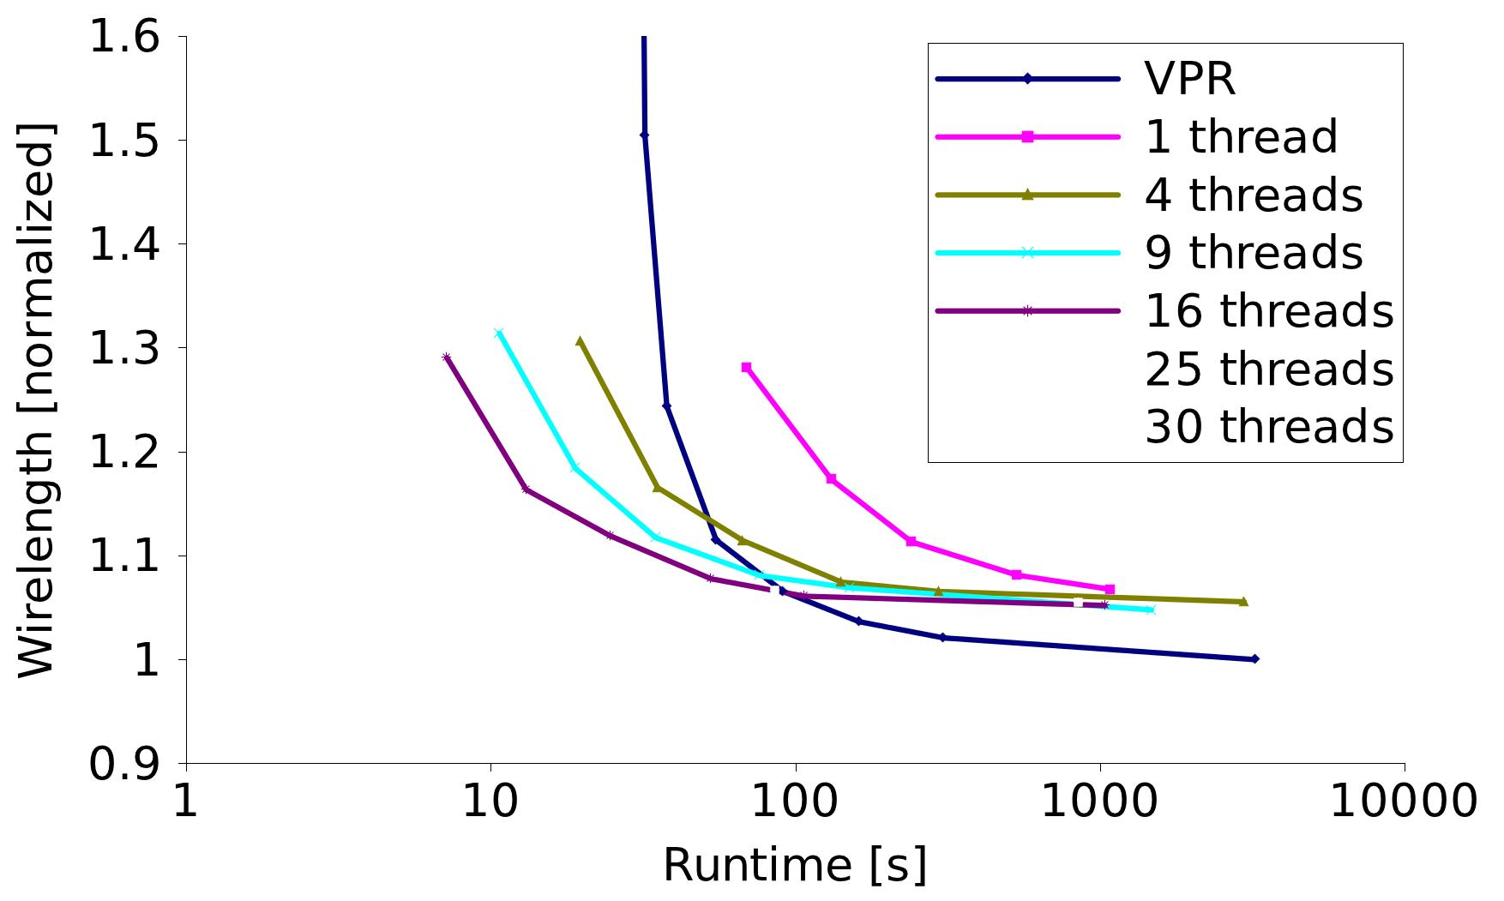
Quality – Post Routing Wirelength
Notes:
Rightmost point is VPR, then VPR fast
VPR curve is created by changing inner_num, and I have generated my curves In a similar fashion

Slide 52
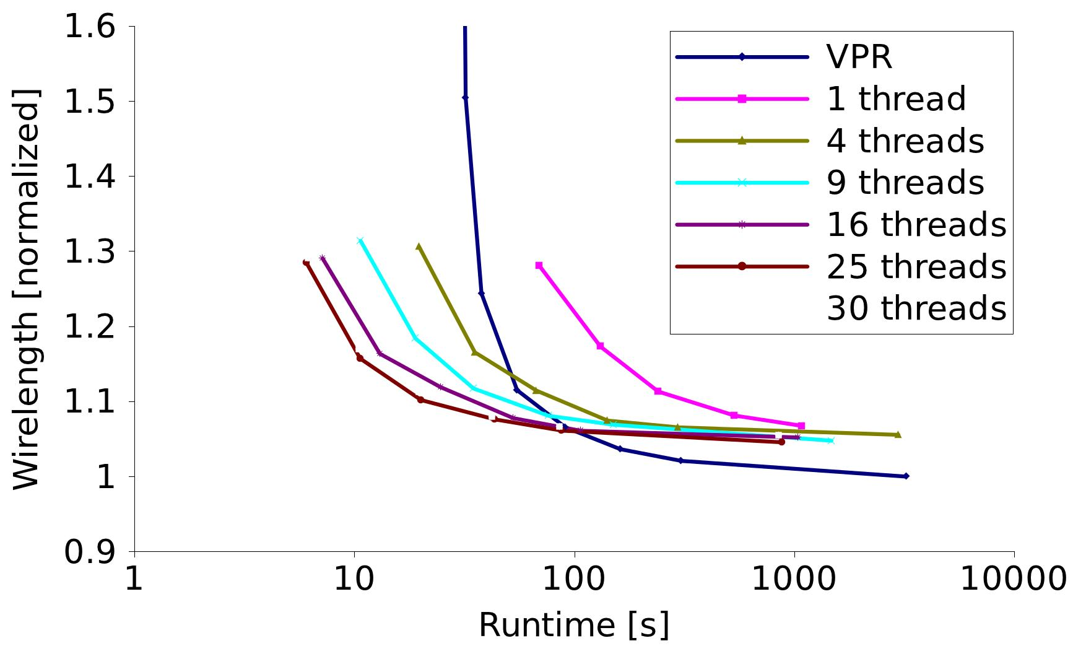
Quality – Post Routing Wirelength
Notes:
Rightmost point is VPR, then VPR fast
VPR curve is created by changing inner_num, and I have generated my curves In a similar fashion

Slide 53
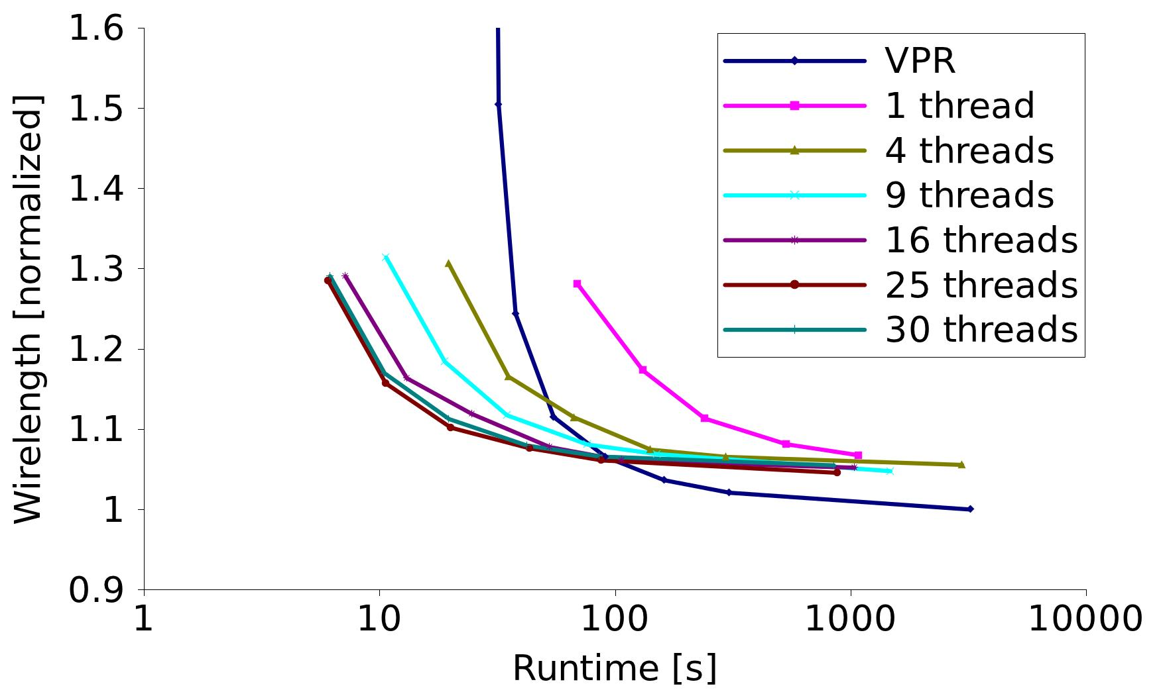
Quality – Post Routing Wirelength
Notes:
Rightmost point is VPR, then VPR fast
VPR curve is created by changing inner_num, and I have generated my curves In a similar fashion

Slide 54
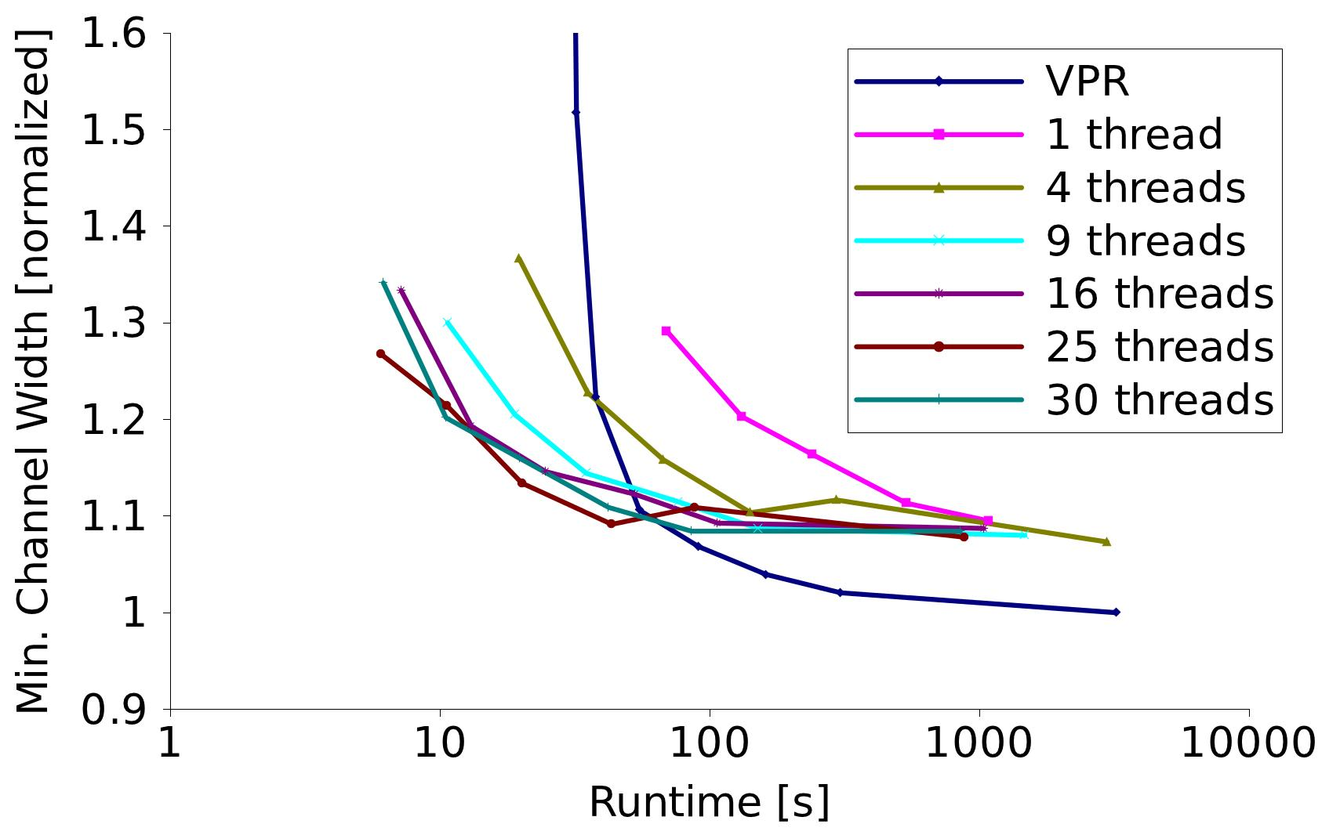
Quality – Post Routing
Minimum Chan Width
Notes:
Rightmost point is VPR, then VPR fast
VPR curve is created by changing inner_num, and I have generated my curves In a similar fashion

Slide 55
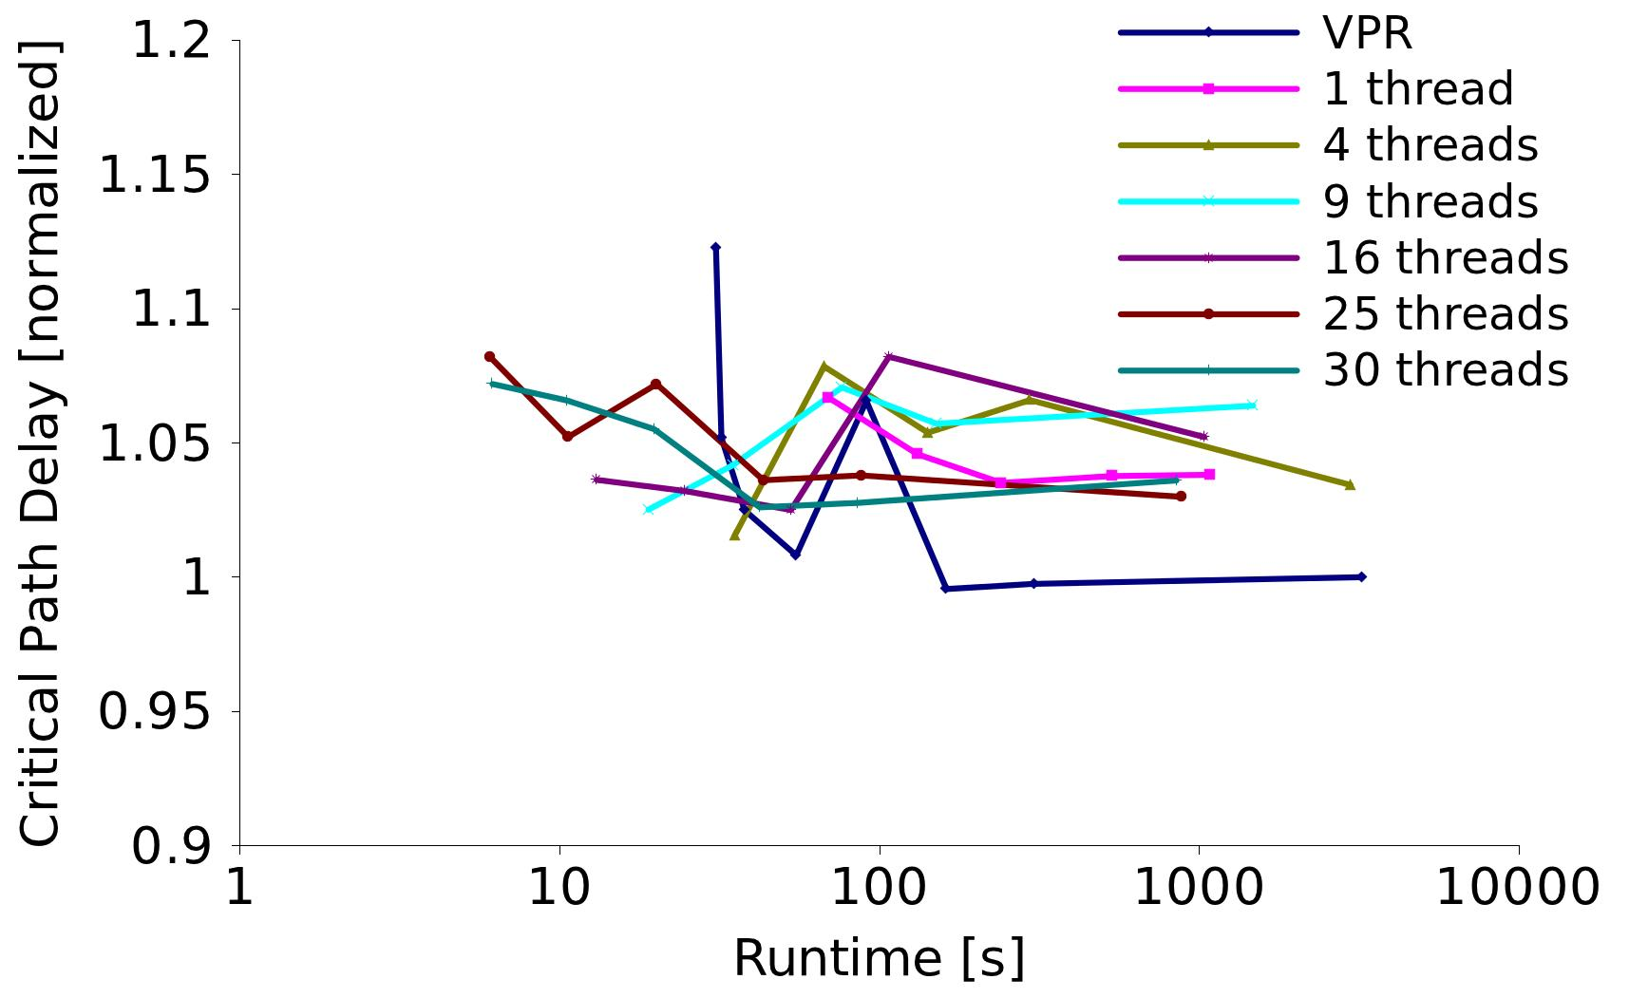
Quality – Post Routing
Critical-Path Delay
Notes:
Rightmost point is VPR, then VPR fast
VPR curve is created by changing inner_num, and I have generated my curves In a similar fashion

Slide 56
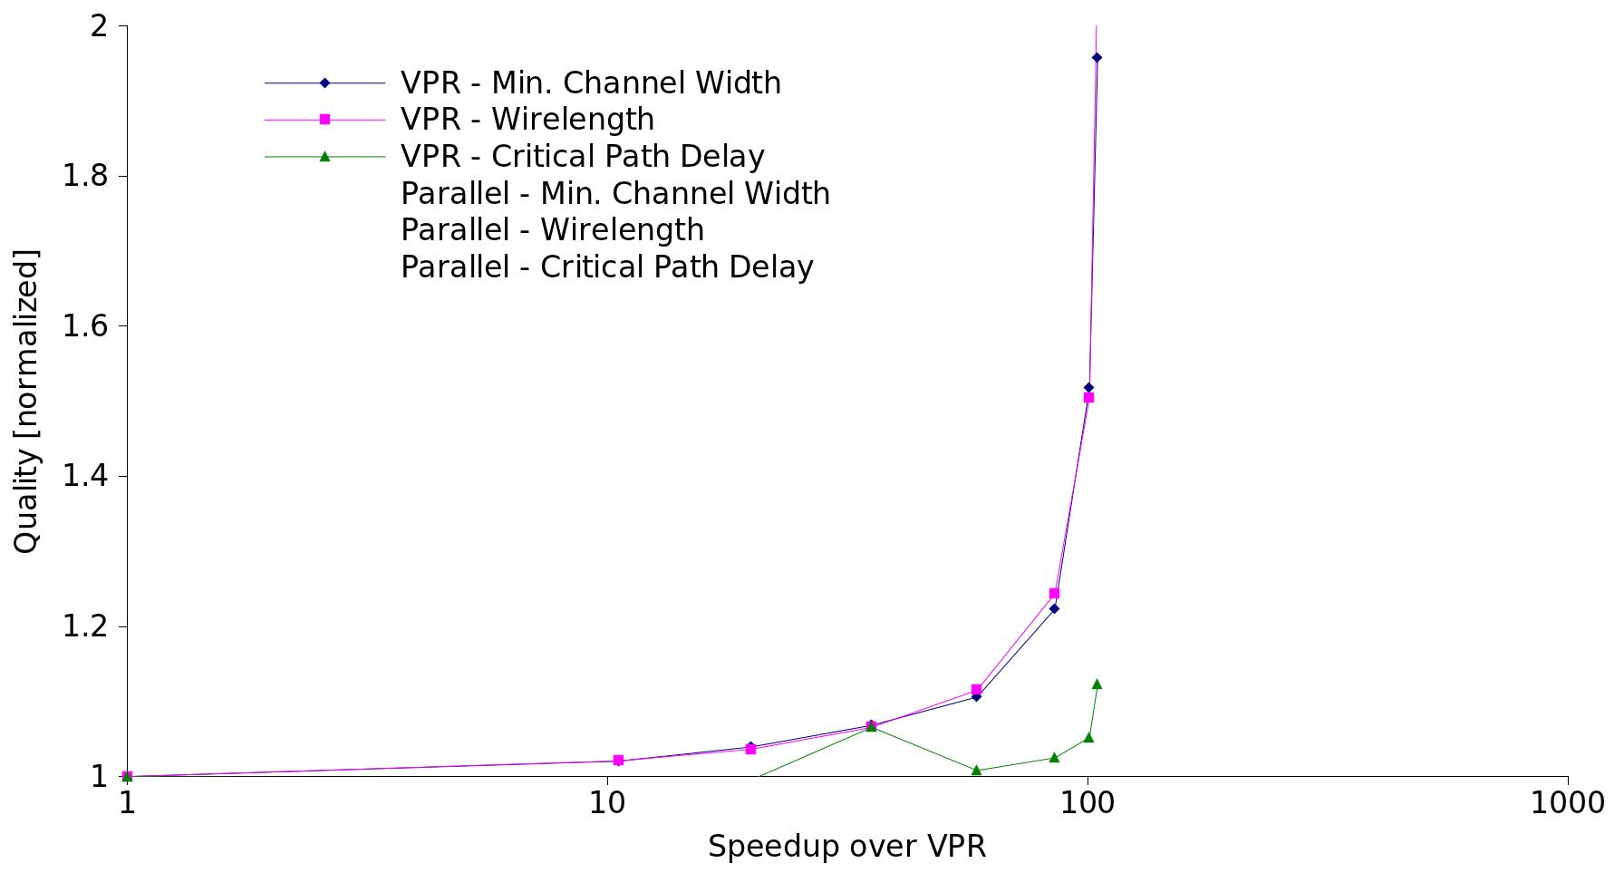
Quality – speed up over VPR
Notes:
Rightmost point is VPR, then VPR fast
VPR curve is created by changing inner_num, and I have generated my curves In a similar fashion

Slide 57
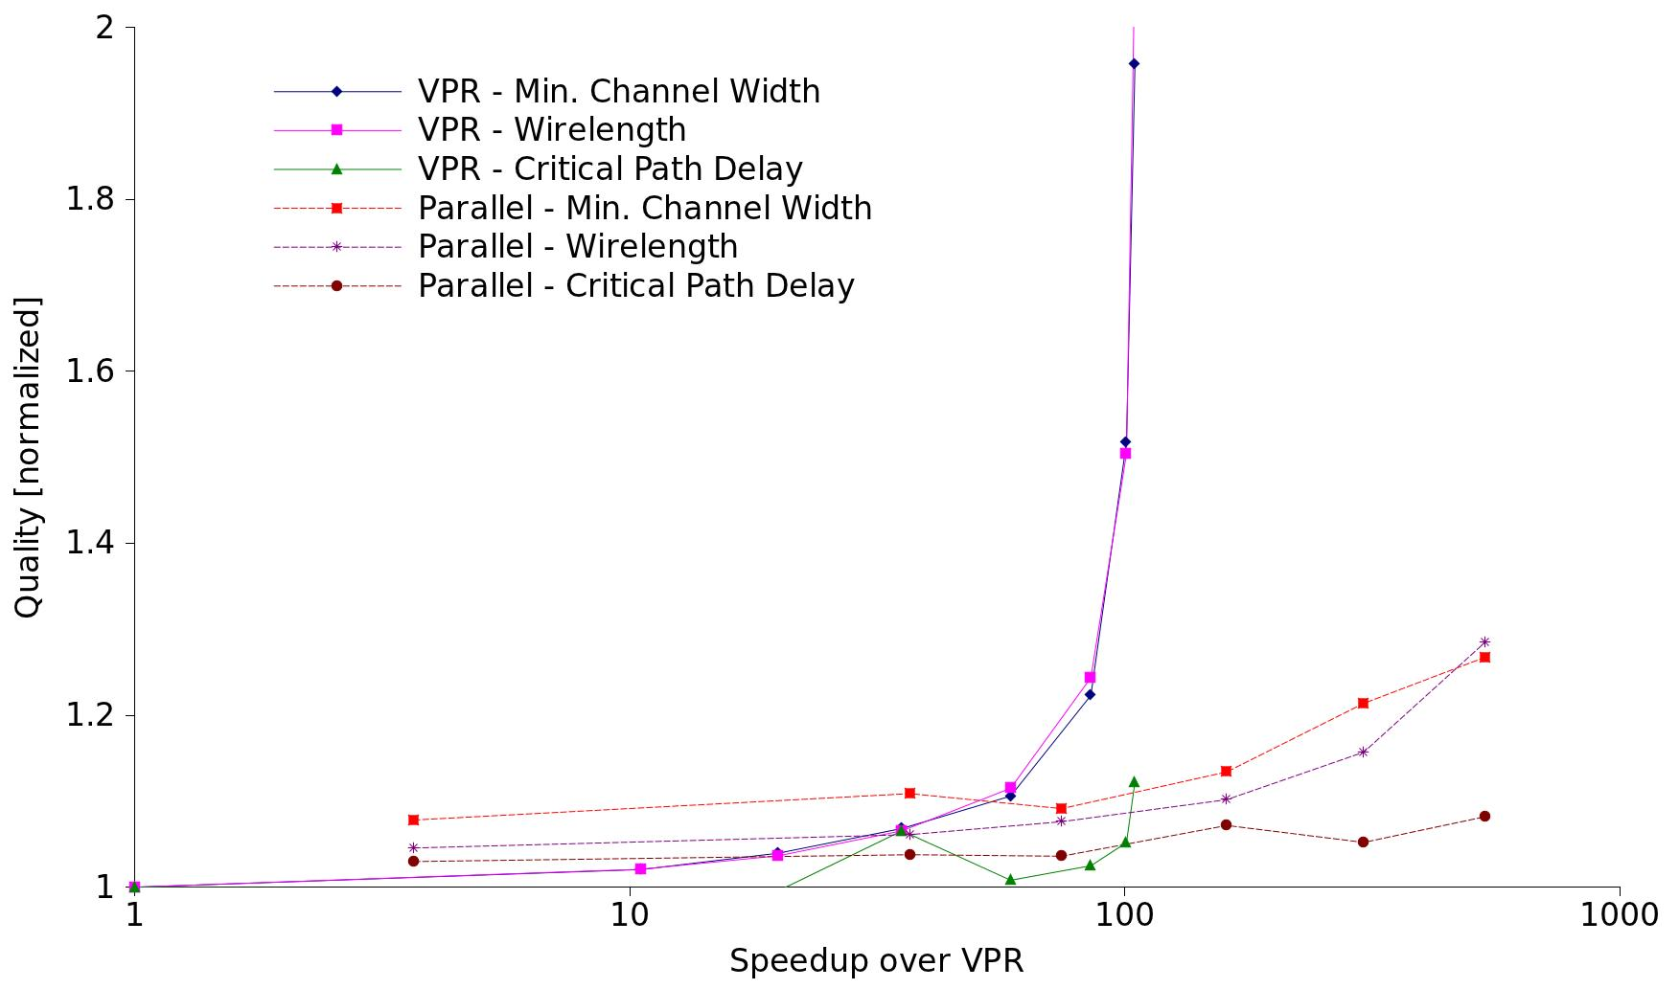
Quality - speed up over VPR
Notes:
Rightmost point is VPR, then VPR fast
VPR curve is created by changing inner_num, and I have generated my curves In a similar fashion

Slide 58
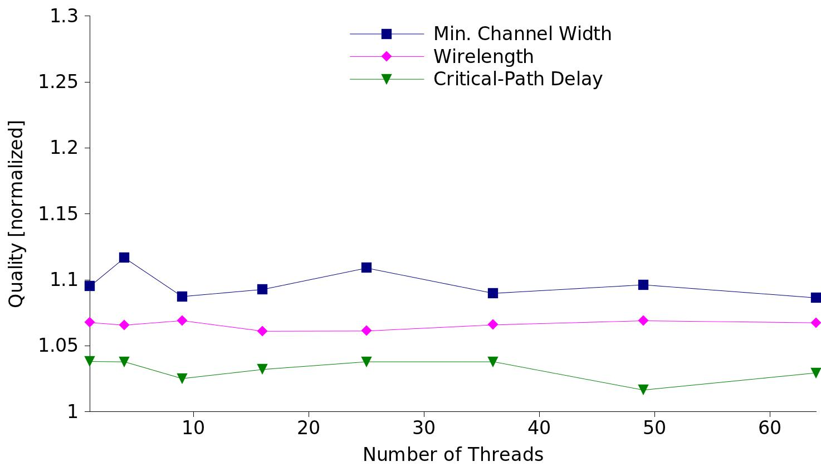
Effect of scaling on QoR
@ inner_num= 1
Notes:
We weren’t able to achieve speedup beyond 25 threads, but let’s see how the quality looks beyond that.
Using region_place_count = 90
Very little impact as we scale

Slide 59
Overview
Motivation
Background
Parallel Placement Algorithm
Result
Future Work
Conclusion

Slide 60
Further runtime scaling
Can we scale beyond 25 threads?
Better load balance techniques
  Improved region partitioning
New data structures
  Support fully parallelizable timing updates
  Reduce inter-processor communication
Incremental timing analysis update
  May benefit QoR as well!

Slide 61
Future Work - LUT placement
k
e
i
c
f
l
n
m
h
g
d
b
j
a

Slide 62
Future Work - LUT placement
k
e
i
c
f
l
n
m
h
g
d
b
j
a

Slide 63
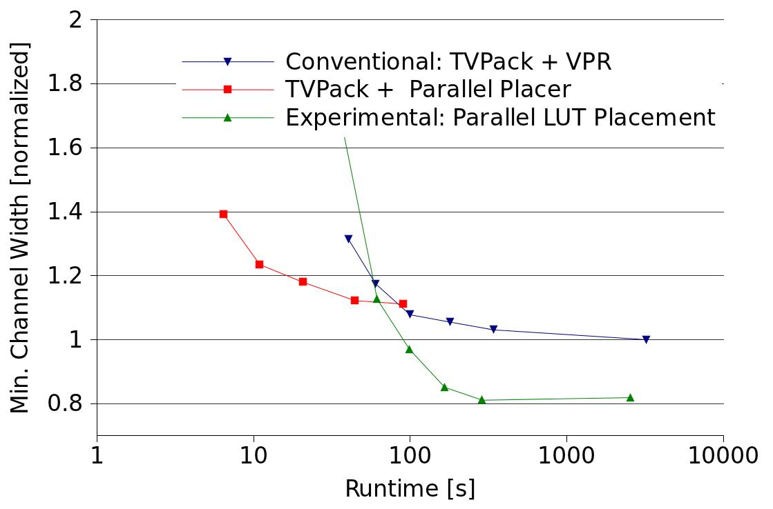
Future Work - LUT placement
21%

Slide 64
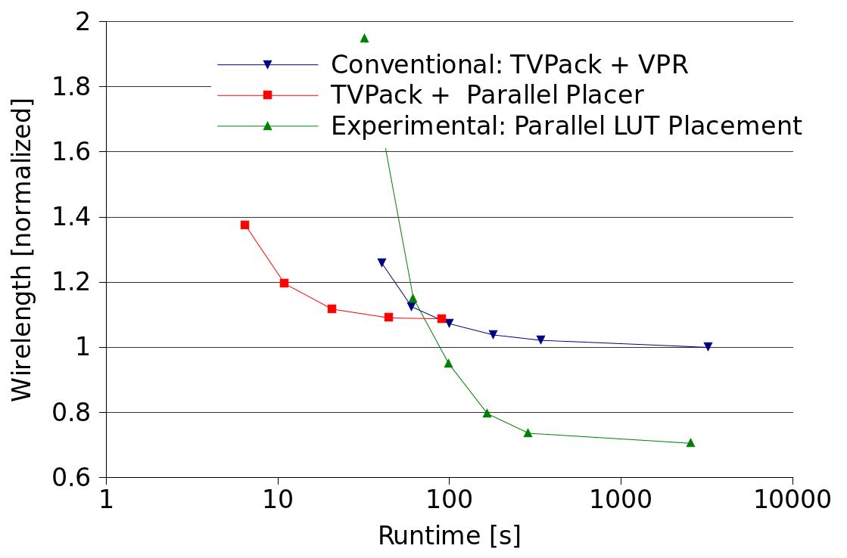
Future Work - LUT placement
28%

Slide 65
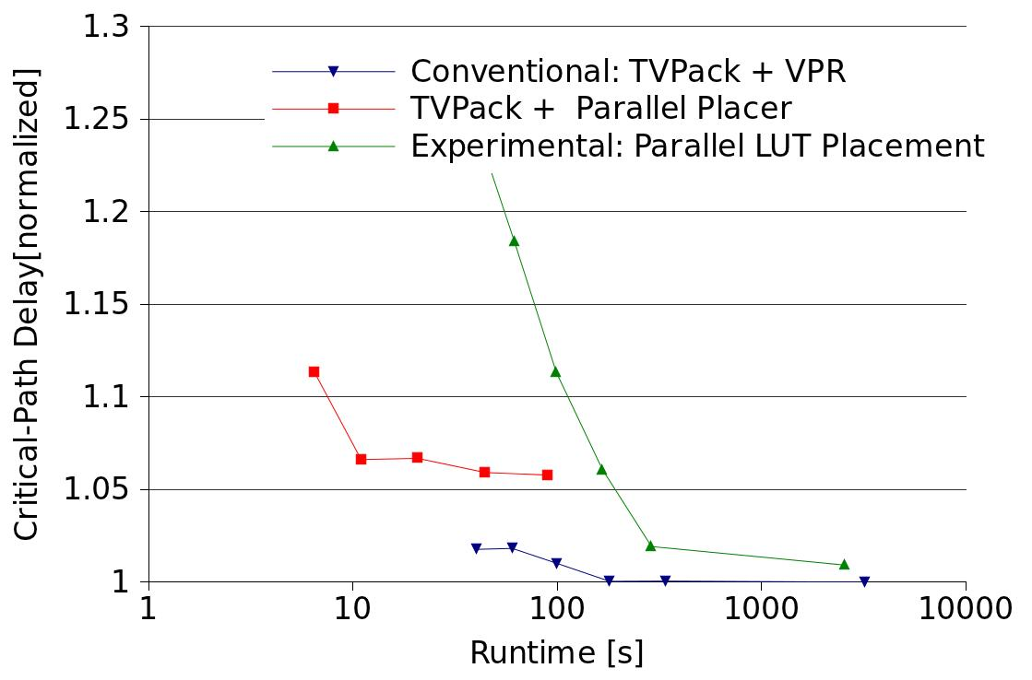
Future Work - LUT placement
1.8%

Slide 66
Conclusion
Determinism without fine-grain synchronization
  Split work into non overlapping regions
  Local (stale) copy of global data
Runtime scalable, timing-driven
Quality unaffected by number of threads
Speedup:
  >500X over VPR with <30% quality degradation
  161X speed up over VPR with 13%, 10% and 7% in post-routing min. channel width, wirelength, and critical-path delay
Limitation – cannot match VPR’s quality
  LUT placement is a promising approach to mitigate this issue

Slide 67
Questions?

