Slide 1

The University of British Columbia
VENICE
A Soft Vector Processor
Aaron Severance
  Advised by Prof. Guy Lemieux
  Zhiduo Liu, Chris Chou, Jason Yu, Alex Brant, Maxime Perreault, Chris Eagleston

Slide 2
Motivation
FPGAs for embedded processing
  Exist in many embedded systems already
    Glue logic, high speed I/O’s
  Ideally do data processing on-chip
    Reduced power, footprint, bill of materials
Several goals to balance
  Performance (must meet, no(?) bonus for exceeding)
  FPGA resource usage; more -> larger FPGA needed
  Human resource requirements & time (cost/time to market)
    Ease of programming, debugging
  Flexibility & reusability
    Both short (run-time) term and long term
Notes:
FPGAs are used today in many embedded tasks
Signal processing, multimedia
Soft processor systems are becoming more common, simplifies development
According to a 2007 survey by Embedded.com, 36% of respondents use soft processor in FPGA design
Although Nios/MB highly optimized

Slide 3
Some Options:
Custom accelerator
  High performance, low device usage
  Time-consuming to design and debug
  1 hardware accelerator per function
Hard processor
  Fixed number (1 currently) of relatively simple processors
  Fixed balance for all applications
    Data parallelism (SIMD)
    ILP, MLP, speculation, etc.
High level synthesis
Overlay architectures
Notes:
Current FPGAs have dual port memory
Register file write ports does not scale well for SS and VLIW
Dependency checking in SS complex
Custom hardware accelerator
Soft-CPU not so easy anymore
Many accelerators need even more time to design and test
Not easy to experiment with different solutions, or different accelerators

Slide 4
HLS vs. Overlays
High level synthesis (bottom up)
  Build from sequential code and make faster
  Only infer needed functions
  Run synthesis (minutes to hours) after algorithm change
Overlay architectures (top down)
  Build from everything, prune unneeded paths later
  Difficult to prune to bare minimum of resources
  Recompile program (seconds) after algorithm change

Slide 5
Programming Model
Both HLS and Overlays have restricted or flexible options
Restricted
  Fixed starting point (e.g. C with vector intrinsics)
  Code can be rewritten to fit the model?
    Yes: Good performance
    No: Give up? (run on soft/hard processor)
Flexible
  Arbitrary starting point (e.g. sequential C code)
  Code can be (is) rewritten to fit possible architectures?
    Yes: Good performance
    No: Poor performance

Slide 6
Our Focus
Overlay architecture
  Start with full data parallel engine
    Prune unneeded functions later
  Fast design cycles (productivity)
    Compile software, don’t re-run synthesis/place & route
  Flexible, reusable
  Could use HLS techniques on top of it…
Restricted programming model
  Forces programmer to write ‘good’ code
  Can be inferred from flexible (C code) where appropriate

Slide 7
Overlay Options:
Soft processor: limited performance
  Single issue, in-order
  2 or 4-way superscalar/VLIW register file maps inefficiently to FPGA
  Expensive to implement CAMs for OoOE
Multiprocessor-on-FPGA: complexity
  Parallel programming and debugging
  Area overhead for interconnect
  Cache coherence, memory consistency
Soft vector processor: balance
  For common embedded multimedia applications
  Easily scalable data parallelism; just add more lanes (ALUs)
Notes:
Current FPGAs have dual port memory
Register file write ports does not scale well for SS and VLIW
Dependency checking in SS complex
Custom hardware accelerator
Soft-CPU not so easy anymore
Many accelerators need even more time to design and test
Not easy to experiment with different solutions, or different accelerators

Slide 8
Soft Vector Processor
Change algorithm → same RTL, just recompile software
Simple programming model
  Data-level parallelism, exposed to the programmer
One hardware accelerator supports many applications
Scalable performance and area
  Write once, run anywhere…
  Small FPGA: 1 ALU (smaller than Nios II/f)
  Large FPGA: 10’s to 100’s of parallel ALUs
  Parameterizable; remove unused functions to save area
Notes:
Scalable to different maximum vector lengths and numbers of parallel pipelines
Regular, makes it easy to accelerate
Shown by Berkeley VIRAM vector processor project to work better than SS and VLIW in data-parallel embedded workload
Soft vector processor abstracts FPGA resources

Slide 9
Vector Processing
Organize data as long vectors
  Replace inner loop with vector instruction
Hardware loops until all elements are processed
  May execute repeatedly (sequentially)
  May process multiple at once (in parallel)
for( i=0; i<N; i++ )
a[i] = b[i] * c[i]
set vl, N
vmult a, b, c

Slide 10
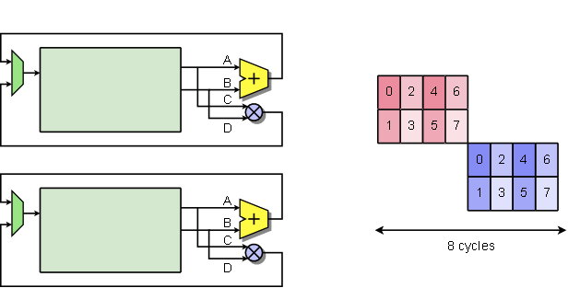
Hybrid Vector-SIMD
C
E
6
4
2
0
for( i=0; i<8; i++ ) {
C[i] = A[i] + B[i]
E[i] = C[i] * D[i]
}
C
E
7
5
3
1

Slide 11
Previous SVP Work
1st Gen: VIPERS (UBC) & VESPA (UofT)
  Similar to Cray-1 / VIRAM
  Vector data in registers
  Load/store for memory accesses
2nd Gen: VEGAS (UBC)
  Optimized for FPGAs
  Vector data in flat scratchpad
    Addresses in scratchpad stored in separate register file
  Concurrent DMA engine

Slide 12
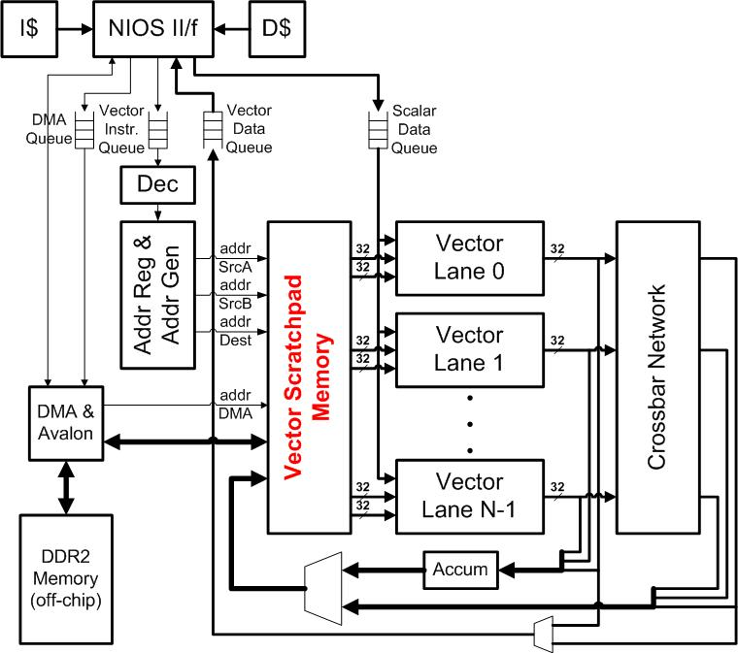
VEGAS (2nd Gen) Architecture
Scalar Core:
NiosII/f
Vector Core:
VEGAS
Concurrent execution:
in order dispatch, explicit syncing
VEGAS
DMA engine: to/from external memory

Slide 13
VEGAS (2nd Gen):
Efficient On-Chip Memory Use
Scratchpad-based “register file” (2kB..2MB)
  Vector address register file stores vector locations
  Very long vectors (no maximum length)
  Any number of vectors
  (no set number of “vector data registers”)
  Double-pumped to achieve 4 ports
    2 Read, 1 Write, 1 DMA Read/Write
Lanes support sub-word SIMD
  32-bit ALU configurable as 1x32, 2x16, 4x8
  Keeps data packed in scratchpad for larger working set
Notes:
Allows area customization according to application requirements
Will discuss customizable aspects in a later slide

Slide 14
VENICE Architecture
3rd Generation
Optimized for Embedded Multimedia Applications
High Frequency, Low Area

Slide 15
VENICE Overview
Vector Extensions to NIOS Implemented Compactly and Elegantly
Continues from VEGAS (2nd Gen)
  Scratchpad memory
  Asynchronous DMA transactions
  Sub-word SIMD (1x32, 2x16, 4x8 bit operations)
Optimized for smaller implementations
  VEGAS achieves best performance/area at 4-8 lanes
    Vector programs don’t scale indefinitely
    Communications networks scale > O(N)
  VENICE targets 1-4 lanes
    About 50% .. 75% of the size of VEGAS

Slide 16
VENICE
Architecture

Slide 17
Selected Contributions
In-pipeline vector alignment network
  No need for separate move/element shift instructions
  Increased performance for sliding windows
  Ease of programming/compiling (data packing)
  Only shift/rotate vector elements
    Scales O( N * log(N) )
    Acceptable to use multiple networks for few (1 to 4) lanes

Slide 18
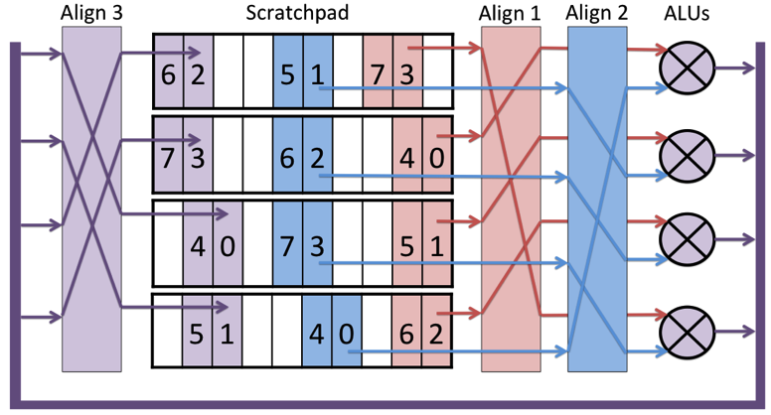
Scratchpad Alignment

Slide 19
Selected Contributions
In-pipeline vector alignment network
2D/3D vector operations
  Set # of repeated ops, increment on sources and dest
  Increased instruction dispatch rate for multimedia
  Replaces increment/window of address registers (2nd Gen)
    Had to be implemented in registers instead of BRAM
      Modified 3 registers per cycle

Slide 20
VENICE Programming
FIR using 2D Vector Ops
int num_taps, num_samples; int16_t *v_output, *v_coeffs, *v_input;
// Set up 2D vector parameters:
vector_set_vl( num_taps ); // inner loop count
vector_set_2D( num_samples, // outer loop count
1*sizeof(int16_t), // dest gap
(-num_taps )*sizeof(int16_t), // srcA gap
(-num_taps+1)*sizeof(int16_t) ); // srcB gap
// Execute instruction; does 2D loop over entire input, multiplying and accumulating
vector_acc_2D( VVH, VMULLO, v_output, v_coeffs, v_input );

Slide 21
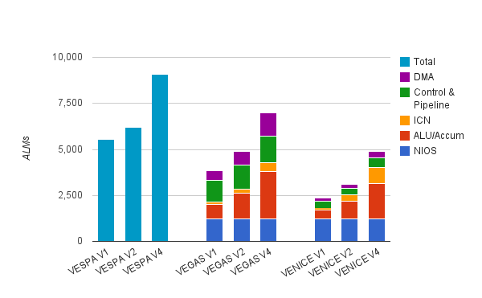
Area Breakdown
VENICE: Lower control & overall area
ICN (alignment) scales faster but does not dominate

Slide 22
Selected Contributions
In-pipeline vector alignment network
2D/3D vector operations
Single flag/condition code per instruction
  Previous SVPs had separate flag registers/scratchpad
  Instead, encode a flag bit with each byte/halfword/word
  Can be stored in 9th bit of 9/18/36 bit wide BRAMs

Slide 23
Selected Contributions
In-pipeline vector alignment network
2D/3D vector operations
Single flag/condition code per instruction
More efficient hybrid multiplier implementation
  To support 1x32-bit, 2x16-bit, 4x8-bit multiplies

Slide 24
Fracturable Multipliers in Stratix III/IV DSPs
2 DSP Blocks + extra logic
2 DSP Blocks (no extra logic)

Slide 25
Selected Contributions
In-pipeline vector alignment network
2D/3D vector operations
Single flag/condition code per instruction
More efficient hybrid multiplier implementation
Increased frequency
  200MHz+ vs ~125MHz of previous SVPs
  Deeper pipelining
  Optimized circuit design

Slide 26
Average Speedup vs. ALMs

Slide 27
Computational Density

Slide 28
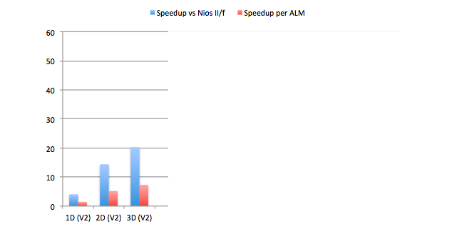
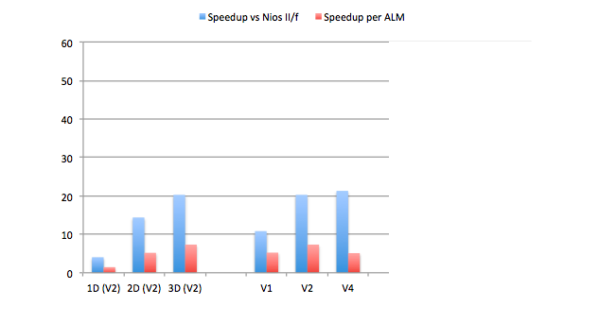
Speeding up the
4x4 DCT (16-bit)

Slide 29
Future Work
Scatter/gather functionality
  Vector indexed memory accesses
  Need to coalesce to get good bandwidth utilization
Automatic pruning of unneeded overlay functionality
  HLS in reverse
Hybrid HLS←→overlays
  Start from overlay and synthesize in extra functionality?
    Overlay + custom instructions?

Slide 30
Conclusions
Soft Vector Processors
  Scalable performance
  No hardware recompiling necessary
VENICE
  Optimized for FPGAs, 1 to 4 lanes
  5X Performance/Area of Nios II/f on multimedia benchmarks

