Slide 1
Wavefront Skipping using BRAMs for Conditional Algorithms on Vector Processors
Aaron Severance
Joe Edwards
Guy G.F. Lemieux

Slide 2
VectorBlox MXP Soft Vector Processor (SVP)
Software programmable
1 to 128 parallel ALUs
(4 shown)
Flat scratchpad memory
Vectors at any address,
have any length
2
Notes:
Software Compilation Times

Slide 3
Vectors in Scratchpad Memory
3

Slide 4
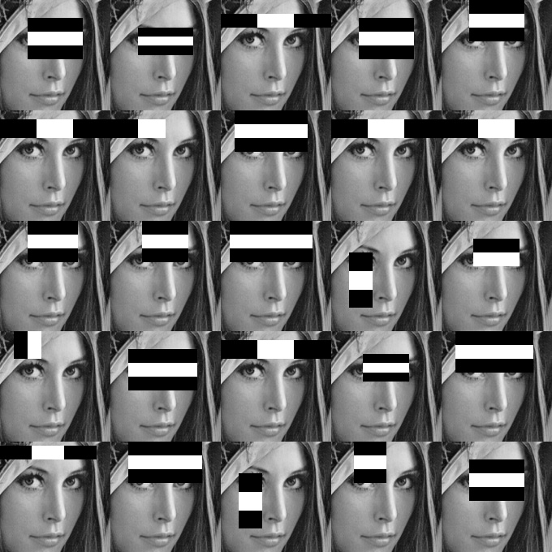
Early Exit Algorithms
Stage 1
Stage 2
Stage 3

Slide 5
Divergent Control Flow on SVPs
Predication/CMOV
Process entire vector
Vector Compress
Load inputs, compress
Expand outputs, store
Wavefronts
(1 per cycle)
Vector
Lanes
Mask Vector:
1’s in corresponding vector are active
0’s are disabled

Slide 6
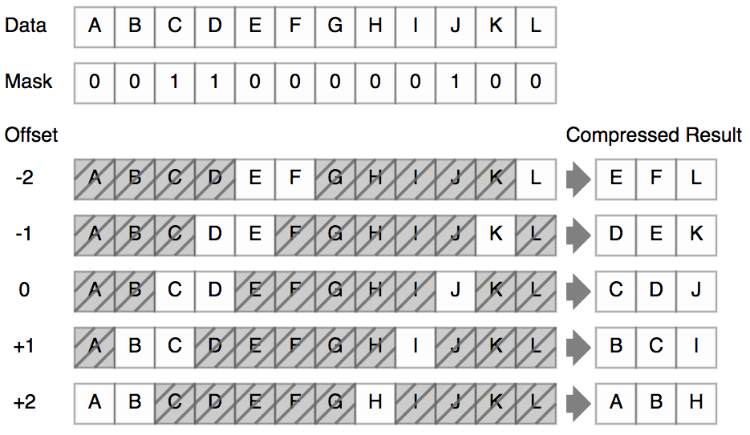
Vector Compress: 5x1 Sliding Window
N*M compress operations (time)
N*M temporary vectors (space)

Slide 7
Divergent Control Flow on SVPs
Predication/CMOV
Process entire vector
Vector Compress
Load inputs, compress
Expand outputs, store
Compress + Scatter/Gather
Compress addresses
Load/store indexed
Density-time
Scan mask for next valid wavefront
Wavefronts
(1 per cycle)
Vector
Lanes
Mask Vector:
1’s in corresponding vector are active
0’s are disabled

Slide 8
Wavefront Skipping using BRAMs
Wavefront Number (Offset)
7
6
5
4
3
2
1
0
Mask Vector
Mask BRAM
mask_setup() comparison populates mask BRAM
Only wavefronts with active elements stored
Masked execution adds offsets from mask BRAM to base

Slide 9
Code Example
#define STRIDE 5
//Toy functition to double every fifth element in the vector v_a
void double_every_fifth_element( int *v_a, int *v_temp int vector_length ){
int i;
//Initialize every fifth element of v_temp to zero
for( i = 0; i < vector_length; i++ ) {
v_temp[i] = i % STRIDE;
}
//Set the vector length which will be processed
vbx_set_vl( vector_length );
//Set mask for every element equal to zero
vbx_setup_mask( CMOV_Z, v_temp );
//Perform the wavefront skipping operation: multiply all non-masked off
//elements of v_a by 2 and store the result back in v_a
vbx_masked( SVW, MUL, v_a, 2, v_a );
}

Slide 10
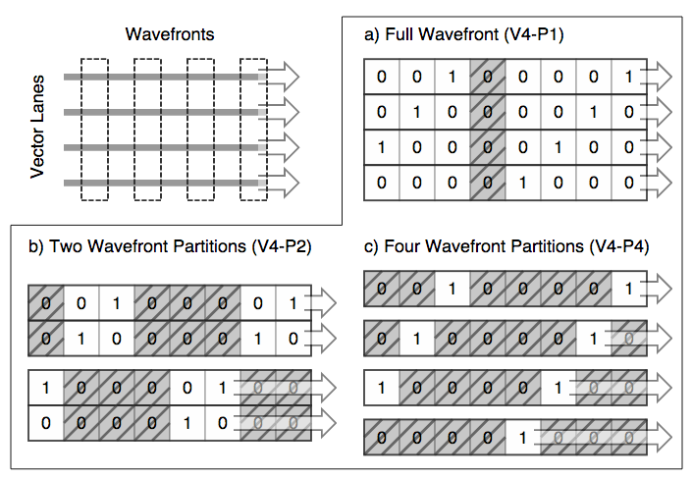
Partial Wavefront Skipping
Notes:
Animate, say # of cycles taken

Slide 11
BRAM Usage for Varying MMVL
Increasing Maximum Masked Vector Length (MMVL):
More wavefronts, more speedup with sparse masks
Deeper BRAMs needed

Slide 12
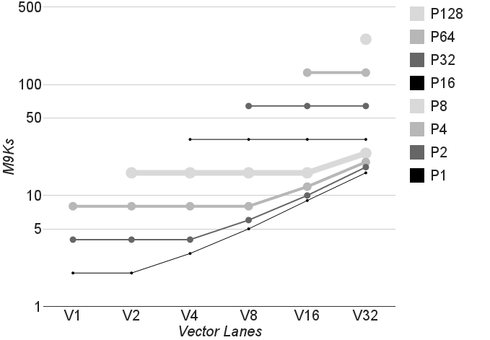
BRAM Usage for Multiple Partitions

Slide 13
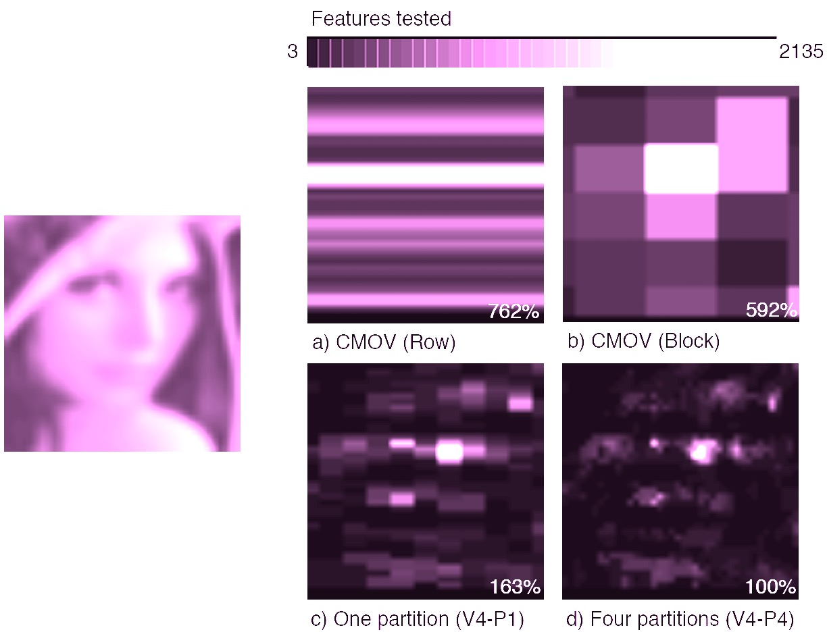
Work Done for Different Strategies

Slide 14
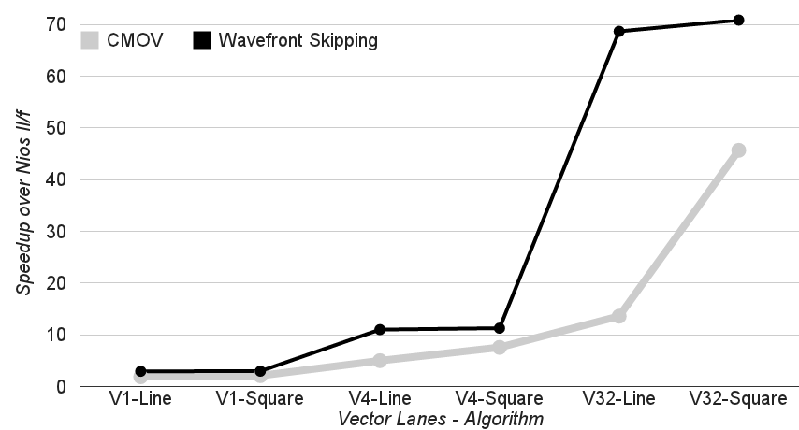
Different Strategies (Mandelbrot Set)

Slide 15
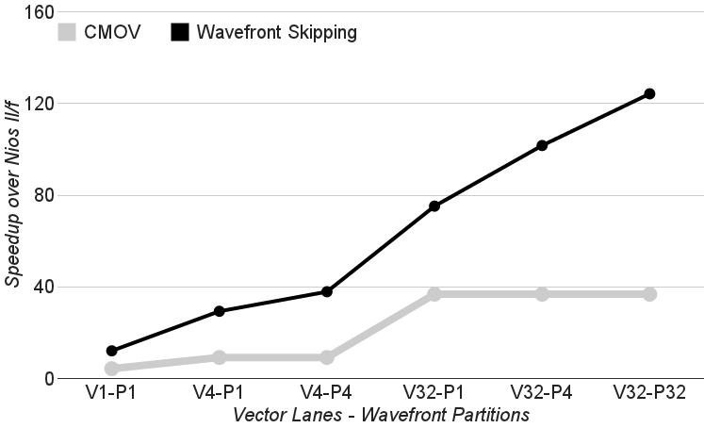
Face Detect Results

Slide 16
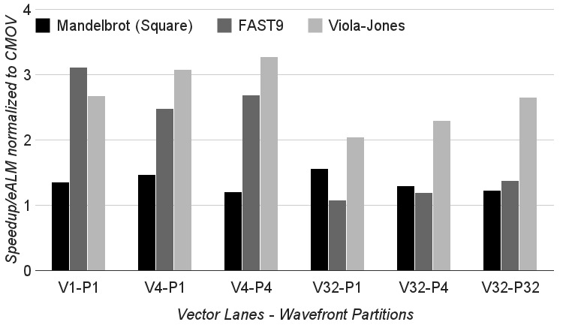
Speedup per Area (eALM)

Slide 17
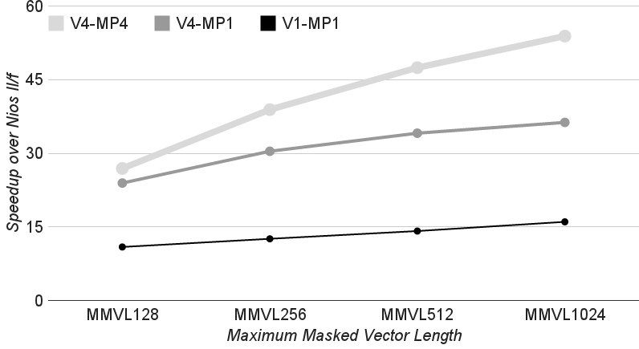
Varying MMVL (Face Detect)

Slide 18
Limitations and Future Work
Large area cost for multiple partitions
Area overhead on V4: 1 partition 4%, 4 partitions 26%
Single mask
Requires extra instructions to store/restore

Slide 19
Conclusions
BRAMs used to implement Wavefront Skipping
Wide configurations space
Full Wavefront Skipping uses <5% more eALMs
Multiple partitions, longer MMVL can use 100’s of BRAMs
3x higher performance per area on early exit algorithms

Slide 20
Thank You!

