Slide 1

Soft Vector Processors with Streaming Pipelines
Aaron Severance
Joe Edwards
Hossein Omidian
Guy G. F. Lemieux

Slide 2

Motivation
Data parallel problems on FPGAs
  ESL?
  Overlays?
  Processors?

Slide 3

Example: N-Body Problem
O(N²) force calculation
  Streaming Pipeline (custom vector instruction)
O(N) housekeeping
  Overlay (soft vector processor)
O(1) control
  Processor (ARM or soft-core)

Slide 4
Soft Vector Processor (SVP)

Slide 5
VectorBlox MXP
1 to 128 parallel vector lanes (4 shown)
Notes:
----- Meeting Notes (2/18/2014 14:43) -----
multibanked scratchpad mention (4 ports)

Slide 6
MXP Datapath

Slide 7
Custom Vector Instructions (CVIs)
Simple CVI parallel scalar CIs
Notes:
Less talk, more onto next
Mention across lanes, briefly

Slide 8
CVI Complications (1)
CVIs can be big
  e.g. square root, floating point
  Bigger than entire integer ALU
Make them cheaper
  Don’t replicate for every lane
  Reuse existing alignment networks
    No additional costs, buffering

Slide 9
Cheap Heterogeneous Lanes

Slide 10
CVI Complications (2)
CVIs can be deep
  e.g. FP addition >> depth than MXP pipeline
    Execute stage is 3 cycles, stall-free
CVI pipeline must ‘warm up’
  Don’t writeback until valid data appears
  Best if vector length >> CVI depth

Slide 11
Multiple Operand CVIs
2D N-body problem: 3 inputs, 2 outputs

Slide 12
4 Input, 2 Output CVI
Option 1: Spatially Interleaved
Easy for interleaved (Array-of-Struct) data
  But vector data is normally contiguous (SoA)

Slide 13
4 Input, 2 Output CVI
Option 2: Time Interleaved
Alternate operands every cycle
  Data is valid every 2 cycles

Slide 14
4 Input, 2 Output CVI
Option 2 with Funnel Adapters
Multiplex 2 CVI lanes to one pipeline
  Use existing 2D/3D instructions to dispatch

Slide 15
Building CVIs
We created CVIs via 3 methods:
  RTL
  Altera’s DSP Builder
  Synthesis from C (custom LLVM solution)

Slide 16
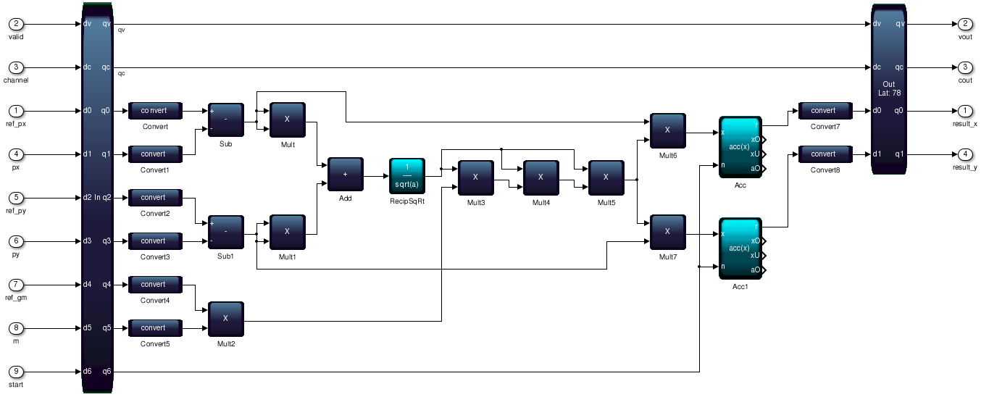
Altera’s DSP Builder
Fixed or Floating-Point Pipelines
  Automatic pipelining given target
Adapters provided to MXP CVI interface

Slide 17
Synthesis From C (using LLVM)
for( int glane = 0 ; glane < CVI_LANES ; glane++ ) {
f16_t gmm = f16_mul( ref_gm, m[glane] );
f16_t dx = f16_sub( ref_px, px[glane] );
f16_t dy = f16_sub( ref_py, py[glane] );
f16_t dx2 = f16_mul(dx,dx);
f16_t dy2 = f16_mul(dy,dy);
f16_t r2 = f16_add(dx2,dy2);
f16_t r = f16_sqrt(r2);
f16_t rr = f16_div(F16(1.0),r);
f16_t gmm_rr = f16_mul(rr,gmm_68);
f16_t gmm_rr2 = f16_mul(rr,gmm_rr);
f16_t gmm_rr3 = f16_mul(rr,gmm_rr2);
f16_t dfx = f16_mul(dx,gmm_rr3);
f16_t dfy = f16_mul(dy,gmm_rr3);
f16_t result_x = f16_add(result_x[glane],dfx);
f16_t result_y = f16_add(result_y[glane],dfy);
result_x[glane] = result_x;
result_y[glane] = result_y;
}
CVI templates provided
Restricted C subset - Verilog
  Can run on scalar core for easy debugging
#define CVI_LANES 8 /* number of physical lanes */
typedef int32_t f16_t
f16_t ref_px, ref_py, ref_gm;
f16_t px[CVI_LANES], py[CVI_LANES], m[CVI_LANES];
f16_t result_x[CVI_LANES], result_y[CVI_LANES];
void force_calc()
{
for( int glane = 0 ; glane < CVI_LANES ; glane++ ) {
//CVI code here
}
}

Slide 18
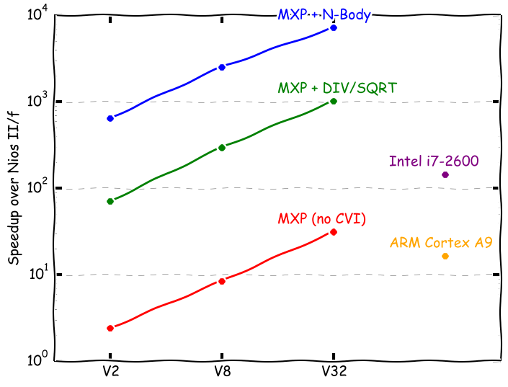
N-Body Performance

Slide 19
Performance/Area
SVP Configuration V32, 16 physical pipelines | Speedup/ALM Relative to Nios II/f
MXP | 1.1
MXP + DIV/SQRT | 19.7
MXP + N-Body (floating-point) | 68.7
MXP + N-Body (fixed-point) | 116.0

Slide 20
Conclusions
CVIs can incorporate streaming pipelines
  SVP handles control, light data processing
  Deep pipelines exploit FPGA strengths
Efficient, lightweight interfaces
  Including multiple input & output operands
Multiple ways to build and integrate

Slide 21

Thank You

