Slide 1
Automated Space/Time Scaling of
Streaming Task Graphs
Hossein Omidian
Supervisor: Guy Lemieux

Slide 2
Contents
Introduction
KPN-based HLS Tool for MPPA overlay
Experimental Results
Future Work
Conclusion

Slide 3
Introduction
Clock frequency scaling has essentially stopped due to power issue
  Coarse-grained parallelism is achieved in multi-core processor
    High-level Languages
  Fine-grained parallelism is achieved in FPGA and ASIC
    Hardware-level solutions
Both can be challenging
In this work we wish to explore the design space in between traditional multi-core CPU and low-level FPGA/ASIC solutions

Slide 4
Motivation/Objectives
We will investigate whether an array of ALUs or very lightweight processors (MPPA overlay), can achieve sufficient levels of performance, and make design entry sufficiently easy
To explore the MPPA as an alternative target, we need three things
  A tool flow that can compile algorithms into the target
  A detailed architecture description or implementation, and
  A set of benchmarks to compile into the framework

Slide 5
Programming Model/KPN model
Ambric Programming model
Java-based
Java object is created for each thread, becoming nodes that communicate together through FIFO communication channels
Similar to Kahn Processing Network
Channels
A
P
P
L
I
C
A
T
I
O
N
1
Primitive node
2
3
4
Composite node
5
6
7

Slide 6
KPN-based HLS for MPPA overlay
Program
Java
Stream Task Graph
Java
Java
Compiler
1111111111111111
aStruct
Intra-Node Optimizer
DB of Implementations
for each node
Inter-Node Optimizer
Trade-off
Trade-off Finder
FPGA
MPPA Overlay Generator
Architecture library
MPPA overlay
Back-end

Slide 7
KPN-based HLS for MPPA overlay
PE PE1 (outbound out, inbound in1, inbound in2){
implementation “PE1_imp.java";
}
PE PE2 (outbound out, inbound in){
implementation ”PE2_imp.java";
}
binding b1 {
channel C0 = {PE1.out ,PE2.in};
}
Program
Java
Stream Task Graph
Java
Java
Compiler
1111111111111111
A={f₁,f₂, …, f_{N}}
aStruct
Intra-Node Optimizer
class C_PE1
{
public static void main(InputStream in1,
InputStream in2, OutputStream out)
{
out = writeTo( in1.readFrom() & in2.readFrom() );
}
}
DB of Implementations
for each node
Inter-Node Optimizer
Trade-off
Trade-off Finder
FPGA
MPPA Overlay Generator
class C_PE2
{
public static void main(InputStream in,
OutputStream out)
{
out = writeTo( in.readFrom()*2 );
}
}
Architecture library
MPPA overlay
Back-end

Slide 8
KPN-based HLS for MPPA overlay
Program
Java
Stream Task Graph
Java
Java
Compiler
1111111111111111
First find the best throughput
Expanding
Combining
Pipelining
aStruct
Intra-Node Optimizer
DB of Implementations
for each node
Inter-Node Optimizer
Trade-off
Trade-off Finder
FPGA
MPPA Overlay Generator
Architecture library
MPPA overlay
Back-end

Slide 9
KPN-based HLS for MPPA overlay
Program
Java
Stream Task Graph
Java
Java
Compiler
1111111111111111
aStruct
Finding different implementation
Clustering
Send operations back and forth between clusters
Intra-Node Optimizer
DB of Implementations
for each node
Inter-Node Optimizer
Trade-off
Trade-off Finder
FPGA
MPPA Overlay Generator
Architecture library
MPPA overlay
Back-end

Slide 10
KPN-based HLS for MPPA overlay
Program
Java
Stream Task Graph
Java
Java
Compiler
1111111111111111
A={f₁,f₂, …, f_{N}}
aStruct
Intra-Node Optimizer
DB of Implementations
for each node
Inter-Node Optimizer
Trade-off
Trade-off Finder
FPGA
MPPA Overlay Generator
Architecture library
MPPA overlay
Back-end

Slide 11
Inter-Node Optimizer (INO)
Implementations P_{m}
Each implementation
  Can perform functionality of f_{m}
  Area cost and Initiation Interval
  Different inverse throughput for each channel input/output throughput
  Input inverse throughput
  Output inverse throughput

Slide 12
N-Body Problem
Gravity Force Calculation

Slide 13
N-Body Problem
Expanding

Slide 14
N-Body Problem
Different implementations

Slide 15
Trade-off Finder
Two modes
  Given available area and different implementations for each node, maximizing throughput
  Given throughput target and different implementations for each node, minimizing area
Two approaches
  Integer Linear Programming (GNU linear programming kit)
  Our heuristic approach

Slide 16
Integer Linear Programming approach
For each composite node
  Which Implementation should be selected
  How many replicas are needed
  Disadvantages:
    Lack of flexibility
    Time inefficient

Slide 17
Our heuristic Trade-off Finder
Throughput Analysis
Application Throughput Propagation and Balancing
Bottleneck Optimizer

Slide 18
Throughput Analysis
Finding throughput slack
To achieve minimum inverse throughput v_{mo}, the input data have to be ready with expected inverse throughput v_{ei}. We define slack v_{s} for each channel as
v_{s}=v_{mo}-v_{ei}

Slide 19
Throughput Analysis
Calculating weight for each node

Slide 20
Throughput Propagation and Balancing
J. Cong et.al. , "Combining module selection and replication for throughput-driven streaming programs

Slide 21
Bottleneck Optimizer
Similar to ILP, it selects an implementation and makes replicas
Unlike ILP it considers neighbouring nodes
Saving area

Slide 22
Bottleneck Optimizer
For nf=4 we will save 75% of area overhead

Slide 23
Heuristic Approach
Starting with implementation with the highest throughput for each node
Passed the area limit
Throughput Analysis in order to find bottlenecks
Calculate Area cost
Budgeting
Bottleneck Optimizer
Passed the area limit
Application Throughput Propagation and Balancing
Calculate estimated Area cost for nodes
Budget the bottleneck

Slide 24
Results
JPEG
Color Conversion
DCT
Quantization
Encoding
Module | Color Conversion |  |  |  | DCT |  |  |  |  | Quantization |  |  |  |  | Encoding
Version | v1 | v2 | v3 | v4 | v1 | v2 | v3 | v4 | v5 | v1 | v2 | v3 | v4 | v5 | v1
Inverse T | 1 | 2 | 4 | 8 | 1 | 2 | 4 | 6 | 32 | 1 | 2 | 4 | 8 | 128 | 512
Area | 512 | 256 | 128 | 64 | 800 | 400 | 224 | 160 | 50 | 512 | 256 | 128 | 64 | 4 | 22
Method | T | Color Conversion |  | DCT |  | Quantization |  | Encoding |  | Overhead | Total Area
 |  | impl | rep | impl | rep | impl | rep | impl | rep
ILP | 8 | v4 | 1 | v4 | 1 | v4 | 1 | v1 | 32 | 1280 | 2976
Heuristic |  | v4 | 1 | v5 | 4 | v5 | 16 | v1 | 32 | 0 | 1736

Slide 25
Future Work
MPPA Overlay Generator
Time and Resource sharing

Slide 26
MPPA Overlay Generator
1 TOPS ->32bit integer overlay and
800GFLOPS -> 32bit single-precision floating point overlay on the largest Stratix 10 device

Slide 27
Time and Resource Sharing
Using underutilized nodes
Stalling most of the times

Slide 28
Conclusion
Studied the problem of automatically finding area/throughput trade-off of streaming applications being mapped onto MPPA overlays
We introduce a high-level synthesis tool that compiles an stream application written in Java as a streaming task graph
Partitions it into composite nodes
Finds all degrees of parallelism for each
Uses different approaches in order to find different implementations for each node
And finally finds a good trade off between area and throughput.
Our approach differs from existing approaches
  it automatically investigates partitioning and finding different implementations, and
  it combines module selection and replication methods with node combining and splitting in order to automatically find a better area/throughput trade-off
This approach has been verified with small designs in StreamIt and a few larger designs like the JPEG encoder

Slide 29

Questions?

Slide 30
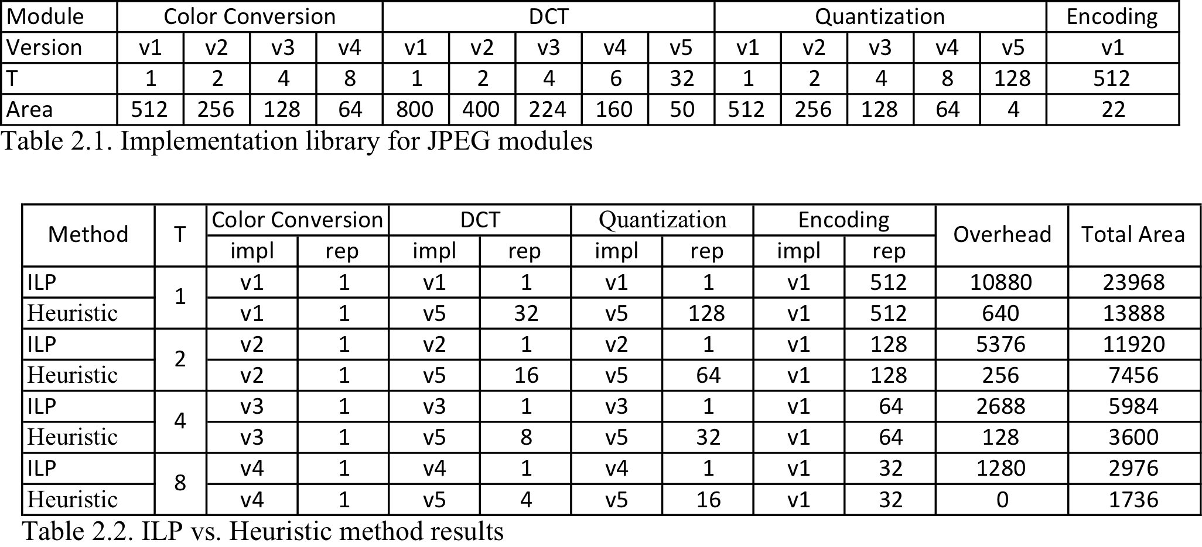
Results
JPEG
Color Conversion
DCT
Quantization
Encoding

