Slide 1
Exploring Automated Space/Time Tradeoffs for
OpenVX Compute Graphs
Hossein Omidian, Guy Lemieux

Slide 2
Motivation: Computer Vision on FPGAs
OpenCV: de facto API/toolkit
    while(operations remaining) {
    read frame;
    frame = Operate(frame);
    write frame;
    }
  Frame size > on-chip memory ➔ Low performance, high power
OpenVX: standards-based API/toolkit by Khronos (OpenCL)
    while(tiles remaining) {
    read tile;
    while(operations remaining)
    tile = Operate(tile);
    write tile;
    }
  Small tile size ➔ Pipelining, cache-friendly, low power

Slide 3
OpenVX Programming Model
C library
Streaming compute graph
  Operations + local data buffering
  Two-phase execution
    Build + optimize graph
    Execute graph
Example: Sobel
  5 nodes, 1 input, 2 outputs
  Send image tiles through pipeline

Slide 4
OpenVX on FPGAs
PROBLEMS
How to “scale” to any size FPGA?
  Only write one C program
  Area target
  Throughput target
How to break into tiles?
How to balance throughput of entire graph?
OUR SOLUTION
JANUS: Tool to automatically balance area/throughput

Slide 5
Example: Streaming Compute Kernel
void compute_kernel()
{
for( int i = 0 ; i < N; i++ ) {
// STREAM INPUTS m[i] px[i] py[i]
gmm = M(ref_gmm,m[i]);
dx = S(ref_px, px[i]);
dy = S(ref_py, py[i]);
dx2 = M(dx, dx);
dy2 = M(dy, dy);
r2 = A(dx2, dy2);
r = SQRT(r2);
rr = D(1, r);
gmm_rr = M(rr, gmm);
gmm_rr2 = M(rr, gmm_rr);
gmm_rr3 = M(rr, gmm_rr2);
dfx = M(dx, gmm_rr3);
dfy = M(dy, gmm_rr3);
}
}
Using HLS
Each compute kernel has unique Initiation Interval
2
1
1
2
Kernel | Initiation Interval
A and S | 1
M | 2
SQRT | 4
D | 8
2
1
4
8
2
2
2
2
2

Slide 6






Example: OpenVX Graph
Critical path with parallelism: 24
Static Time Analysis
Throughput Analysis
$$x_{ref}$$
1
2
$$x_{i}$$
S
M
1
4
8
M
2
2
$$y_{ref}$$
1
2
A
Sqrt
D
M
M
M
2
S
M
2
2
$$y_{i}$$
M
$$M_{ref}$$
2
$$M_{i}$$
M

Slide 7
Example: OpenVX Graph
Critical path with parallelism: 24
Static Time Analysis
Throughput Analysis
$$x_{ref}$$
1
2
$$x_{i}$$
S
M
1
4
8
M
2
2
$$y_{ref}$$
1
2
A
Sqrt
D
M
M
M
2
2
2
24
$$y_{i}$$
S
M
M
$$M_{ref}$$
2
$$M_{i}$$
M

Slide 8
Example: OpenVX Graph
Pipelining
Balancing
Sending/gathering data to/from system
  Scheduling or back pressure
$$x_{ref}$$
1
2
$$x_{i}$$
S
M
1
4
8
M
2
2
$$y_{ref}$$
1
2
A
Sqrt
D
M
M
M
2
S
M
2
2
$$y_{i}$$
M
$$M_{ref}$$
2
$$M_{i}$$
M

Slide 9
Example: OpenVX Graph
Pipelining
Balancing
Sending/gathering data to/from system
  Scheduling or back pressure
$$x_{ref}$$
1
2
$$x_{i}$$
S
M
1
4
8
M
2
2
$$y_{ref}$$
1
2
A
Sqrt
D
M
M
M
2
S
M
2
2
$$y_{i}$$
M
$$M_{ref}$$
2
$$M_{i}$$
M

Slide 10
Example: OpenVX Graph
Pipelining
Balancing
Sending/gathering data to/from system
  Scheduling or back pressure
$$x_{ref}$$
1
2
$$x_{i}$$
S
M
1
4
8
M
2
2
$$y_{ref}$$
1
2
A
Sqrt
D
M
M
M
2
S
M
2
2
$$y_{i}$$
M
$$M_{ref}$$
2
$$M_{i}$$
M
24 ➔ 8

Slide 11
Balancing Throughput
In both cases, B is faster than A. Either:
Make A faster to match B
OR
Make B slower to save area

Slide 12
Example: OpenVX Graph
Replicating
Sending data in round-robin order
4
A
A
A
A
Sqrt
A
A
A
A
1
4
Sqrt
Sqrt
Sqrt
Sqrt

Slide 13
Example: OpenVX Graph
Replicating
Sending data in round-robin order
4
A
A
A
A
Sqrt
A
A
A
A
1
4
A
A
A
A
Sqrt
A
A
A
A
A
A
A
A
Sqrt
A
A
A
A
A
A
A
A
Sqrt
A
A
A
A
A
A
A
A
Sqrt
A
A
A
A

Slide 14
Example: OpenVX Graph
Replicating
Sending data in round-robin order
4
A
A
A
A
Sqrt
A
A
A
A
1
4
A
A
A
A
Sqrt
A
A
A
A
A
A
A
A
Sqrt
A
A
A
A
A
A
A
A
A
A
A
A
A
A
A
A
A
A
A
A
A
A
A
A
A
A
A
A
A
A
A
A
A
A
A
A
A
A
A
A
Sqrt
A
A
A
A
A
A
A
A
Sqrt
A
A
A
A

Slide 15
Example: OpenVX Graph
$$x_{ref}$$
1
2
$$x_{i}$$
S
M
1
4
8
M
2
2
$$y_{ref}$$
1
2
A
Sqrt
D
M
M
M
2
S
M
2
2
$$y_{i}$$
M
$$M_{ref}$$
2
$$M_{i}$$
M

Slide 16
Example: OpenVX Graph
Expanding (Maximum throughput)
D
M
M
D
S
Sqrt
D
M
M
Sqrt
D
M
M
M
+
Sqrt
D
M
M
M
M
M
Sqrt
D
S
D
M
M
D
M
M

Slide 17
Example: OpenVX Graph
Saving area (Minimum area)
Decrease the throughput
$$x_{ref}$$
8
8
$$x_{i}$$
S
M
8
8
8
M
8
8
$$y_{ref}$$
8
8
A
Sqrt
D
M
M
M
8
S
M
8
8
$$y_{i}$$
M
$$M_{ref}$$
8
$$M_{i}$$
M

Slide 18
OpenVX problem space
Problem:
Target throughput of 5
Find tile width NP = # pixels
Find a wide range of different implementations
  Automatically
  Cover the solution space as much as possible
  A variety of possible solutions

Slide 19
Framework: OpenVX accelerator
AXI DMA to AXI Stream
Memory access pattern
  Vertical stripes from image
  Read “Tile-width” pixels from each row
    Affects how OpenVX compute kernel is written

Slide 20
JANUS Tool flow
2 Phases
  Pre-compute (library characterization)
  Implementation
Pre-compute
  Kernels written in Parameterized C++ for HLS
  Different Implementation Generator (DIG)
    Sweep parameterized space for each kernel
    Throughput, Area, Tile-width
  Intra-Node Optimizer
    Replication vs. tile size
Implementation
  Throughput Analysis
  Automated space/time tradeoffs
    Integer Linear Programming
    JANUS heuristic with Inter-Node Optimizer

Slide 21
JANUS Tool flow
2 Phases
  Pre-compute (library characterization)
  Implementation
Pre-compute
  Kernels written in Parameterized C++ for HLS
  Different Implementation Generator (DIG)
    Sweep parameterized space for each kernel
    Throughput, Area, Tile-width
  Intra-Node Optimizer
    Replication vs. tile size
Implementation
  Throughput Analysis
  Automated space/time tradeoffs
    Integer Linear Programming
    JANUS heuristic with Inter-Node Optimizer

Slide 22
JANUS Tool flow
2 Phases
  Pre-compute (library characterization)
  Implementation
Pre-compute
  Kernels written in Parameterized C++ for HLS
  Different Implementation Generator (DIG)
    Sweep parameterized space for each kernel
    Throughput, Area, Tile-width
  Intra-Node Optimizer
    Replication vs. tile size
Implementation
  Throughput Analysis
  Automated space/time tradeoffs
    Integer Linear Programming
    JANUS heuristic with Inter-Node Optimizer

Slide 23
JANUS Tool flow
2 Phases
  Pre-compute (library characterization)
  Implementation
Pre-compute
  Kernels written in Parameterized C++ for HLS
  Different Implementation Generator (DIG)
    Sweep parameterized space for each kernel
    Throughput, Area, Tile-width
  Intra-Node Optimizer
    Replication vs. tile size
Implementation
  Throughput Analysis
  Automated space/time tradeoffs
    Integer Linear Programming
    JANUS heuristic with Inter-Node Optimizer

Slide 24
Stream Data Adjuster (SDA)
Connecting kernels for throughput-matching
Different tile widths
Different initiation intervals
1. Pixel-to-Pixel (eg, vxColorConvert)
B1 | A1
B2 | A2
B3 | A3
B4 | A4
2
f_{m}
2
B1 | A1
B2 | A2
B3 | A3
B4 | A4
2
2
B’1 | A’1
B’2 | A’2
B’3 | A’3
B’4 | A’4
1
1
f_{m}
1
1
B’1 | A’1
B’2 | A’2
B’3 | A’3
B’4 | A’4
SDA
B3 | B1 | A3 | A1
B4 | B2 | A4 | A2
B’3 | B’1 | A’3 | A’1
B’4 | B’2 | A’4 | A’2
SDA
2. Window-to-Pixel (eg, vxSobel3x3)
2
f_{m}
2
C0 | B0 | A0
C1 | B1 | A1
C2 | B2 | A2
C3 | B3 | A3
C4 | B4 | A4
C5 | B5 | A5
2
C0 | B0 | A0
C1 | B1 | A1
C2 | B2 | A2
C3 | B3 | A3
C4 | B4 | A4
C5 | B5 | A5
1
2
B’1
B’2
B’3
B’4
C2 | C0 | B2 | B0 | A2 | A0
C3 | C1 | B3 | B1 | A3 | A1
C4 | C2 | B4 | B2 | A4 | A2
C5 | C3 | B5 | B3 | A5 | A3
1
f_{m}
1
1
B’1
B’2
B’3
B’4
SDA
B’3 | B’1
B’4 | B’2
SDA

Slide 25
Intra-node Optimizer
Node replication
  Increase the throughput (only for Pixel-to-Pixel kernels)
  Widen the tile-width

Slide 26
JANUS Tool flow
2 Phases
  Pre-compute (library characterization)
  Implementation
Pre-compute
  Kernels written in Parameterized C++ for HLS
  Different Implementation Generator (DIG)
    Sweep parameterized space for each kernel
    Throughput, Area, Tile-width
  Intra-Node Optimizer
    Replication vs. tile size
Implementation
  Throughput Analysis
  Automated space/time tradeoffs
    Integer Linear Programming
    JANUS heuristic with Inter-Node Optimizer

Slide 27




Throughput Analysis
Finding throughput slack
Inverse throughput ($θ$)
  Number of Clock Cycle to Produce/Consume data in each firing
Minimum inverse throughput for the output ➔ $θ_{mo}$
Expected inverse throughput for the input ➔ $θ_{ei}$.
We define slack $θ_{s}$for each channel as : $θ_{s}=θ_{mo}−θ_{ei}$
$$θ_{ei}$$
$$θ_{mo}$$
$$θ_{ei}$$
$$θ_{mo}$$
A
B

Slide 28
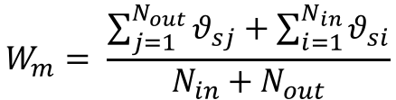
Throughput Analysis
Calculating weight for each node
$$W_{m}= \frac{\sum_{j=1}^{N_{out}}{θ_{sj}}+\sum_{i=1}^{N_{in}}{θ_{si}}}{N_{in}+N_{out}}$$

Slide 29
JANUS Tool flow
2 Phases
  Pre-compute (library characterization)
  Implementation
Pre-compute
  Kernels written in Parameterized C++ for HLS
  Different Implementation Generator (DIG)
    Sweep parameterized space for each kernel
    Throughput, Area, Tile-width
  Intra-Node Optimizer
    Replication vs. tile size
Implementation
  Throughput Analysis
  Automated space/time tradeoffs
    Integer Linear Programming
    JANUS heuristic with Inter-Node Optimizer

Slide 30







Inter-node Optimizer
Node combining and Node replication
  Saving area
  Cannot be done in ILP approach
$$\frac{θ_{IO}}{N}$$
$$W_{T}$$
$$W_{T}$$
$$\frac{θ_{IO}}{N}$$
$$θ_{IO}$$
$$W_{T}$$
$$W_{T}$$
$$f_{n}$$
$$f_{m}$$
$$θ_{IO}$$
$$\frac{θ_{IO}}{2}$$
$$W_{T}$$
$$W_{T}$$
$$\frac{θ_{IO}}{2}$$
$$θ_{IO}$$
$$W_{T}$$
$$W_{T}$$
$${f′}_{n}$$
$$f_{m}$$
$$θ_{IO}$$

Slide 31
Experimental Results (area target)
SOBEL and Harris benchmarks
  Area Target: fill each Xilinx 7-series device
Average utilization: 95% of the chip area

Slide 32
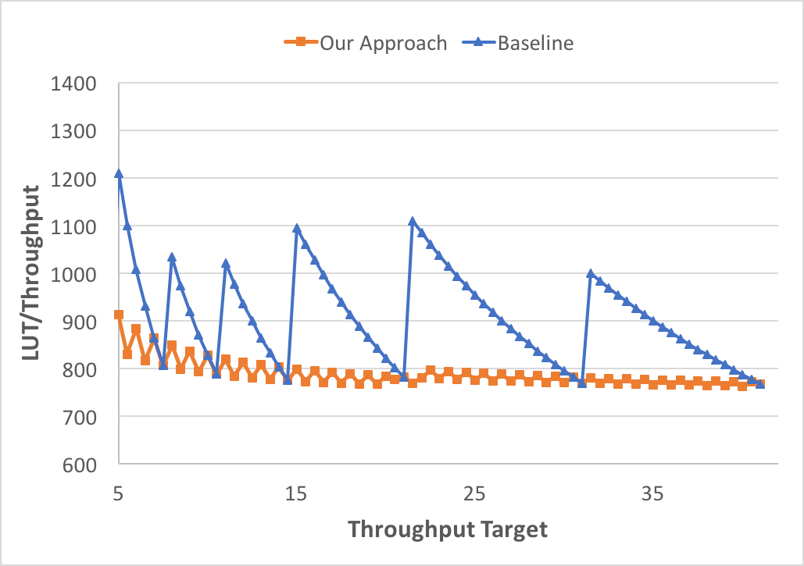
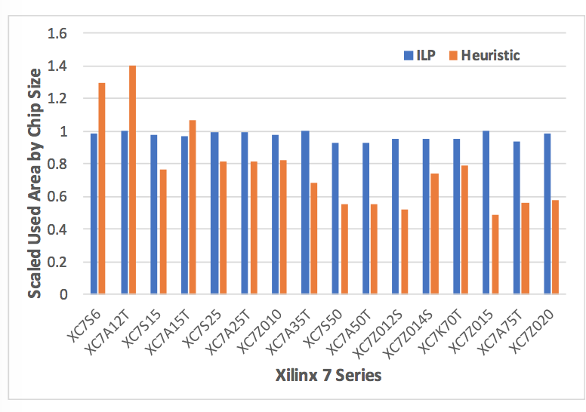
Experimental Results (throughput target)
JANUS vs. Manual HLS
(average 30% area reduction)
JANUS vs. Automated ILP
  (average 19% area reduction
  @ 2% throughput penalty)

Slide 33
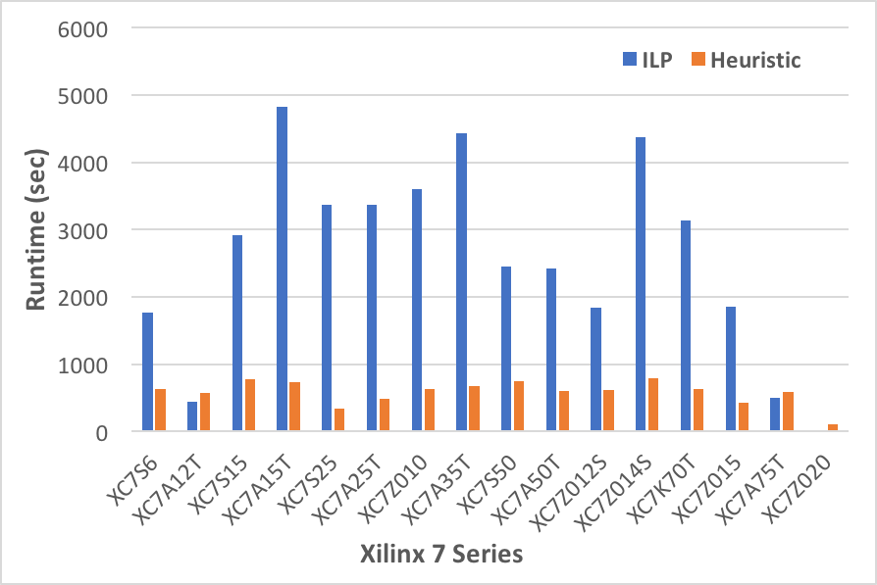
Run-time vs ILP
Heuristic is 3.6x faster on average
  Note: also saves 19% area

Slide 34
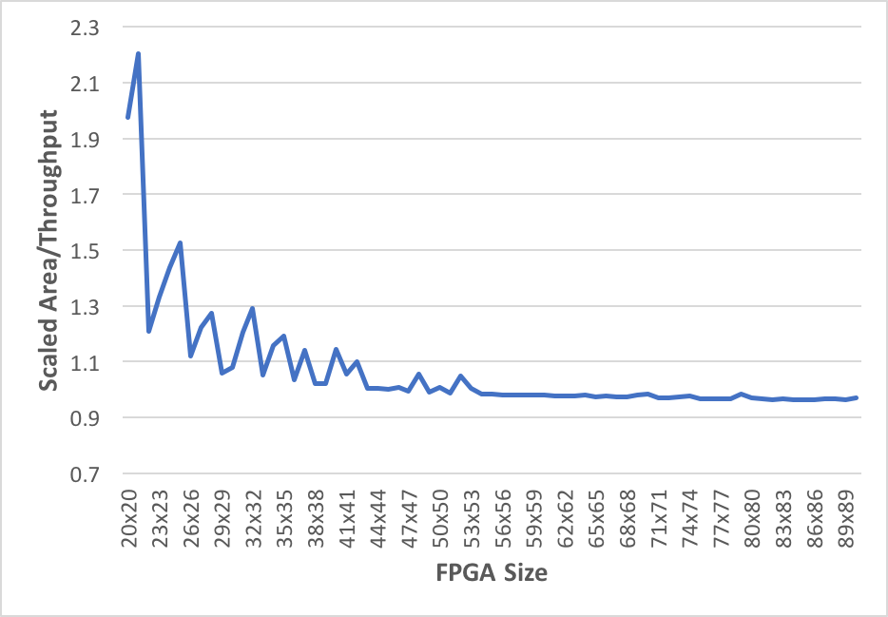
Area Efficiency
Efficiency (LUTs per throughput)
  Vertical axis is normalized by “median” value
Area target mode
Throughput target mode

Slide 35
Conclusions / Summary
We studied the problem of automatically finding area/throughput trade-off of CV applications
We proposed JANUS (OpenVX based)
Our approach is differentiated from the existing approaches as:
  It automatically investigates finding different implementations
  It combines module selection and replication methods as well as changing tile-size with node combining and splitting in order to automatically find a better area/throughput tradeoff.
Satisfy different area budgets
  Average utilization: 95% of the chip area
Satisfy different throughput target
  JANUS vs. Automated ILP
    19% area reduction @ 2% throughput penalty
    3.6x faster

