Slide 1
JANUS: A Compilation System for Balancing
Parallelism and Performance in OpenVX
Hossein Omidian, Guy Lemieux
hosseino@ece.ubc.ca
Vancouver, Canada

Slide 2
Which target for Computer Vision or other similar applications?
The goal is to run CV application faster while using less power
Which hardware target? When? How?
Source: Altera (Intel) slides by Tom Spyrou

Slide 3
Motivation: Computer Vision on FPGAs and Many-core systems
OpenCV: de facto API/toolkit
    while(operations remaining) {
    read frame;
    frame = Operate(frame);
    write frame;
    }
  Frame size > on-chip memory ➔ Low performance, high power
OpenVX: standards-based API/toolkit by Khronos (OpenCL)
    while(tiles remaining) {
    read tile;
    while(operations remaining)
    tile = Operate(tile);
    write tile;
    }
  Small tile size ➔ Pipelining, cache-friendly, low power

Slide 4
OpenVX Programming Model
C library
Streaming compute graph
  Operations + local data buffering
  Two-phase execution
    Build + optimize graph
    Execute graph
Example: Sobel
  5 nodes, 1 input, 2 outputs
  Send image tiles through pipeline

Slide 5
OpenVX on different targets
PROBLEMS
How to “scale” to different target size?
  Only write one C program
  Area target
  Throughput target
How to break into tiles?
How to balance throughput of entire graph?
OUR SOLUTION
JANUS: Tool to automatically balance area/throughput

Slide 6
Example: Streaming Compute Kernel
void compute_kernel()
{
for( int i = 0 ; i < N; i++ ) {
// STREAM INPUTS m[i] px[i] py[i]
gmm = M(ref_gmm,m[i]);
dx = S(ref_px, px[i]);
dy = S(ref_py, py[i]);
dx2 = M(dx, dx);
dy2 = M(dy, dy);
r2 = A(dx2, dy2);
r = SQRT(r2);
rr = D(1, r);
gmm_rr = M(rr, gmm);
gmm_rr2 = M(rr, gmm_rr);
gmm_rr3 = M(rr, gmm_rr2);
dfx = M(dx, gmm_rr3);
dfy = M(dy, gmm_rr3);
}
}
Using HLS
Each compute kernel has unique Initiation Interval
2
1
1
2
Kernel | Initiation Interval
A and S | 1
M | 2
SQRT | 4
D | 8
2
1
4
8
2
2
2
2
2
Takes us 31 Clock cycles

Slide 7






Example: OpenVX Graph
Critical path with parallelism: 24
Static Time Analysis
Throughput Analysis
$$x_{ref}$$
1
2
$$x_{i}$$
S
M
1
4
8
M
2
2
$$y_{ref}$$
1
2
A
Sqrt
D
M
M
M
2
S
M
2
2
$$y_{i}$$
M
$$M_{ref}$$
2
$$M_{i}$$
M

Slide 8
Example: OpenVX Graph
Critical path with parallelism: 24
Static Time Analysis
Throughput Analysis
$$x_{ref}$$
1
2
$$x_{i}$$
S
M
1
4
8
M
2
2
$$y_{ref}$$
1
2
A
Sqrt
D
M
M
M
2
2
2
24
$$y_{i}$$
S
M
M
$$M_{ref}$$
2
$$M_{i}$$
M
31 ➔24

Slide 9
Example: OpenVX Graph
Pipelining
Balancing
Sending/gathering data to/from system
  Scheduling or back pressure
$$x_{ref}$$
1
2
$$x_{i}$$
S
M
1
4
8
M
2
2
$$y_{ref}$$
1
2
A
Sqrt
D
M
M
M
2
S
M
2
2
$$y_{i}$$
M
$$M_{ref}$$
2
$$M_{i}$$
M
31 ➔24

Slide 10
Example: OpenVX Graph
Pipelining
Balancing
Sending/gathering data to/from system
  Scheduling or back pressure
$$x_{ref}$$
1
2
$$x_{i}$$
S
M
1
4
8
M
2
2
$$y_{ref}$$
1
2
A
Sqrt
D
M
M
M
2
S
M
2
2
$$y_{i}$$
M
$$M_{ref}$$
2
$$M_{i}$$
M
31 ➔24 ➔8

Slide 11
Example: OpenVX Graph
Replicating
Sending data in round-robin order
4
A
A
A
A
Sqrt
A
A
A
A
1
4
Sqrt
Sqrt
Sqrt
Sqrt

Slide 12
Example: OpenVX Graph
Replicating
Sending data in round-robin order
4
A
A
A
A
Sqrt
A
A
A
A
1
4
A
A
A
A
Sqrt
A
A
A
A
A
A
A
A
Sqrt
A
A
A
A
A
A
A
A
Sqrt
A
A
A
A
A
A
A
A
Sqrt
A
A
A
A

Slide 13
Example: OpenVX Graph
Replicating
Sending data in round-robin order
4
A
A
A
A
Sqrt
A
A
A
A
1
4
A
A
A
A
Sqrt
A
A
A
A
A
A
A
A
Sqrt
A
A
A
A
A
A
A
A
A
A
A
A
A
A
A
A
A
A
A
A
A
A
A
A
A
A
A
A
A
A
A
A
A
A
A
A
A
A
A
A
Sqrt
A
A
A
A
A
A
A
A
Sqrt
A
A
A
A

Slide 14
Example: OpenVX Graph
Let’s make it faster by expanding (Replicate slow nodes)
$$x_{ref}$$
1
2
$$x_{i}$$
S
M
1
4
8
M
2
2
$$y_{ref}$$
1
2
A
Sqrt
D
M
M
M
2
S
M
2
2
$$y_{i}$$
M
$$M_{ref}$$
2
$$M_{i}$$
M
31 ➔24 ➔8

Slide 15
Example: OpenVX Graph
Expanding
  Maximum throughput by using maximum area
D
M
M
D
S
Sqrt
D
M
M
Sqrt
D
M
M
M
+
Sqrt
D
M
M
M
M
M
Sqrt
D
S
D
M
M
D
M
M
31 ➔24 ➔8 ➔ 1

Slide 16
Example: OpenVX Graph
Saving area (Minimum area)
Decrease the throughput
$$x_{ref}$$
8
8
$$x_{i}$$
S
M
8
8
8
M
8
8
$$y_{ref}$$
8
8
A
Sqrt
D
M
M
M
8
S
M
8
8
$$y_{i}$$
M
$$M_{ref}$$
8
$$M_{i}$$
M

Slide 17


Example: OpenVX Graph
What about Many-core systems?
Clustering (assume we have 5 Processing Elements (PEs)
$$x_{ref}$$
1
2
$$x_{i}$$
S
M
1
4
8
M
2
2
$$y_{ref}$$
1
2
A
Sqrt
D
M
M
M
2
S
M
2
2
$$y_{i}$$
M
$$M_{ref}$$
2
$$M_{i}$$
M

Slide 18
Example: OpenVX Graph
Implementing on 5 Processing Elements (PEs)
S()
S()
M()
M()
A()
NOP
SQRT()
NOP
NOP
NOP
NOP
D()
M()
M()
M()
M()
M()
M()
A()
A()
NOP
NOP
17.5% running NOP

Slide 19
JANUS Tool flow
CV Kernels
Kernel 1
Kernel 3
Kernel Analyzer
Kernel 2
Kernel 4
DB of Implementations
for each kernel (node)
Different Implementations Generator
2 Phases
  Pre-compute (library characterization)
  Implementation
Pre-compute
  Kernels written in Parameterized C++ for HLS
  Different Implementation Generator (DIG)
    Sweep parameterized space for each kernel
    Throughput, Area, Tile-width
  Intra-Node Optimizer
    Replication vs. tile size
Implementation
  Throughput Analysis
  Automated space/time tradeoffs
    Integer Linear Programming
    JANUS heuristic with Inter-Node Optimizer
1
3
2
4
Design Evaluator + Throughput Calculator
Area/Throughput/Tile-width
correlation for each node
DB of Implementations
for each node
1
3
Intra-Node Optimizer
1
3
2
4
2
4
CV Compute Graph
Trade-off Finder
1
Trade-off
3
4
2
1
3
4
Backend
2
Many-core system
FPGA Fabric
Heterogeneous

Slide 20
JANUS Tool flow
CV Kernels
Kernel 1
Kernel 3
Kernel Analyzer
Kernel 2
Kernel 4
DB of Implementations
for each kernel (node)
Different Implementations Generator
2 Phases
  Pre-compute (library characterization)
  Implementation
Pre-compute
  Kernels written in Parameterized C++ for HLS
  Different Implementation Generator (DIG)
    Sweep parameterized space for each kernel
    Throughput, Area, Tile-width
  Intra-Node Optimizer
    Replication vs. tile size
Implementation
  Throughput Analysis
  Automated space/time tradeoffs
    Integer Linear Programming
    JANUS heuristic with Inter-Node Optimizer
1
3
2
4
Design Evaluator + Throughput Calculator
Area/Throughput/Tile-width
correlation for each node
DB of Implementations
for each node
1
3
Intra-Node Optimizer
1
3
2
4
2
4
CV Compute Graph
Trade-off Finder
1
Trade-off
3
4
2
1
3
4
Backend
2
Many-core system
FPGA Fabric
Heterogeneous

Slide 21
JANUS Tool flow
CV Kernels
Kernel 1
Kernel 3
Kernel Analyzer
Kernel 2
Kernel 4
DB of Implementations
for each kernel (node)
Different Implementations Generator
2 Phases
  Pre-compute (library characterization)
  Implementation
Pre-compute
  Kernels written in Parameterized C++ for HLS
  Different Implementation Generator (DIG)
    Sweep parameterized space for each kernel
    Throughput, Area, Tile-width
  Intra-Node Optimizer
    Replication vs. tile size
Implementation
  Throughput Analysis
  Automated space/time tradeoffs
    Integer Linear Programming
    JANUS heuristic with Inter-Node Optimizer
1
3
2
4
Design Evaluator + Throughput Calculator
Area/Throughput/Tile-width
correlation for each node
DB of Implementations
for each node
1
3
Intra-Node Optimizer
1
3
2
4
2
4
CV Compute Graph
Trade-off Finder
1
Trade-off
3
4
2
1
3
4
Backend
2
Many-core system
FPGA Fabric
Heterogeneous

Slide 22
Experimental Results (area target)
SOBEL and Harris benchmarks
  Area Target: fill each Xilinx 7-series device
Average utilization: 95% of the chip area

Slide 23
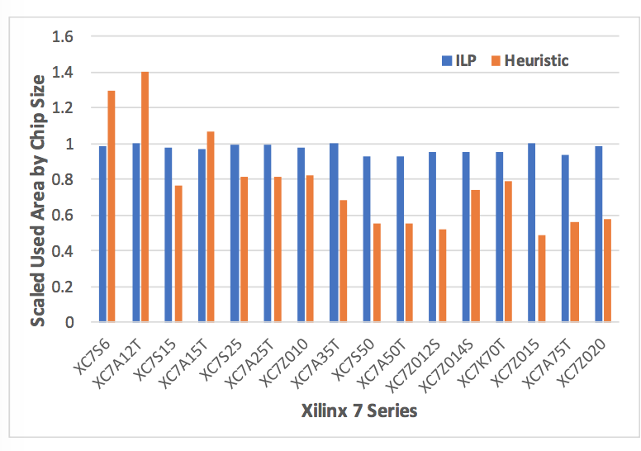
Experimental Results (throughput target)
JANUS vs. Automated ILP
  (average 19% area reduction
  @ 2% throughput penalty)

Slide 24
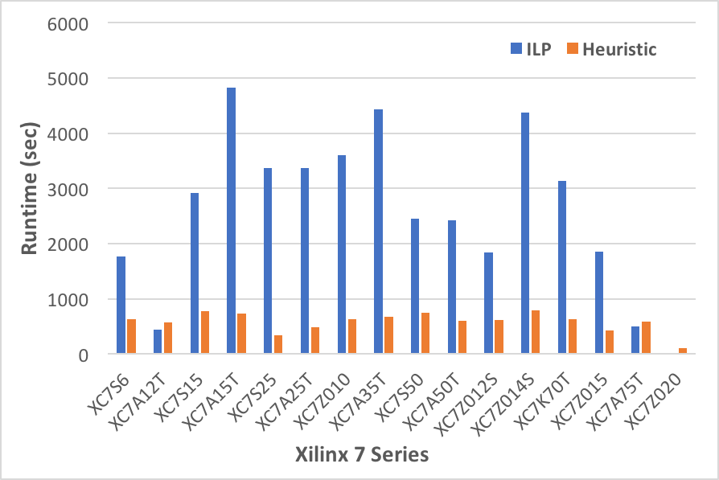
Run-time vs ILP
Heuristic is 3.6x faster on average
  Note: also saves 19% area

Slide 25
Area Efficiency on Zedboard
Achieved 5.5 GigaPixel/Sec for Sobel on a $125 SOC chip

Slide 26
Conclusions / Summary
We studied the problem of automatically finding area/throughput trade-off of CV applications
We proposed JANUS (OpenVX based)
  Targeting FPGAs and programmable Many-core systems
Satisfy different area budgets
  Average utilization: 95% of the chip area
Satisfy different throughput target
  JANUS vs. Automated ILP
    19% area reduction @ 2% throughput penalty
    3.6x faster
  Achieved 5.5 GigaPixel/sec on a small FPGA (Zynq7020 costs $125)

