Slide 1

TinBiNN: Tiny Binarized Neural Network Overlay
…. in about 5,000 LUTs
The University of British Columbia
Guy Lemieux
Joe Edwards
Joel Vandergriendt
Aaron Severance
Ryan De Iaco
Abdullah Raouf
Tom Watzka
Satwant Singh
2017 OLAF Workshop
February 22

Slide 2


Smarter Sleep

Slide 3


Smarter Doorbell

Slide 4

Smarter Security

Slide 5
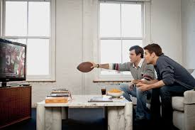

Smarter TVs
(stay on)
(turn off)

Slide 6
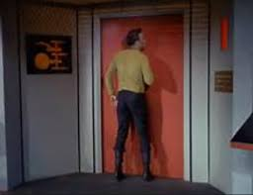
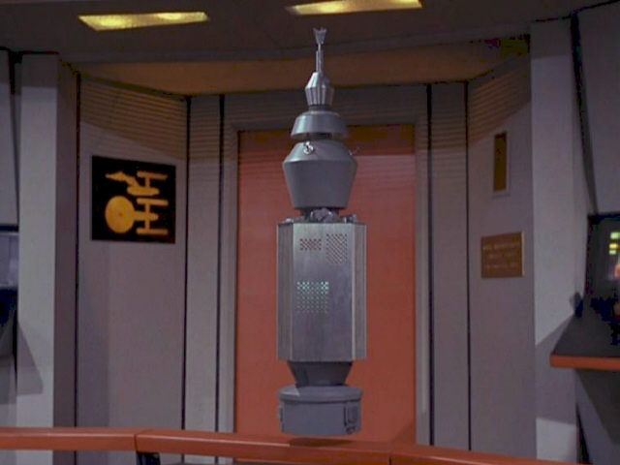
Smarter Doors

Slide 7
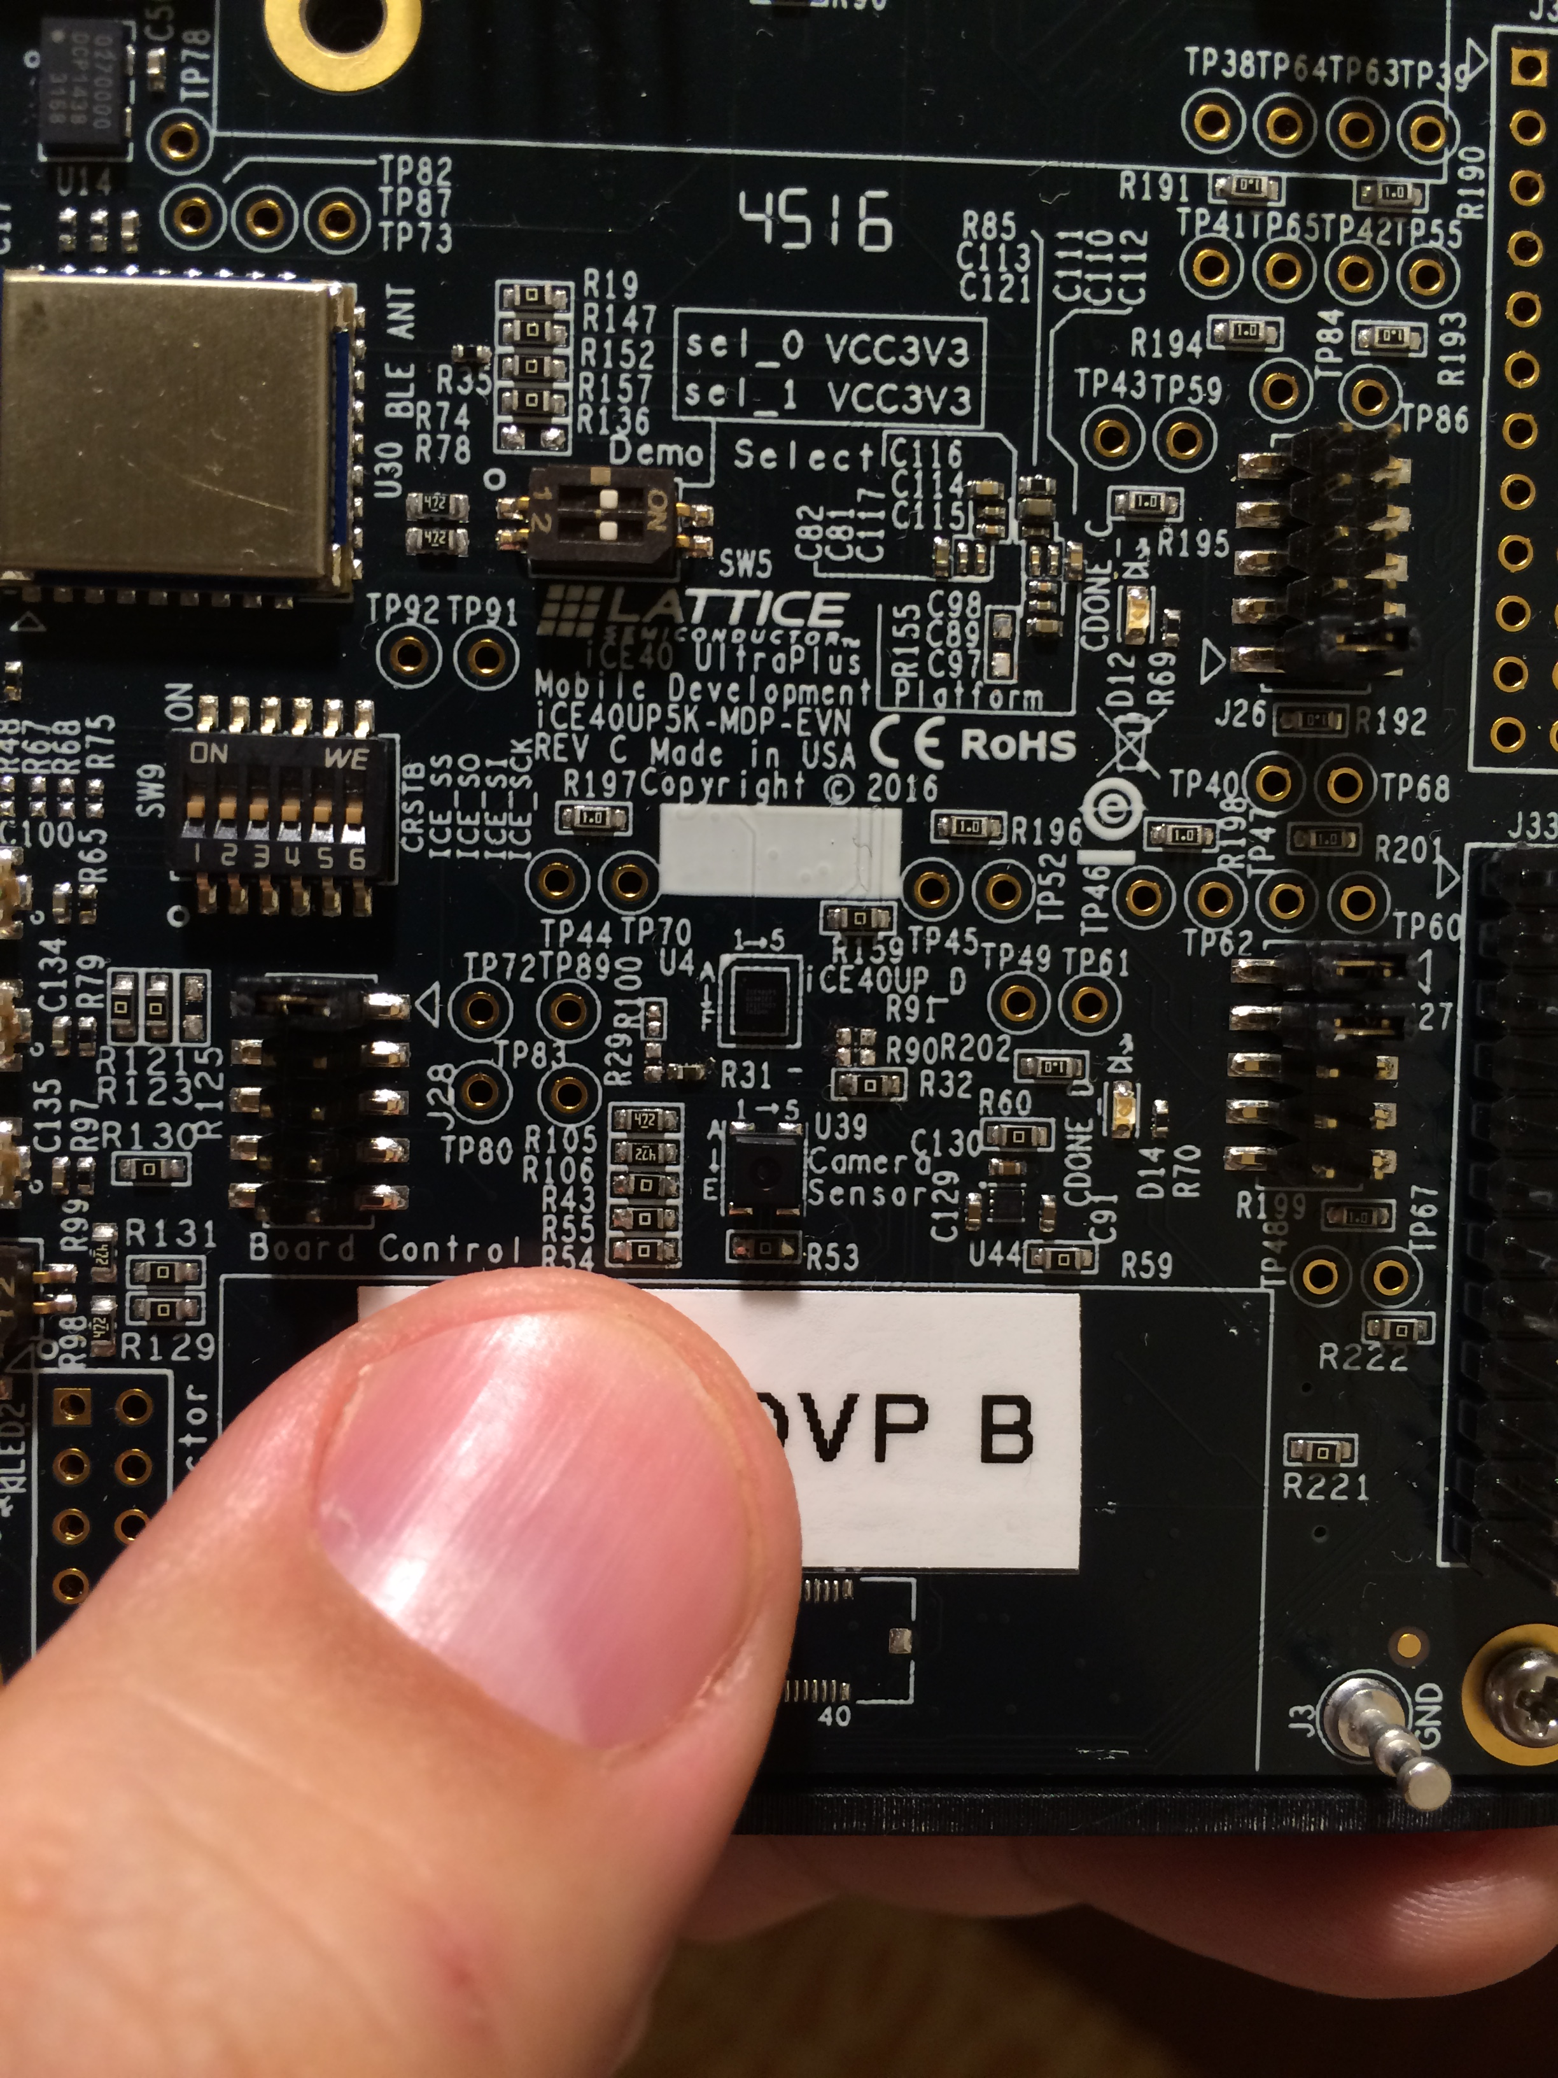
Mobile Development Platform iCE40 UltraPlus FPGA
Omnivision OVM7692 Camera about 3mm (1/8”) per side

Slide 8
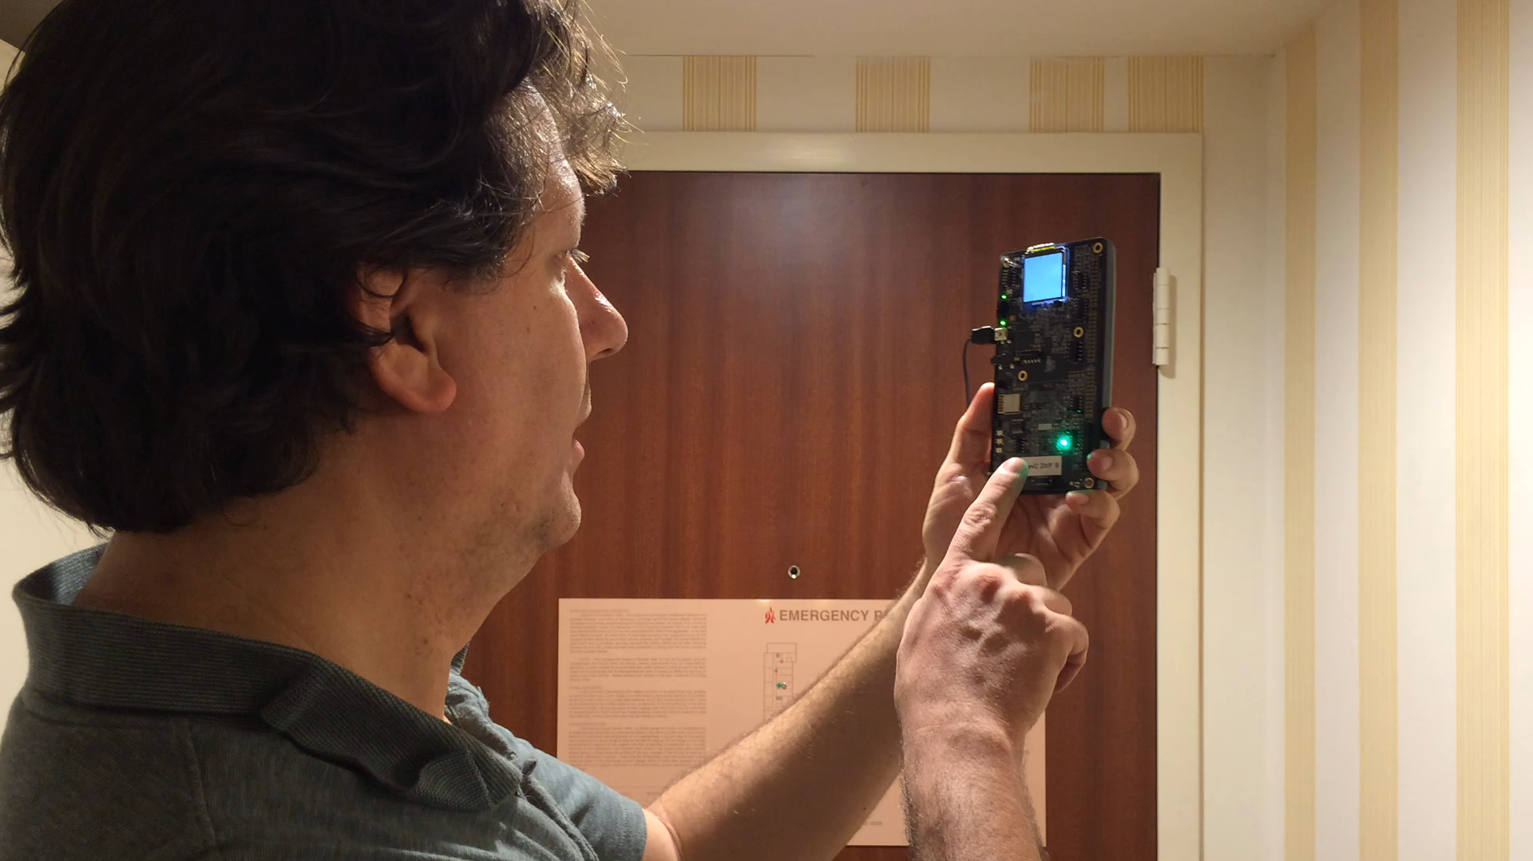
Person Detection

Slide 9
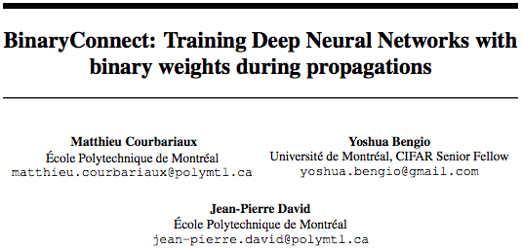
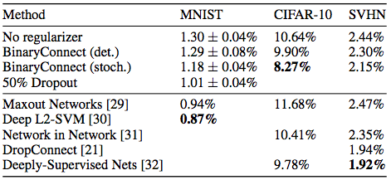

https://arxiv.org/pdf/1511.00363.pdf

Slide 10
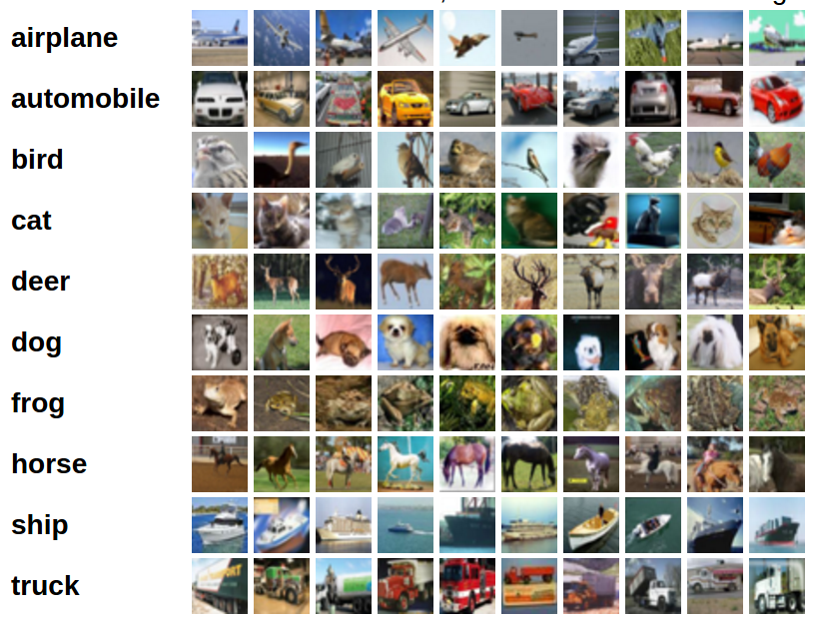
CIFAR-10 Image Dataset
People from CIFAR-100 (man, woman, boy, girl, baby)

Slide 11
Trained Network
BinaryConnect
  128 – 128 – mp – 256 – 256 – mp – 512 – 512 – mp – 1024d – 1024d – 10d
  91.7% accurate
Ours
  48 – 48 – mp – 96 – 96 – mp – 128 – 128 – mp – 256d – 256d – 10d 87.7 % accurate
  9x fewer operations

Slide 12
System Diagram
Overlay: RISC-V + Accelerators
16 x 16
Downscale
ORCA RISC-V
w/ TinBiNN

Slide 13

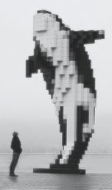
Open source RISC ISA spec
Family of RISC-V implementations
  Highly parameterized (<2000 LUT4)
  Portable
    Lattice, Altera, Xilinx, Microsemi
  BSD license open source
ORCA

Slide 14
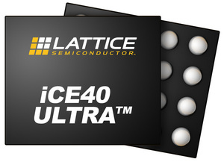
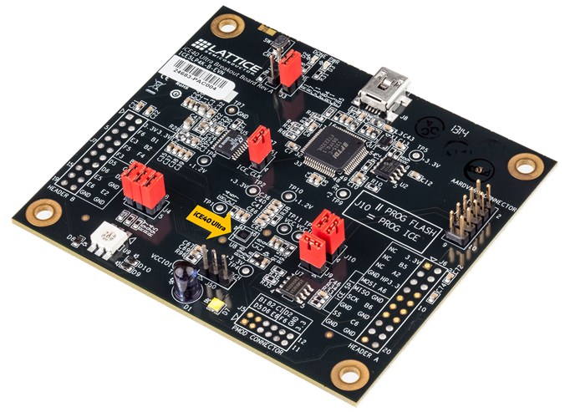
Tiny, Low-Power FPGAs
3,500 LUT4s
4 MUL16s
LOW COST
VectorBlox ORCA
FPGA-optimized:
RV32IM can be < 2,000 LUTs, 20MHz

Slide 15
Lightweight Vector Extensions
  Vadd Vsub // I base instructions
  Vsll Vsrl Vsra
  Vxor Vor Vand
  Vslt Vsltu // data-conditional instructions
  Vmul Vmulh // M instruction extension
  Vdiv Vrem
  Vcmv_z Vcmv_nz // conditional move if zero/nonzero
  Vtype // sets data type, vector length
  Vset2Dsrc Vset2Ddst // optional extensions for 2D
  Vset3Dsrc Vset3Ddst // and 3D matrices

Slide 16
LVE System Model
Data
Memory
Different addresses
Memory Bus
LVE
ORCA
Processor
(RV32IM)
Scratchpad
Memory
Vector instructions operate only on scratchpad
  Address generator hardware
  Streams data through RISC V ALU
Allocate a vector of 8 words
  vbx_word_t *vsrc1 = vbx_sp_malloc( 32 );

Slide 17
FIR filter (12x speedup)
RV32IM
00000030 <scalar_fir(long*, long*, long*, int, int)>:
30: 40e686b3 sub a3,a3,a4
34: 06d05263 blez a3,98 <.L6>
38: 00269693 slli a3,a3,0x2
3c: 00271e13 slli t3,a4,0x2
40: 00d50eb3 add t4,a0,a3
44: 01c60e33 add t3,a2,t3
48: 00100f13 li t5,1
0000004c <.L10>:
4c: 0005a683 lw a3,0(a1)
50: 00062803 lw a6,0(a2)
54: 00460793 addi a5,a2,4
58: 00058893 mv a7,a1
5c: 03068833 mul a6,a3,a6
60: 01052023 sw a6,0(a0)
64: 02ef5263 ble a4,t5,88 <.L11>
00000068 <.L13>:
68: 0048a683 lw a3,4(a7)
6c: 0007a303 lw t1,0(a5)
70: 00478793 addi a5,a5,4
74: 00488893 addi a7,a7,4
78: 026686b3 mul a3,a3,t1
7c: 00d80833 add a6,a6,a3
80: 01052023 sw a6,0(a0)
84: fefe12e3 bne t3,a5,68 <.L13>
00000088 <.L11>:
88: 00450513 addi a0,a0,4
8c: 00458593 addi a1,a1,4
90: faae9ee3 bne t4,a0,4c <.L10>
94: 00008067 ret
RV32IM + LVE
00000000 <vector_fir(long*, long*, long*, int, int)>:
0: 000007b7 lui a5,0x0
4: 00e7a023 sw a4,0(a5)
8: 40e686b3 sub a3,a3,a4
c: 02d05063 blez a3,2c <.L1>
10: 00269693 slli a3,a3,0x2
14: 00d586b3 add a3,a1,a3
00000018 <.L3>:
18: 08c5fe2b vtype.www a1,a2
1c: a6e50cab vmul.vv.1d.sss.acc a0,a4
20: 00458593 addi a1,a1,4
24: 00450513 addi a0,a0,4
28: fed598e3 bne a1,a3,18 <.L3>
0000002c <.L1>:
2c: 00008067 ret
Vectors:
1 instruction + no stalls
20 bytes code
No vectors
8 instructions + stalls
72 bytes code

Slide 18
Convolution Accelerator
Implementation uses two
of these in parallel.

Slide 19
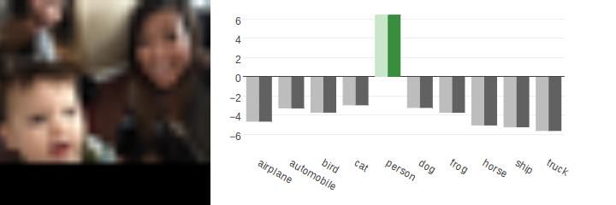
Person

Slide 20
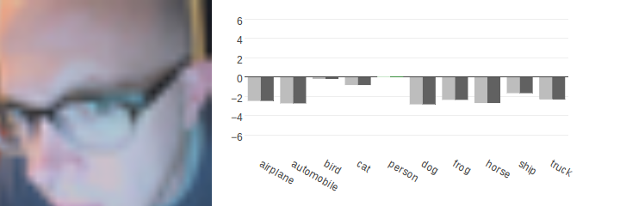
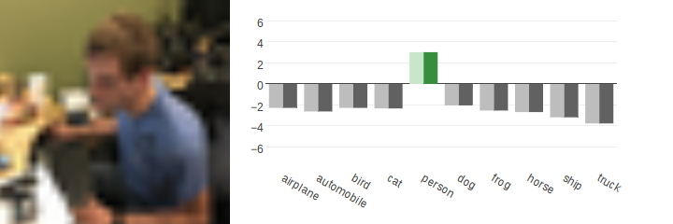
Person

Slide 21
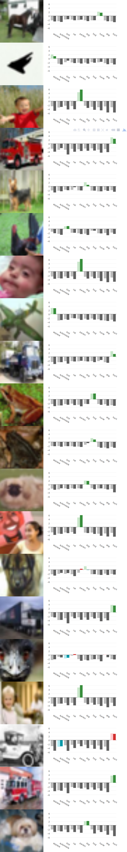
Airplane

Slide 22
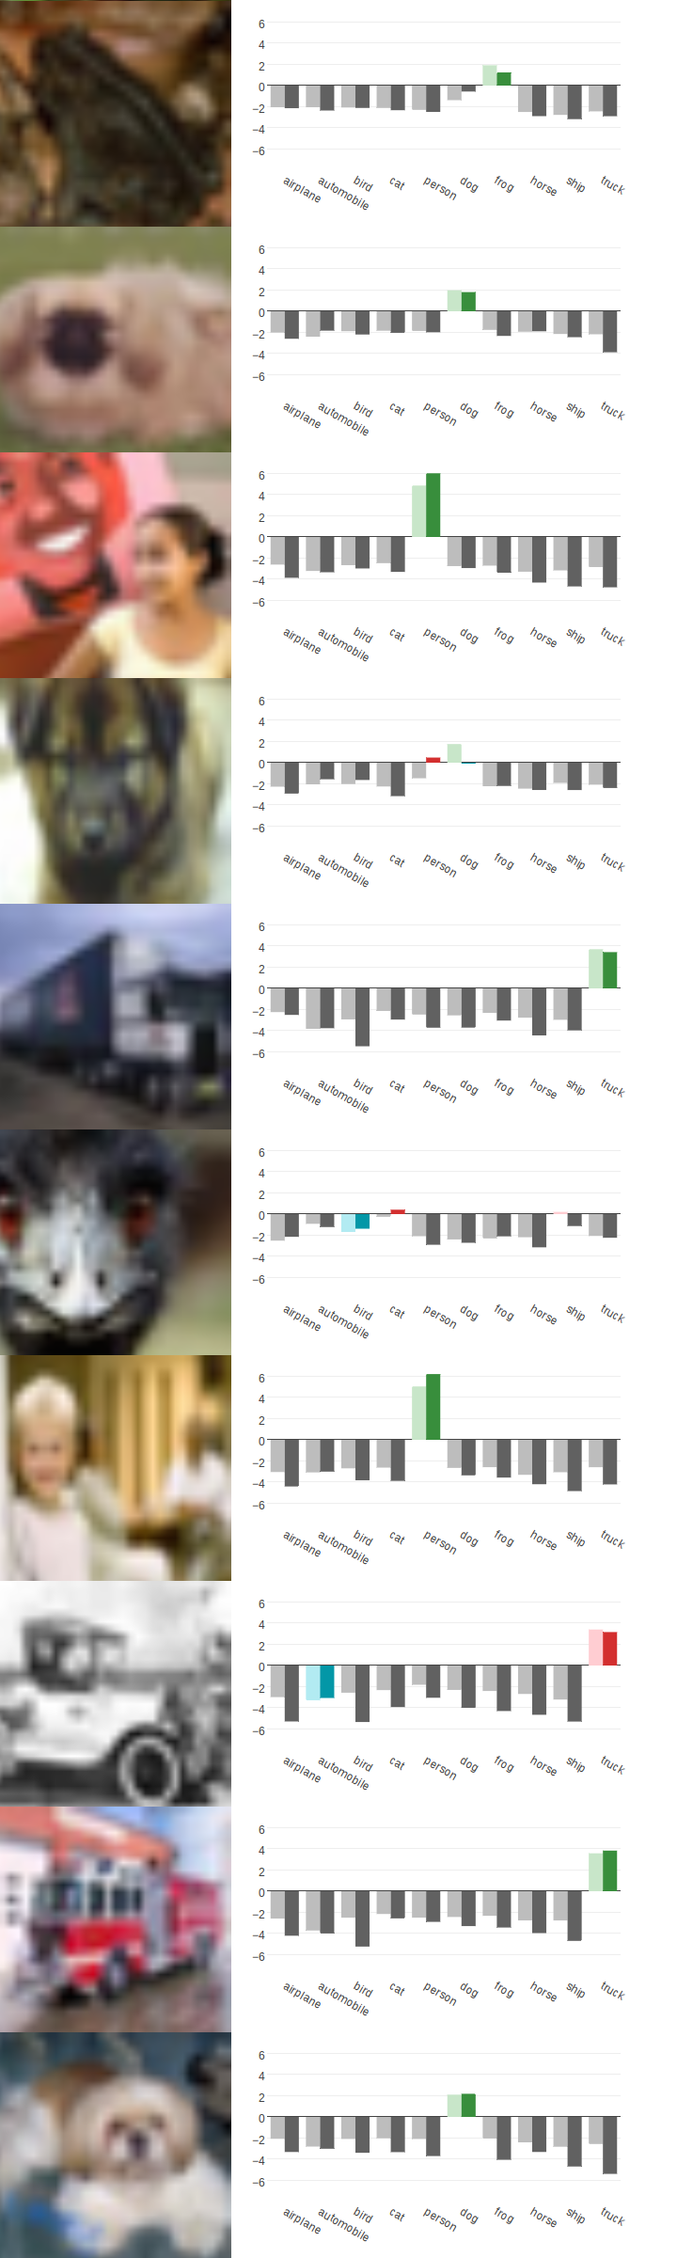
Automobile
Red: max score (incorrect), Blue: correct choice
Automobile
(proper choice)
Truck
(incorrect)

Slide 23
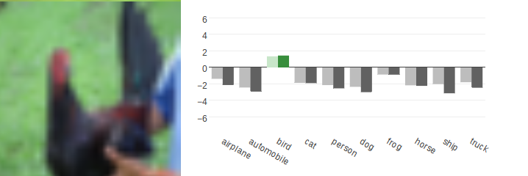
Bird
Red: max score (incorrect), Blue: correct choice
fix8: cat
float32: ship

Slide 24
Dog

Slide 25
Dog (Person?)
RED: incorrect maximum (fix8)
GREEN: correct maximum (float32)
fix8: person (incorrect)
float32: dog (correct)

Slide 26
Frog

Slide 27
Horse

Slide 28
Truck

Slide 29
Person

Slide 30
Conclusions
Overlay 1: RISC-V Lightweight Vector Extensions
  Low area overhead ( < 1,500 LUT4)
  Used for maxpool, activation, etc
  8.3x speedup over RISC-v (dense layers)
Overlay 2: Convolution Accelerators
  Reasonable size ( < 1,000 LUT4)
  73x speedup over RISC-V (convolution layers)
Take-away
  Algorithm fully implemented in software
  70.9x speedup (overall)
  Person detection in 1.3s (overlay) vs 4s (Intel Atom)

Slide 31
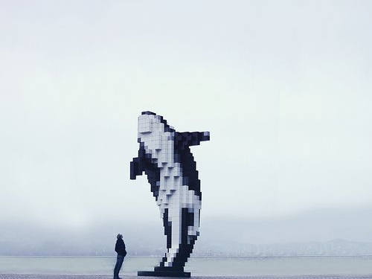
LUNCHTIME (almost)
So Long, and Thanks for All the Fish !!

