Slide 1
Cache Coherence for GPU Architectures
Inderpreet Singh¹, Arrvindh Shriraman², Wilson Fung¹, Mike O’Connor³, Tor Aamodt¹
¹ University of British Columbia
² Simon Fraser University
³ AMD Research
Image source: www.forces.gc.ca
Notes:
First academic work on cache coherence on GPU architecture
3 main points of this work and talk
Cache coherence is a natural evolution for GPU computing
Existing coherence protocols are not quite fully suited for the unique set of challenges that GPUs pose for cache coherence
Our protocol is designed to address these new and unique challenges, and it does so by using global time, instead of coherence messages

Slide 2
What is a GPU?
Workgroups
CPU
Wavefronts
spawn
GPU Core
GPU Core
GPU
L1D
L1D
▪▪▪
done
CPU
Interconnect
CPU
spawn
L2 Bank
▪▪▪
GPU
time
Notes:
GPU hardware is made up of GPU cores connected via an on-chip interconnection network to a shared banked L2 cache. There’s also L1D
CPU spawns tens of thousands of GPU threads. These are divided into groups called WORKGROUPS
Workgroups are scheduled onto the GPU, one per core. Threads within the workgroup are further divided into SIMD execution groups called WAVEFRONTS. These are 32 or 64 threads wide
Important #1: GPU is latency tolerant. It hides long memory latencies by selecting among thousands of threads for execution
Important #2: To do that, GPU memory system is designed to handle 1000s of inflight requests
Current GPUs do not have cache coherence -> threads on different cores can’t communicate with each other. So the GPU programming models require that any communication between threads be limited to within a workgroup only

Slide 3
Evolution of GPUs
Graphics pipeline
Compute (OpenCL, CUDA)
e.g. Matrix Multiplication
OpenGL/
DirectX
Vertex
Shader
Pixel
Shader
Notes:
GPUs were originally designed to render polygons for displays
The graphics pipeline is setup so that pixels and vertices can be processed independently and threads don’t need to communicate -> so no need for cache coherence
Then programmers began using this highly parallel hardware for general purpose computation, so manufacturers released extensions to simply GPGPU programming
They used the same abstraction as the graphics pipeline of parallel threads, but added some communication between threads by introducing workgroups
This is great for applications like matrix multiplication, where threads are independent but the added ability to communicate within groups of threads helps with caching

Slide 4
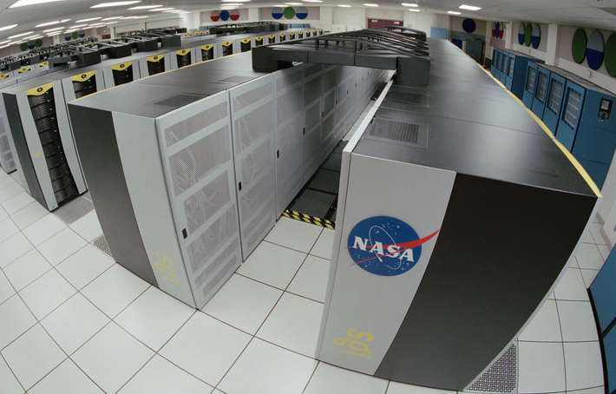
Evolution of GPUs
Future: coherent memory space
Efficient critical sections
Load balancing
Stencil computation
lock shared structure
…
computation
…
unlock
Workgroups
Notes:
So then clearly, the next evolution in GPU computing is to allow communication between all threads by adding cache coherence
Take stencil as an example -> it is used in many scientific applications for things like solving differential equations. Think supercomputing
16 nodes. Each node reads from neighbours and produces a new value. Highly parallel and well suited for GPU
GPU stencil app would split threads into workgroups
But, GPU programming model does not allow communication between nodes at workgroup boundaries
Programmer works around this by manually managing cached memory, and splitting execution into multiple kernel launches -> both result in reduced productivity
By adding coherence, programmer worries less about working around restrictive memory system, and can focus more on optimizing code
Another example: critical sections. Example of these: updating shared data structures in parallel by locking them beforehand
Here coherence ensures these updates become visible to all threads
Many other examples including load balancing
AMD has coherence between CPU and GPU on their roadmap, and GPU coherence is a stepping stone to that goal

Slide 5
GPU Coherence Challenges
Challenge 1: Coherence traffic
Load C
Load D
Load E
Load F
…
Load G
Load H
Load I
Load J
…
Load K
Load L
Load M
Load N
…
Load O
Load P
Load Q
Load R
…
No coherence
MESI
GPU-VI
Load C
2.2
C1
C2
C3
C4
1.5
Recalls
1.3
L1D
L1D
L1D
L1D
A
B
A
B
A
B
A
B
Interconnect traffic
rcl A
rcl A
rcl A
1.0
ack
ack
rcl A
ack
ack
gets C
L2/Directory
0.5
A
B
Do not require
coherence
Notes:
First challenge is coherence traffic
We first look at interconnect traffic for existing GPU applications that do not require coherence
When we add MESI, traffic doubles. More details about this in the paper
Then we created write-through GPU-VI. GPU-VI better than MESI, but still adds traffic over no coherence. Turns out it is recall traffic
Cores have cache lines A and B cached and the directory is tracking them
One core wants space in the directory for a new entry, so the directory has to drop one of the entries. This requires recall messages to all the sharers of this entry so they can invalidate their cached copy
If we didn’t send these recalls before dropping the entry, we would have an incoherent system
On a GPU, there are thousands of memory requests bombarding the directory for space – so we have a lot more recalls than we may on a CPU
We evaluated aggressive directory sizes and found it still remains a problem
Key point: independent of the directory size, adding coherence to a GPU introduced a traffic and hence a power power

Slide 6
GPU Coherence Challenges
Challenge 2: Tracking in-flight requests
Significant % of L2
S Shared
S_M
M Modified
L2 / Directory
MSHR
Notes:
Second challenge is tracking inflight coherence requests
Let’s start with looking at coherence states. Most of us are familiar with the textbook Shared and Modified states
In real coherence implementations, these are not all. We also have transient states between these stable states
The transient states are needed because transitions are not atomic/instant; they require multiple messages bouncing between components. Transient states track those messages
These transient states need to be tracked somewhere. This is typically in Miss Status Holding Register / MSHR entries. Aka Transaction Buffer Entries or TBEs
So how many of these do we need?
In CPUs, you can easily size these for the worst case because there are only tens of requests at a time
On a GPU, we have thousands of requests
We estimate that worst case sizing here would take up a significant portion of the L2 just for MSHRs, upto a third of the L2
With a smaller table we can introduce subtle complexities that easily lead to deadlocks and faulty hardware

Slide 7
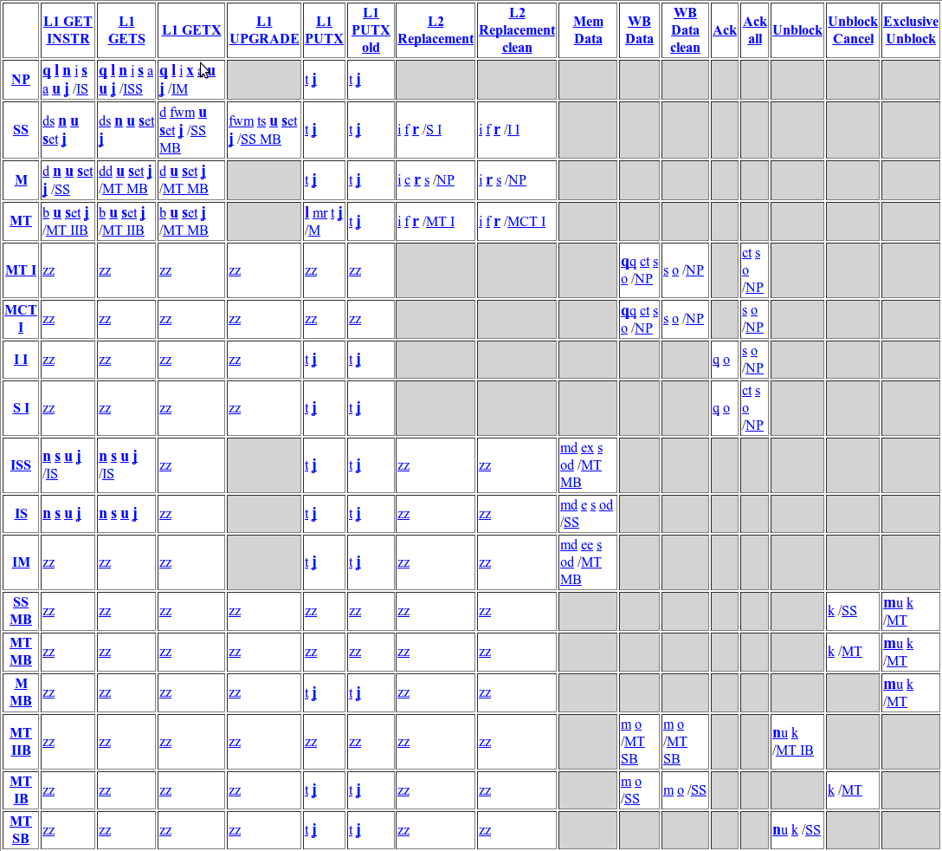
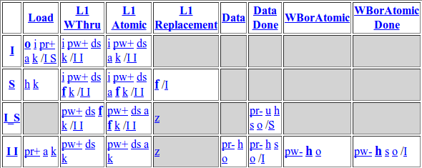
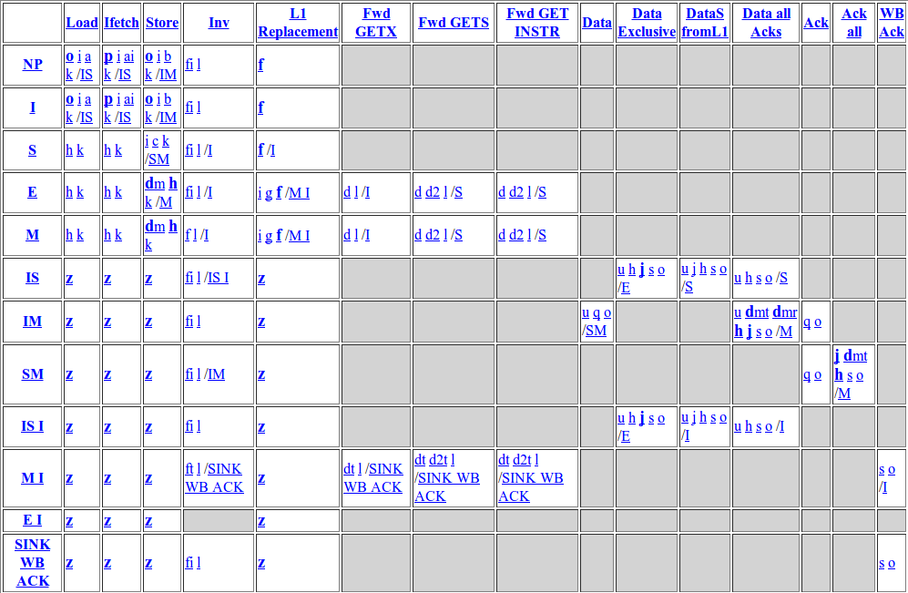
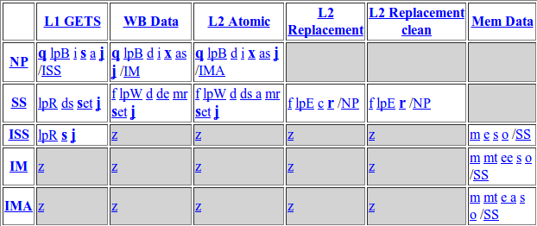
GPU Coherence Challenges
Challenge 3: Complexity
MESI L2 States
Non-coherent L1
MESI L1 States
Events
States
Non-coherent L2
Notes:
The third challenge is implementation complexity
Let’s look at how coherence protocols are specified. Examples here are from GEMS Ruby
I want you to focus on the size of these tables because gives us an idea of how complex the protocol is
For those interested, I’ll give a very quick high level description of the table
Rows corresponds to states, Columns correspond to events. Each box lists the actions that will be taken and the next state when an event occurs for a cache line in the given state
Now let’s look at MESI’s tables.
These tables are significantly more complex because coherence messages introduces potential race conditions, which all needed to be handled
So by asking GPU manufacturers to implement a protocol like MESI we are asking them to significantly increase the complexity of their hardware and spend a lot of effort on verifying the changes

Slide 8
GPU Coherence Challenges
All three challenges result from introducing coherence messages on a GPU
Traffic: transferring
Storage: tracking
Complexity: managing
GPU cache coherence without coherence messages?
YES – using global time
Notes:
Turns out they all stem from coherence messages
The traffic overhead was from transferring these messages around
The storage overhead was from tracking them
The complexity overhead was from managing the races between these messages
Next question is, is GPU coherence possible without these messages? YES – using global time

Slide 9
Temporal Coherence (TC)
Global time
Local Timestamp
> Global Time → VALID
Core 1
Core 2
L1D
L1D
▪▪▪
0
A=0
Interconnect
Global Timestamp
< Global Time →
NO L1 COPIES
L2 Bank
▪▪▪
0
A=0
Notes:
We call our protocol Temporal Coherence, or TC for short
At this level of detail, TC looks similar to the recently proposed Library Cache Coherence
TC relies on global system time. One way to implement global time is through synchronized timestamp counters at each component. In fact, current Intel and AMD processors already implement these synchronized counters for other reasons, and TC can simply leverage them
TC also adds a timestamp entry to each L1 cache line called Local Timestamp
This entry will track the time until this block is valid in this L1
So a line is only valid in the L1 if its local timestamp is greater than the current time
It adds a timestamp entry to each L2 cache line called Global Timestamp
This entry will track the time until this block is valid in any of the L1s
So a global timestamp that is less than the current time indicates that none of the L1s have a valid copy of this line

Slide 10
Temporal Coherence (TC)
T=11
T=0
T=15
Core 1
Core 2
L1D
L1D
No coherence messages
10
A=0
10
A=0
Interconnect
Load A
Store A=1
T=10
L2 Bank
▪▪▪
10
0
A=0
A=0
A=1
10
A=0
Notes:
Let’s take a look at how TC works by going through an example
In this example we start with a line A in the L2
Core 1 issues a load for line A
TC requires that each load request include a request for the block’s lifetime in the L1. Let’s assume Core 1 requests A until time 10
The L2 will updated the global timestamp to accommodate this request, and send the timestamp and data back to Core 1
Core will store both of these in its L1
When time advances to 11, this line self-invalidates in the L1. This event happens implicitly because the next read request will find the local timestamp to be expired
Later, Core 2 wants to write to A. It writes through to the L2
The L2 checks the global timestamp for A and finds that it is less than the current time. This means none of the L1s have it
So the store completes right away without any coherence messages
Notice how by self invalidating a line in the L1, and allowing the L2 to know when this event has occurred allowed TC to have coherence without any messages

Slide 11
Temporal Coherence (TC)
What lifetime values should be requested on loads?
Use a predictor to predict lifetime values
What about stores to unexpired blocks?
Stall them at the L2?
Notes:
Two possible questions at this point
First, what lifetimes should the cores request on loads
For this, we use a lifetime predictor. You can see the details of this predictor in our paper
The second question you may have is what if we have a store operation to a line that hasn’t expired in an L1. What should we do?
One possibility is to simply stall the store request at the L2 until the copy in the L1 has expired, and then complete the store

Slide 12
TC Stalling Issues
Stall?
Problem #1: Sensitive to mispredictions
Problem #2: Impedes other accesses
Problem #3: Hurts existing GPU applications
Solution: TC-Weak
Notes:
This solution is straight-forward but actually problematic
The first problem is that it makes performance sensitive to lifetime mispredictions
If we predict really large lifetimes, then our store operations will be waiting for a long time to complete
The second problem is that we have to stall these store operations at the L2, which is a shared resource
This means that requests from one core and impede requests from other cores, hurting overall system performance
Thirdly, existing GPU applications don’t require coherence. And this method would unnecessarily stall their store requests
Our solution to this is a version of TC protocol we call TC-Weak

Slide 13
TC-Weak
Stores return Global Write Completion Time (GWCT)
T=0
T=1
T=31
1 data=NEW
2 FENCE
3 flag=SET
1 data=NEW
2 FENCE
3 flag=SET
1 data=NEW
2 FENCE
3 flag=SET
1 data=NEW
2 FENCE
3 flag=SET
GPU Core 1
GPU Core 2
No stalling at L2
L1D
L1D
GWCT Table
W0:
W1:
GWCT Table
W0:
W1:
30
data=OLD
30
data=OLD
Store data=NEW
Store flag=SET
Interconnect
L2 Bank
30
30
data=OLD
data=NEW
47
47
flag=NULL
flag=SET
Notes:
Let’s take a look at how TC-Weak works
In TC-Weak, every store operation returns a timestamp called Global Write Completion Time or GWCT
As its name suggestion, it indicates the time when that particular load will become visible to the entire system
It is actually just the global timestamp from the L2 line at the time of the store operation – because by this time all the L1s will have self-invalidated their old values
We store these values that are returned n a GWCT table
This table has one entry per wavefront. Each entry tracks the maximum of the values returned. The maximum value will give us a time after when all the stores from this wavefront will have become globally visible
Let’s again look at an example
In this example, Core 1 is executing the following code. This code writes a new value to the variable data, executes a memory fence, and then set a flag to indicate that the data variable has been updated
The purpose of the fence operation here is to make sure that data is updated before the flag is set, so that other cores don’t end up reading the old value of data
We also started with Core 2 already caching data and flag with old values
So we start with the store to data from Core 1
The L2 will complete the store right away and return the global timestamp. This will be stored in this wavefront’s GWCT table entry
Next we execute the fence. Now the fence’s job here is to make sure that the update to data is globally visible. Notice that Core 2 still has the old value for data and will expire at time 30, which Core 1 knows through its GWCT table
So TC-Weak will deschedule this wavefront until that time
At time 31, Core 2’s stale copy self-invalidates, and the fence on Core 1 completes
The store to flag will then issue and return its global timestamp. We store this in the GWCT table because it is greater
Key point: TC-Weak used the timestamps available to enforce ordering, and did so without having to stall memory requests

Slide 14
TC-Weak
 | Stalling | TC-Weak
Misprediction sensitivity
Doesn’t impedes other accesses
Good for existing GPU applications
Notes:
Let’s revisit the problems that TC-Weak was trying to solve and see if it solved them
With stalling we increased the performance’s sensitivity to lifetime mispredictions
With TC-Weak we no longer stall, so sensitivity is reduced
With stalling we had requests from one wavefront impeding requests from others
With TC-Weak we deschedule wavefronts individually, that doesn’t affect other wavefronts
With stalling we affected GPU applications that didn’t need coherence
With TC-Weak, we only deschedule wavefronts at fence operations. Most GPU applications that don’t require coherence don’t use fences and remain unaffected

Slide 15
Methodology
GPGPU-Sim v3.1.2 for GPU core model
GEMS Ruby v2.1.1 for memory system
All protocols written in SLICC
Model a generic NVIDIA Fermi-based GPU (see paper for details)
Applications:
6 do not require coherence
6 require coherence
Barnes Hut
Cloth Physics
Versatile Place and Route
Max-Flow Min-Cut
3D Wave Equation Solver
Octree Partitioning
Locks
Stencil communication
Load balancing

Slide 16
Interconnect Traffic
NO-COH
MESI
GPU-VI
TC-Weak
1.50
2.3
Reduces traffic by 53% over MESI and 23% over GPU-VI for intra-workgroup applications
Lower traffic than 16x-sized 32-way directory
1.25
1.00
0.75
Interconnect Traffic
0.50
0.25
0.00
Do not require coherence
Notes:
First let’s take a look at interconnect traffic
I already showed you some of this data before
Again, I’m showing you GPU applications that don’t require coherence, and we are normalized to our baseline GPU without coherence
We saw earlier that other coherence protocols added unnecessary traffic overheads. TC-Weak is able to eliminate this overhead and reduce traffic by 53% over MESI and 23% over GPU-VI
TC-Weak also offers traffic saving over really large and highly associative directories. There are more details in the paper

Slide 17
Performance
NO-L1
MESI
GPU-VI
TC-Weak
2.0
TC-Weak with simple predictor performs 85% better than disabling L1 caches
Performs 28% better than TC with stalling
Larger directory sizes do not improve performance
1.5
Speedup
1.0
0.5
0.0
Require coherence
Notes:
Next let’s look at the performance
This time I’m going to show you the performance for the set of GPU applications that require coherence (highlight inter-workgroup communication)
This means we have to disable the non-coherent L1 caches on our GPU for these applications to work correctly
TC-Weak improves the performance by 85% because it does not have to disable the L1 caches
TC-Weak also performs 28% better than the stalling alternative I discussed earlier
Finally, we observed that larger directory sizes generally do not improve performance
Directory miss latency hurts on a CPU but GPUs are latency tolerant

Slide 18
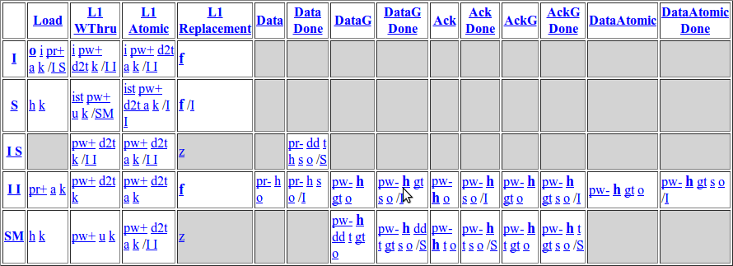
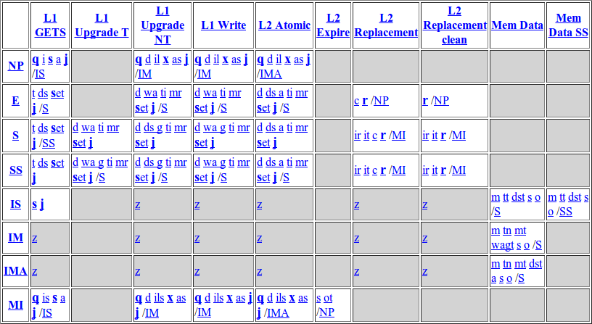
Complexity
MESI L2 States
Non-Coherent L1
TC-Weak L1
MESI L1 States
Non-Coherent L2
TC-Weak L2
Notes:
Finally, let’s revisit the complexity challenge
I’m again showing the state tables for the non-coherent GPU and MESI protocol
Looking at TC-Weak, it is much closer to no coherence in terms of complexity than it is to MESI
This really reduces the extra overhead on GPU manufacturers for adding coherence to their hardware
In our paper we show the complete state tables for TC-Weak and provide numerical comparisons in the number of states against other protocols

Slide 19
Summary
First work to characterize GPU coherence challenges
Save traffic and energy by using global time
Reduce protocol complexity
85% performance improvement over no coherence
Questions?
Notes:
This was the first academic study to characterize the challenges posed by coherence on GPUs
We addressed these challenges by proposing a protocol based on time
This helped save energy
And reduce the protocol complexity
In Fermi, for our coherent applications the caches had to be disabled by the user, otherwise the GPU application deadlocks. In Kepler, this is fixed by automatically disabling L1 caching of shared data. In this study we show that enabling this caching can buy you an 85% performance improvement with coherence

Slide 20
Backup Slides

Slide 21
Lifetime Predictor
One prediction value per L2 bank
Events local to L2 bank update prediction value
Store A
Events Prediction
Expired load: ↑
Unexpired store: ↓
Unexpired eviction: ↓
Load A
L2 Bank
T = 20
T = 0
prediction--
Prediction Value
prediction++
30
A
10
A
Notes:
Now let’s take a quick look at our predictor
Our predictor is very simple in that we maintain a single prediction per L2 bank. All accesses that go to this bank use this prediction
We use events local to the L2 bank to update the prediction
The first of these feedback events is a load to an expired block
This indicates to us that the load might have missed at the L1 due to short lifetime so we should increase the prediction
The second even is a store to an unexpired block
This indicates that there may be a delay before this store is made globally visible, so we should decrease the lifetime prediction
The last event is eviction of unexpired blocks
Here we decrease the lifetime to reduce the storage overage of tracking these unexpired but evicted entries
We have more details about the specifics of this predictor in the paper and I encourage you to take a look

Slide 22
TC-Strong vs TC-Weak
TCSUO
TCS
TCSOO
TCW
TCW w/ predictor
Fixed lifetime for all applications
Best lifetime for each application
1.4
1.2
1.2
1.0
1.0
Speedup
Speedup
0.8
0.8
0.6
0.6
All applications
All applications

Slide 23
Interconnect Power and Energy

